Slide 1

UT Dell Medical School
Department of Pediatrics
November 2023
Organizational Chart & Financial Support Model
Sima Patel, Senior Director & Amy LEE, Associate director
Operations & Strategy, UT Dell Medical School, Department of Pediatrics

Slide 2

Overview:
History, Who are we?
Department of Pediatrics Organizational Chart
Compensation and FTE allocations
  DMS MSRDP vs AMG Compensation Models
  DMS Annual Merit
  Faculty Benefits
Questions

Slide 3

We are only 7 years old
How it all began….
1891: The University of Texas opened its first medical school in Galveston.
2011: State Sen. Kirk Watson (D-Austin) creates a list of “10 Goals in 10 Years” centered on health care.
2012: Travis County Voters approved Proposition 1 which raised property tax revenue to improve the health care in Travis County, including support of a new medical school.
2016: The medical school welcomes its first class of 50 students and opens its Health Learning Building.
2017: Ascension Seton opens the Dell Seton Medical Center at The University of Texas, the primary teaching hospital for Dell Med.

Slide 4
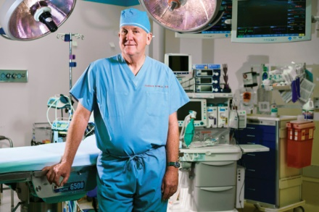
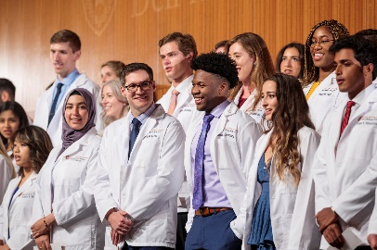
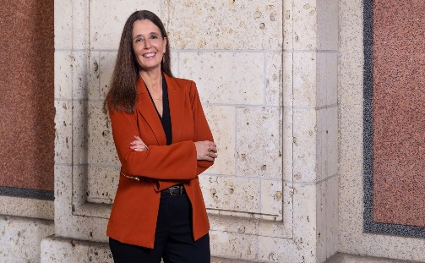
We are only 7 years old
2018:
  UT Health Austin & Dell Children’s Medical Center together launch the Texas Center for Pediatric and Congenital Heart Disease
2020:
  Dell Med earns full accreditation. In March, the first students participate in national Match Day.
  In October, the Texas Center for Pediatric and Congenital Heart Disease performs the first-ever pediatric heart transplant in Austin
2022:
  UT Health Austin and partner Ascension Seton perform the first kidney transplants at Dell Seton Medical Center and launch the first pediatric abdominal transplant center in Central Texas.
  UT President announces that Claudia F. Lucchinetti, M.D. will be the second Dell Med Dean and UT’s senior vice president for medical affairs.
2023:
  The University of Texas System announces the creation of The University of Texas at Austin Medical Center, which will include two new, state-of-the-art hospitals ­­— a UT specialty hospital and a cancer center being built by MD Anderson.

Slide 5
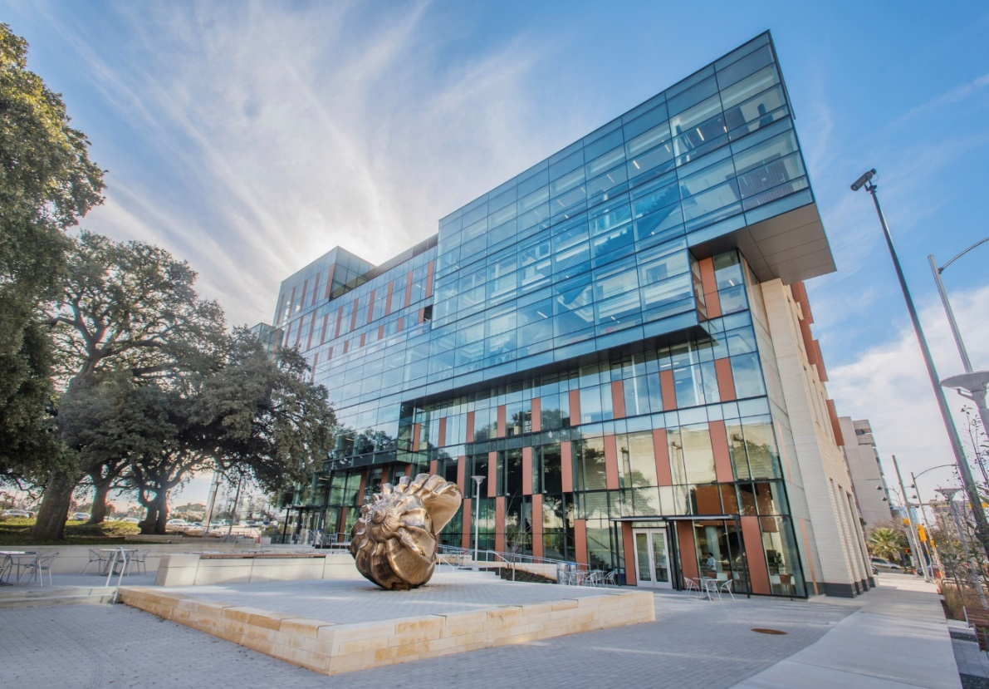
What makes Dell Med different:
The first medical school in nearly 50 years to be built from the ground up on the foundation of a Tier 1 research university.
Unprecedented partnership with our community ($35 million annual investment by Travis County taxpayers)
Opportunity to start from scratch (groundbreaking curriculum, diverse team, no bad habits or old ways of doing things)

Slide 6
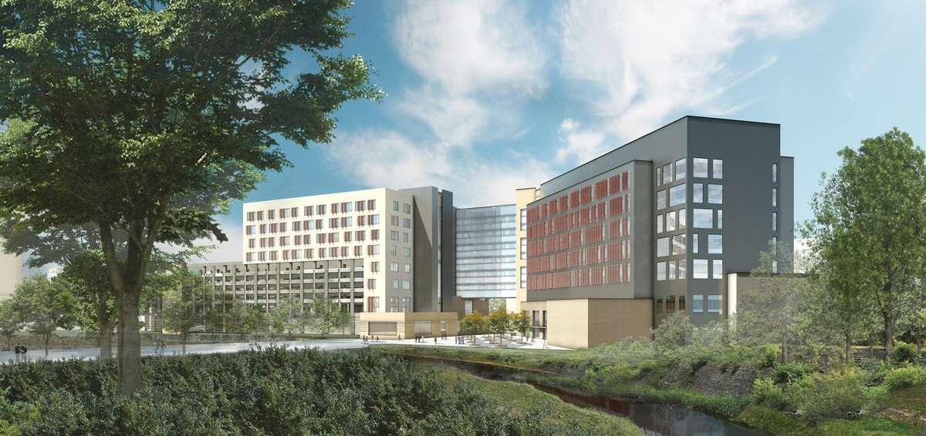
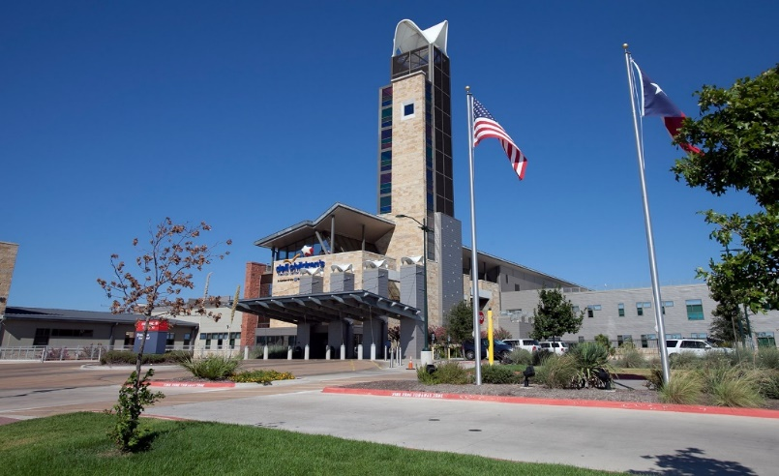
partnership
UT Austin Dell Medical School
Partners in Advancing Pediatric Care in our Community
Dell Children’s Medical Center

Slide 7
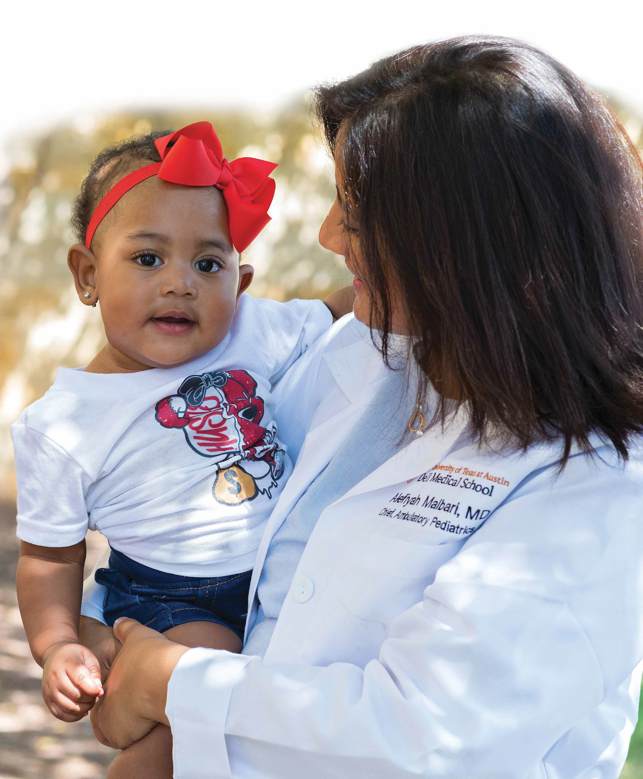
MISSON STATEMENT
Advancing Clinical Care, Education and Research to Improve Children’s Lives
Notes:
The Department of Pediatrics provides care with skill and compassion, develops clinical and educational resources for children, advances research to find treatments for pediatric diseases and advocates for those in need in the community.
Areas of Focus
No. 1: Delivering Comprehensive Clinical Care
No. 2: Training the Next Generation of Pediatric Leaders
No. 3: Furthering Clinical Research to Improve Pediatric Care
The Department of Pediatrics is home to the Dell Pediatric Research Institute, where faculty across disciplines partner with health care providers to conduct research that translates into new products, programs and treatments that improve children’s health and pediatric care.
The department also partners with Dell Children’s Medical Center of Central Texas to operate the Simulation Center at Dell Children’s — an innovative program that strives to advance education, training and research in medical simulation.

Slide 8
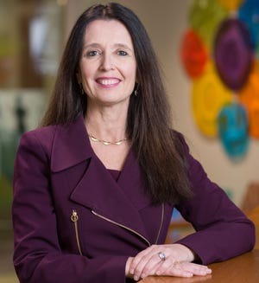
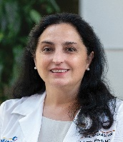
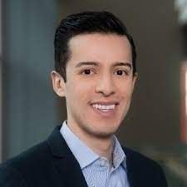
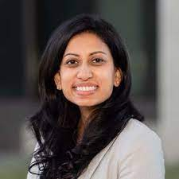
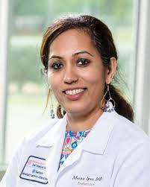
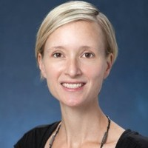
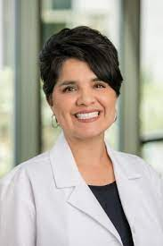
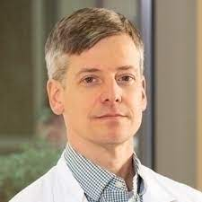
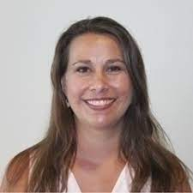
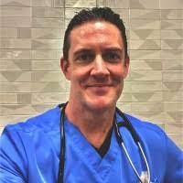
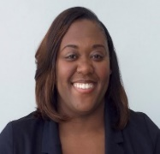
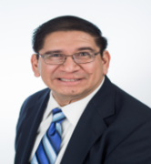
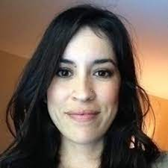
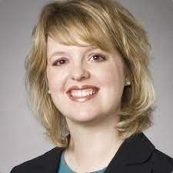
Claudia Lucchinetti, MD
Dean, Dell Medical School
Z. Leah Harris, MD
Chair
Esteban De Santiago
Executive Assistant to the Chair
Sima Patel, MHA
Senior Director of Operations & Strategy
Meena Iyer, MD
Associate of Clinical Affairs
Kate Remick, MD
Associate Chair of Quality, Innovation, and Outreach
Kim Avila Edwards, MD Associate Chair of Advocacy
TBD
Associate Chair of Research
Dan Richards, MD
Associate Chair of Academic Affairs
Division Chiefs
Quality
Sponsored Programs
Advocacy Leads
Education
UME & GME Directors
Faculty Affairs
Amy Lee MSW, PMP
Associate Director of Operations & Strategy
Matt Wilkinson, MD
Asst. Chair of Clinical Research
Juliet Laney
Faculty
Affairs Manager
Faculty
Affairs Manager
Krystle Bartley
Assistant Director
Louis Gonzales
Director
Business Analyst
Keli Hawthorne
Director of Clinical Research
Executive Assistants
Clinical Research Coordinators

Slide 9
Operations & Strategy
Clinical Operations
Business Development of New Programs
Ongoing Faculty Support
Recruitment
Compensation (Recruits and Existing Faculty)
Notes:
We will talk now more about the compensation model and FTE allocations and faculty benefits

Slide 10
Salary CALCULATIONs
Dell Medical School:
General physician hires:
  AAMC benchmarks 50%-75%
Specific subspecialties or highly specialized specialties ( i.e. Hepatologist, ERCP- GI Specialist)
  AAAP benchmarks (National or Southern) ~50%
Ascension:
All physician hires:
  Blended benchmark (AAMC, MGMA, Sullivan Cotter)

Slide 11
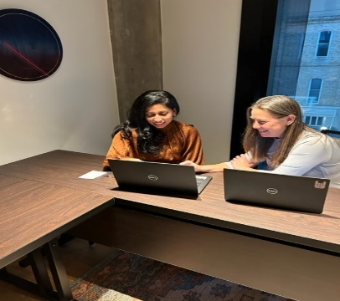
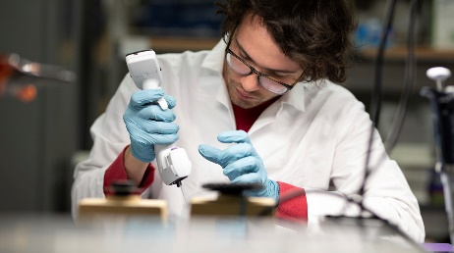
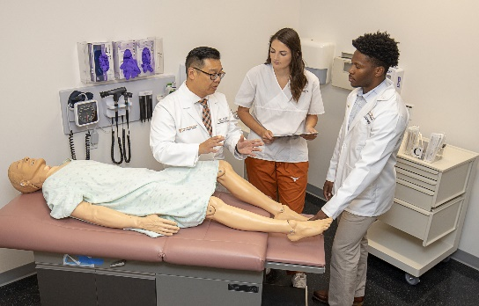
FTE ALLOCATIONS OVERVIEW
Administrative/ Leadership
Supported by Hospital
Division Head/Chief: .5 FTE
Medical Directors: .1 FTE
Quality Directors: .1 FTE
Advocacy Leads: .1 FTE
Chairs supported between DMS and Hospital
Education
Supported by DMS or Hospital
Clerkship Directors: .5 FTE
Residency Directors: .5 FTE
Fellowship Program Directors: .2 FTE
Assoc. Prog. Directors: .1 FTE
Asst. Prog. Directors: .1 FTE
Research
Supported by extramural or core medical school funds
Basic Science Expectations:
1 year = 20%
2 years = 35%
3 years = 50%
4 years = 60%
5 years = 75%
Clinical Research:
Dependent on funding
Notes:
Administrative and Leadership: Stay with clinical value of 50-75% of AAMC
Education: For education roles we stick to 50% of AAMC for that FTE
Research: We cover bridge funding, cost sharing, and med school department funding covers protected research time that extramural does not at the clinical value rate (stay within NIH cap)

Slide 12

Compensation Models
DMS MSRDP Model
Annual Faculty Evaluations
XYZ Model (Guaranteed)
  X = rank
    $30K – Instructor
    $45K – Assistant Professor
    $60K – Associate Professor
    $80K – Professor
  (Exceptions (longevity) to be made at the chair’s discretion
  Y= Clinical, Administrative, Research, Education
  Z =Bonus TBD; under review with compensation committee
Ascension Medical Group Model
Annual Faculty Evaluations
wRVU or shift compensation

Slide 13
ANNUAL MERIT
CURRENT STATE
Merit each year recommended by Dell Medical School Dean
Final Approval through Board of Regents
Merit includes faculty and staff positions
One-time, Annual Merit, Up to 3%
Recommendations for merits are based on performance
FUTURE STATE
For Faculty- Z component (Bonus) in MSRDP Compensation Plan
For Staff- maintain current merit methodology
Notes:
The University offers the possibility for a merit increase which is defined as a salary increase that is discretionary financial recognition of an employee who has demonstrated increased productivity, improved efficiency and/or exceptional quality of work performance above and beyond that which would be considered standard performance of duties.
The Dell Medical School merit policy was approved for 2.5%. For the current fiscal year, 2022-2023, DMS has requested a merit policy which includes a 3% merit budget. This includes faculty and staff positions whom are eligible for merit by meeting the guidelines mentioned below. While the aggregate merit budget is set at 3%, individual merit awards are based on performance and may not be as high as 3%;
recommendations for merit salary increases should be based on performance above and beyond that is normally expected or required by the employee as evaluated and determined by the supervisor.
Per University guidelines, employees are eligible for a merit increase if they have been employed by the University for the six months immediately preceding the beginning of the academic calendar year

Slide 14
Faculty Benefits
Relocation Bonuses
Paid Medical Licensure, DEA costs, Credentialing, & Board/MOC Fees
Professional Development Funds $3500
  Number of Days Based on Rank
Paid Time Off
Retirement, Health Insurance
Professional Development Training Opportunities
Employee Assistance Program – financial planning, health and wellness, parenting and family support, and mental health services, including short term counseling
 | Non-Faculty Sr. Leaders | Faculty | Faculty Chairs/Senior Faculty
In-State | Up to $5,000 | $10,000 - $15,000 Varies based on level of position | Up to $20,000
Out of State | $10,000 - $20,000 Varies based on level of position | $10,000 - $20,000 Varies based on level of position | Up to $25,000
Rank | Days per Year
Professor | 20
Associate Professor | 15
Assistant Professor | 10
Instructor | 5
Notes:
Any other benefits were missing EAP and gym memberships

Slide 15
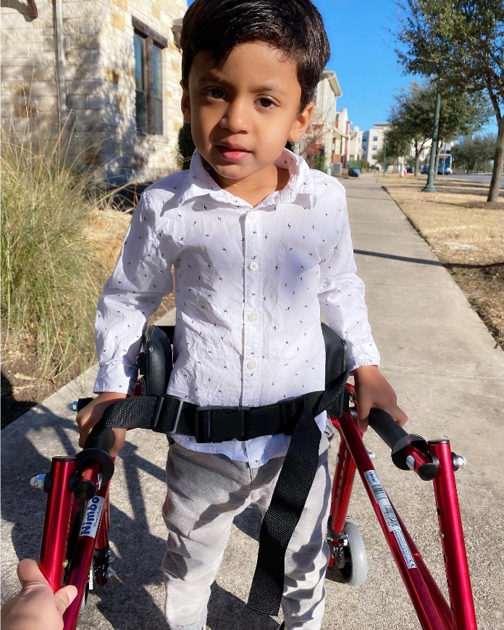
Always Have A North Star

Slide 16
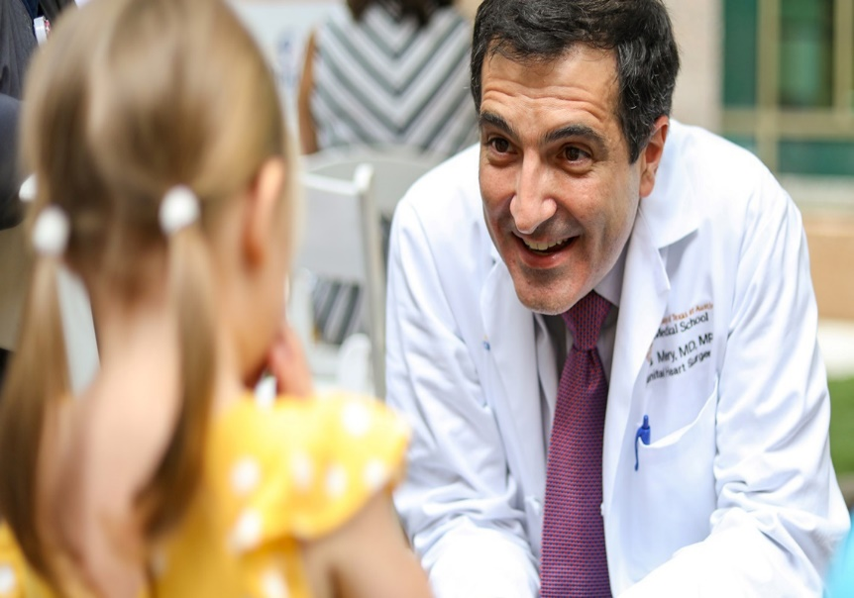
Thank You & Questions
Sima Patel, MHA sima.patel@austin.utexas.edu
Amy Lee, MSW, PMP amy.lee@austin.utexas.edu

Slide 17
OUR Department leadership & Growth
November 3, 2023
Z. Leah harris, md
Chair of Pediatrics, Dell Medical School
Director, Dell Pediatric Research Institute
Physician-in-Chief, Dell Children’s Medical Center

Slide 18
zlharris@peds.bsd.uchicago.edu
harris_z@kids.wustl.edu
zharris1@jhmi.edu
zena.harris@vanderbilt.edu
zlharris@luriechildrens.org

Slide 19
zlharris@peds.bsd.uchicago.edu
harris_z@kids.wustl.edu
zharris1@jhmi.edu
zena.harris@vanderbilt.edu
zlharris@luriechildrens.org
Dean
Chairman
Dean/President
CEO >> Chair
CEO = Chair

Slide 20
If you could build your department from scratch – what would it look like?
What programs would be essential?
What support would be essential?
How would you utilize existing programs?
How important is culture?
Who are your most significant allies?
Do you build it or do you buy it?

Slide 21
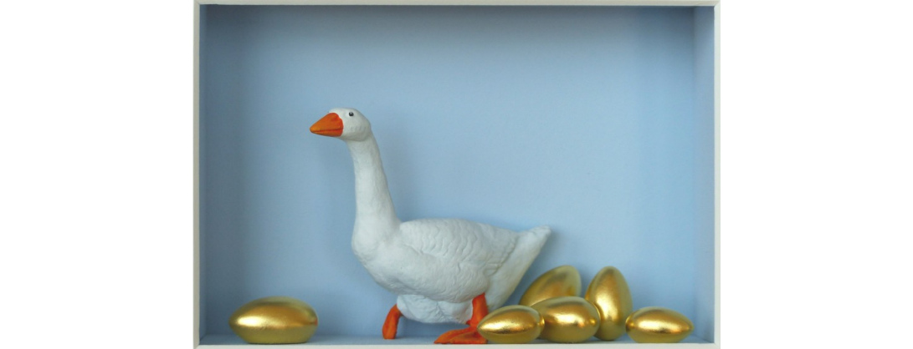
What comes first – the department or the hospital?
Clinical Programs
Clinical Revenues

Slide 22
2020 2023
Notes:
Dell Children’s Medical Center – Mueller Campus
296 beds (320 beds)
297 faculty (120 Asst, 44 Assoc, 8 Prof)
23 Divisions (22+1), 1 Center
310 faculty

Slide 23

2020
Have
Developing
Need
Clinical Programs
Research
CT Surgery and Cardiology (ECMO/VAD)
Neurology, Epilepsy and
Neurosciences
Orthopedic Surgery
Mental Health Programs
Transport
Trauma Center
DMS Faculty
Mother/Child Program
Hematology-Oncology Cancer Center
Fellowships (Neonatology and Critical Care)
Ambulatory Pediatrics
DPRI
Interprofessional Faculty with academic promise
DMS, UTA Engineering, Computer Science
Graduate/Medical students
Reorganize the DPRI
Recruit research faculty
Protected time for current faculty
Starter grants and funding initiatives
Clinical research center
Translational research center
Administrative
CEO –Dean
Executive Leadership teams
Magnet Status
CHA/SPS
QI COE
Marketing
Safety/QI analysts
Local control
Limited dashboards

Slide 24

Fragmented versus Independent

Slide 25
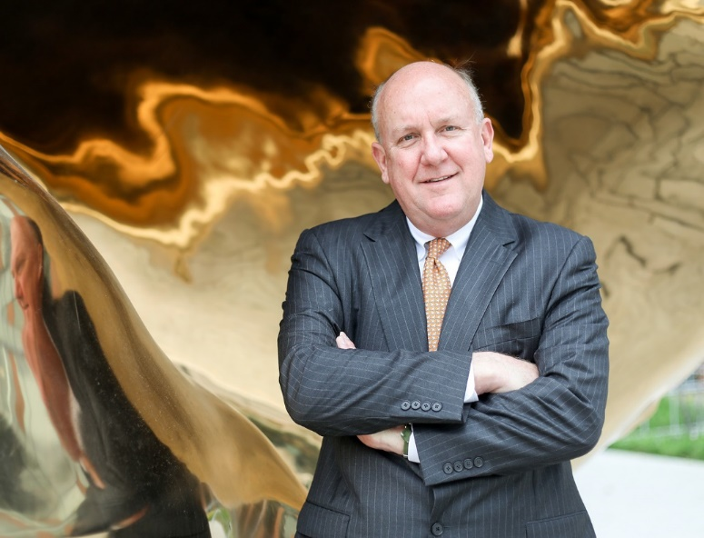
Chuck Fraser Phenomenon
Recognize excellence
Reward hard work
Celebrate courage
Destination program
Immediate impact
True Pediatric partner

Slide 26
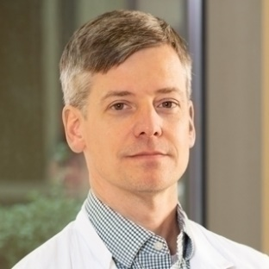
Dell Med Funding
Education
Vice Chair for Academic Affair | Dan Richards, MD
Program Director | Valli Annamalai, MD
Electives Director | Valli Annamalai, MD
Program Coordinator | Kasey Cleghorn
Electives Coordinator | Kasey Cleghorn
Admin
Director, Operations and Strategy | Joanne Salman
Manager, Strategic Initiatives | Amy Lee
Sr Administrative Associate | Juliet Laney
Total Dell Med Funding | $775,000

Slide 27
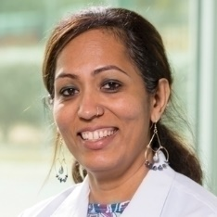
Mini Kahlon, PhD
Vice Dean for Health Ecosystem
Claudia Lucchinetti, MD
Dean, Dell Medical School
Jewel Mullen, MD, MPH
Associate Dean for Health Equity
Martin Harris, MD
VP Health Enterprise, CBO
TBD, MD
Vice Dean of Professional Practice, Chief Clinical Officer
Beth Nelson, MD
Interim Vice Dean of Education,
Senior Associate Dean of Undergraduate Medical Education
Bill Matsui, MD
Vice Dean for Research
Z. Leah Harris, MD
Chair
Esteban De Santiago
Executive Assistant to the Chair
Sima Patel, MHA
Senior Director of Operations & Strategy
Kate Remick, MD
Associate Chair of Quality, Innovation, and Outreach
Meena Iyer, MD
Associate of Clinical Affairs
Kim Avila Edwards, MD Associate Chair of Advocacy
Dan Richards, MD
Associate Chair of Academic Affairs
TBD
Associate Chair of Research
Amy Lee MSW, PMP
Associate Director of Operations & Strategy
Louis Gonzales
Director
Division Heads
TBD-Ascension Employed
Advocacy Manager –
Education
Faculty Affairs
Matt Wilkinson, MD
Assistant Chair of Clinical Research
Lisa Gray
Associate Director
Valli Annamalai, MD
Clerkship Director
Juliet Laney
Administrative & Faculty Affairs Manager
Juliet Laney
Admin. & Faculty
Affairs Manager
Fred Coste, MD & Tara Greendyk, MD
Community Lead
Keli Hathorne MS, RD, LD
Director of Research
Krystle Bartley
Assistant Director
Nalinda Charnsangavej, MD
Residency Program Director
Shu-Ching Tseng
Advocacy Coordinator
Liza Hinojosa
Senior Admin Coord.
Lauren Gambill, MD & Nalinda Charnsangavej, MD
Education
Karagan Day
Administrative Assistant
Suzette Nava
Executive Assistant
Maria Villamil Jarauta
Business Analyst
Laura Aird
Sr. Project Mgr.
Lynn Thoreson, DO
Fellowship Director
Julie Shelton
Advanced QI Specialist
Ada Earp, MD
Innovation/Research
Gina Lento
Manager of Clinical Research Coordinators
Brooke Rael
Executive Asst to Assoc Chair of Quality
Joanna Saucedo
Sr. Admin. Prog. Coord.
Sujit Iyer, MD
ER Fellowship Director
Lisa Barber, MD & Ashley Lucke, MD
Policy/Legislative
Eleni Balourdos
Project Associate
Clinical Research Coordinators
Keli Hathorne MS, RD, LD
Director of Research
Ryan Lowery, MD & Meena Iyer, MD
Social Determinants
Alan Groves, MD
NICU Fellowship Director
Kasey Petika
Project Specialist
Krystle Bartley
Assistant Director
Angie Poorman
St Partnership Specialist
Shu-Ching Tseng
Advocacy Coordinator
Paul Sheeran, MD
PICU Fellowship Director
Hanna De Hoyos
Media Relations Mgr
Notes:
Can speak to dual roles on this slide:
Z. Leah Harris, MD – Chair of Pediatrics & Physician-In-Chief
Meena Iyer, MD – Associate Chair of Clinical Affairs & Chief Medical Officer
Dan Richards, MD – Associate Chair of Academic Affairs & Physician Hospitalist
Kim Avila Edwards, MD – Associate Chair of Advocacy & Director of Advocacy and External Affairs for Ascension

Slide 28
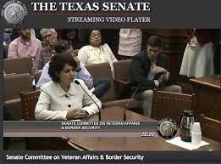
ADVOCACY – test case!
Introduce “supported” time
  DCMG/AMG DMS
Introduce scholarship
Introduce value versus volume
Already a strength!
Crossover all Divisions/Centers
$$
Kimberly Avila Edwards, MD

Slide 29
Divisions within the Department of Pediatrics
Faculty employed by DMS
Faculty employed by DCMG, USACS , Mednax
Cardiology
Division Chief:
Byron Holt, MD
Infectious Disease
Division Chief:
Sarmistha Hauger, MD
Developmental Pediatrics
Division Chief:
Sheri Ravenscroft, MD
Nephrology
Division Chief:
David Simon, MD
Neurology
Division Chief:
Steve Roach, MD
Endocrinology
Division Chief:
Shona Rabon, MD
Cardiac Critical Care
Division Chief:
Dan Stromberg, MD
Allergy/Immunology
Division Chief:
Jackee Kayser, MD
Genetics, Metabolic
Division Chief:
James Gibson, MD
Comprehensive Care Pediatrics
Division Chief:
Rahel Berhane, MD
Child Abuse Pediatrics
Division Chief:
Katherine Snyder, MD
Hematology Oncology
Division Chief:
Amir Mian , MD
Genetics, Clinical
Division Chief:
Jaya George-Abraham, MD
Dermatology
Division Chief:
Lucia Diaz, MD
Critical Care Medicine
Division Chief:
Marita Thompson, MD
Ambulatory Pediatrics
Division Chief:
Alefiyah Malbari, MD
Emergency Medicine
Division Chief:
Winnie Whitaker, MD
Palliative Care
Division Chief:
Patrick Jones, MD
Pulmonology & Sleep
Division Chief:
Jason Fullmer, MD
Adolescent Medicine
Division Chief:
Maria Monge, MD
Hospital Based
Medicine
Interim Division Director
Jennifer Hughes, MD
Gastroenterology
Division Chief:
Jeff Zweiner, MD
Rheumatology
Division Chief:
Janet Orrock, MD
Neonatology
Division Chief:
John Loyd, MD
Notes:
Leadership Team 5F 4M
Division Directors 14F 10M

Slide 30
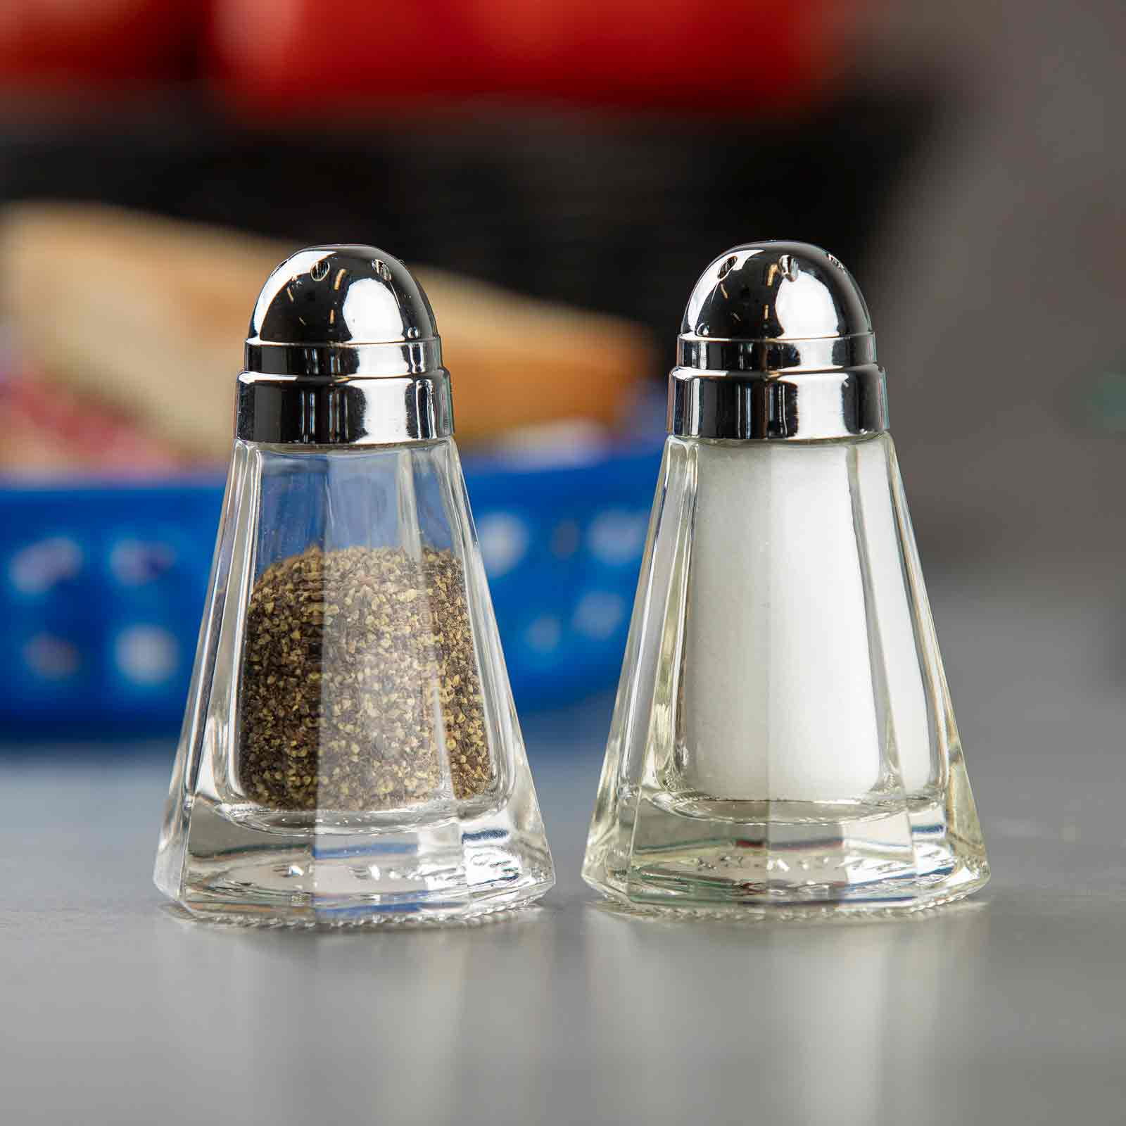



“SUCCESS IS BEST WHEN IT’S SHARED”
Howard Schultz, Institute Success

Slide 31
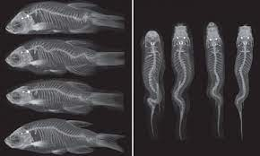
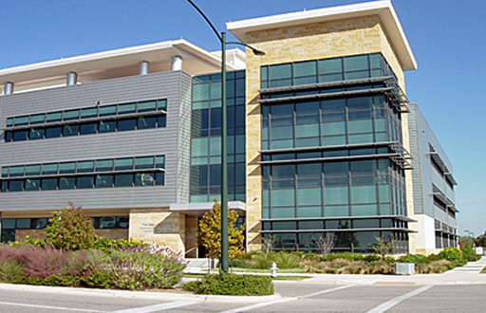
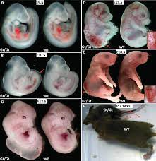
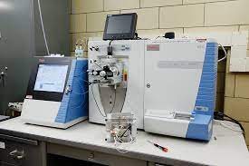
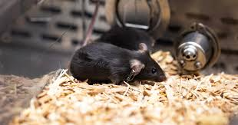
Dell pediatric research institute

Slide 32
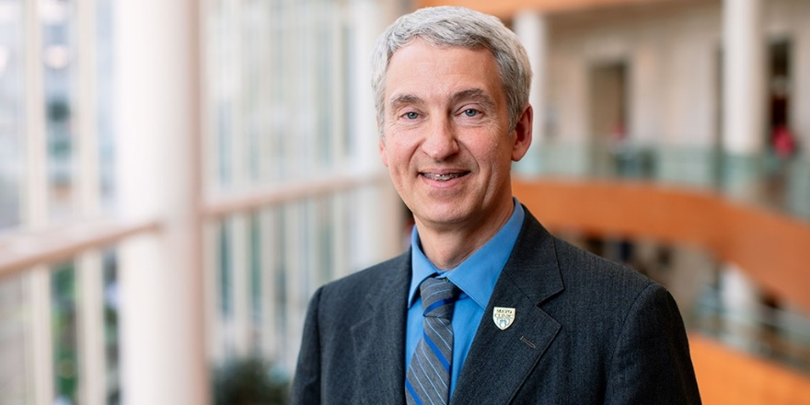

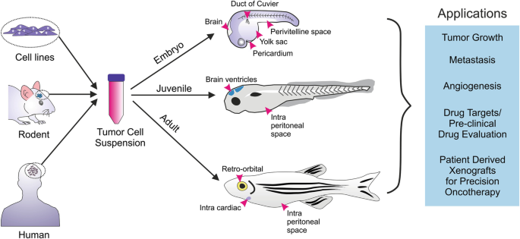
Steve ekker, phd
Dean of the Mayo Clinic Graduate School of Biomedical Sciences
Professor of Biochemistry & Molecular Biology
Director Clinical Office of
Entrepreneurship
Associate Dean of Innovation and Entrepreneurship at DMS
Associate Vice President for Research Translation at UT Austin

Slide 33
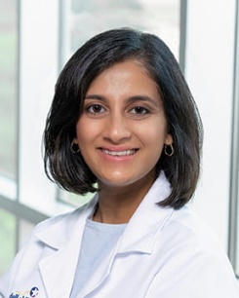
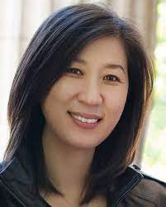


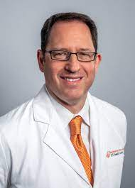
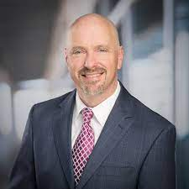
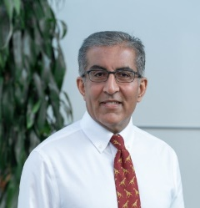
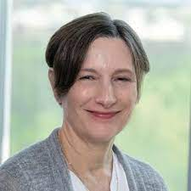
Pediatrics and the Future of Child Health
There can be no keener revelation of a society’s soul than the way in which it treats its’ children. - Nelson Mandela
Build out our BMT program ~ 18 months
Grow the Kidney Transplant program
Development of a Pain Program
Growth of an Autism Center
Initiation of a Rare Disease Institute
Advancing our Transport Program
Growth of the Cardiac Critical Care program
Development of our ECMO program
Expansion of our Level IV NICU
Growth of our Trauma program
Increase deliveries at SDU
Foster Care Medical Home
New Chief of Child and Adolescent Psychiatry

Slide 34

lessons learned
CEO/COO relationship
Dean alignment
Resources, Resources, Resources
Never underestimate the impact of culture
Never underestimate the value of the right leader
Know your North Star
Take care of your faculty, residents and medical students
Notes:
Department leadership structure

Slide 35
