Slide 1
Combatting Market Competition
Deb Brown, RN, BSN, MHA
Vice President, Chief Operating Officer
Notes:
Test

Slide 2
Competing in the marketplace
Know your organization
Know your competitor
Know your assets
What are you are willing to do to compete?
Know what you cannot do
Challenges
Building across systems to compete

Slide 3
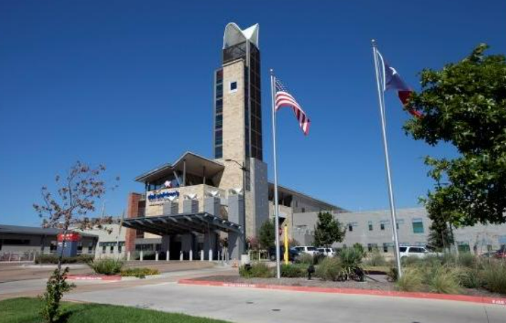
Know your organization
Opened in 1987 and expanded in 2007
299 bed quaternary, academic, children’s hospital
Service line specialization
Cardiac
Neurosciences
Mental Health
Maternal/Fetal/Neonatology
Orthopedics
Hematology/Oncology
Affiliation with Dell Medical School at the University
of Texas
Growing community and answering the call

Slide 4
Know your organization
Dell Children’s North
Population growth
Austin traffic
Affordability
Need for more lower acuity beds
36 beds
Destination programs
Orthopedics/Sports
ENT
Community pediatrician engagement
This is ‘your’ hospital

Slide 5
Know your competitor
HCA St. David’s North Austin Children’s Hospital - hospital within an adult hospital
Opened 2018
ED
PICU
Acute Care
Large NICU
Women’s Services

Slide 6
Know your competitor
Texas Children’s Hospital - Austin
2nd foray outside of Houston
Women and Children’s services
Will send high acuity patients and their families to Houston
USNWR - ranked in 10 specialties

Slide 7
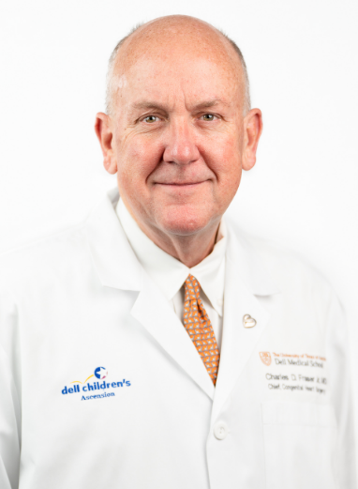
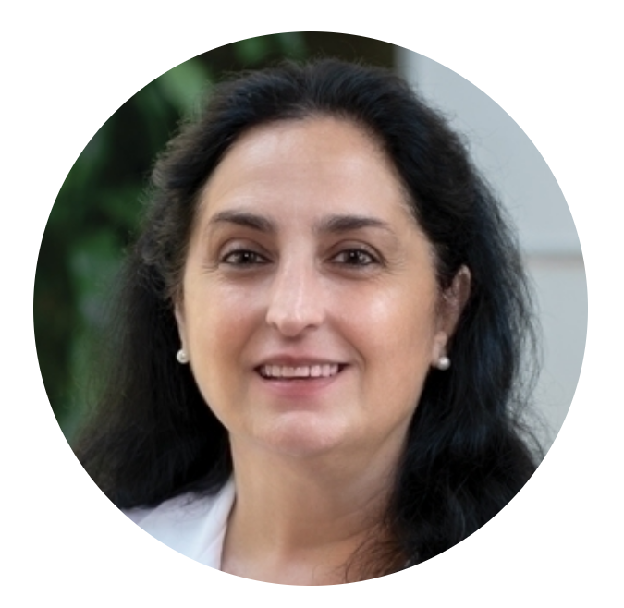
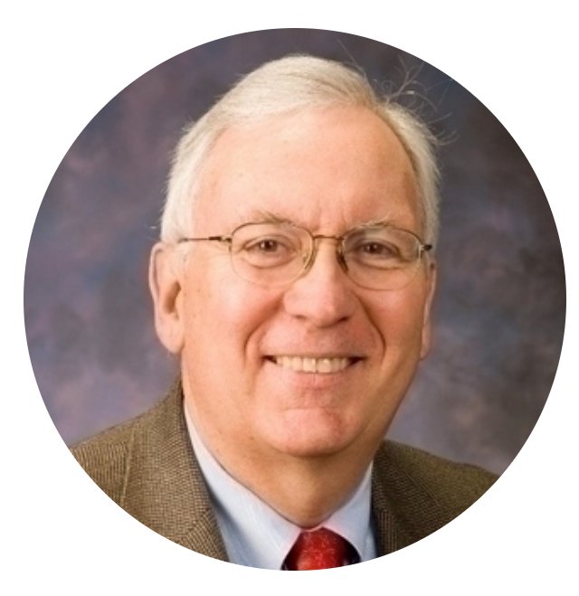
Know your assets
Relationship with Dell Medical School at the University of Texas
Recruitment of luminary providers
Infrastructure development
Research
Education
Programs/Service Lines
Long standing relationships with community providers
Long standing relationships with industry
Long standing relationships with philanthropists

Slide 8
What are you willing to do to compete?
Culture
Compensation
Service Line investment
Unlikely partnerships with previous competitors

Slide 9
What can’t or won’t you do?
Retain everyone
Compensation
Benefits
Have a negative culture
Exit employees in a negative manner…they may be back

Slide 10
Challenges
Grass is greener mentality
Employees seek out ‘better’ opportunities at other organizations
Compensation
Difficult to ‘keep up with the Joneses’
Career advancement
Promises of ‘leadership’ positions
Work-life balance
Promises of fewer call shifts, robust staffing, alternative work schedules

Slide 11
Building capabilities across systems
The MOST IMPORTANT competitive threat Dell Children’s has is its relationship with the Dell Medical School at the University of Texas

Slide 12
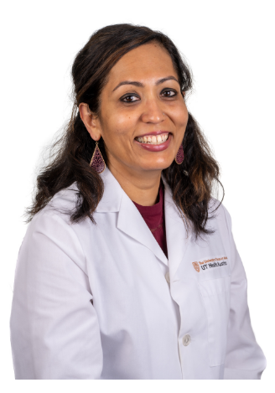
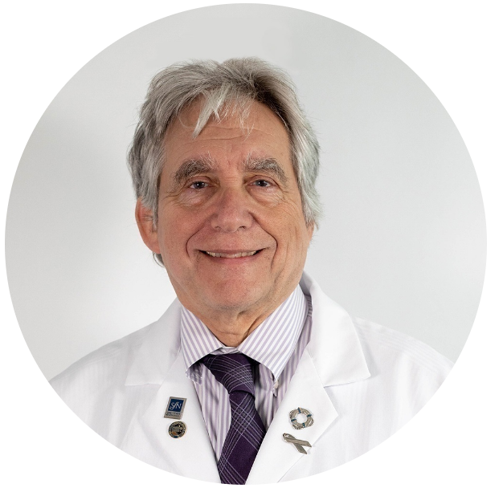
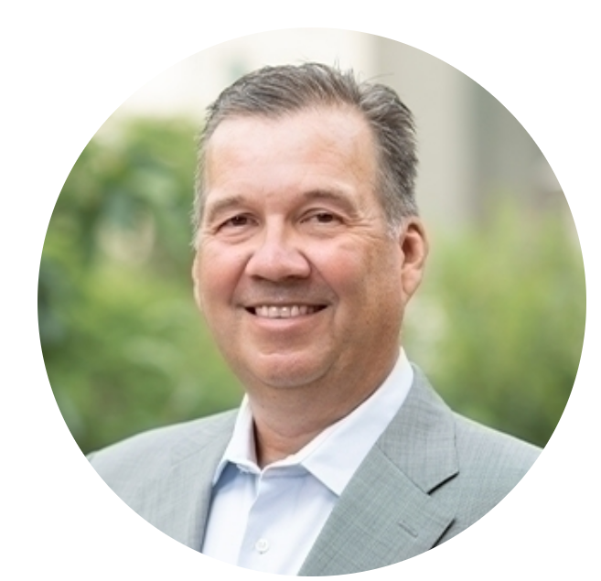
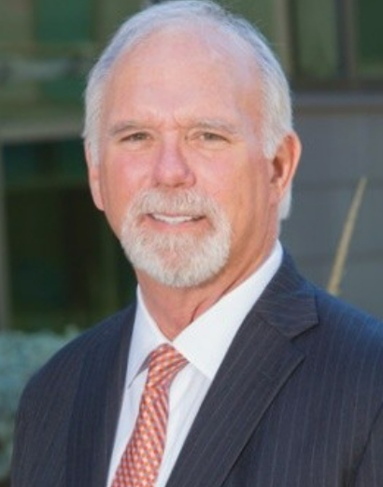
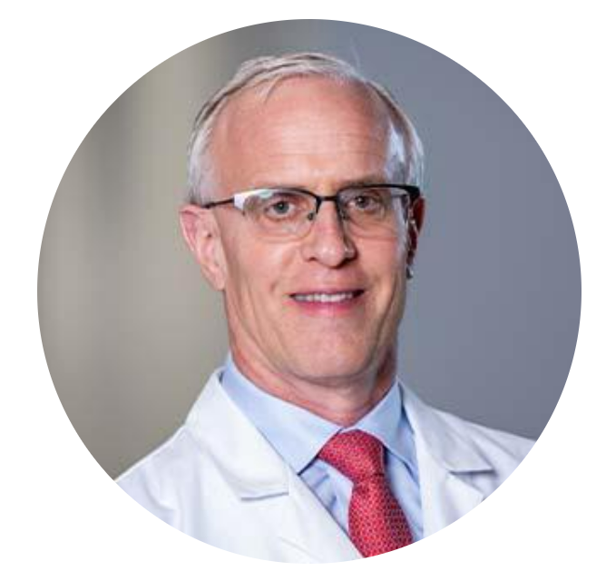
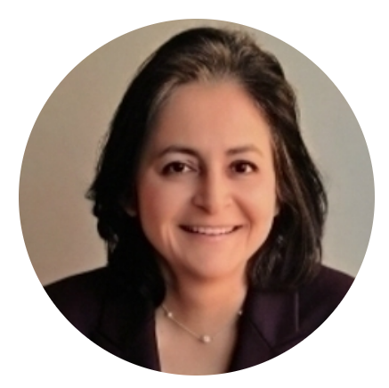
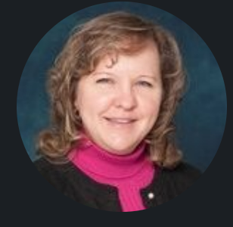
What makes it work?
Relationships
Department Chairs
Leah Harris, MD
Charlie Nemeroff, MD
Kevin Bozic, MD
George Macones, MD
Dell Children’s Leadership team
Chris Born (retired)
Deb Brown
Meena Iyer, MD
Nilda Garcia, MD
Program Agreements
Define positions
Define structure
Define funds flow
Define quality expectations

Slide 13
Thank you

