Slide 1
Building Across Systems and Partnership Principles

Slide 2
Partnerships in Literature
Transactional-Process Focus
Attributes & Keys to Success
Values
Discussion
Notes:
Right now, you, our leaders, drawing on your knowledge, experience, and innovative spirt, are creating the most forward-thinking, state-of-the-art integrated academic system of care in the nation, if not the world
Your Marketing team supports your work by documenting, explaining, and promoting it to the public
We feel a tremendous responsibility to create a suite of easily accessible vehicles through which we can deliver a relatable, compelling body of work that accurately reflects the power of the enterprise you are building
You deserve a level support that reflects the quality of your work, and the extent of your commitment
So please help us help you by providing us with the staff, working space, and tools (physical and digital) we need to succeed

Slide 3
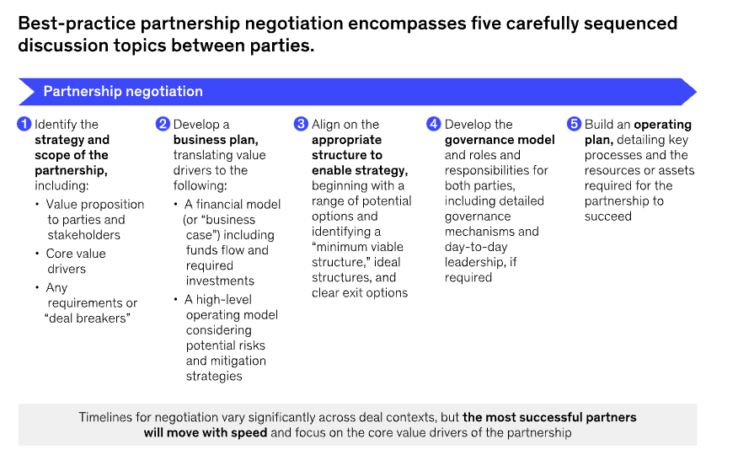
McKinsey & Co (2023)

Slide 4
Attributes of Partnerships
Collaborative Leadership
Purposeful Partnership
Mission aligned
Ideal partner characteristics
How should partnership be structured
Coordination
Agreed upon alliance strategies
Clearly communicates a unified strategy
Creates environment for effective vertical communication
Coordinates decisions and actions across functions, units and organizations
Progress
Sustain core services
Strive to expand offerings
Chelsey(2021)

Slide 5
Partnership Keys to success
Joint Operating Committees meeting regularly
Willingness to compromise
Clear roles
Direct communication channels at the top
Culture of shared values
(Pawlak & Colby 2015)

Slide 6
Values Framework (Helfrich et al 2007)
Internal
Team Culture
Cohesion
Morale
Human Resource development
Mutual Support
Hierarchical Culture
Clear lines of authority over org processes
Respect for formal hierarchy
Adherence to rules
Stability & predictability
Flexibility
Control
Flexibility & creativity
Acquisition of resources
Responding to challenges in
external environment
Growth & entrepreneurship
Clarity of tasks
Planning & productivity
Efficiency
Measurable outcomes
External

