Slide 1
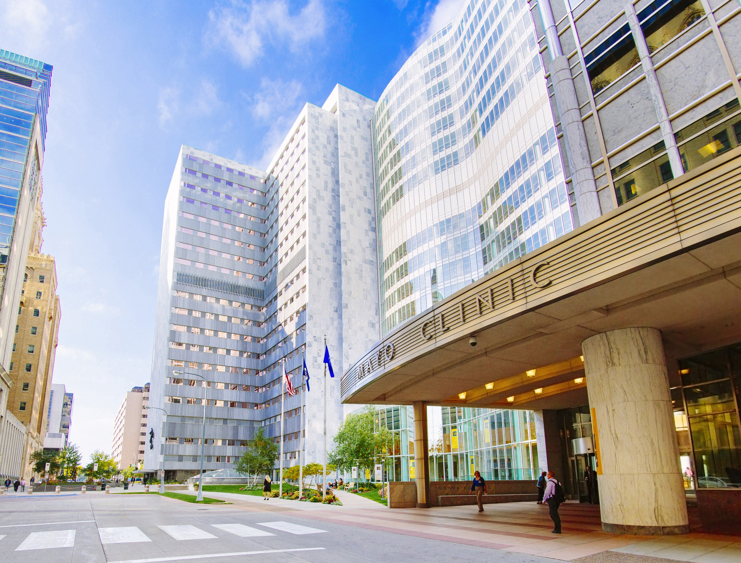
Mayo Model of leadership & Administration
MA Morrey, PhD
Ryan Johnson, MHA

Slide 2
Outline
History, Evolution & Foundations
Differentiated Features of Mayo
The Model in Practice: How it works
Questions & Answers

Slide 3
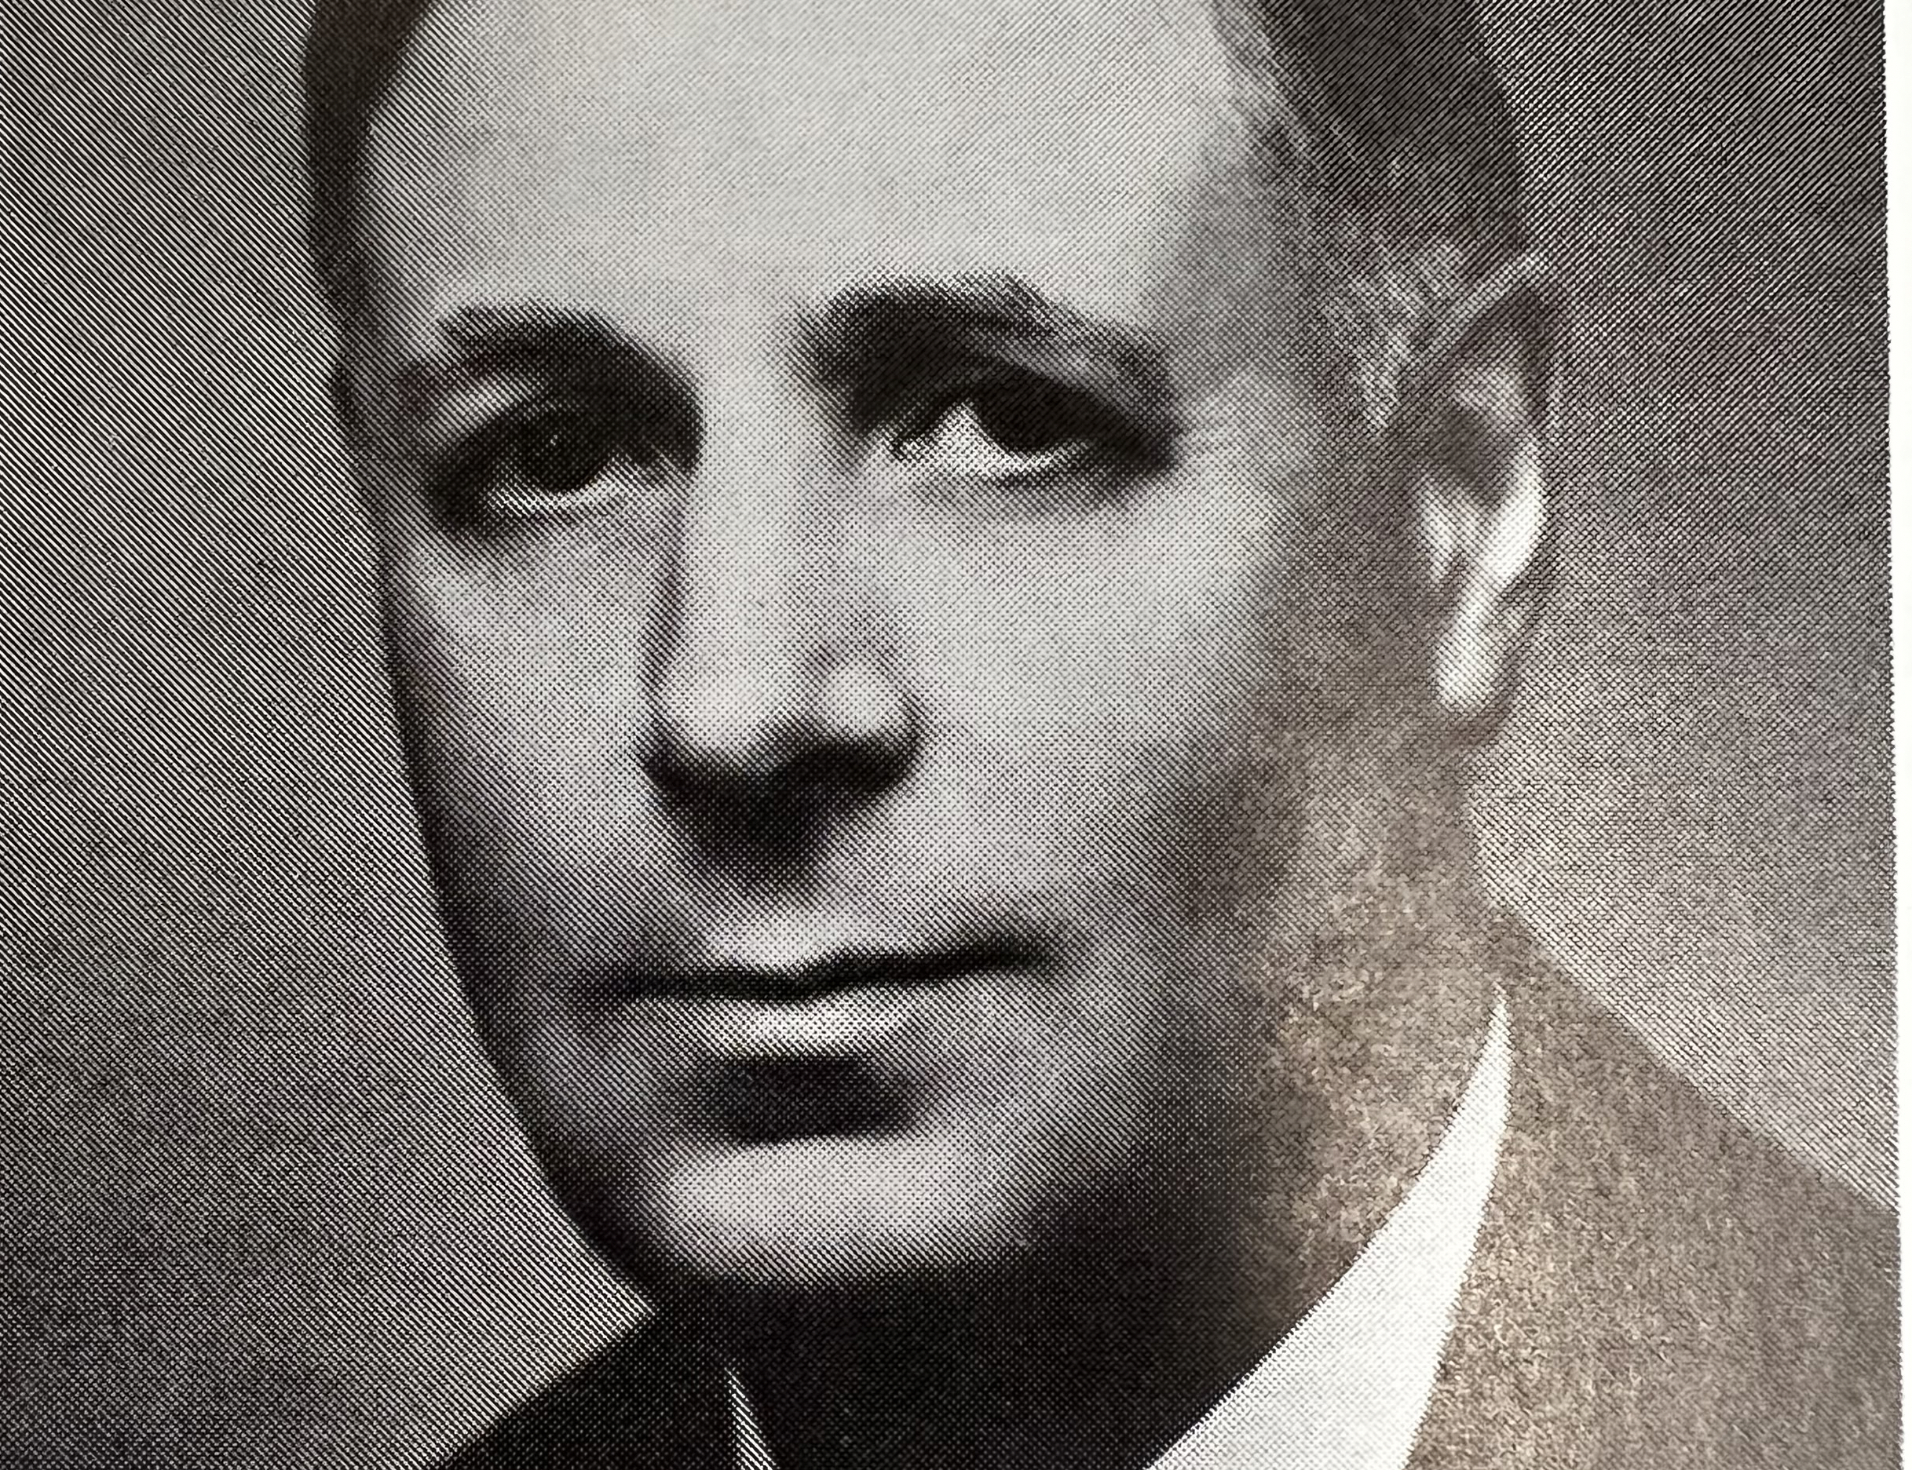
History & Evolution
Harry Harwick: Mayo’s First Administrator
1908-1952
Harry Harwick Selection
Harwick’s Partnership with Mayos & Plummer
Harwicks Organizational Innovation
Harwick’s Talent Cultivation

Slide 4
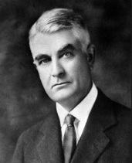
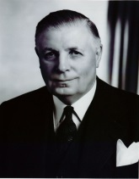
Physician Led; Professionally Managed Shared Governance Leadership Model “Defined the Dyad”
1908-1939
Shared governance (Dyad MD - Administrator)
Complementary skill sets
Teamwork is critical
Leadership defined by humility & service to others
1908-1952

Slide 5
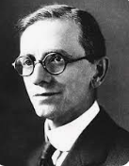
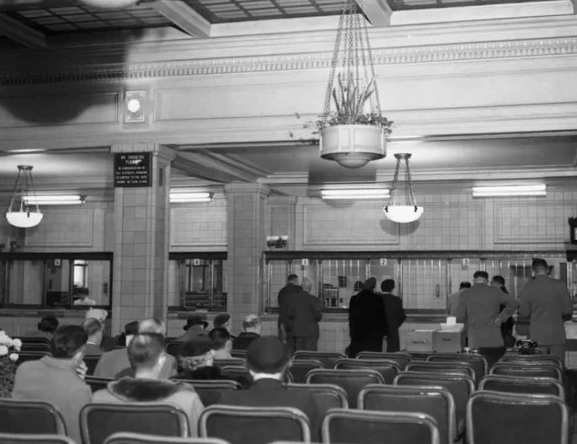
Plummers Practice
Single registration
Multiple Specialties under one roof
Singular medical record
Harwick-Plummer Team up in 1910
Medical records-ledger
Building Committee

Slide 6
Harwicks Organizational Innovation
Distributed and Shared Governance-Board of Governors (8 MDs ; 1 Admin)
Author of 1919 Mayo Trust
Section of Administration-Business Partners to the Practice

Slide 7
Harwicks Talent Cultivation
Eight potential successors
Harvard MBA-2
Harvard Law
Dartmouth School of Business-2
University of Minnesota-2
Lawrence College

Slide 8
Key differentiators of Mayo Clinic

Slide 9
6 Distinguishing features of Mayo Clinic
“…The best interest of the patient is the only interest to be considered…..”
Centralized & REINVESTED Finances
Physician Led DYAD Leadership Philosophy
The Needs of the Patient come first
Rotational leadership
Integrated & Coordinated Multispecialty Group Practice
Salaried Physicians
Steadfast Commitment to foundational Values
Respect, Integrity, Compassion, Healing, Teamwork, Innovation, Excellence, Stewardship

Slide 10
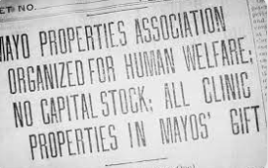
Mayo Properties to trust
Assets from Mayo’s(Will & Charlie) formed into Mayo Foundation for Medical Education & Research
Not for profit
Established physician salary model:
No financial incentives to care for the sick

Slide 11
Mayo Administrator Role

Slide 12
Role of the Mayo Administrator
Partner (could be multiple MD leaders, colleagues)
Accessible & visible
Introspection-
Pulse of the staff
Timing
Innate sense of knowing
Humble
Give direction, not details
Harwick, 1957

Slide 13
Qualities of a Mayo Administrator
Humility
Self-awareness
Tact & diplomacy
Flexibility & patience
Ability to take to long view of plans
Advocate with clarity
Gracefully meet opposition
Accept slow progress
Practical harmonious balance between medical ideals and reasonable business methods
Harwick, 1957

Slide 14
Relieve the MD Leader of Admin “Burden”
Eyes and ears of MD partners
Aid in establishing efficient systems and processes to effective solutions

Slide 15
The Model in Practice-How it Gets Done
Talent Cultivation
Assignments – Engagement – Impact
MD Leadership Pairing
Rotations
Attributes of High Performing Administrators

Slide 16
Talent Cultivation 3 Epochs
1908 – 1982 : From the farm & local business
1982 – 2000 : Admin Fellowship Introduction & from within
2000-2012: Formalizing a Model
2012 – present: Evolving the Model

Slide 18
Assignments
Dive in deep
Engage cross-disciplinary and shared service colleagues
Leverage the teams strengths
Be prepared for “other duties as assigned…”

Slide 19
Examples of impact-Patient Centric
Hand/Face transplant program-union of forces and influence
Kidney transplant CMS citations-change management & excellence
Urology OR schedule optimization-manual calculations/stewardship of resources
Data scientists and AI for patient centered access-influence/innovation
Neurology access optimization-data driven integrity

Slide 20
Physician Leadership & Assignment Matching
Art of assignments
Complementary skill sets
Change Management
Optimize influence

Slide 21
Rotational leadership
Every 3-6 years (roughly)
Exposure to a variety of departments
Augmented by institutional assignments/task forces
All MD-Admin led
Mentorship (Informal → Formal )

Slide 22
Rotational Advantages
Exposure to a number of areas – assignments – systems thinking - leadership styles and attributes
Continuous, career-long learning
Assimilate and apply best administrative & care model support practices
Keeps one “fresh”
Establish and solidify formal and informal networks for influence (expanding the local team)
Priviledge to work with multiple physician leaders

Slide 23
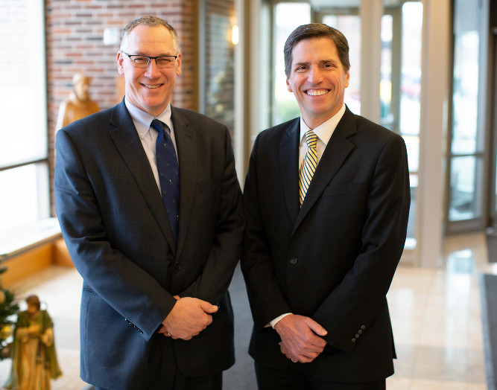
Critical Success Factors of a Mayo Administrator
Realized Leadership
Credibility & Authenticity
Physician partnership(s)
Team player and relationship management
Analytical & financial acumen
Influence & humility

Slide 24
Establishing Credibility- Must be earned must be authentic
Realized Leadership
Listen
Listen & learn to get-along with and relate to physicians
Walk in your providers shoes
Be
Be visible-especially with AHS but also to MDs in departments
Pulse of staff
MD visibility =partnerships
Learn
Learn your area
Practice settings
Translate operations to financial indicators
Teams & influencers
Have
Have to:
1. Work Hard
2. Perform (deliver results)
Listen to the team
Staff visibility = credibility & loyalty
“Practical harmonious balance between medical ideals and reasonable business methods”
HJ Harwick, 1948

Slide 25
Managing Performance
Performance management – 360 reviews
Assigned areas
Physician leader feedback heavily weighted

Slide 26
Managing Career Growth
Seek tough assignments/tasks
Risk taking – additional work / no pay expectations
Mentorship –informal
Self reflection
External coaching
Network internally & externally
Career planning

Slide 27
QUESTIONS & ANSWERS

