Slide 1
Institute for Cardiovascular Health
Charles D. Fraser, Jr., MD
Executive Director, ICVH
Blake Gentile
VP – Cardiovascular Services
Executive
Steering
Committee
Charles D. Fraser, Jr., MD
Exec Director ICVH
George Arnaoutakis, MD
Chief – Adult CV Sugery
Mark Pirwitz, MD
Chief – Adult Cardiology
Byron Holt, MD
Chief – Pediatric Cardiology
Carlos Mery, MD
VP Clinical Affairs, Dell Medical School
Erin Gottlieb, MD
Chief Pediatric Anesthesia
Dan Stromberg, MD
Chief – Pediatric Cardiac Critical Care
Peter Montenleone, MD
Adult Cardiology
Texas Center for Pediatric and Congenital Heart Disease
Adult CVT | Ascension CV/HVI
Charles Fraser
Executive Director, TCPCHD
Joel Wise
Cardiac Service Line Director, TCPCHD
Mark Pirwitz, MD
Exec. Co-Director, Chief-Cardiology
George Arnaoutakis, MD
Exec. Co-Director, Chief-Adult CV Surgery
CV Surgery
Cardiology
CV Anesthesia
Critical Care
Perfusion
Cardiology
CV Surgery
Heart/Vascular & Thoracic
Anesthesia
Critical Care
CV Nursing
CCU Nursing
HTD
Heart Failure/
Transplant
APPs
Outreach
CCU Nursing
Outcomes/Registries
Development
Perfusion
Development
Academic
Imaging/Echo
Clinic
Steering Committee
Steering Committee
Pirwitz
Arnaoutakis
Texeria
CAA TBD
Monteleone
CCU TBD
Cauthen
PerfusionTBD
APP
Thoracic TBD
Community Cards
Surgery
Wes Tidwell
CVOR TBD
CCU Nursing
Gottlieb
Fraser
Stromberg
Mery
Affolter
McCullum
Krauklis
Hemingway
DCMC Admin
Morton
McKaig
Owens
Notes:
Updated 10-16-2023

Slide 2
The Texas Center for Pediatric and Congenital Heart Disease
Charles Fraser, MD
Executive Director, TCPCHD
Joel Wise
Cardiac Service Line Director, TCPCHD
Steering Committee
CV Surgery
Cardiology
CV Anesthesia
Critical Care
Gottlieb
Fraser
Stromberg
Mery
Affolter
McCullum
Krauklis
Hemingway
DCMC Admin
Morton
McKaig
Owens
Perfusion
CCU Nursing
HTD
Heart Failure/
Transplant
APPs
Outreach
Development
Academic
Imaging/Echo
Clinic
Notes:
Updated 10-16-2023

Slide 4
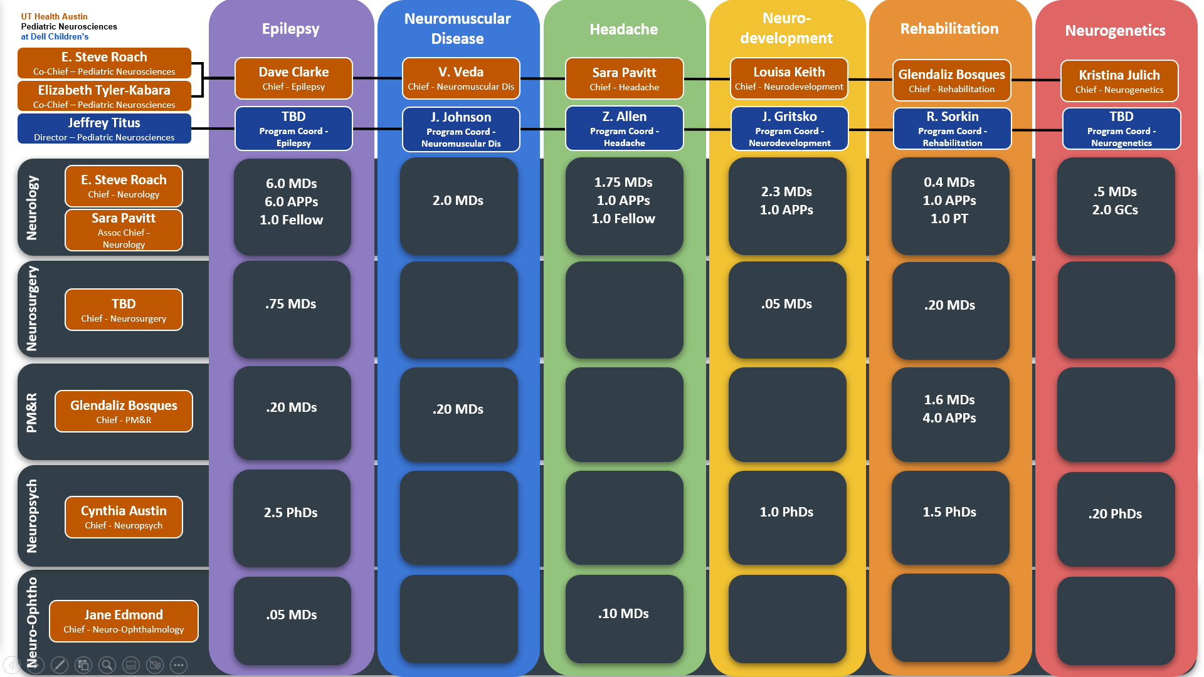

Slide 5
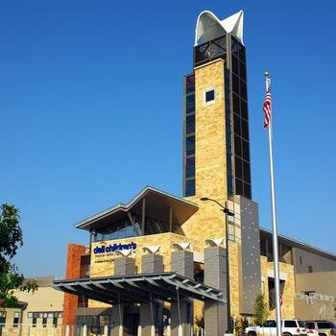
Program development
Clinical operations
Facility management
Community outreach
Infrastructure for innovation
Clinical leadership
Faculty development
Quality & outcomes
Educational oversight
Research & innovation
UT Health Austin
Pediatric Neurosciences
at Dell Children’s
Notes:
SR

