Slide 1
Deep learning and generative AI in Healthcare
Bimal Desai, MD, MBI
Chief Health Informatics Officer
Children’s Hospital of Philadelphia

Slide 2
Learning Objectives
Describe the fundamental difference between traditional ML and Deep Learning algorithms
Understand the inherent limitations and potential limitations of large language models
Summarize potential applications of deep learning and large language models in healthcare
Articulate the role of healthcare executive leaders in embracing digital transformation, prepare your organizations for that sea change

Slide 3
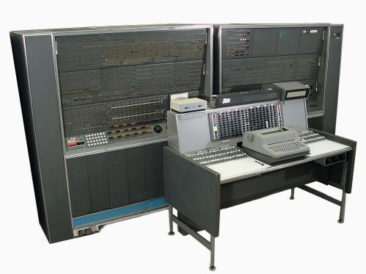
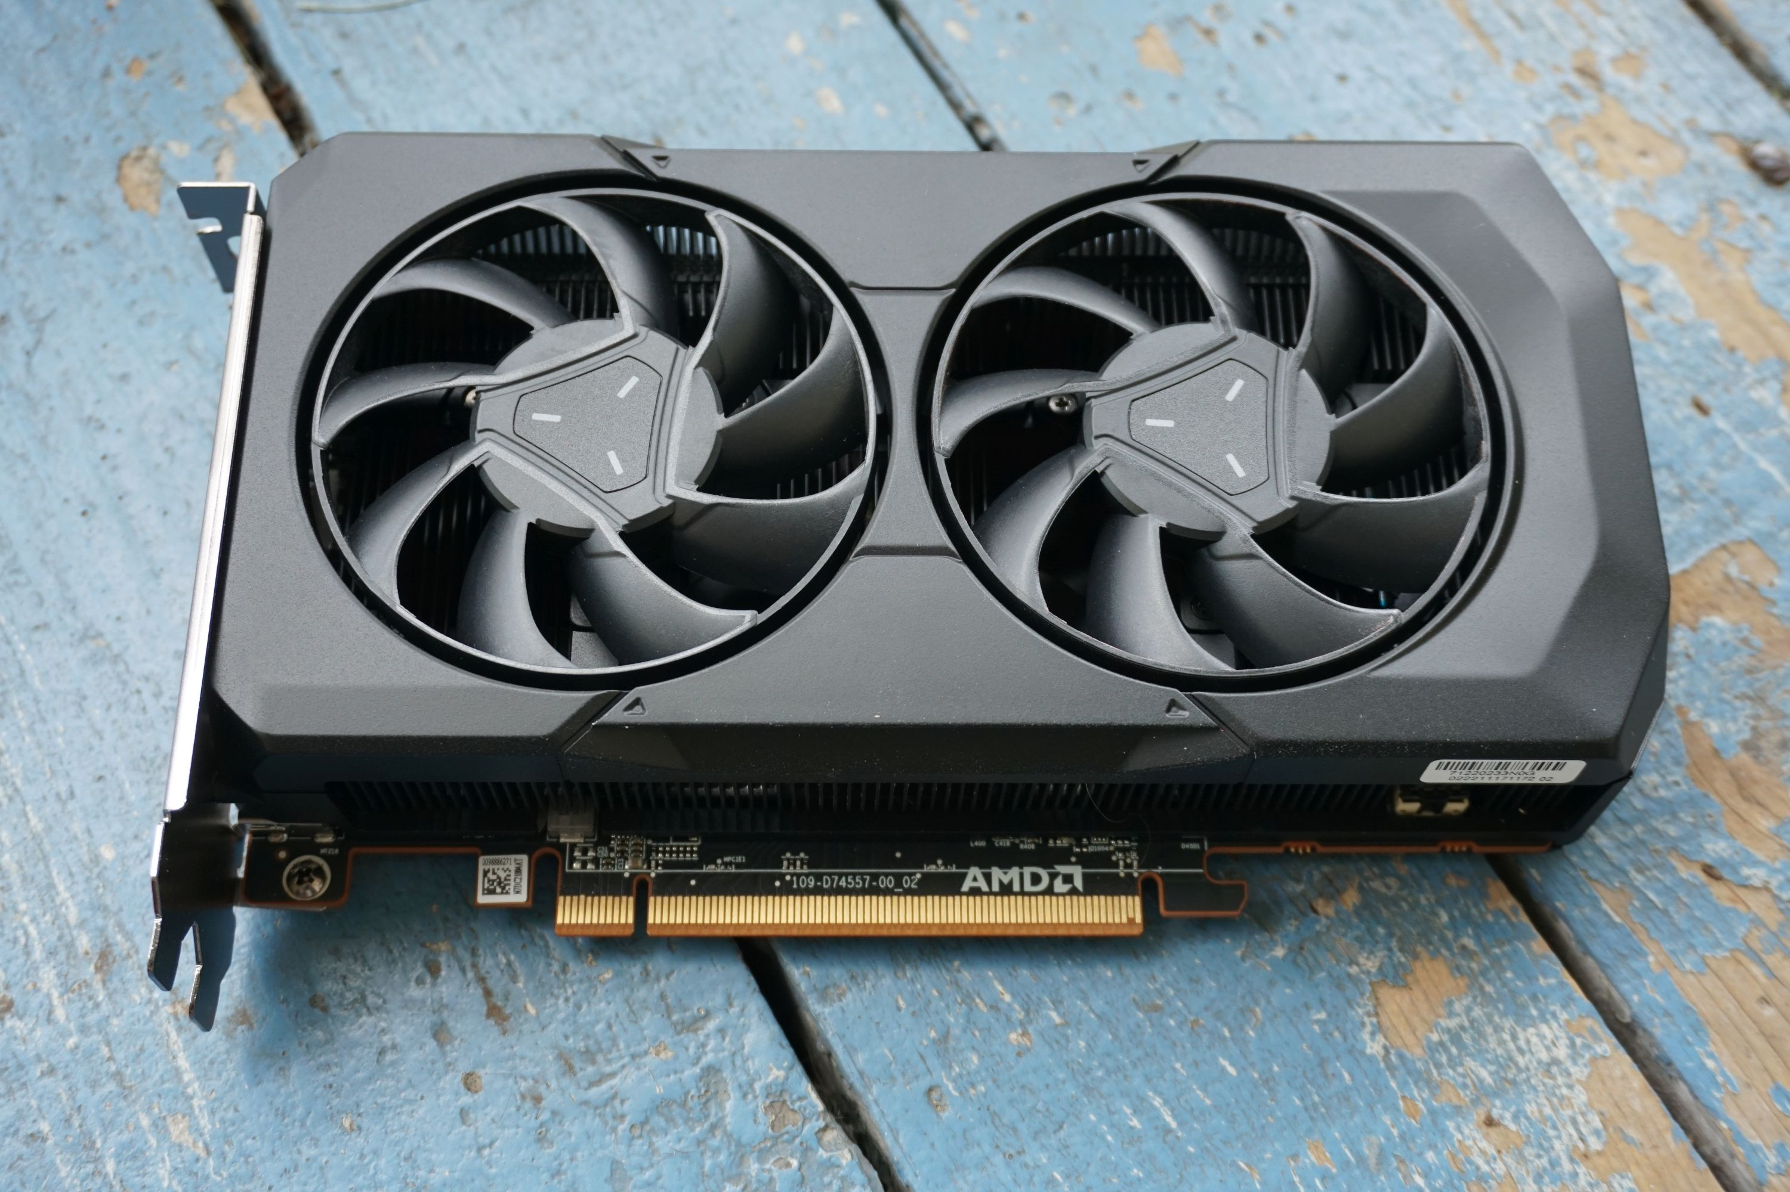
Cost of compute has dropped 5.3 Trillion-fold in 60 years
Reduction in cost of compute has empowered the Deep Learning revolution.
AI models like ChatGPT were simply infeasible a decade ago.
ChatGPT uses a deep learning neural network with 175B parameters.
Runs on a compute cluster with 285K processor cores and 10,000 GPUs (like the one on the right).
800 million GigaFLOPS of processing power
1961
IBM 7030 x 2400 units
2023
Radeon RX 7600 x 1
Cost per GFLOPS = $156B (adjusted)
Cost per GFLOPS = $0.02 (adjusted)
2.3 pounds
84,000 tons
FLOPS = floating point operations per second. 1 Gigaflop = 1 billion mathematical calculations per second.
Notes:
Chat GPT-3 developed on a massive neural network with 175 billion parameters​
Model runs on a compute cluster with 285,000 processor cores​
10,000 graphics cards​
800 petaflops (equal to 800 million gigaflops) of processing power​
Carbon footprint of driving a car 700,000 miles​
To train the model on a single NVIDIA GPU would take over 200 years of compute time

Slide 4
What is Generative AI?
Generative AI algorithms can generate novel content based on training data. Examples of “GenAI” include tools like Dall-E that generate images from text prompts, ChatGPT that can create novel human prose across a broad range of use cases, and Spotify Voice Translation which can translate podcast audio into different languages

Slide 5
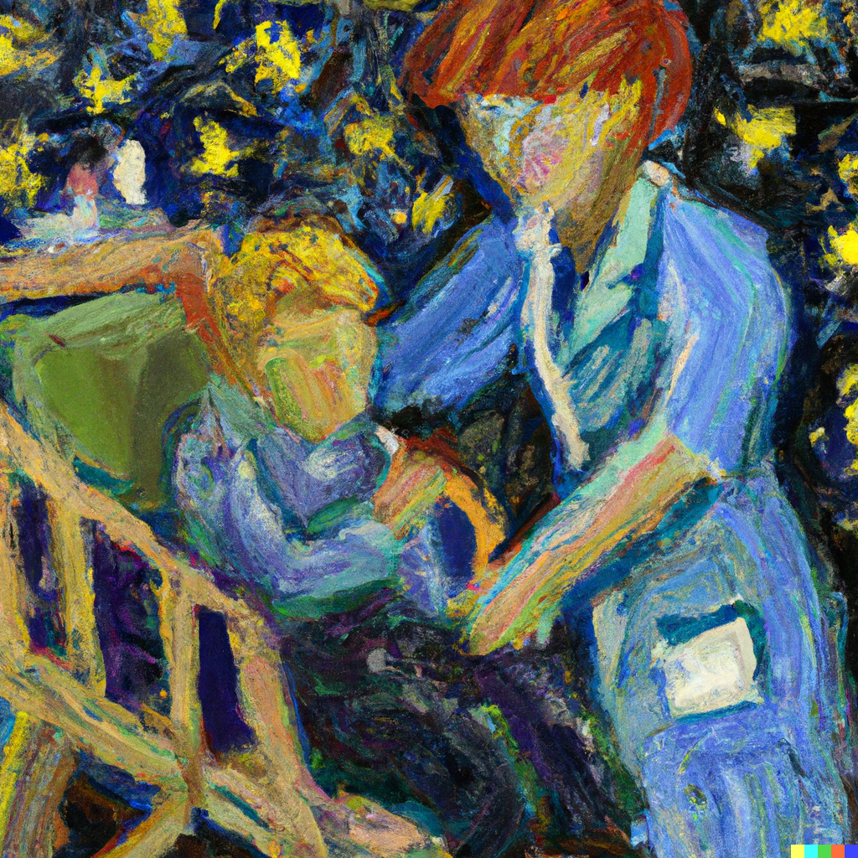
DALL-E
“Van Gogh impressionist painting in the style of Starry Night showing a pediatrician caring for a child with an arm injury”

Slide 6
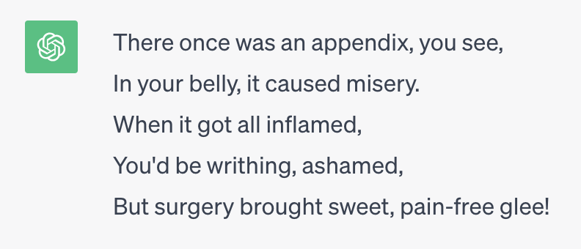
Chat GPT
“Write a limerick about appendicitis”

Slide 7
Spotify AI

Slide 8
What is a Large language model?
A generative AI technique that uses deep learning and massive datasets to model language.
LLMs can interpret, summarize, generate, and predict new content.
ChatGPT is a type of LLM created by OpenAI. It was developed with a neural network that features 175 billion parameters and trained against a corpus of 570 Gigabytes of text.

Slide 9
How DO LLMs WORK?
LLMs work by recursively predicting the next most likely word in a phrase based on context and the prompts supplied.

Slide 10
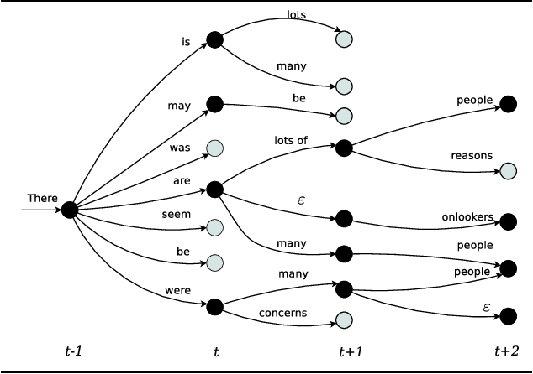

Slide 11
“TELL ME ABOUT ASTHMA”
Asthma is a condition characterized by wheezing and hyperreactivity of the
Asthma is a condition characterized by wheezing
Asthma is a condition characterized by wheezing and hyperreactivity of the airways.
Asthma is a condition characterized by

Slide 12
Limitations of LLMs
Prompt & Corpus Bias
Information Security/Privacy
You get different answers depending on how the prompt is phrased, which can introduce bias.
The corpus used to train the LLM may contain implicit bias which skews output.
ChatGPT is not HIPAA compliant.
Users may inadvertently disclose PHI or protected institutional information.
“AI Hallucinations”
Lack of Factual Grounding
As an “autocomplete” engine, LLMs can generate plausible but wholly inaccurate output
LLMs are not designed to be knowledge engines, though this is getting better with time.
Training set only includes data since 2021.

Slide 13
Caveat emptor
“Text generated by an LM is not grounded in communicative intent, any model of the world, or any model of the reader’s state of mind.”
“The problem is, if one side of the communication does not have meaning, then the comprehension of the implicit meaning is an illusion arising from our singular human understanding of language”
- Bender et al

Slide 14
This book does not exist

Slide 15
Encoding of bias
Political views
Implicit bias
Uncurated sources
“Is Taiwan a part of China?”
“Women doctors”
“Both sexes”
Hate speech websites, extremist views, and the general wasteland that is the internet.

Slide 16
ChatGPT has “Opinions”
Prompt source and examples: https://www.brookings.edu/articles/the-politics-of-ai-chatgpt-and-political-bias/

Slide 17
Takeaway:
Given the current state of LLMs, the most appropriate use of large language models is as a co-pilot that augments human capacity, not an auto-pilot that replaces the human.
For now, there should always be a “human in the middle”.

Slide 18
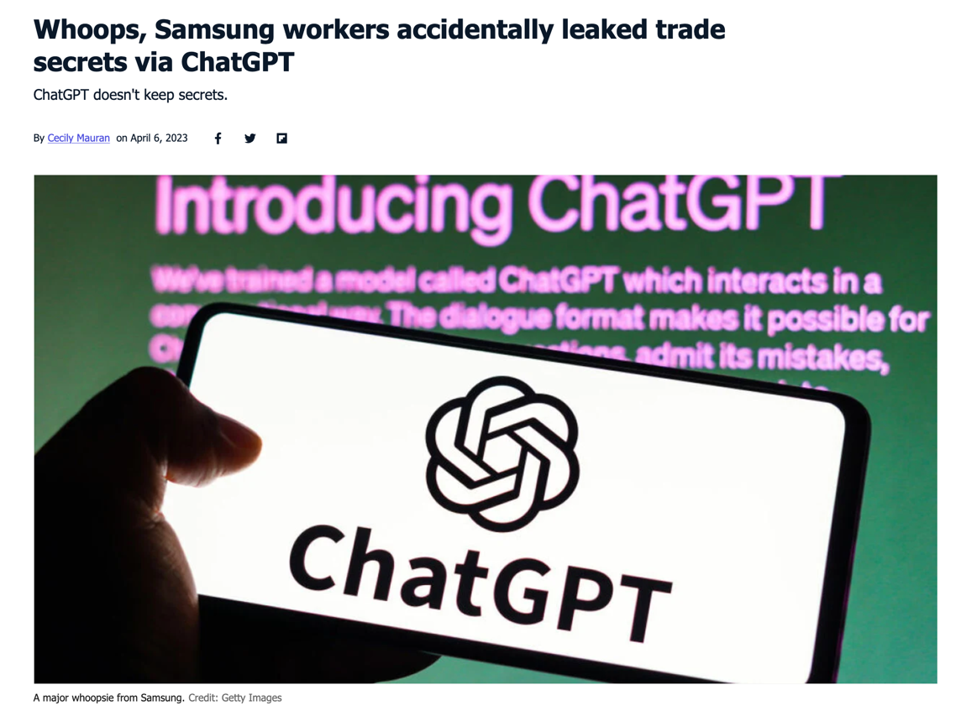
Risk of Disclosure of intellectual property
Source: https://mashable.com/article/samsung-chatgpt-leak-details

Slide 19
RESEARCHERS MUST KNOW THE RULES

Slide 20
CHOP GUIDANCE
Follow all relevant CHOP guidelines
Privacy, ethics, compliance, research, and acceptable use of technology. OpenAI ChatGPT is not HIPAA compliant and not secure.
DO NOT VIOLATE HIPAA
OpenAI.com is not appropriate for any PHI. CHOP is working to develop HIPAA-compliant options, including our own Azure instance of ChatGPT.
BE AWARE OF BIAS AND AI HALLUCINATIONS
Users must verify all factual assertions and output of the LLM. Users must double-check both the prompt and output for potential for bias.

Slide 21
Current and future applications in healthcare

Slide 22
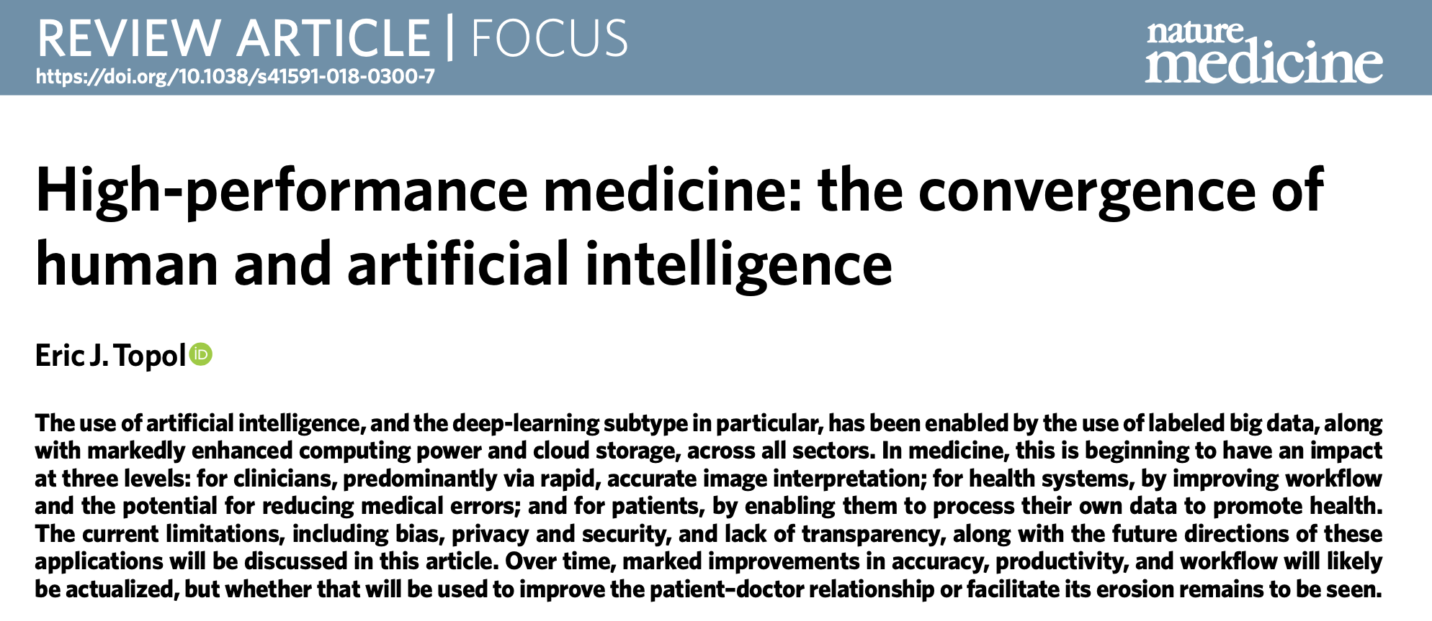
Clinical Applications of Deep Learning
Predict deterioration in hospitalized patients from EHR features
Classify patients who are high utilizers
Recognize significant findings in radiographic and pathology images
Robotic surgery
Tumor classification
Forecasting ICU length of stay
ICU mortality

Slide 23
“AI won’t replace radiologists, but radiologists who use AI will replace radiologists who don’t.”
Curtis Langlotz, MD, PhD
Stanford Center for AI in Medicine and Imaging

Slide 25
Predicting Mortality with a Chest X-Ray
85,000 chest x-rays
Deep-learning algorithm (CNN) called CXR-Risk
Goal of predicting long-term mortality (Low / Med / High)
53% of “High Risk” patients died within 12 years compared to only 4% of “Low Risk” patients
Most mortality was due to conditions other than lung cancer
Emergent features were variable: body fat (habitus), breast tissue (sex), shape of aortic knob and arch (?)

Slide 26
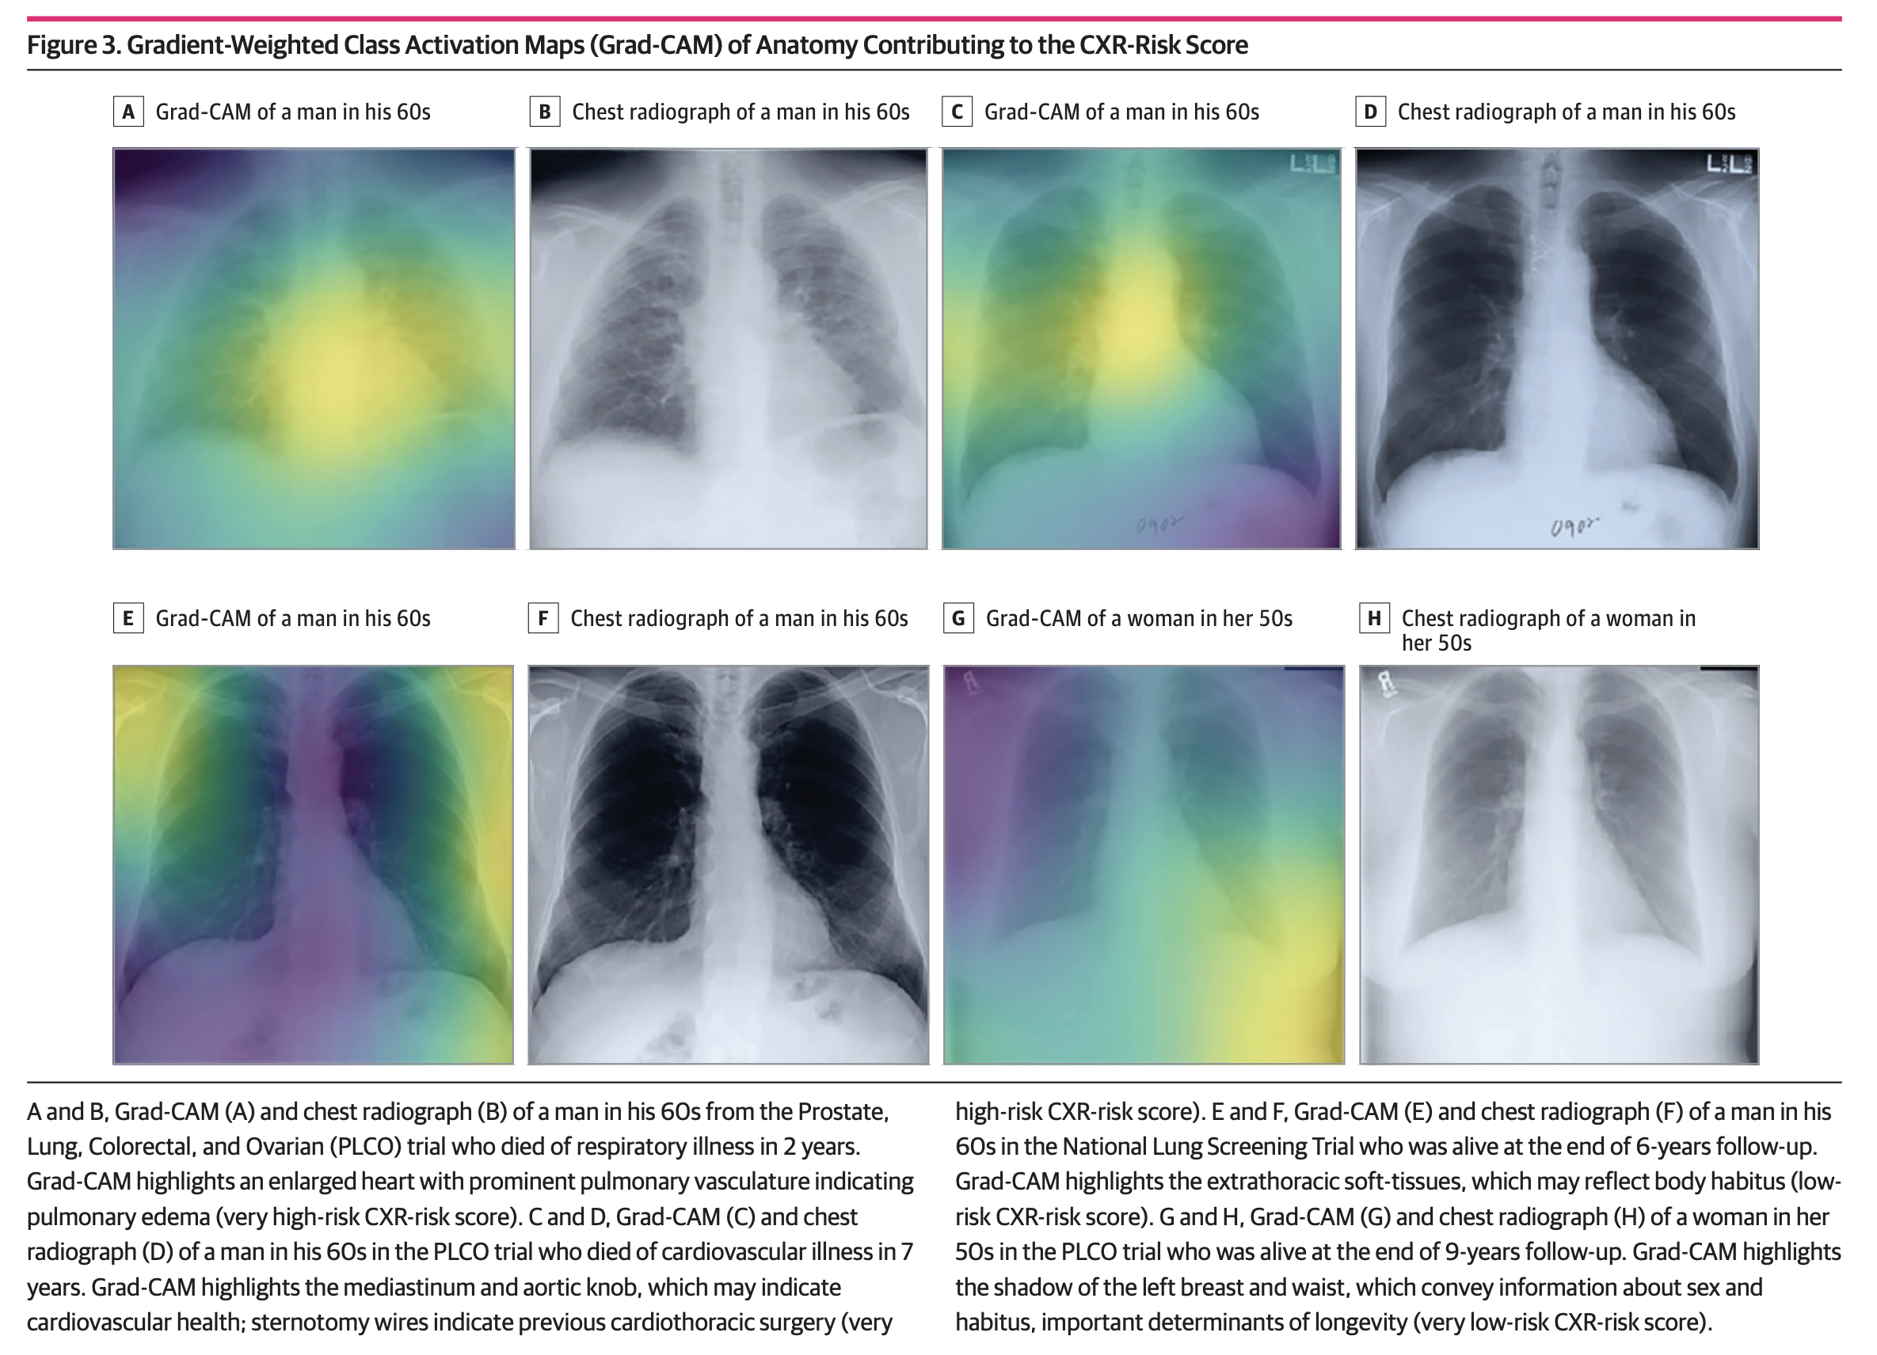

Slide 27
Use cases in development by Epic
Auto-summarization of interval events
Auto-draft letters and MyCHOP replies
Auto-translation of documents and queries
“Since you last saw Jared in clinic…”
Epic developing ability for EHR to automatically summarize interval history, relevant labs.
ChatGPT can create a full draft-response to a MyCHOP message that user can edit or refuse.
Language Services: potential to have clinical documents draft-translated into other languages.
Slicer Dicer: natural language queries translated into appropriate syntax

Slide 28
Summarization of Interval Events

Slide 29
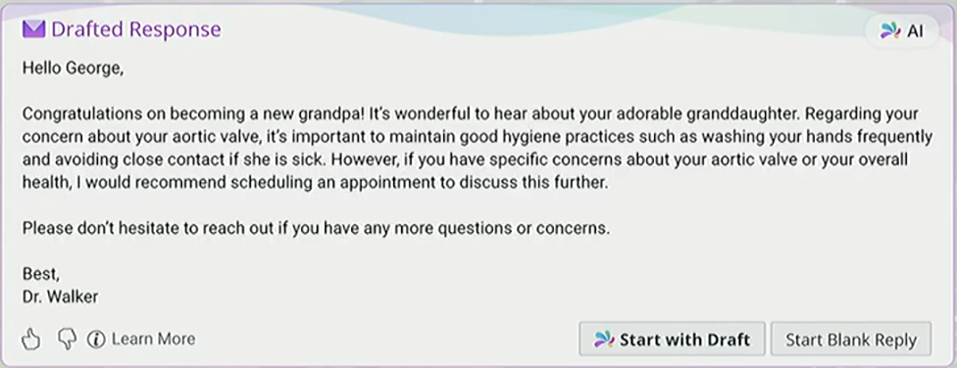
Auto Draft Replies

Slide 30
AUTO-Translation to Patient-Friendly Language
Anterolateral and anteromedial portals were made under spinal needle localization and the arthroscope as insertered intra-articularly.
Two small cuts were made in your knee, and a special camera (arthroscope) was put inside to let the surgeon see what was going on.

Slide 31
“Voice is the new joy”

Slide 32
Ambient Listening

Slide 33
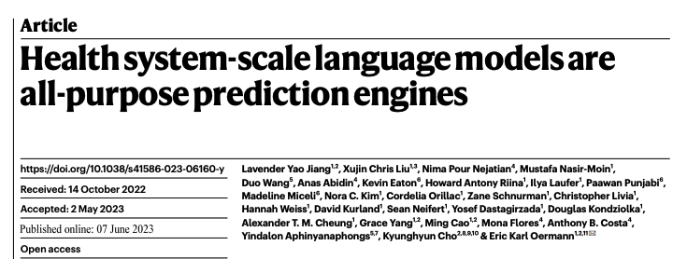
NYUTron

Slide 34
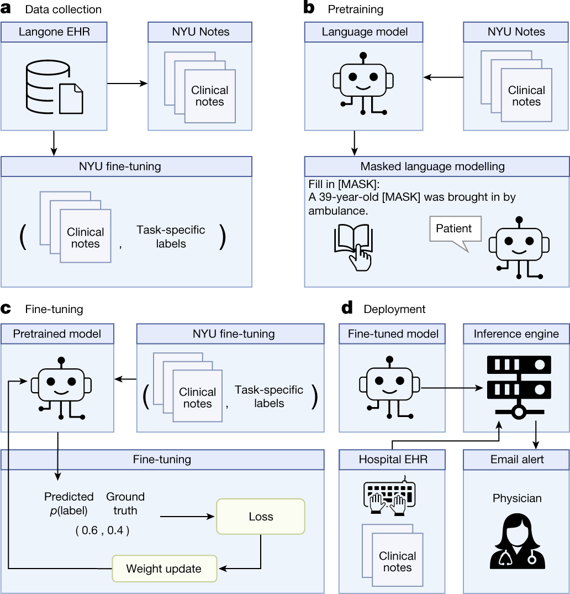
NYUTron
10 years of clinical notes (387K patients)
109 million parameter LLM based on BERT
Trained in 5 tasks using 1-10 years of labeled notes
30-day all cause readmission prediction
In-hospital mortality prediction
Comorbidity index prediction
LOS prediction
Insurance denial prediction

Slide 35
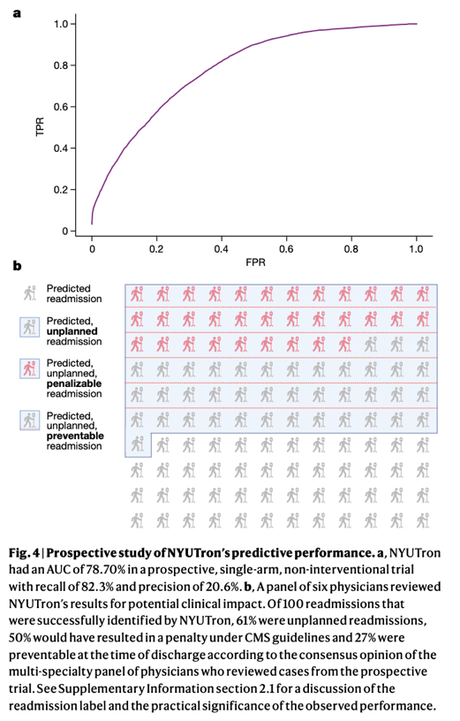
NYUTron
Prediction tasks (mortality, readmission, LOS, insurance denial)
AUC = 78.9%-94.9%, improved by 5-15% from traditional clinical models
Comorbidity index imputation
Median AUC of 89.4%
Prospective study of readmission
AUC of 78.7% (Recall 82.3%, Precision of 21%)

Slide 36
Administrative applications
Office 365 CoPilot → Meeting minutes and notetaking
Enterprise ChatBot → train AI on corpus of hospital policies and procedures for simpler query interface
Coding and Abstraction → parse clinical notes for billable ICD-10 concepts or discrete data elements

Slide 37
Potential Patient-Facing applications
Explanation of benefits and healthcare bill
Triage / symptom checker chatbot
Complex scheduling assistant
Health coach or care management chatbot

Slide 38
SPECIAL CONSIDERATIONS
Ethics
Disclosure to patients and families?
Privacy
Consent to record for ambient voice solutions?
Cost
Do you require the cost to be offset by increasing patient volume?
Risk
How much do you have to worry about AI hallucinations?

Slide 39
Recommendations for healthcare leaders
Establish AI governance, policies, and procedures
Cultivate leaders who have a vision for clinical and operational transformation in healthcare using technology
Culturally, embrace innovation and change while also being cognizant of risk, ethical, and legal concerns.
Adopt a broad-based approach that looks for AI wins in unexpected
Insist on demonstration of value. These tools can be expensive.

Slide 40
Resources
COURSERA COURSE
Prompt Engineering for ChatGPT
Keynote address by Emily bender
On the danger of stochastic parrots:
Can language models be too big?
UCSF Grand Rounds
Chat GPT: Will it transform the world of healthcare?

Slide 41
Questions
What do you see as the greatest opportunities for LLMs in healthcare?
What do you see as the greatest risks in using LLMs in healthcare?
As administrative leaders, what will your role be in enabling the AI transformation of healthcare?

