Slide 1
Leading and Navigating Change
Elida Lee
Director for Organization Effectiveness
University of Texas at Austin

Slide 2
What is change?
Make (someone or something different)
Alter or modify
Replace something with something else, especially something of the same kind that is newer or better
Substitute one thing for another

Slide 3
Two Trips

Slide 4
Change
Navigating
Leading

Slide 5
Navigating Change

Slide 6
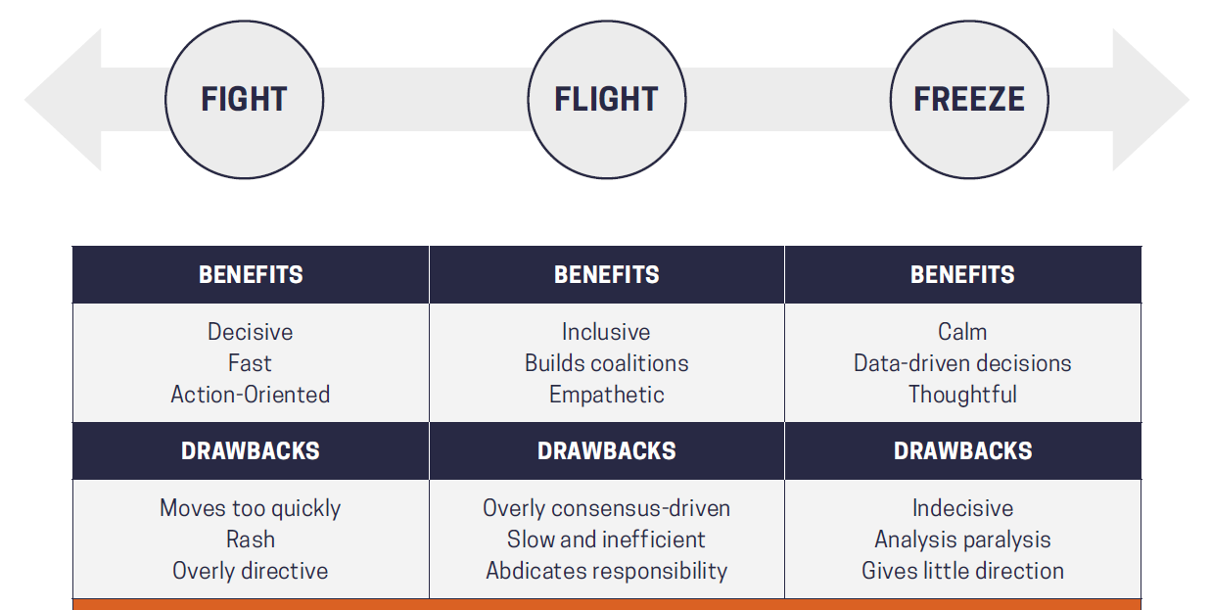
Human Danger Response
https://www.mcchrystalgroup.com/insights/operating-crisis-leaders-guide/

Slide 8
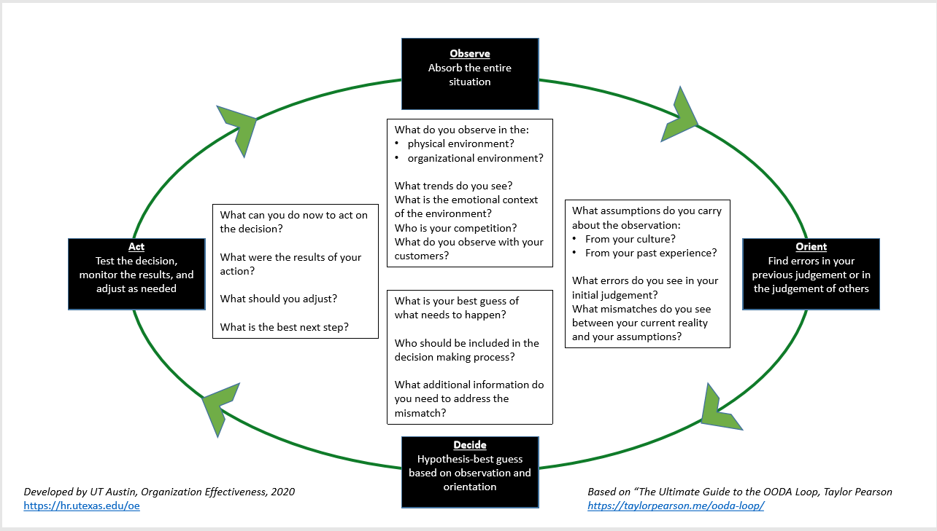

Slide 9
Leading Change

Slide 10
Six Step Process for Planned Change
Make the case for change
Develop a Vision and Strategy
Communicate
Remove Barriers
Set milestones and acknowledge progress
Reinforce the change

Slide 11
Where Change Fails…or Succeeds
Common Vision
Communication
Barriers
Progress
Reinforcements
Complacency
False Starts/
Confusion/
Misalignment
Case
Communication
Barriers
Progress
Reinforcements
Case
Common Vision
Barriers
Progress
Reinforcements
Inaction/
Confusion/
Resistance
Case
Common Vision
Communication
Progress
Reinforcements
Frustration
Cynicism/
Loss of
Momentum
Case
Common Vision
Communication
Barriers
Reinforcements
Case
Common Vision
Communication
Barriers
Progress
Wasted
Effort
Case
Common Vision
Communication
Barriers
Progress
Reinforcements
CHANGE
Change Leadership, Linkage, 2012

Slide 12
Questions

Slide 13
Elida Lee
Elida.lee@austin.utexas.edu

