Slide 1
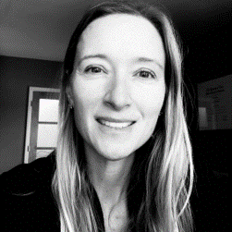
Quality, innovation, and outreach
Our Global Aim:
To be a data-driven, healthcare community striving to improve pediatric outcomes
KATE REMICK, MD, FAAP, FACEP, FAEMS
Associate Professor, Department of Pediatrics, Dell Medical School
Associate Chair for Quality, Innovation, and Outreach
Co-Director, National EMS for Children Innovation and Improvement enter
KRYSTLE BARTLEY, MA
Assistant Director of Quality | Department of Pediatrics

Slide 2
Foundation of our work
Notes:
Adapted from the Toyota Lean model

Slide 3
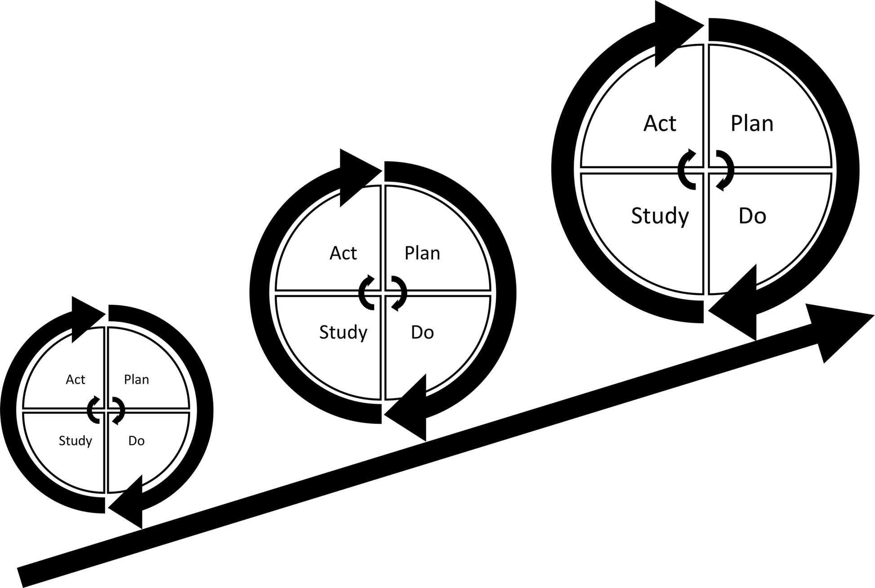
Foundation of our work
Quality Improvement (QI) Science
Quality improvement seeks to standardize processes and structure to reduce variation, achieve predictable results, and improve outcomes for patients, healthcare systems, and organizations
Notes:
Quality improvement (QI) is the framework used to systematically improve care.
https://www.cms.gov/Medicare/Quality-Initiatives-Patient-Assessment-Instruments/MMS/Quality-Measure-and-Quality-Improvement-#:~:text=Quality%20improvement%20is%20the%20framework,%2C%20healthcare%20systems%2C%20and%20organizations.

Slide 4
Research vs. quality improvement
 | RESEARCH | QUALITY IMPROVEMENT
Intent | Develop or contribute generalizable knowledge (e.g., testing hypothesis) | Improve a practice or process within a particular institution
Design | Systematic; Follows a rigid protocol that remains unchanged throughout the project | Adaptive, iterative design
Effect on Program or Practice Evaluated | Findings are not expected to directly affect institutional or programmatic practice | Findings are expected to directly affect institutional practice and identify corrective action(s) needed
Benefits | Participants may/may not benefit directly; often a delayed benefit to future knowledge or individuals | Directly benefits a process, program, or system; may/may not benefit participants

Slide 5
OUR APPROACH
Patient Care
Research
QUALITY IMPROVEMENT
Notes:
Approach it from the perspective that quality is a bridge btwn clinical care (locus of faculty desires) and
Patient care (one side) ----- Researchers (opposite side of bridge)
Austin (Town lake ) ----- we use QI as that bridge
Enterprise: University of Texas
Neighborhoods (Healthcare Community) Health System (all hospitals – referral 46 county catchment area)
Children’s Hospital
Here’s what we found (what the bridge looked like)
What structures would make it successful and sustainable over time

Slide 6
Our Community
Local Community
(Pediatricians, Families, Subspecialists)
Medical Center
Academic Institution
Peds
This Was Our Starting Point…

Slide 7
Scope of programming
Academic Institution
Academic Department
Health System
Healthcare Community
Population Health
Multi-Disciplinary Collaboration
Innovation
Machine Learning
24 Divisions
Faculty, Staff, & Trainees
QI efforts ideal for wider dissemination and spread across system
Standardizing pediatric care
Patient and families
Community providers
EMS Agencies
Touchpoints across continuum of care delivery

Slide 8
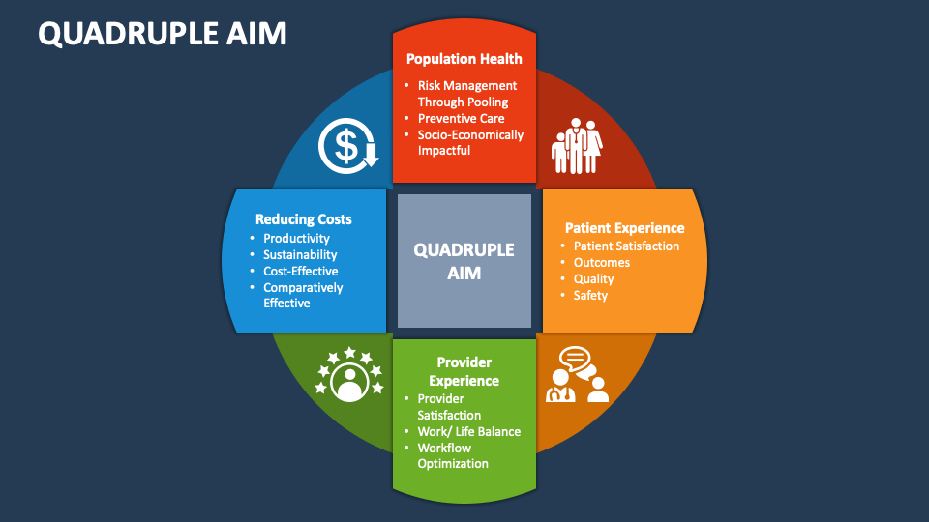
Benefits of QI Scholarship
Proactive, generative culture
Collaborate across disciplines and community
Leverage academic scholarship/critical inquiry
High-reliability organizations
Notes:
Optimize clinical outcomes, minimize variability in care
Improve patient and provider satisfaction
Reduce inefficiencies
Leverage as academic scholarship for promotion
Promote collaboration across units, disciplines, and specialties
Move towards a proactive, generative culture
Move towards a high-reliability organization

Slide 9
OUR SETTING
Notes:
IMAGE SOURCE: https://www.istockphoto.com/photo/new-growing-modern-city-of-austin-texas-at-golden-hour-sunset-perfect-travel-gm1226293105-361267717
https://www.istockphoto.com/portfolio/RoschetzkyIstockPhoto?mediatype=photography
Start with the setting -
Med school 7 years old
Developed by and for the community
Faculty came from other institutions –
Close ties to Austin community
Fear of research and academic thresholds for manuscripts

Slide 10
Environmental scan
Infrastructures & Stakeholders Supporting QI

Slide 11
THE environmental scan
Domains & Implications
Team Composition
QI Efforts Underway
Evaluation Plan
Methods of Evaluation
Metrics Tracked & Reporting
Data Infrastructure
Abstraction
Storage
Data Analysis
Generating Performance Reports
Perceived Barriers
Conducted Fall 2022
79% Response Rate
Notes:
Environmental Scan
79% response rates – with 19 divisions participating in the evaluation
Missing only 5 divisions
Quality improvement ranks 3rd in the number of champions identified in a division (behind education and research) (before sim and advocacy)
9 Champions across the 19 divisions
Only 5:9 have a clinical outcomes/quality data specialist
Only 3:9 divisions have a statistician/data analyst
Team Composition: Physicians primarily reported as the individual that reviews metrics and participates in implementation of improvement efforts
Opportunity: Engaging more members of the care team in improvement work
Metrics: Various types of measures being evaluated (clinical processes/condition-specific/regulatory/administrative)
Minimum 4 – Max of 7 divisions are submitting their outcomes externally to national registries, collaboratives, or CMS
4:19 divisions are not tracking any measures
Data:
Majority of divisions are conducting chart reviews and manual data entry for improvement efforts
Data stored in spreadsheets and database programs (implications about limited sharing of data)
Barriers:
Time was listed as the number 1 barrier to engaging in QI.
2 – Support Staff
3 – QI Expertise/Training
4 – Incentives
Lowest Ranking was faculty engagement

Slide 12
Our Global Aim: To Be A Data-driven, Healthcare Community Striving To Improve Pediatric Outcomes
Convene Clinical Division Quality Directors
Enhance Data & Analytics Infrastructure
Establish Clinical Microsystems to Drive Improvement Efforts
Expand Our Impact through Outreach
Collaborate to Demonstrate High-Quality Care
Current Efforts
Organization
People
Effectiveness/
Agility
Technology

Slide 13
Scope of Activities for Clinical Division QI Dyads
Prioritize top 3 areas of focus for their division
Based on clinical conditions, clinical processes, division-specific
Balanced scorecard process to prioritize measures
Implement QI efforts within their division
Develop portfolio of efforts underway with results
Endorse use of QI tools and concepts for new projects
Disseminate clinical impact and best practices
Venues: Annual Quality Forum | Professional Societies | Manuscripts | Conferences/Symposiums | Dell Children’s Quality, Safety, and Patient Experience Council
Collaborate with partners across continuum of care and larger community
Engage in outreach/training of new learners
Locally, Regionally, State-Level, Nationally

Slide 14
Global Aim
Key Drivers
Change Strategies
Formal approval from each division director and protected time
Identification of a physician AND nurse champion
Change agents to lead QI efforts
To be a data-driven, healthcare community striving to improve pediatric outcomes
Pursue opportunities to strengthen QI and process improvement acumen
Disseminate knowledge and best practices across divisions and broader community
Centralized coaching
Strengthen QI and process improvement knowledge

Slide 15
Global Aim
Key Drivers
Change Strategies
Contractual Agreements
Establish data use agreement with Ascension
Identify Data Warehouse
Cost-benefit analysis of data platforms that compile info from disparate sources
To be a data-driven, healthcare community striving to improve pediatric outcomes
Data Infrastructure
Supporting Personnel Org Chart
Biostatistician
Data Analyst
Data Abstractor
Approval Structure
Prioritization of projects
End-user data literacy

Slide 16
Additional considerations
Importance of creating a non-punitive, supportive culture
Prioritize projects (bottom up vs. top down approach)
Mandates from state and regulatory bodies
QI education is a wide-spread need
Integrate existing resources
Train-the-trainer approach
Mentoring & Coaching
”Pay it Forward”
Our Team to Faculty, Faculty to Residents and Broader External Audiences

Slide 17
Cost | Investment
Time
Faculty members (allocate time for QI when results are not immediate)
Personnel
Data analyst, Statisticians, Data Abstractors
Technology
Amazon Workspace vs. Google Products, Server-Space, Software Licenses (Visualization Tools and Analyses)

Slide 18
Evaluation plan
PEOPLE
Number of learners (stratify by faculty, staff, external entities)
PROJECTS
Rate of completion
Project performance
Publications
IMPACT
Patient Outcomes
Reach (organization, community)
External Funding Secured
Faculty Promotion (building portfolios for professional advancement)

Slide 19
Questions/Discussion
Kate Remick: Kate.Remick@austin.utexas.edu
Krystle Bartley: Krystle.Bartley@austin.utexas.edu

