Slide 1
U OF U HEALTH
AAAP Spring Conference 2026
Artificial Intelligence in Administrative Work
PRESENTED BY
SHAWN
TERRELL
JAKE
Shawn Halladay
Terrell Rohm
Jake Zimmerli
Sr. Director, AI Strategy & Enablement
Associate Director, AI Integration & Value
Director, Pediatric Cardiology

Slide 2
AAAP 2026 · AGENDA
U OF U HEALTH
What We'll Cover
Three sections, in order. Each builds on the one before.
01
02
03
SEAN
TERRELL
JAKE
AI in the industry & at U of U Health
The healthcare AI tool landscape & live use cases
Putting AI to work — prompts, risks, and roadmap
Where AI sits in healthcare today, where U of U Health is heading, and the governance and innovation framework that gets us there.
The six categories of AI tools, how to choose between them, and the deployed pilots already returning measurable value across U of U Health.
Practical prompting habits, the two risks worth naming out loud, and a three-step path each of us can take from this room.
U of U Health · AI Health Team

Slide 3

AI Thought Moment
U OF U HEALTH
What’s the most surprising thing you’ve heard or seen AI do?
If AI could take over one of your daily tasks, what would you happily give up?
Notes:
Open AI patient record integration
Claude software build/framework for clinical solutions and coding
Mythos

Slide 4
Artificial intelligence in the industry
Notes:
Jim and Ken

Slide 5

Search engine land YOU + AI = Value
U OF U HEALTH
Human-written content dominates Google’s top rankings, appearing in the No. 1 position 80% of the time versus just 9% for purely AI-generated pages
Human-written pages outperformed AI and mixed AI content.
AI content appeared more often lower on first search result page.
A new Adobe Express survey reveals that 77% of Americans are using ChatGPT as a search engine, and 24% say they turn to it before Google
*AI detection tools are widely known to be inconsistent
87% of teams keep humans heavily involved in content creation.
64% use a human-led, AI-assisted workflow.
AI is most common in research, drafting, and optimization.
AI accelerates output but doesn’t reliably improve it.
70% cite faster production as AI’s top benefit.
Only 19% say it improves content quality
*Perception vs. data. 72% of SEOs said AI content performs as well or better than human content, yet ranking data showed a clear human advantage at the top.

Slide 6
Too much ai or not enough
U OF U HEALTH
Healthcare AI Industry
Healthcare is a $4.9-trillion industry that makes up one-fifth of the U.S. economy but only 12% of national software spending.
Limited technology impact outside of EHR – AI is changing that…why?
• Kaiser Permanente deployed Abridge’s ambient documentation platform across 40 hospitals and 600+ medical offices—the largest generative AI rollout in healthcare history.
• Advocate Health implemented 40 use cases documentation, imaging, and call-center.
• Mayo Clinic is investing more than $1 billion in AI
AI Primary Benefit | % of Use Cases
Time savings | 34.3%
Quality improvement | 15.0%
Increased output | 14.2%
New capabilities | 12.4%
Improved decision making | 9.0%
Cost savings | 7.4%
Increased revenue | 4.0%
Risk reduction | 3.7%
AI Access & Use
Requires Maturity
Data & Alignment
Notes:
Copy this into AI and see what it tells you? Let the group know your results.
Have any of you tried telling AI to say Banana if it is unable to answer?
1. Healthcare Is Data-Rich but Workflow-Poor
Healthcare generates enormous volumes of unstructured data (clinical notes, images, messages, reports),
but traditional software could not effectively use it. AI—particularly modern language and vision models—can finally interpret, summarize, and act on this data, unlocking value that EHRs alone never could.
This is not new data—it is new capability.
AI Extends Beyond the EHR Boundary
EHRs optimized record-keeping.
AI optimizes workflows, decisions, and throughput.
AI operates:
Before the encounter (access, scheduling, triage)
During care (documentation, decision support)
After care (coding, billing, follow-up)
Across the enterprise (finance, HR, research, operations)
22% of healthcare organizations have already implemented domain-specific AI tools, a 7× increase over 2024 and 10× over 2023

Slide 7



U OF U HEALTH
WHAT'S CHANGING · STRATEGIC FORCES
Three Forces Reshaping Healthcare
Where C-suite leaders are placing their strategic bets for 2026.
The Empowered Consumer
AI at Operational Scale
Cross-Industry Partnerships
Patient trust is eroding. Digital-first experiences, transparent pricing, and seamless access are now baseline — not differentiators.
From pilots to production: generative and agentic AI are scaling into claims, clinical documentation, and back-office workflows.
Boundaries are dissolving. Payers, life sciences, retail, and tech are converging on care models no single player can build alone.
70% plan tech-company alliances in 2026
88% of leaders express trust in AI
63% rank partnerships a top priority
Sources: Deloitte 2026 US Health Care Outlook; EY 2026 Health Trends; MHA Leadership Survey.

Slide 8
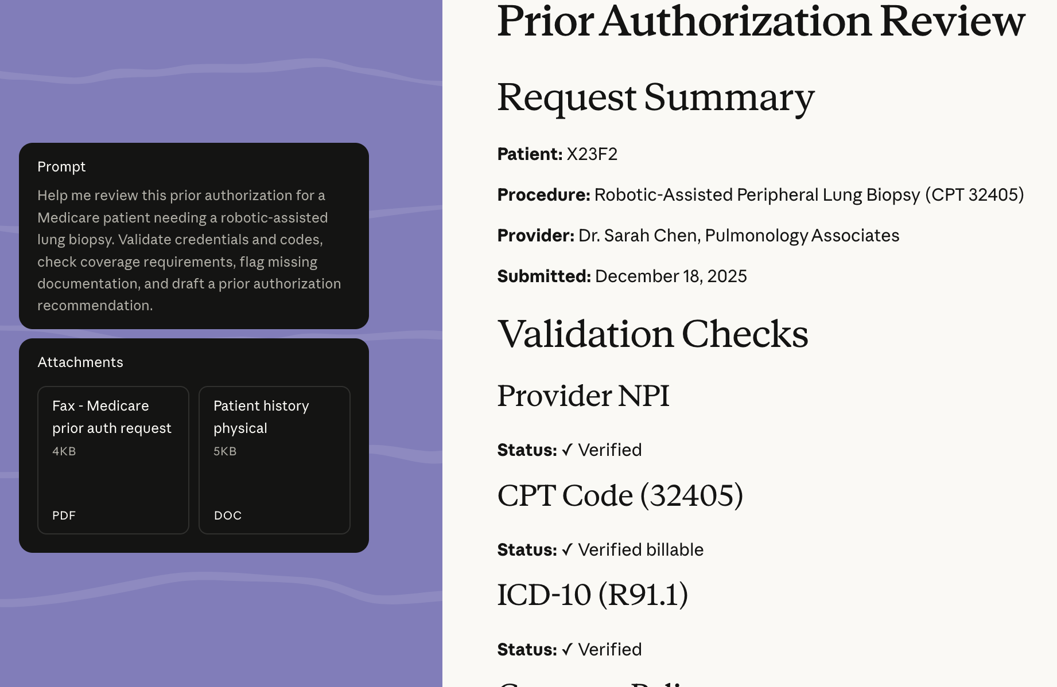
AI industry OpenAI & Anthropic
U OF U HEALTH
Important changes shaping the future of healthcare
Over 230 million people globally ask health and wellness related questions on ChatGPT every week.
Why?
Does this support or replace medical care?
Why?
Anthropic
OpenAI
Natural Language
Building workflows
Coding
Policies
Natural Language
Summary
Translation
Suggestions
Notes:
This puts knowledge and clear decisions in the hands of those who own the decision rights. The ability to improve your own outcome
Today, health information is often scattered across portals, apps, wearables, PDFs, and medical notes—so it's hard to see the full picture, and people are left to navigate a complex healthcare system on their own.
AI brings access to knowledge that may be beyond our reach, skill, awareness or ability to consume.
Concise translation or summary, or educational training engagement

Slide 9
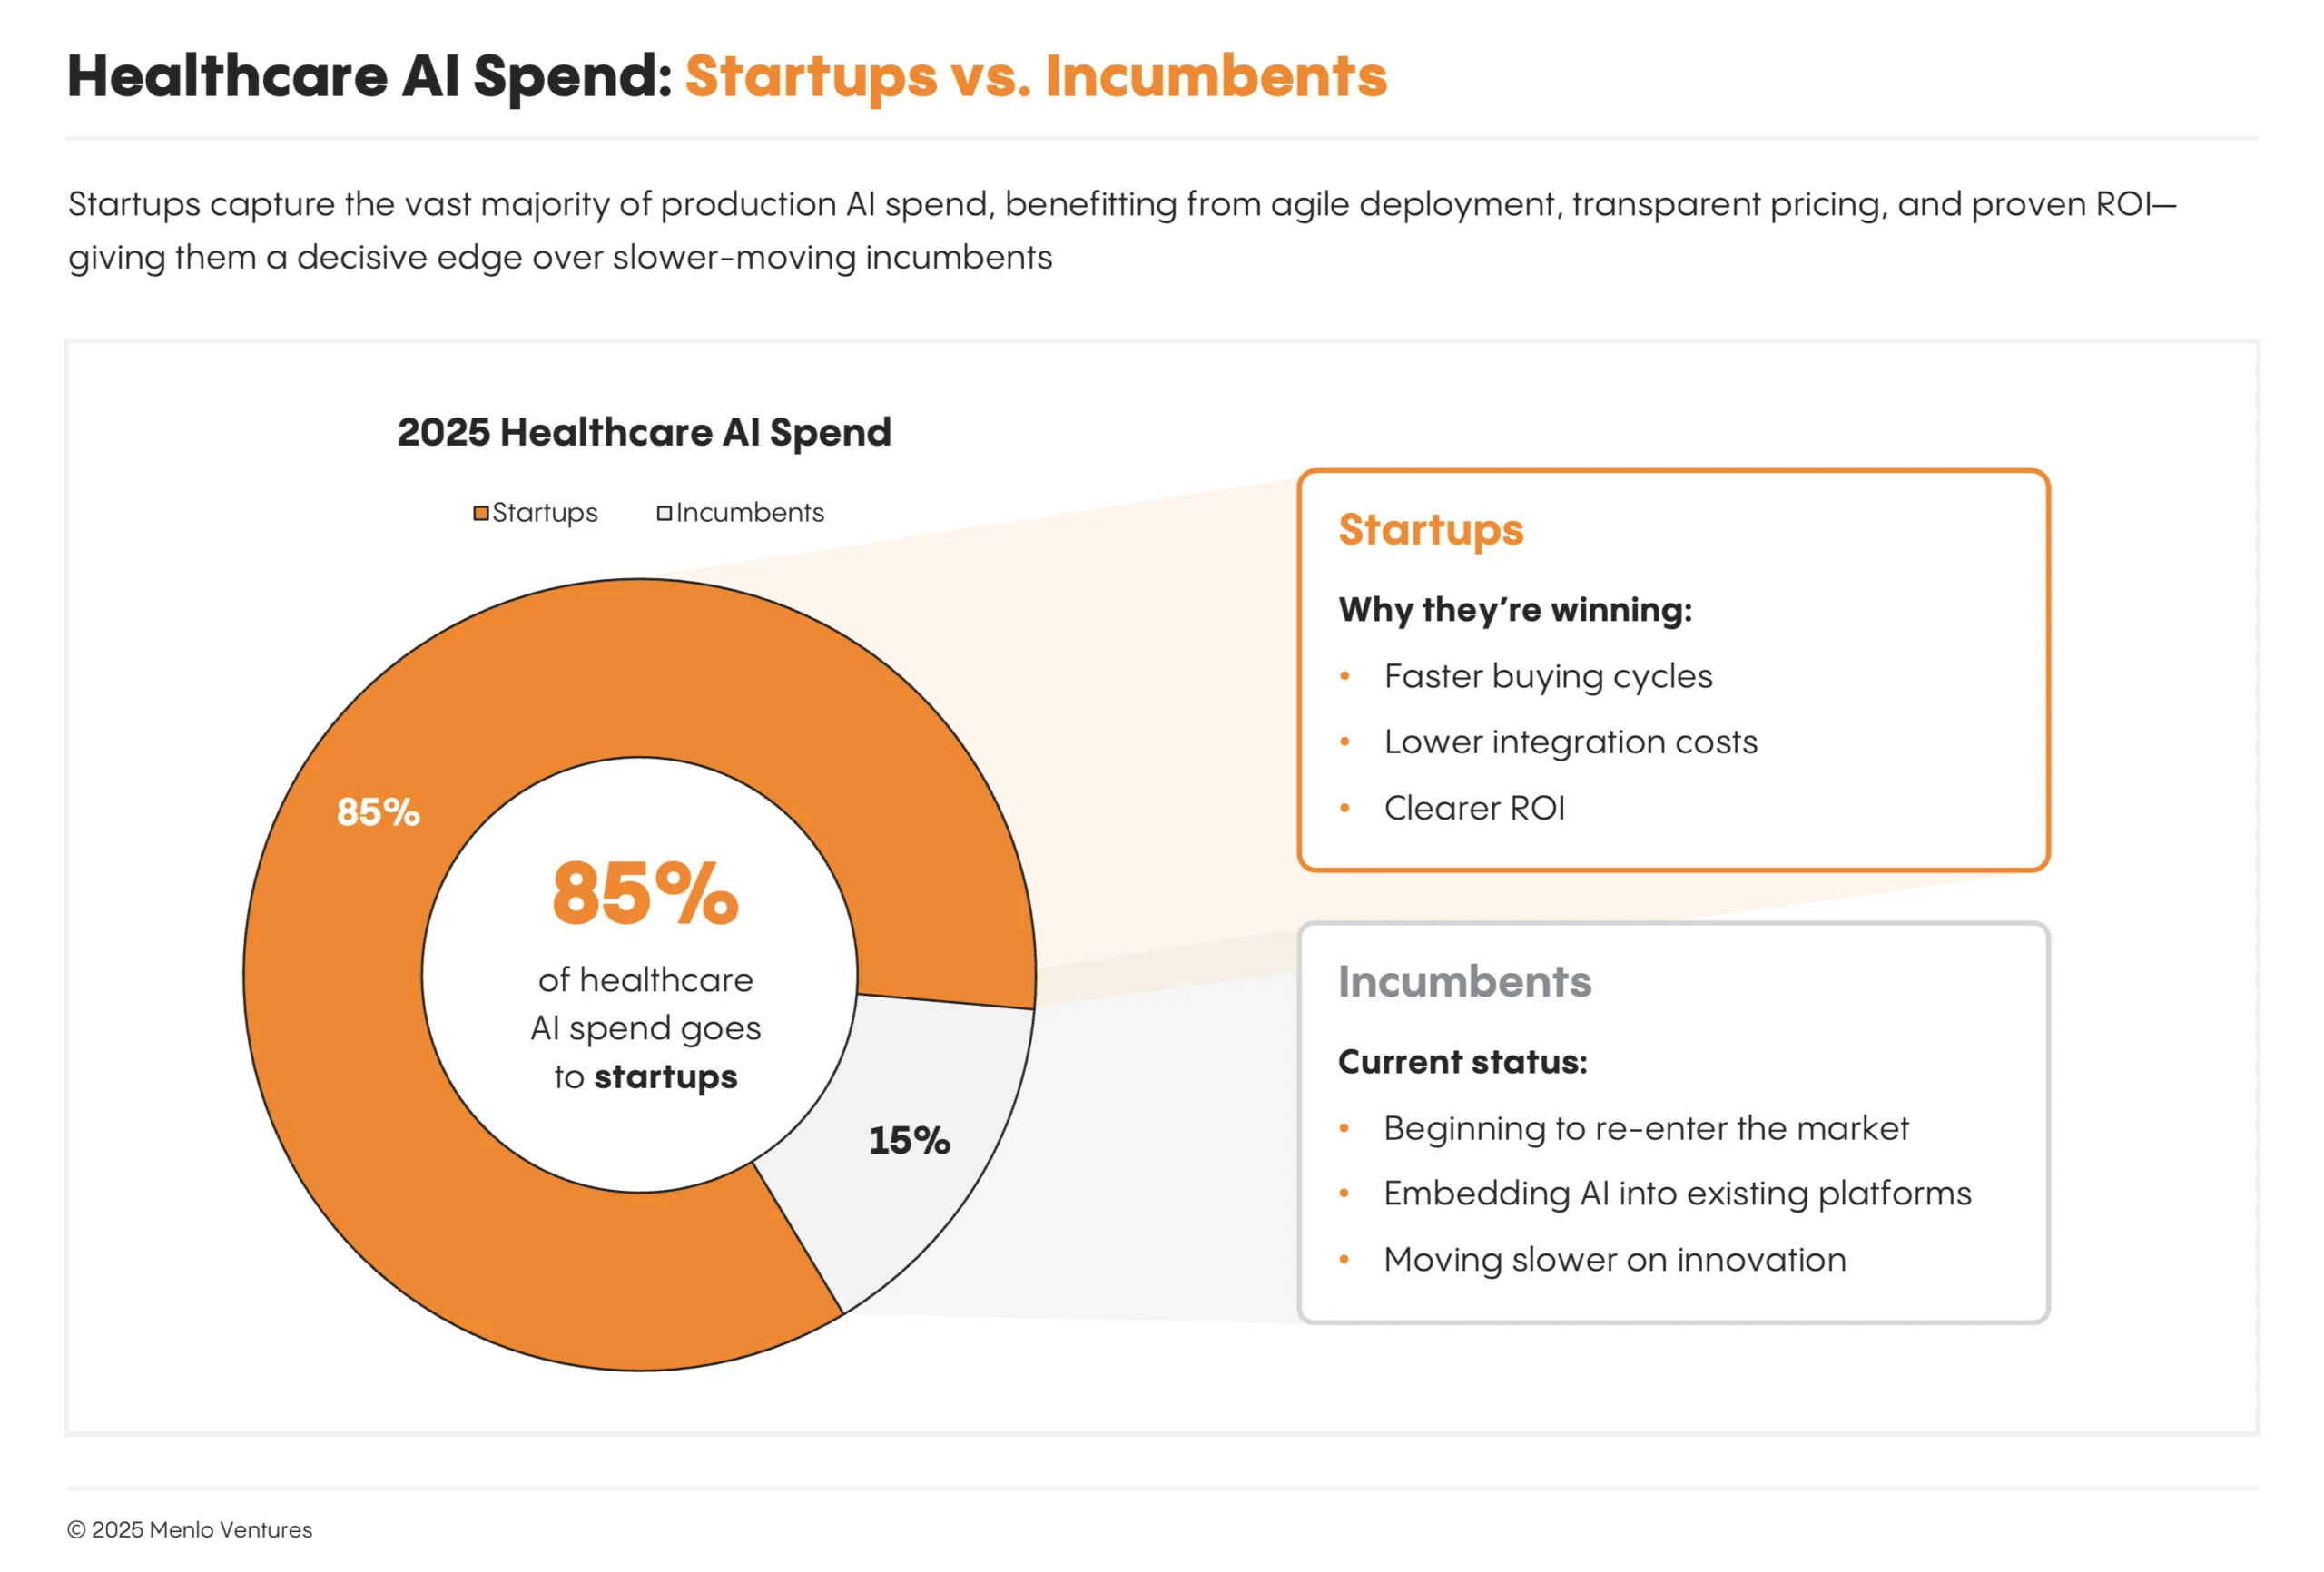
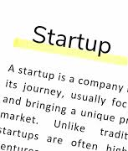
U OF U HEALTH
Notes:
Startups have some advantages: They can move faster and design products natively around AI capabilities, unburdened by legacy technical debt and the bureaucracy of larger organizations. Incumbents’ new AI offerings have largely been bolt-on features to legacy platforms. As a result, AI-native challengers have gained rapid adoption and market share.

Slide 10
Artificial intelligence at University of Utah Health system
Notes:
Jim and Ken

Slide 11
Data as a Strategic Asset – essential to managing risk and cost
U OF U HEALTH
Unified Data Ecosystem
A unified data ecosystem provides a single source of truth, enabling accurate and informed decision-making for organizations.
Advanced Analytics Impact
Population Health Management
Risk Stratification
Predictive Modeling
Connecting Systems for Outcomes
Linking clinical and operational systems helps organizations deliver precise interventions, improve outcomes, reduce costs, and enhance care quality.
© UNIVERSITY OF UTAH HEALTH
Notes:
Shawn
A unified data ecosystem creates a single source of truth, facilitating informed decision-making. Advanced analytics leverage integrated data to support population health, risk stratification, and predictive modeling. By connecting clinical and operational systems, organizations achieve precise interventions and improved outcomes, ultimately reducing costs and enhancing care quality.
Data is a strategic asset critical to managing risk, cost, and performance Establishing a unified data ecosystem creates a single, trusted source of truth
Consistent, governed data enables faster; more informed decision-making Advanced analytics shift us from reactive to proactive care delivery Enables population health management, risk stratification, and predictive modeling
Early insights drive better outcomes while reducing avoidable costs Connecting clinical and operational systems creates a complete, actionable view Integration improves care quality, operational efficiency, and resource utilization
Strong data foundation is essential to scale innovation and digital transformation Ultimately, leveraging data effectively improves outcomes while controlling cost and risk
Risk stratification (means the data pool can automatically analyze patients before they get indicators of disease) – in old infrastructure data existed in silos, ER, primary care Doctor, billing all working from variations in data. A unified data system pulls everything into a single real time source of truth, that the system can analyze the singular data pool to
By looking at the intersections of data through unifying it, a diabetic patient, with high blood pressure can be flagged as they miss a prescription at the pharmacy can pull these three isolated events together in predictive modeling to prevent risks such as mortality events that could be enabled through a combination of risk factors.
Could operational interventions prevent risk events in a patient journey, through early preventative points, such as patient followups
Data is knowledge and a critical strategic asset

Slide 12
enterprise AI AT u hEALTH
U OF U HEALTH
Governed AI to Reduce cost, Risk and Variability
How We Execute
Contract Control
Right AI, Right Setting
Measured Impact
Value Delivered to Payors
Cost Discipline
Risk & Compliance
Predictable Performance
© UNIVERSITY OF UTAH HEALTH
Notes:
Jim
Value Delivered to Payors – deploy the right AI and solutions, through accurate notes, complications are captured early, providing intentional outcomes ensures we support efficient care
Cost Discipline
Enterprise contracting avoids fragmented AI spend
Standardized services reduce duplication and per‑use cost
Risk & Compliance
Consistent controls for data use, privacy, and model behavior
Alignment with regulatory and contractual expectations
Predictable Performance
AI deployed with defined use cases, metrics, and owners
Ongoing monitoring across the full lifecycle
How We Execute
Contract → Control
Technical enforcement of contractual and regulatory requirements
Right AI, Right Setting
AI access aligned to role, risk, and clinical intent
Measured Impact
Adoption, outcomes, and value tracked continuously

Slide 13

What this looks like in Practice
Virtual Nursing & Smart Rooms
Navigation & Scheduling
Remote Patient Monitoring
Ambient Documentation
Notes:
Jim
Virtual Nursing and Smart Rooms
Enhances care team capacity
Reduces labor strain and improves throughput
Remote Patient Monitoring
Identifies issues earlier
Reduces readmissions and high-cost events
Ambient AI Documentation
Reduces clinician administrative burden
Increases provider capacity and patient access
AI-Assisted Navigation & Scheduling
Improves access and patient experience
Directs patients to the right level of care

Slide 14
Innovation intake workflow
U OF U HEALTH
Ideation pipeline
INTAKE
TRIAGE
PROOF
VALIDATE
IMPLEMENT
Problem + sponsor
Success metric
Risk class
Build / buy
Rapid prototype
Data + workflow fit
Pre-production eval
Bias + safety checks
Production Integration + training
SPEED TO SCALE
TRUST BY DESIGN
COMPOUNDING VALUE
Rapid-cycle proofing
Governed innovation
Scalable services
Simplified intake and triage
48-hour go / no-go for low-risk concepts
Speed of innovation is greatly increased through AI Labs
Risk-classed evaluation (clinical, privacy, security)
Strategic aligned innovations
Monitoring plan for drift, safety, and equity
Shared AI engineering + integration services
Innovative AI solutions
Standard AI services = faster scale across entities
Notes:
Jim

Slide 15
NCI Study Examines aI Versus Radiologists in Assessing Tumors
U OF U HEALTH
NIH – National Cancer institute
AI was particularly useful in identifying and annotating localized cancers. Moreover, AI was able to perform these tasks very quickly, with reproducible results.
Radiologists could identify the extent of the tumor better than AI, especially on whole slide images, but this process remains tedious and time consuming.
Good to excellent: 80 - 87% AUC
AI Assisted: 91 – 93%
1.0 is perfect

Slide 16





University Health system AI tools
AI access & use
AWS
Data enabled AI
AI assistant services
Compliant & trustworthy
Digital intelligence
Data security
Cloud compute
Anthropic
Notes:
Jim
AWS supports data enabling AI, from our EDW and Decision Support areas increasing insights into operational systems
Assistant AI services support operational work, such as analysis, creation and AI enabled user data
Health system AI services are compliant for restricted data use, protecting our patients and digital identities
AI enables every worker with greater access to knowledge
Foundational data security is the core of AI use and access
AI enabled cloud compute services support agility of innovation and secure workloads

Slide 17

U OF U HEALTH
AI IN HEALTHCARE · THE CASE FOR ACTING NOW
BY THE NUMBERS
The Question
Isn’t Whether.
It’s How Fast.
72%
of physicians report burnout — administrative burden is the #1 driver
AMA Physician Burnout Survey
~50%
reduction in physician documentation time with AI ambient scribes
Microsoft/Nuance DAX Copilot
AI is already reshaping clinical workflows, reducing administrative burden, and recovering physician time. The data to the right explains why waiting is no longer a neutral position.
$265B
in annual U.S. healthcare administrative waste — AI directly targets this
JAMA 2019, Shrank et al.
U of U Health · AI Health Team

Slide 18
U OF U HEALTH
AI TOOLS · LANDSCAPE OVERVIEW
The Healthcare AI Tool Landscape: Six Categories to Know
CONVERSATIONAL AI
CLOUD AI PLATFORMS
EHR-EMBEDDED AI
ChatGPT | OpenAI
Claude | Anthropic
Gemini | Google
Microsoft Copilot
General-purpose; accessible via browser
AWS Bedrock & HealthLake
Azure AI + OpenAI Service
Google Vertex AI
IBM Watson Health
Enterprise hosting; HIPAA-eligible options
Epic: Abridge, Inbasket AI
Epic: Prior Auth Drafts
Epic: HB / PB Coding AI
Oracle Health AI
Workflow-native; within your EHR
CLINICAL IMAGING AI
AMBIENT DOCUMENTATION
RESEARCH & DATA AI
Aidoc (radiology triage)
Viz.ai (stroke & PE detection)
Nuance PowerScribe 360
Gleamer (bone AI)
FDA-cleared diagnostic support tools
Abridge (Epic-native)
Nuance DAX Copilot
DeepScribe
Suki AI
Real-time visit transcription & note drafting
Custom LLM pipelines
Cohort extraction & NLP
Population health analytics
Genomics & multi-modal models
Institution-built or vendor-partnered R&D

Slide 19
U OF U HEALTH
AI TOOLS · DECISION GUIDE
Choosing the Right AI Tool: Match the Use Case to the Category
Not all AI tools are created equal — and not all are appropriate for every setting. Use this framework to guide conversations with vendors, IT, and clinical leadership.
If your goal is…
Look in this category
Key questions to ask
Automate clinical documentation
Ambient Documentation AI
Is it Epic-native? HIPAA eligible?
Draft patient messages or letters
Conversational AI (general)
Does it allow PHI? Is it enterprise-licensed?
Triage or flag abnormal imaging
Clinical Imaging AI
Is it FDA-cleared for this indication?
Code patient encounters faster
EHR-Embedded AI
What is the measured accuracy / adoption rate?
Answer staff or patient questions
Conversational AI (general)
What data can it access? Who sees the prompts?
Analyze population-level data
Research & Data AI
Who owns the model output? Is it validated?
Build custom AI workflows
Cloud AI Platforms
What is the governance & oversight model?
Speed up prior authorizations
EHR-Embedded AI
Does it integrate with our payer contracts?
⚠ Always confirm HIPAA compliance, data governance, and security review before deploying any AI tool in clinical or administrative workflows.

Slide 20
U OF U HEALTH
ARTIFICIAL INTELLIGENCE · EHR ECOSYSTEM
AI Capabilities in EHRs
CLINICAL WORKFLOW
AMBIENT AI
PATIENT MESSAGING
PRIOR AUTHORIZATION
Abridge Ambient Documentation
Inbasket Messaging Drafts
Prescription Prior Auth Drafts
Reduces documentation time and resources (scribes, MA-started notes)
Time savings can unlock additional appointment slots — untapped at UUH
Clinical documentation improvement supports reimbursement
Pending value analysis at U of U Health
UCI Health: 43 sec saved per draft
Baylor: 44% MD / 55% APP draft adoption
Mount Sinai: 3.5 hrs faster reply
Ochsner: MAs reply 2 hrs faster
Reduces time spent on prior authorization questions
Reduces staff burden across pharmacy and clinic teams
REVENUE CYCLE
PROFESSIONAL BILLING
HOSPITAL & PROFESSIONAL BILLING
Coding Assistant
HB / PB Denial Tools
Reduces coding time per encounter
Reduces coding-related denials
ITS actively optimizing in collaboration with the UMB team
Reduces staff time required to work appeals
Improves revenue recovery on denied claims
Notes:
Epic AI is being deployed in multiple areas within the organization.

Slide 21


U OF U HEALTH
PILOT
AUTOMATED IDENTIFICATION OF SEPSIS CASES
EMERGENCY MEDICINE
Improving care quality and coding of sepsis cases relies heavily on our ability to automatically identify and label sepsis cases. Expert physician review is the gold standard but is time-intensive and expensive. The U of U Health Data Science Team is building an LLM-based surveillance system to automate case identification with greater accuracy and efficiency.
DEPLOYMENT
VALUE ADDED
API
~0.25 physician FTE in chart-review hours recaptured
Automation
Over a 6-month time frame
Notes:
Leveraging artificial intelligence to enhance the early identification of sepsis, thereby reducing the need for physicians to manually review medical records for clinical indicators.

Slide 22
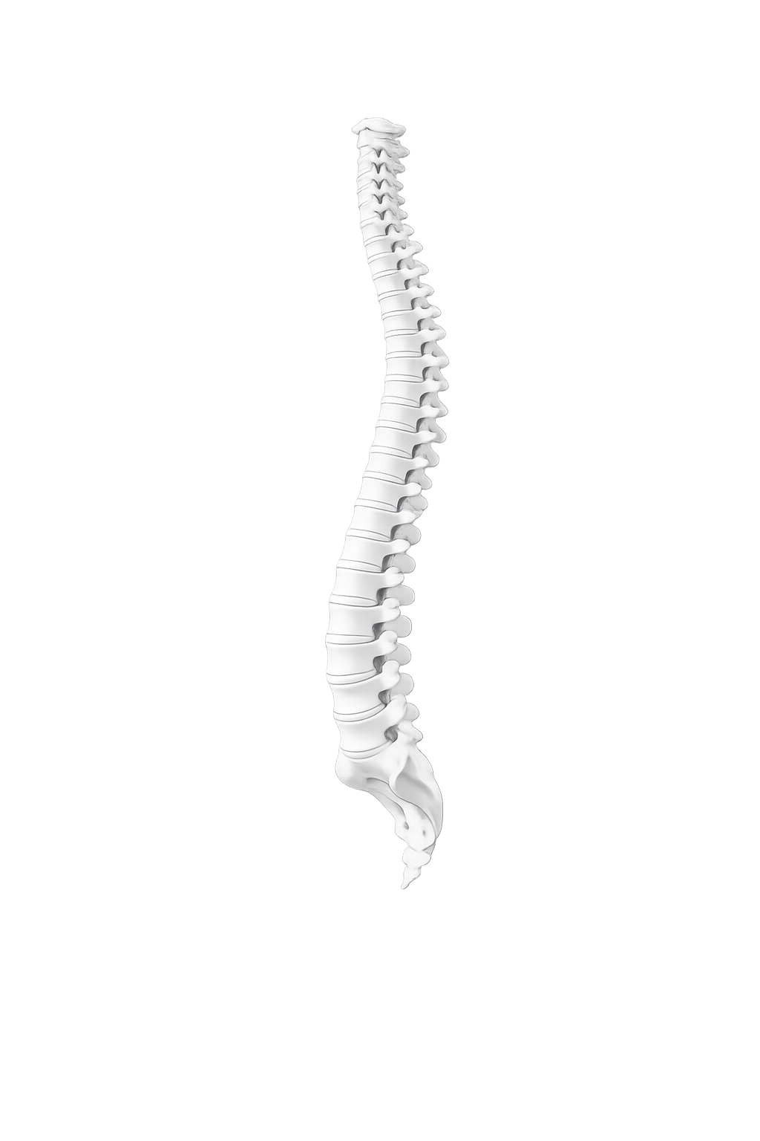
U OF U HEALTH
LIVE
AI-ASSISTED SCOLIOSIS PATIENT IDENTIFICATION
RADIOLOGY
A HIPAA-compliant LLM pipeline processes over 33,000 radiology reports to identify scoliosis patients and extract structured data on curve severity, characteristics, and spinal hardware. Free-text reports become research-ready datasets, accelerating AI development in musculoskeletal and neuro-imaging through a scalable institutional extraction framework. Cross-institutional collaboration with the Fayazi Lab and USC drives NLP validation and vision-language modeling for automated scoliosis imaging analysis.
DEPLOYMENT
VALUE ADDED
API
>1000 hours of resident time saved
50x acceleration in cohort development
Automation
per active study
Notes:
Utilizing artificial intelligence to identify patients with scoliosis for research cohort development, resulting in the savings of over 1,000 hours of manual chart review.

Slide 23


U OF U HEALTH
LIVE
ADA WEBSITE ACCESSIBILITY
WEB AND MARKETING
Three years ago, our web platform migrated from a system that did not preserve image meta-information, leaving tens of thousands of images on the site without ADA-compliant alt text and descriptions. The volume far exceeds what manual remediation can address. An LLM pipeline generates contextually appropriate alt text and descriptions across the legacy library, with human review for clinically sensitive imagery. The same pipeline runs on net-new uploads, so the backlog never re-accumulates.
DEPLOYMENT
VALUE ADDED
API
~0.2–0.5 FTE - 10s of thousands of images
Over a 6-month time frame
Automation
Reduces ADA Title III and Section 508 exposure
Notes:
To address the need for ADA compliance across thousands of website images requiring metadata, artificial intelligence was leveraged to automate this process, significantly reducing manual effort and employee time.

Slide 24


U OF U HEALTH
PILOT
IMPROVED DIAGNOSIS IN ALAGILLE SYNDROME
DATA SCIENCE
Application of AI tools to improve Alagille syndrome case ascertainment. A large language model is trained to identify Alagille syndrome cases from unstructured clinical data — including clinical notes, radiology, and pathology reports — an essential source of information for rare disease identification and population health.
DEPLOYMENT
VALUE ADDED
API
Research capacity
rare-disease ascertainment unlocked
Automation
Cohort identification not previously feasible
Notes:
Given the complexity and difficulty of diagnosing Alagille syndrome, artificial intelligence is being leveraged to enhance the identification of this critical patient population for research purposes.

Slide 25

U OF U HEALTH
LIVE
HEAL AT HOME
HEAL AT HOME
AI-facilitated identification of patients eligible for the Heal at Home program — bringing acute-level care into the patient's home. The model surfaces qualifying candidates from the EHR so care teams can extend hospital-quality treatment beyond the four walls of the hospital, expanding capacity and improving the patient experience.
DEPLOYMENT
VALUE ADDED
AI Labs
~0.25 Care manager FTE
Recaptured from manual census review over a 6-month time frame
On-Prem
Bed-day turnover unlocks system capacity
Notes:
Utilizing artificial intelligence to identify patients eligible for the Hospital at Home program, thereby reducing Care Manager workload and improving bed availability through more efficient patient flow.

Slide 26

U OF U HEALTH
LIVE
HCI CLINICAL TRIALS
HCI CLINICAL TRIALS OFFICE
AI-facilitated identification of patients eligible for clinical trials run by the Huntsman Cancer Institute. The system reviews patient data against trial criteria to surface qualifying candidates earlier and at higher volume — accelerating enrollment and broadening access to investigational therapies.
DEPLOYMENT
VALUE ADDED
AI Labs
~0.25 Clinical Research Coordinator FTE
per trial screening cycle
On-Prem
Enrollment lift drives sponsor revenue
Notes:
Artificial intelligence streamlines identification of patients eligible for Huntsman Cancer Institute clinical trials by matching patient data to trial criteria, accelerating enrollment and expanding access to therapies.

Slide 27

U OF U HEALTH
PILOT
QUALITY OF CARE DRIVEN EDUCATION PLATFORM
ANESTHESIOLOGY
AI analyzes fragmented patient quality-of-care data to identify care strengths and weaknesses. The platform delivers targeted micro-learning opportunities and just-in-time nudges to clinicians at the point of care. All AI-generated content and assessments are validated by healthcare domain experts prior to delivery.
DEPLOYMENT
VALUE ADDED
API
~0.25 Educator capacity FTE
Over a 6-month time frame
Automation
Notes:
AI analyzes fragmented quality-of-care data to identify gaps and deliver validated, real-time learning and guidance at the point of care.

Slide 28


U OF U HEALTH
LIVE
AI ASSISTED SOFTWARE DEVELOPMENT
AI ENABLEMENT AND STRATEGY
Software Engineer that utilizes Generative AI to help build, test, and ship software applications faster than a human-only team can. For example, the engineer uses agentic AI that evaluates the proposed AI project based upon risk and priority. The use of this agent reduces the need for human evaluation.
DEPLOYMENT
VALUE ADDED
Claude
~1.25 Developer FTE -
over 12-month time frame
Application
Fast deployment of applications
Notes:
With rising software developer costs, AI-assisted coding extends team capabilities and reduces the need for large software development teams.

Slide 29

U OF U HEALTH
PILOT
SYSTEM GOALS AI AGENT
DECISION SUPPORT
AI assistant that analyzes organizational goals and strategic initiatives across fiscal years, transforming complex goal-related data into structured insights and comparative analyses. Surfaces trends, tracks progress against targets, and delivers evidence-based recommendations that support strategic decision-making at the leadership level.
DEPLOYMENT
VALUE ADDED
Amazon Quick
~0.2–0.4 FTE
Over 3-month time frame
Application
Notes:
Utilizing Cloud AI technology to reduce business analyst time required for operational analysis.

Slide 30

U OF U HEALTH
PILOT
ROOM UTILIZATION AGENT
DECISION SUPPORT
AI agent that evaluates monthly room utilization data using structured decision frameworks and weighted criteria to identify inefficiencies across clinical spaces. Benchmarks performance against prior periods and delivers targeted, metrics-focused recommendations grounded in specific utilization measurements.
DEPLOYMENT
VALUE ADDED
Amazon Quick
~0.25–0.5 analyst FTE
Over 3-month time frame
Application
Enables finer monthly cadence and granularity
Notes:
Utilizing Cloud AI technology to reduce business analyst time required for operational analysis.

Slide 31
U OF U HEALTH
AI THOUGHTS · PART TWO
Prompting, Practiced.
From the AI landscape to the daily mechanics — how to actually use these tools well.
U of U Health · AI Health Team

Slide 32
AI THOUGHTS · HOW TO PROMPT
U OF U HEALTH
The A·B·Cs of Prompting
Three questions to answer before you hit send — the difference between vague output and usable output.
A
B
C
Assign a role
Build the context
Constrain the format
How will you assign a role to ChatGPT in your prompt?
What specific context will you provide to ensure relevant responses?
How will you specify the format of your desired output?
Example: "Act as an academic advisor reviewing a personal statement."
Example: "The applicant has 8 years of pediatric nursing experience and is applying to a DNP program."
Example: "Return a 3-paragraph letter, ~250 words, with no bullet points."
U of U Health · AI Health Team

Slide 33
AI THOUGHTS · PROMPT QUALITY
U OF U HEALTH
Prompting Tips That Compound
Small habits that move the average response from "okay" to "usable on the first try."
Be specific
Give examples
Iterate, don't restart
Generic prompts produce generic output. Name the audience, the constraint, and the deliverable.
One example of the tone or format you want is worth a paragraph of description.
Refine in follow-up turns: "Make it shorter," "Less formal," "Add a callout."
Define the audience
Ask for structure
Push back
"For a hospital board" produces different copy than "for a clinical team."
Request headings, bullets, or a table when you want output you can scan quickly.
If the answer feels generic, say so. "Be more direct" or "Drop the hedging" works.
U of U Health · AI Health Team

Slide 34
AI THOUGHTS · STARTER PROMPT
U OF U HEALTH
Fill-in-the-Blank Starter Pack
Copy, fill in the brackets, send. Works for almost any first draft.
PROMPT TEMPLATE
You are an expert [role] with extensive experience in [industry] and [area of expertise]. For context, [organization name] is also [target market] for [solution or initiative]. The project involves designing a [system/process/output] with the methods/technologies to optimize and tailor for the [specific scenario]. The objective is to [goal] — including [key deliverables or milestones]. By [date], deliver [final output] with details such as [key details].
U of U Health · AI Health Team

Slide 35
AI THOUGHTS · COUNTERINTUITIVE
U OF U HEALTH
Not Common Sense — But It Works
Three prompt patterns that change AI output in non-obvious ways. Try them next time.
URGENCY
SLOW DOWN
ENCOURAGE
"What else do you need from me to complete this task?"
"Take a deep breath and think through it step by step."
"I know it's a hard task, but I believe in you — you can do it."
Surfaces gaps the model would otherwise paper over with assumptions.
Cues the model to reason rather than answer reflexively. Measurably improves complex reasoning.
Sounds silly. Empirically lifts quality on stretch tasks. The model has read a lot of pep talks.
U of U Health · AI Health Team

Slide 36
AI THOUGHTS · RESPONSE STYLE
U OF U HEALTH
What These Settings Have in Common
Every AI tool lets you dial these in. They make the biggest difference in how the output sounds.
WARMTH
ENERGY
STYLE & TONE
Warm · Neutral · Direct
Reserved · Engaged · Enthusiastic
Formal · Professional · Conversational · Casual
Choose how the output addresses the reader. Warmth helps in patient-facing material; direct works for executive memos.
Energy controls how much the writing leans in. Most clinical contexts want engaged, not enthusiastic.
Style governs sentence shape and vocabulary. Pair with audience: board → professional; staff email → conversational.
U of U Health · AI Health Team

Slide 37
AI THOUGHTS · SLIDE DESIGN
U OF U HEALTH
AI Prompts for Slide Work
Copy-ready prompts for the small slide tasks that eat the most time.
TASK
AI PROMPT
Crafting a hook
Summarize my [topic] into a single, attention-grabbing sentence.
Simplifying complex ideas
Explain [complex concept] in simple terms suitable for [audience].
Revising for brevity
Shorten this text while retaining its main message and impact.
Writing slide titles
Create a concise, impactful title for this slide about [topic].
Creating a call to action
Write a strong call-to-action for the final slide of my presentation.
Designing slide layouts
Suggest a clean, professional layout for presenting [topic] with a focus on clarity.
U of U Health · AI Health Team

Slide 38
AI THOUGHTS · REAL EXAMPLE
U OF U HEALTH
Everyday Output: A Letter of Recommendation
A real example. The recipe is generic; the personal detail is what makes the result work.
1. WHAT YOU GIVE THE MODEL
2. WHAT YOU GET BACK
PROGRAM
A personalized first draft, in your voice
The DNP program description (URL or pasted text)
The model assembles the program-fit narrative, weaves in the specific qualities you mentioned, and matches the register of a professional reference. You edit — you don't draft from scratch. Net effect: ~30 minutes saved per letter, with stronger specificity than a generic template.
CV
The applicant's current CV or résumé
DETAIL
Specific qualities you've personally observed
U of U Health · AI Health Team

Slide 39
AI THOUGHTS · THE PROMPT
U OF U HEALTH
The Actual Prompt That Worked
Note what's included: role, materials, the specific reader, and an explicit tone instruction.
PROMPT
I've been asked to write a letter of recommendation. Here is the applicant's CV, her LinkedIn profile, and the program she's applying to.
Please write a letter of recommendation tailored to this program, drawing on the specifics in her CV. Craft it to appeal to the reviewing committee. Make it personal, make it meaningful, and make it sound human.
The last sentence is what stops the output from reading like a template.
U of U Health · AI Health Team

Slide 40
AI THOUGHTS · KNOW THE LIMITS
U OF U HEALTH
Two Risks Worth Naming Out Loud
Not reasons to avoid AI — reasons to use it with your eyes open.
RISK 1 · HALLUCINATIONS
RISK 2 · PUBLIC VS PRIVATE
Confident, made-up facts.
Where your prompt goes matters.
Citations, statistics, and quotes that don't exist — delivered in the same calm voice as the things that are true. Most common where the prompt asks for specifics the model wasn't actually given. Verify anything you'd attribute to a source before it leaves your hands.
Consumer chatbots may log and train on whatever you paste. PHI, financial detail, and unpublished strategy belong in HIPAA-eligible, enterprise-licensed tools — never in a free public chat window. Anonymize, or use an approved instance.
U of U Health · AI Health Team

Slide 41
AI THOUGHTS · GUARDRAILS
U OF U HEALTH
Mitigating Risk in Day-to-Day Use
Four habits that turn AI from a liability into a reliable collaborator.
01
Fact-check what you publish
02
Treat AI as an assistant, not an authority
Verify citations, statistics, and claims with trusted sources before they leave your hands.
Output is a starting point. Human expertise refines, validates, and contextualizes.
03
Double-check numbers
04
Be transparent about AI use
Models routinely miscount, mis-sum, and misquote financial detail. Spot-check every figure.
Tell collaborators when and how AI was involved. Trust scales with disclosure, not concealment.
U of U Health · AI Health Team

Slide 42
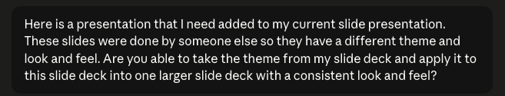
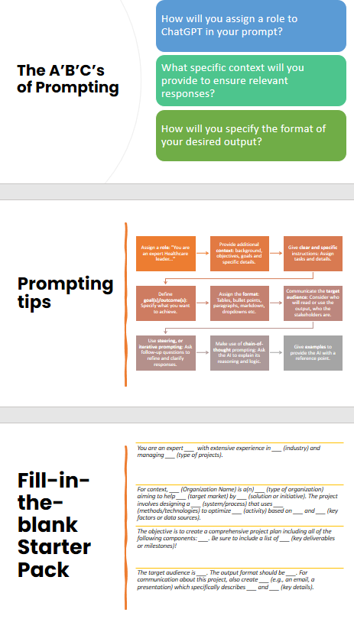
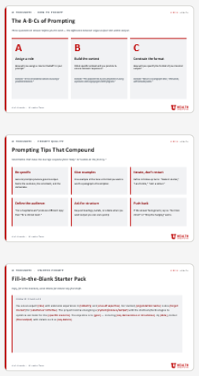
AI THOUGHTS · KNOW THE LIMITS
U OF U HEALTH
AI Prompting FTW!
Not reasons to avoid AI — reasons to use it with your eyes open.
Version 1 ·Before Prompt
Version 2 · Post Prompt
Straw Man
Presentation
Almost Ready
to Present
List ideas
What you know
What you have
Check for flow
Logic
Modify outliers
Prompt!
Present!
U of U Health · AI Health Team

Slide 43
AI THOUGHTS · YOUR ROADMAP
U OF U HEALTH
Completing the AI Journey
Three sequential moves. Skip a step and the next one gets harder.
01
02
03
Understand AI
Integrate into your work
Find use cases that matter
Build a working mental model: what these tools are, what they're not, and where they fit. Enough to make decisions, not enough to build them.
Find one workflow this week that AI demonstrably accelerates. Measure the time saved. Repeat with the next workflow.
Stop asking "what could AI do here?" Start asking "which of my hardest problems would AI actually move the needle on?"
U of U Health · AI Health Team

Slide 44
AI THOUGHTS · YOUR NEXT MOVE
U OF U HEALTH
Now What?
Two paths. Both end up in the same place.
PATH A
PATH B
Find your dedicated AI partner
Be that person for your team
Most teams already have someone — an analyst, an engineer, a curious clinician — who has put hours into this. Find them. Borrow their judgment.
If you've gotten this far, congratulations: you may be the AI partner for everyone else. Document what you learn. Lower the cost of entry for the next person.
U of U Health · AI Health Team

Slide 45
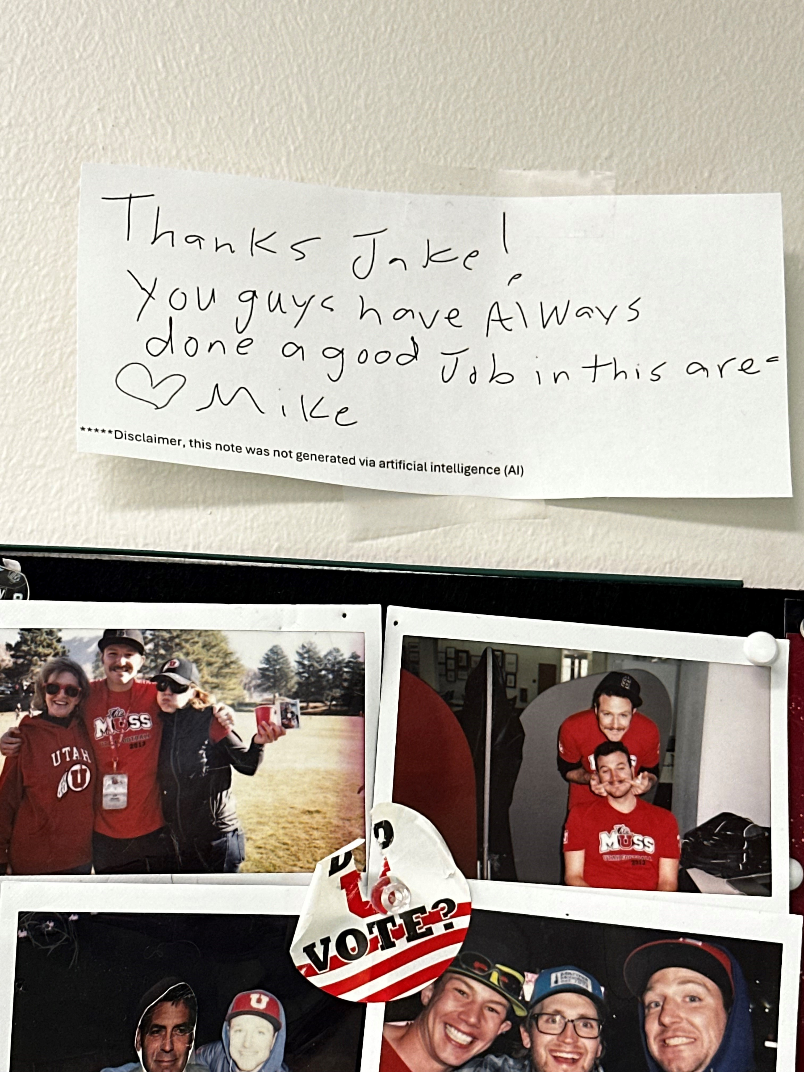
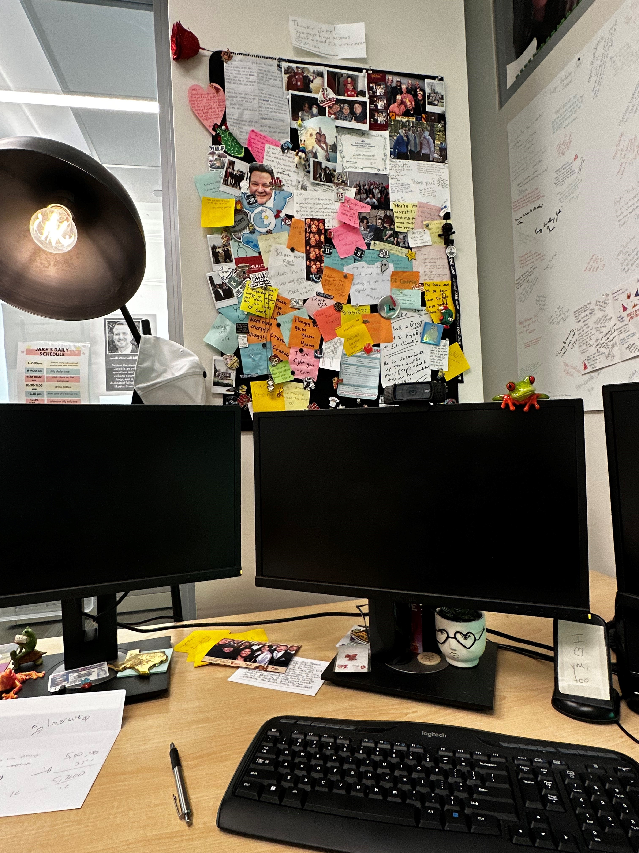
AI THOUGHTS · YOUR NEXT MOVE
U OF U HEALTH
Final Thoughts
AI is great - don’t be afraid to keep it personal
Be that person for your team
U of U Health · AI Health Team

