Slide 1
AAAP 2026 ANNUAL BUSINESS MEETING
May 20th, 2026

Slide 2
President Update
Kristi Baker
AAAP President
AdventHealth for Children

Slide 3

General Organization Updates
AMSPDC/AAAP continued relationship
Communications Update
Membership Value
Launched Mentor/Mentee program
Increase virtual educational offerings
Conference and membership cost mitigation (sponsorships, scholarships, etc.)
Salary Survey

Slide 4
Past-President Update
Jack D. Curran, MHA
AAAP Past-President
Vice Chair, Finance & Administration
Department of Pediatrics
Department of Psychiatry
University of Florida
May 20, 2026

Slide 5
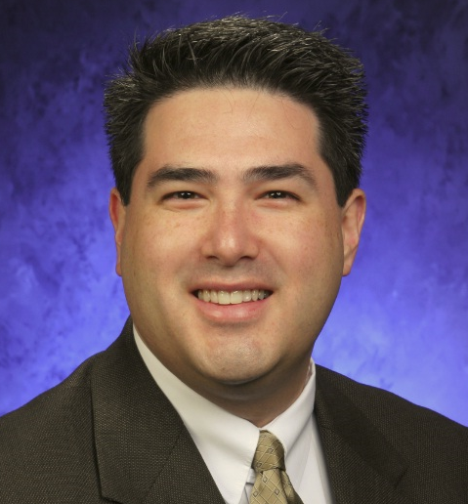
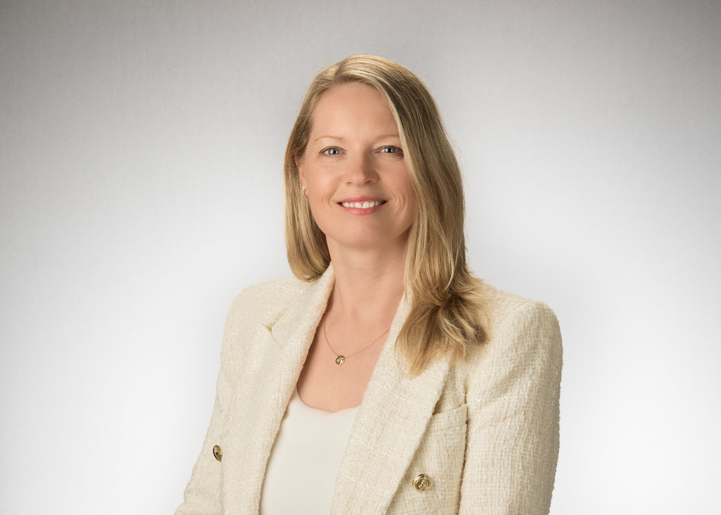
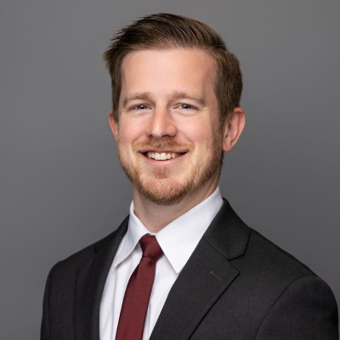
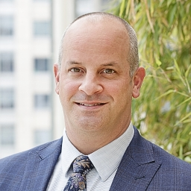
President-Elect, 2026-2027
1 Position Open
Program Director-Elect, 2025-2026
1 Position Open
Gil Pak
Operations Director
Penn State Hershey Children's Hospital
Susan Delaney, DBA
Administrative Director
Hematology/Oncology
Children’s Hospital of Philadelphia
Salary Survey Director, 2026-2029
1 Position Open
Communications Director, 2026-2028
1 Position Open
Jeff Renner, MHA
Division administrator
University of Washington
Seattle Children’s Hospital
Brad Bender, MHA
Clinical Department Administrator
UT Southwestern
2026 Slate for Board of Directors

Slide 6
Vote
Any other nominations from active members?
Call for Motion to Approve the 2026 Slate
Call for Second of Motion to Approve
  Vote by a show of hands
  All in Favor?
Vote

Slide 7
President-Elect Update
Gina-Marie Bounds
AAAP President Elect
Vice President, Pediatrics
Northwell Health
Cohen Children’s Medical Center

Slide 8



Sponsors - Thank you

Slide 9
Communications Director Update
Brad Bender

Slide 10
Membership Update
Angela Fuste, MHSA
AAAP Membership Director
Senior Administrative Officer, Pediatrics
University of Miami, Miller School of Medicine
May 17, 2026

Slide 11
AAAP Membership Report 2020-2026
 | 2026 | 2025 | 2024 | 2023 | 2022 | 2021 | 2020
Members | 173 | 197 | 184 | 197 | 184 | 183 | 164
New Members | 19 | 26 | 26 | 29 | 48 | 58 | 15-20
AMSPDC Schools | 157 | 157 | 157 | 157 | 157 | 157 | 141
Schools Not Represented in AAAP | 63 | 59 | 59 | 57 | 59 | 55 | 49
Includes count as of 11/9/25

Slide 12
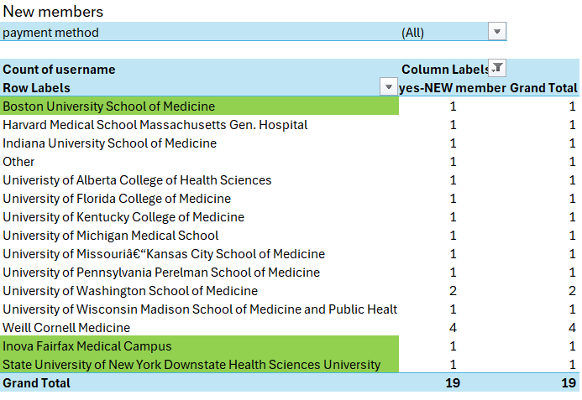
New Members- By institution
Includes count as of 11/9/25

Slide 13
New for 2026: Membership Fee Scale
Annual Membership Rates | Rate
Annual | 600
After July 1st | 300
Nov/ Dec | complimentary

Slide 14
AAAP Secretary Update
Molly Barnes
AAAP Secretary
University of Illinois
University of Virginia
University of Virginia

Slide 15

AAAP Mentorship Program
32 Submissions, 15 matches – 1 match pending

Slide 16
AAAP Treasurer Update
Amelia Randall
2024 Business Meeting
May 20, 2025

Slide 17
2025 Actuals vs. Budget
Actuals reported on a cash basis
  Timing: Meeting Costs, Sponsorship Payments
  Fall Meeting/Board Meeting
cFTE Survey Costs
Administrative Support
1 MAP Recipient for 2025 Meeting
Multiple job postings and purchases of the salary survey
Interest Income
2026 Budget
Dues remain at $600, will reassess annually
Align revenue with associated costs/benefit to member/attendee
No Fall Meeting or Fall Board Meeting
Increasing budget for board meeting to include additional board member support

Slide 18
2025 Notes
Continue to use PayPal for membership dues, Eventbrite for conference registration
Quantified Reserve Need
  Spring Meeting
  Salary Survey
  Website
  Legal/Insurance/Accountant
  Contingency
Used surplus to pay for administrative pilot, will assess dues and operating costs pending results
Invested $50,000 in a CD at Bank of America

Slide 19
AAAP Salary Survey Update
Tyler Sebahar
University of Utah
University of Virginia
University of Virginia

Slide 20
Faculty Compensation and productivity survey

Slide 21
2025 – 2026 Survey by the numbers
Compensation Records
  17,515 MD records collected.
  1,994 PhD/Other records collected.
Productivity Records
  14,712 MD records collected.
School Participation
  97 Institutions Participated

Slide 22
Recent Areas of emphasis
New Specialties Added
  Psychiatry: 40 Records Collected
  Neuropsychiatry: Not enough records collected to report.
Incentive Pay and Productivity
  Productivity: cFTE/wRVU Reporting and Alignment
  Compensation: Salary vs Reportable Incentive Pay
Physical Booklet ‘Opt-In’
RoundTable Platform Login Reconciliation

Slide 23
Future considerations
Feedback Survey during Transition
  Collection Process
  Platform Functionality
  Distribution Methods
cFTE Survey Alignment
Future Specialties to Add
  Surgical Specialties
Webinars & Survey Footnotes
Benefits/Retirement Quantitative Benchmarking

Slide 24
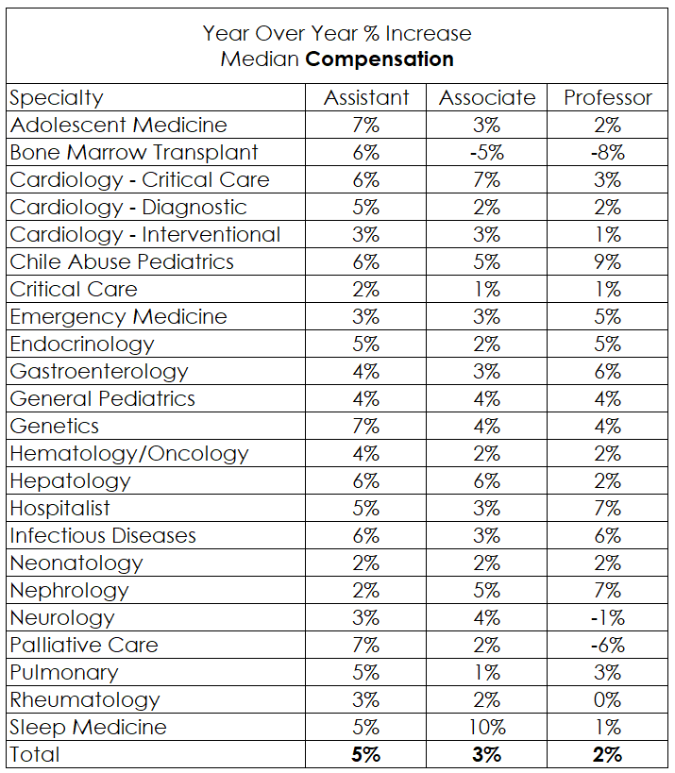
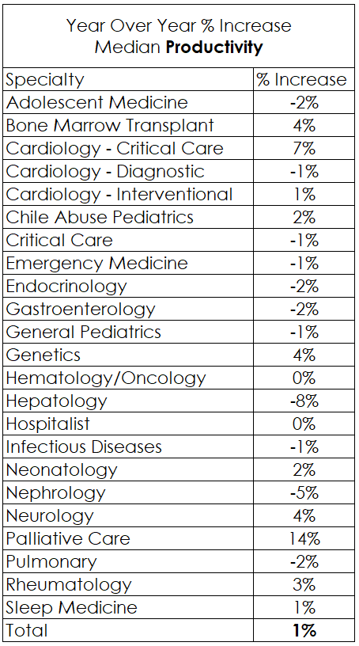
Deep Dive

Slide 25
Program Director’s Update
Jamie Hoffman
AAAP Program Director
Vice Chair Administration, Department of Pediatrics
Children’s Hospital of Philadelphia

Slide 26
Who’s Here?
116 Program Attendees
36 First-Time Attendees
62 Institutions Represented

Slide 27

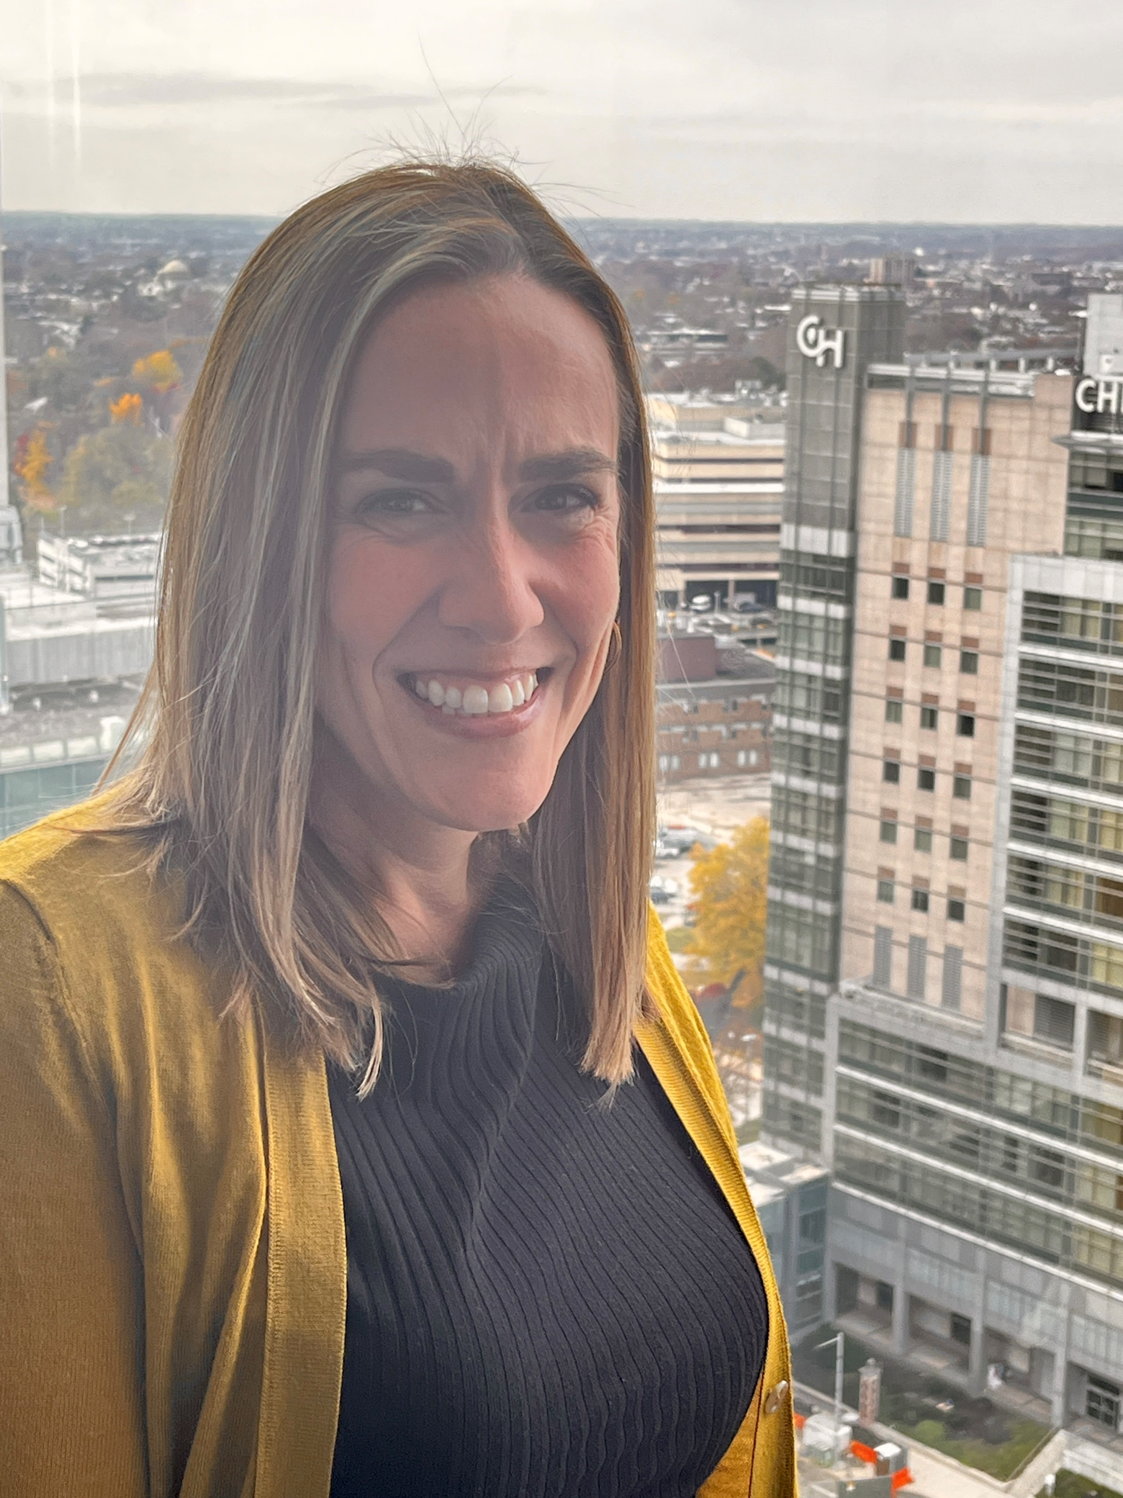
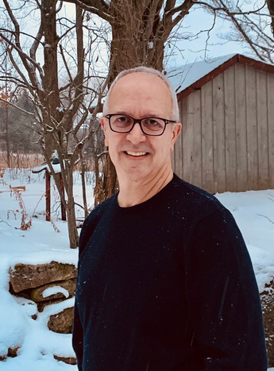
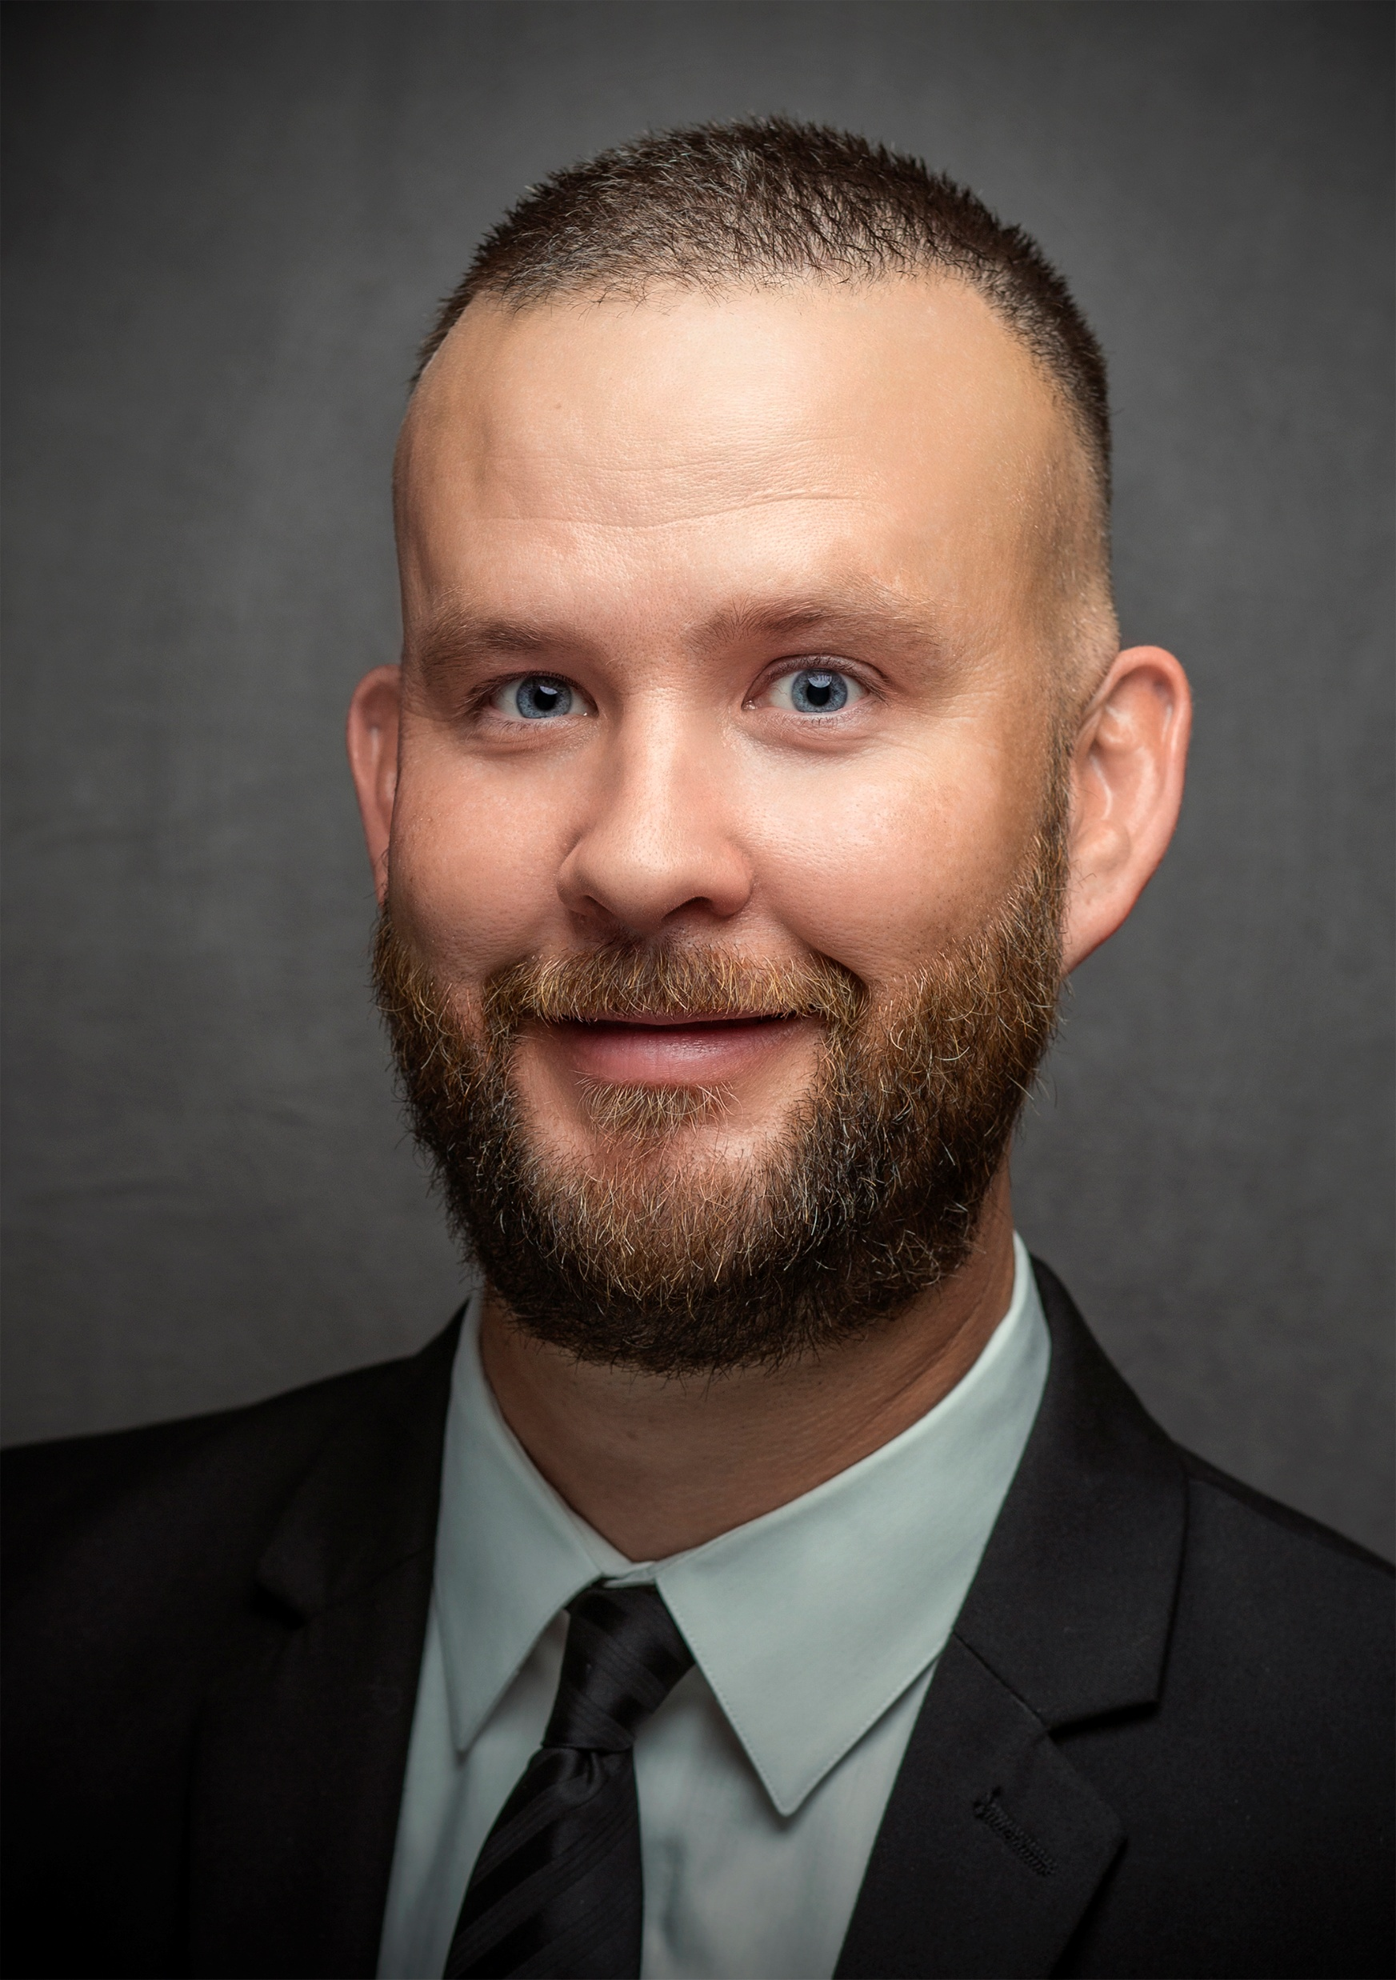
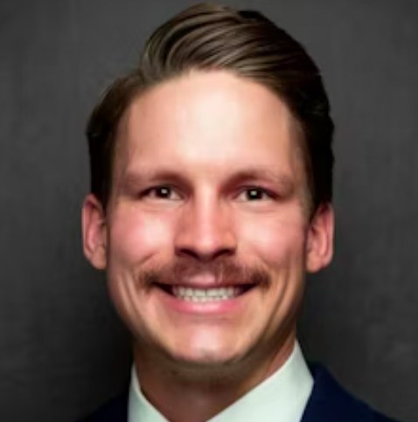
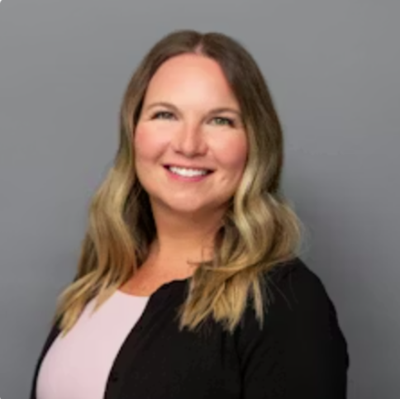
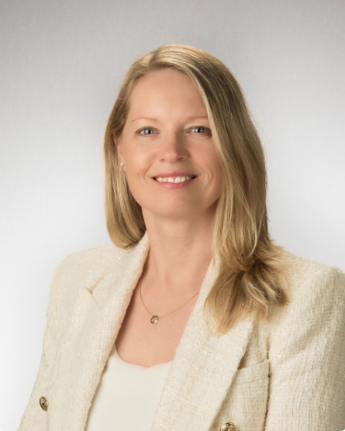
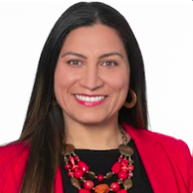
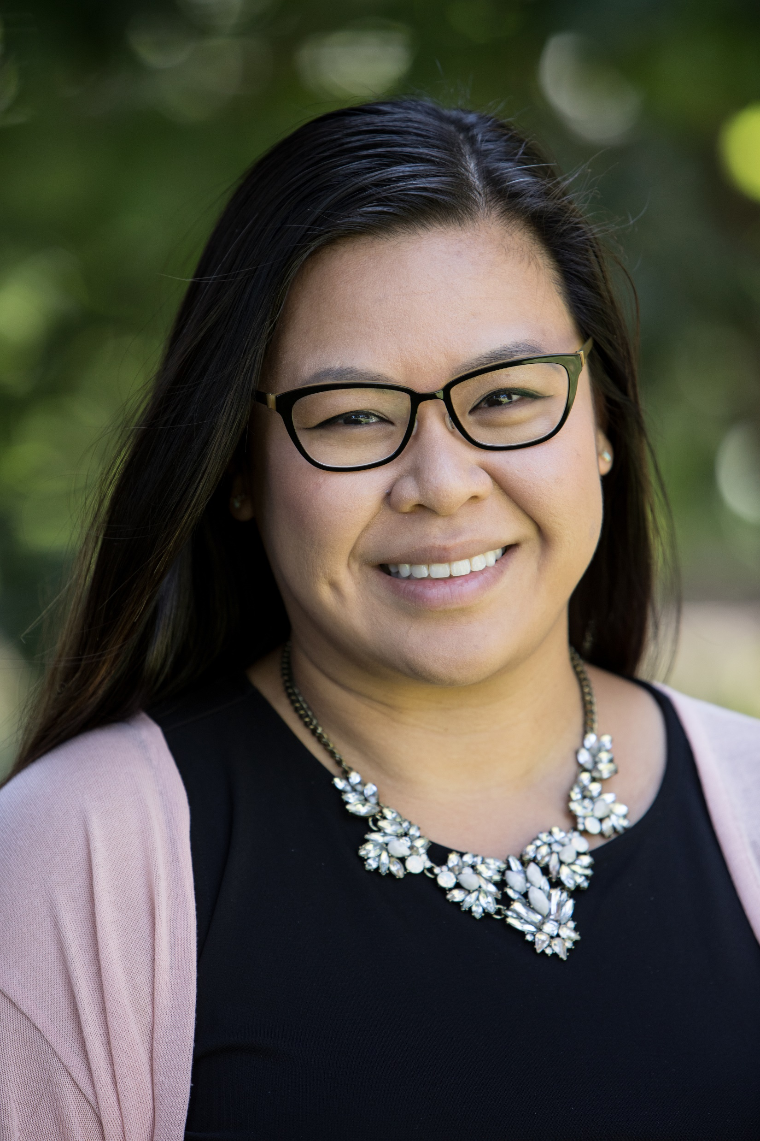
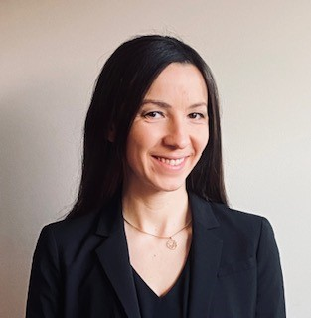
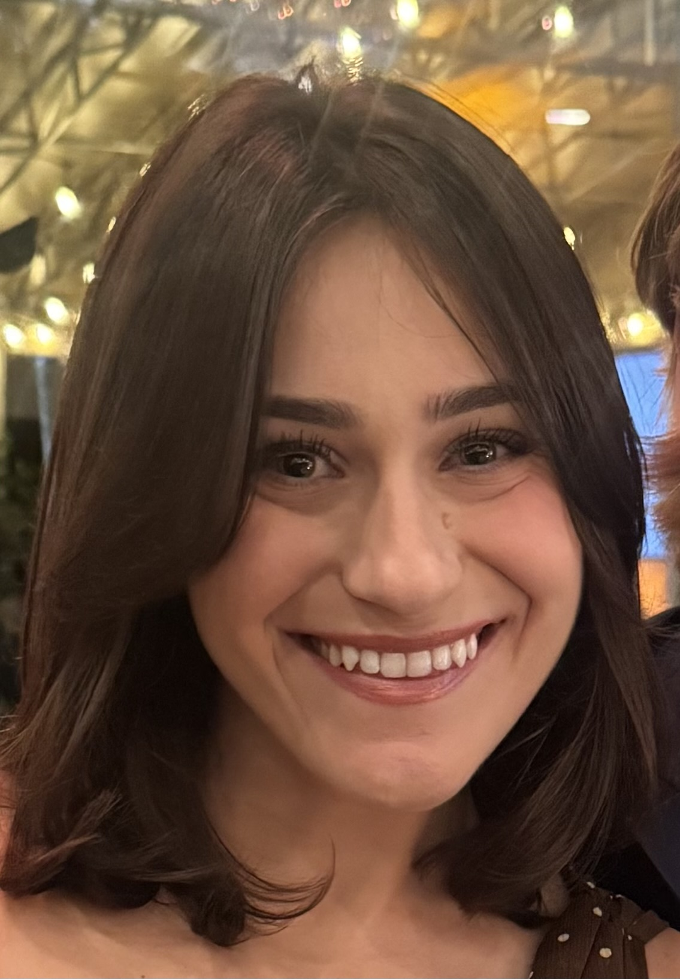
2026 Spring Planning Committee
Program Director
Program Director - Elect
Site Host
Site Host
Jamie Hoffman
Chris Carew
Mike Rogers
Tyler Sebahar
Susan Cameron
Children’s Hospital
of Philadelphia
The Hospital for Sick Children
University of Utah
University of Utah
University of Washington
AAAP Administrator
Susan Delaney
Silvia Hernandez
Nam Ly-Sarmiento
Rachel Tkaczyk
Marissa Lembo
Children’s Hospital
of Philadelphia
Children’s Mercy Kansas City
Stanford Medicine
Children’s Hospital
of Philadelphia
Cohen Children’s Medical Center

Slide 28

Thank You!
Department of Pediatrics for being Site Host!
  Mike Rogers,
  Chief Administrative Officer
  Tyler Sebahar,
  Sr. Director of Finance and Administration
  ...and John Braccili & Mailisa Williams
  of CHOP for managing our AV!
Thank You

Slide 29
Get Involved!
Annual Spring & Fall Meetings
Fall meetings occur every other year - in October or November
Spring meetings alternate annually between March and May
        March years overlap with AMSPDC
Planning Committee Members
Panel Members
Poster Presenters
Presenters/Speakers
Breakout Session Facilitators
Ideas for future meeting topics
Or…be the Site Host and bring AAAP to you!
In exchange for helping with local logistics you receive two free registrations.
*Joint AAAP-AMSPDC meetings occur in March
Get Involved

Slide 30
PROGRAM DIRECTOR-ELECT UPDATE
Chris Carew
AAAP PROGRAM DIRECTOR-ELECT
Executive Director, Paediatric Operations
The Hospital for Sick Children, Toronto

Slide 31


Announcing the Joint AAAP and AMSPDC Meeting in 2027

Slide 32
https://www.youtube.com/watch?v=f7wmvJQY0kM

Slide 33

“Thank-you to Children’s National
who will serve as our meeting site host”

Slide 34
Programming at-a-Glance
Below is a summary of the joint AMSPDC/AAAP Washington DC dates;
Tuesday March 2nd
              check-in and welcome reception
Wednesday March 3rd
AAAP conference programming all day
evening social event
Thursday March 4th
Joint programming for ‘Day on the Hill’
Joint AAAP-AMSPDC Cocktail Reception (following Day on Hill)
Friday March 5th – AAAP conference programming – half day

