Slide 1
Comprehensive Pediatric Behavioral Health Services Across the Continuum of Care
Alexander A. Morrell, MHA

Slide 2
University of Utah—Primary Children’s Hospital Partnership

Slide 3
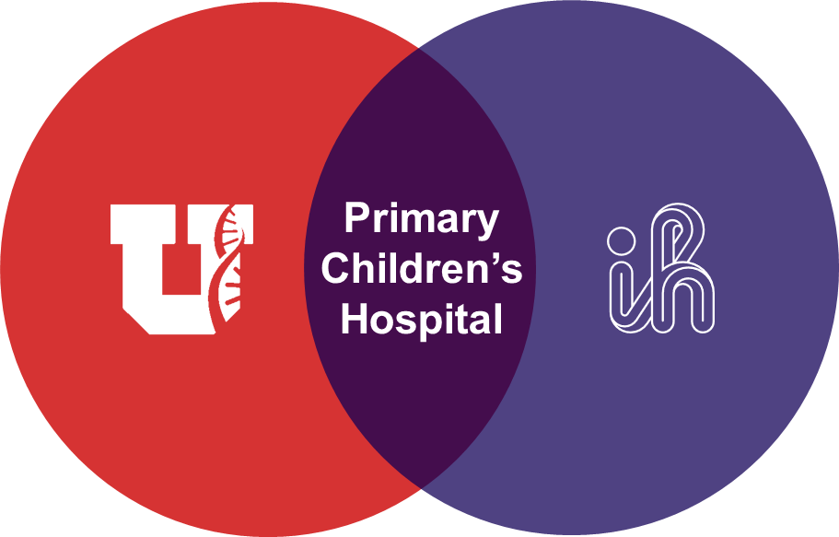
A Unique Collaboration
Since 1977 Primary Children’s Hospital (PCH) has served as the primary teaching hospital for the University of Utah Department of Pediatrics
Intermountain Health provides scale, infrastructure, operational support, and system-level innovation which furthers academic work
University faculty members fulfill Medical Director/Leadership roles and staff PCH services which inform strategy

Slide 4
Behavioral Health Services Offered
Notes:
Include a slide for services offered and then a slide for by the numbers

Slide 5
Comprehensive Behavioral Health Services Across Levels of Care
Outpatient Mental Health Services
  Outpatient services providing therapy, medication management, and psychological testing for children and adolescents
Intensive Outpatient Services (IOP)
  Additional coping and emotional support program held after school, 3 days a week for 6 weeks
Day Partial Hospitalization Program
  Structured day program focused on strengthening coping skills, supporting family relationships, and promoting academic success, held 5 days a week for 8–12 weeks
Crisis Partial Hospitalization Program (PHP)
  Short-term intensive program focused on stabilization, safety planning, and building coping strategies, held 5 days a week for 5–7 days

Slide 6
Comprehensive Behavioral Health Services Across Levels of Care (Continued)
24/7 Crisis Walk-in Center
  Crisis stabilization service for youth needing short-term support to develop a safety and treatment plan, typically lasting 24–48 hours
Inpatient Psychiatric Hospitalization
  Short-term inpatient psychiatric stay for youth at risk of harming themselves or others, focused on stabilization, assessment, and safety planning, typically lasting 4–7 days
Consult Liaison Service
  Provides behavioral health support for hospitalized children during medical or surgical care through a multidisciplinary consult liaison team (psychiatry, psychology, and clinical specialists)
  Works closely with medical teams to coordinate care, support families and staff with behavioral management, and connect patients to outpatient behavioral health services after discharge

Slide 7
Scope and Volume of Services
Program | # of Locations | Annual Patient Volume
Outpatient Mental Health Services | 3 | 29,000 visits
Intensive Outpatient Services (IOP) | 3 | 380 unique patients
Day/Crisis Partial Hospitalization Program (PHP) | 4 | 950 unique patients
Crisis Walk-in Center | 1 | 1,800 unique patients
Inpatient Psychiatric Hospitalization | 3 | 2,500 unique patients
Consult Liaison Service | 1 | 650 unique patients

Slide 8
5-Year Growth of Division

Slide 9
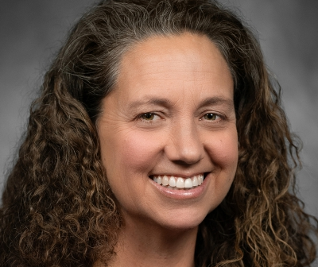
Introducing Dr. Lisa Giles, M.D.
Dr. Lisa Giles is a Professor of Pediatrics and Psychiatry at the University of Utah School of Medicine and Division Chief of Child Psychiatry and Behavioral Health in the Department of Pediatrics.
She serves as Chief Medical Officer at Primary Children's Hospital - Taylorsville and is the Senior Medical Director for the Intermountain Children’s Health Behavioral Health Service Line.
Dr. Giles is board‑certified in pediatrics, adult psychiatry, and child & adolescent psychiatry, with expertise in caring for youth with complex medical and behavioral health needs.
Her work focuses on integrating behavioral health into pediatric care, suicide prevention, and supporting hospitalized children and their families.
Notes:
Please join me in welcoming Dr. Lisa Giles, Professor of Pediatrics and Psychiatry at the University of Utah School of Medicine and Division Chief of Child Psychiatry and Behavioral Health in the Department of Pediatrics. Dr. Giles also serves as the Chief Medical Officer at Primary Children's Hospital -Taylorsville, and is the Senior Medical Director for the Intermountain Children’s Health Behavioral Health Service Line. She is board‑certified in pediatrics, adult psychiatry, and child and adolescent psychiatry, and has dedicated her career to improving the integration of medical and behavioral health care for children—particularly those with complex medical needs. Dr. Giles is a nationally recognized leader in pediatric behavioral health, suicide prevention, and collaborative care.

