Slide 1

Behavioral Health in Utah
Lisa Giles, MD
Division Chief, Behavioral Health, Department of Pediatrics

Slide 2
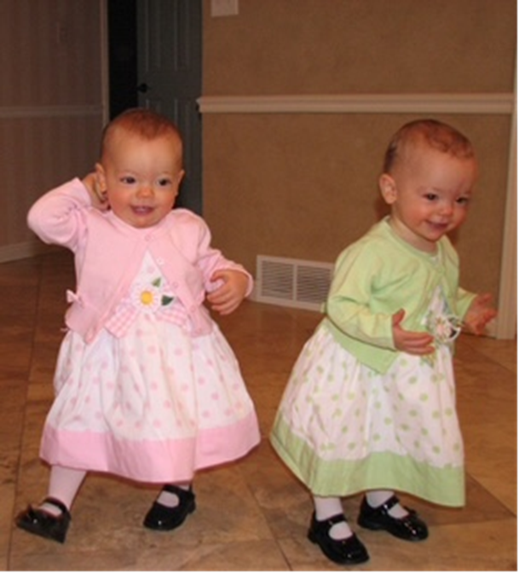

2008: Behavioral Health Division
Newly formed division within Department of Pediatrics
New partnership with Primary Children’s Hospital for behavioral health care
Division Size = 2 Psychiatrists and 1 Psychologist
Partnered with three privately contracted child psychiatrists, several psychologists, and master-level clinicians
Primary Children’s had been involved in behavioral health services for years (1st inpatient unit in the 1960’s) but no connections to academics unlike the rest of pediatrics
In 2005, all psych services were moved off-site from main hospital

Slide 3
Suicide death rates among youth in Utah
U.S.
Source: Utah Medical Examiner Database
Notes:
Suicide rates rose across the US from 1999-2016 (even more so in Utah)
Suicide is the leading cause of death among 10-17 year olds in Utah
For every completed suicide, 50-200 attempts are made
(Majority of those that attempt do not go on to complete)

Slide 4
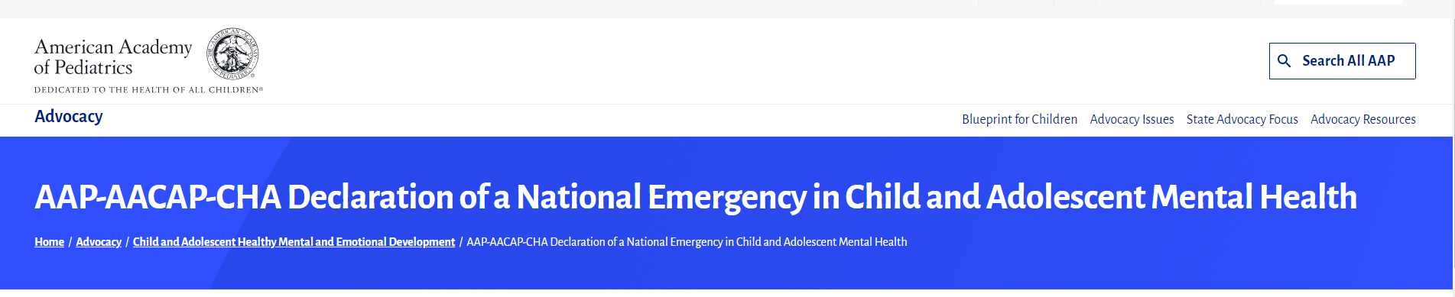


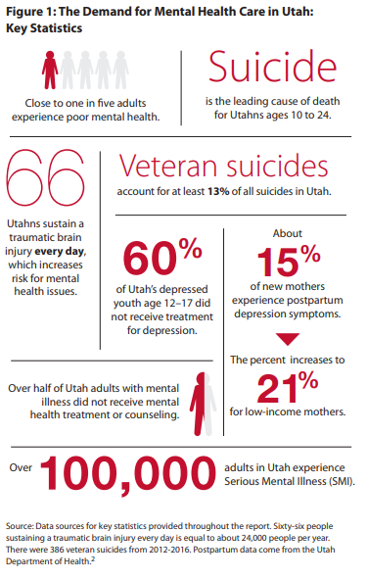
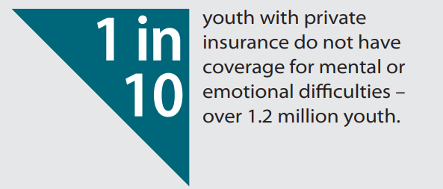
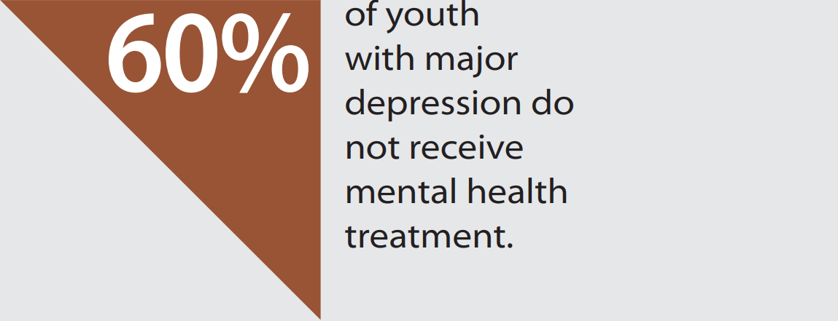
There are only 9 child psychiatrists for every 100,000 children in Utah.
The national average is 15.

Slide 5
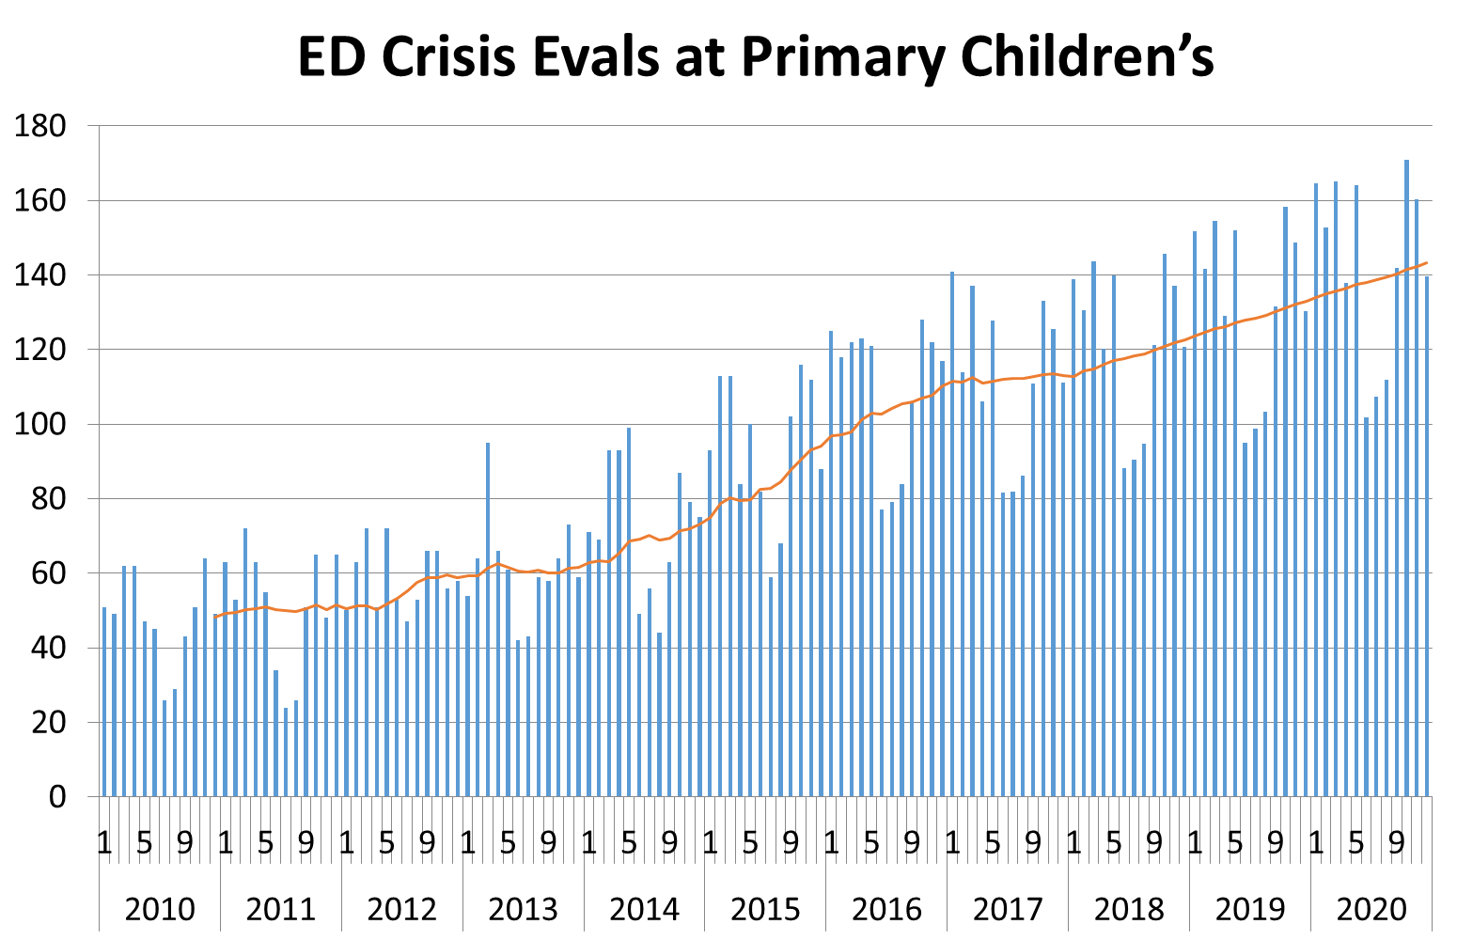

Slide 6

Solutions
Right Treatment at the Right Place at the Right Time
Upstream work in the primary care setting
Improve triage and access to services
Increase workforce
Expand clinical services
Build right infrastructure to provide evidence-based treatments
*Create Various Funding Streams
Notes:
Lisa
So what is the solution??
Good news is that we have EBT but accessing those treatment is problematic
The solution is to get kids to the right treatment at the right place at the right time.
So I wanted to briefly share the work we are doing in 4 areas to get closer to this solution.
In

Slide 7

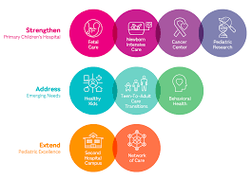

Funding Streams
Partnerships with Intermountain Foundation and the Community
Notes:
Lisa
So what is the solution??
Good news is that we have EBT but accessing those treatment is problematic
The solution is to get kids to the right treatment at the right place at the right time.
So I wanted to briefly share the work we are doing in 4 areas to get closer to this solution.
In

Slide 8
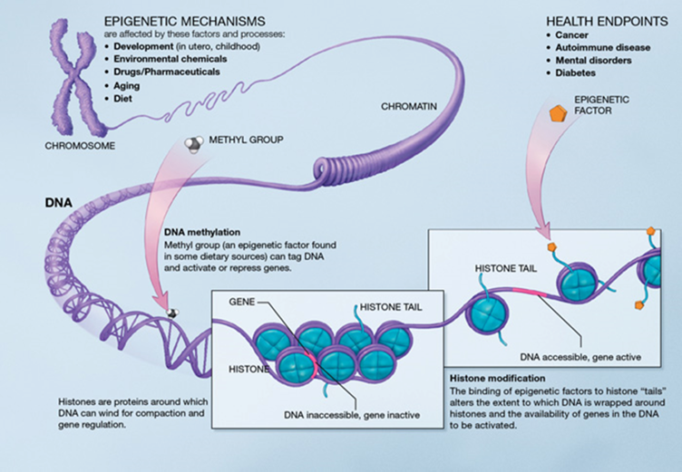
Expanding Behavioral Health in Primary Care
Partnerships with Intermountain Children’s Health Primary Care Network
Advanced adolescent depression, trauma, and anxiety screening
Improved suicide assessment and safety planning
Expanded integrated behavioral health care
Currently focused on early childhood
mental health
Notes:
Lisa
So what is the solution??
Good news is that we have EBT but accessing those treatment is problematic
The solution is to get kids to the right treatment at the right place at the right time.
So I wanted to briefly share the work we are doing in 4 areas to get closer to this solution.
In

Slide 9


Assessment Referral Consultation Services
Referent
Tiered Triage Process
Services
Outcomes
Care Managers
Crisis Response & Stabilization
ED / Crisis Center
In home mobile crisis
Parents
Population Knowledge:
Client Profile
Medical Record
Appropriate Interventions
Treatment & Settings
In-home Stabilization
Outpatient
Primary Care Integrated Care
Education/ Support Groups
Therapy
Medication Management
Psychological Testing
Intensive & Specialty
Intensive Outpatient Partial Hospitalization Day Treatment
Right Care
Right Place
Right Time
Pediatricians/
Primary Care Providers
School Districts
Insurance Providers
Program Knowledge:
Insurance
Community Partners
Resource Availability
Interventions
Emergency Department
Residential
Notes:
Lisa
Goal is to help families navigate the behavioral health system by identifying what their individual needs are, providing education on the needs and the behavioral health system, linking families to services and resources, while improving access to care
Services offered:
Triage phone line, with a tiered triage system
Assessment Clinic with access for high acuity, complex patients – seen by a therapist/LCSW in-person or virtually
Connection to appropriate resources that meet the clinical need, in the geographic area, and match with family insurance
Ability to schedule into needed services
Liaison for family while they wait to access treatment within the service line to provide support and guidance
Ability to work with insurance companies for authorizations and approval of care
Provide support to community providers in connecting their patients to behavioral health services in and out of the service line
*talk about community networks of care/partnerships including HMHI and University, The Children’s Center, etc.

Slide 10
Increasing the Work Force
Partnerships with Intermountain, Universities, Community
Psychiatry:
  Expanded child psychiatry fellowship from 3 to 6
  Flexibility and creativity in recruiting
  Doubled faculty in the past 5 years
Psychiatric Nurse Practitioners:
  Started a pediatric psychiatric nurse practitioner fellowship
  Partnered with University DNP program for clinical rotations
Psychologists
  Added additional fellowships in med-psych
Master’s level clinicians
  Partnered with University of Utah, Weber State, BYU for clinical rotations and internships
Notes:
Lisa
So what is the solution??
Good news is that we have EBT but accessing those treatment is problematic
The solution is to get kids to the right treatment at the right place at the right time.
So I wanted to briefly share the work we are doing in 4 areas to get closer to this solution.
In

Slide 11
Expanding Clinical Services
Partnerships with Intermountain, Universities, Community
2019-2021
In-home stabilization and mobile response services in SL County
Assessment Consultation Referral Service
2022
Crisis partial hospitalization program
Pediatric crisis enhancement
Stabilization and Mobile Response beyond SL County
Subspecialty and primary care behavioral health integration expansion
Partial hospitalization program in Centerville
2023
Partial hospitalization and intensive outpatient services in Ogden
Med-Psych and subspeciality clinic expansion
2024
Inpatient unit, partial hospitalization, and outpatient services at second Primary Children’s Lehi Hospital
Further expansion of Stabilization and Mobile Response services
School-based primary care/integrated behavioral health clinic
2025
Pediatric telecrisis service (serving Intermountain EDs across Utah and Idaho)
Collaborative care model introduced to over 35 primary care practices
Primary Children’s Taylorsville Behavioral Health Center
Notes:
Lisa
So what is the solution??
Good news is that we have EBT but accessing those treatment is problematic
The solution is to get kids to the right treatment at the right place at the right time.
So I wanted to briefly share the work we are doing in 4 areas to get closer to this solution.
In

Slide 12
Pediatric Behavioral Health Continuum
Assessment Referral and Consultation Services Navigation (Front Door)
Treatment
Crisis Response & Stabilization
Intensive & Specialty
Crisis & Stabilization
Community
Stabilization Mobile Response
Mental Health Integration in Primary Care
Outpatient Clinics
Community Affiliates & Schools
Mental Health Coaching
Inpatient Units
Crisis Center
Hospital-based crisis response team
  ED, Inpatient
  Pediatric Crisis tele-consults
Med-Psych Service
Intensive Outpatient Programs
Day Treatment Programs
Crisis Partial Hospitalization Programs

Slide 13
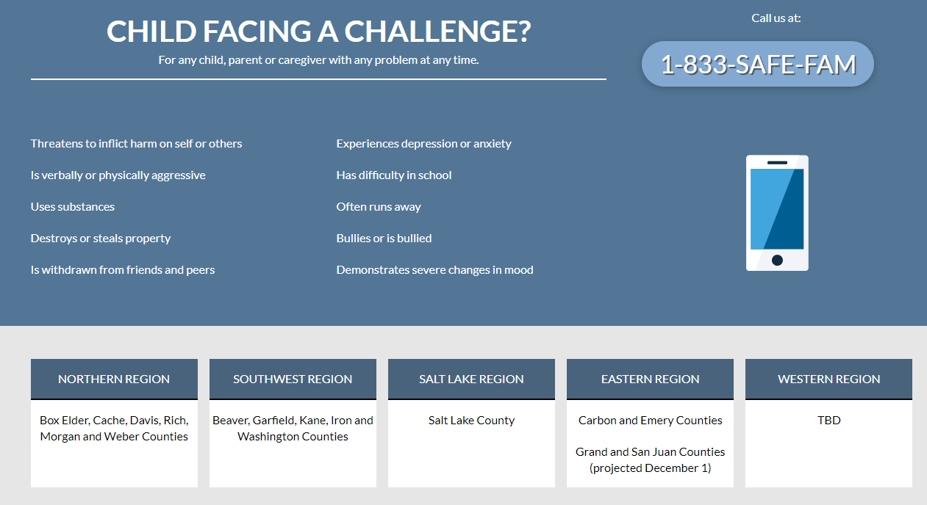
Stabilization & Mobile Response
Box Elder, Cache, Davis, Morgan, Rich, and Weber Counties
Beaver, Garfield, Iron, Kane, and Washington Counties
Salt Lake County
Carbon, Emery, and Grand Counties
Juab, Millard, Piute, Sanpete, Sevier, Utah, Wasatch, and Wayne Counties
Notes:
Lisa
The SMR program is a partnership with the state to provide in-home crisis stabilization services through most of Utah. Primary Children's provides services in SL, Utah Conty, and what is know as the Western Region of this state. Over 30% of the families served by this program say they would have brought their child to the ED if this was not available.
K

Slide 14
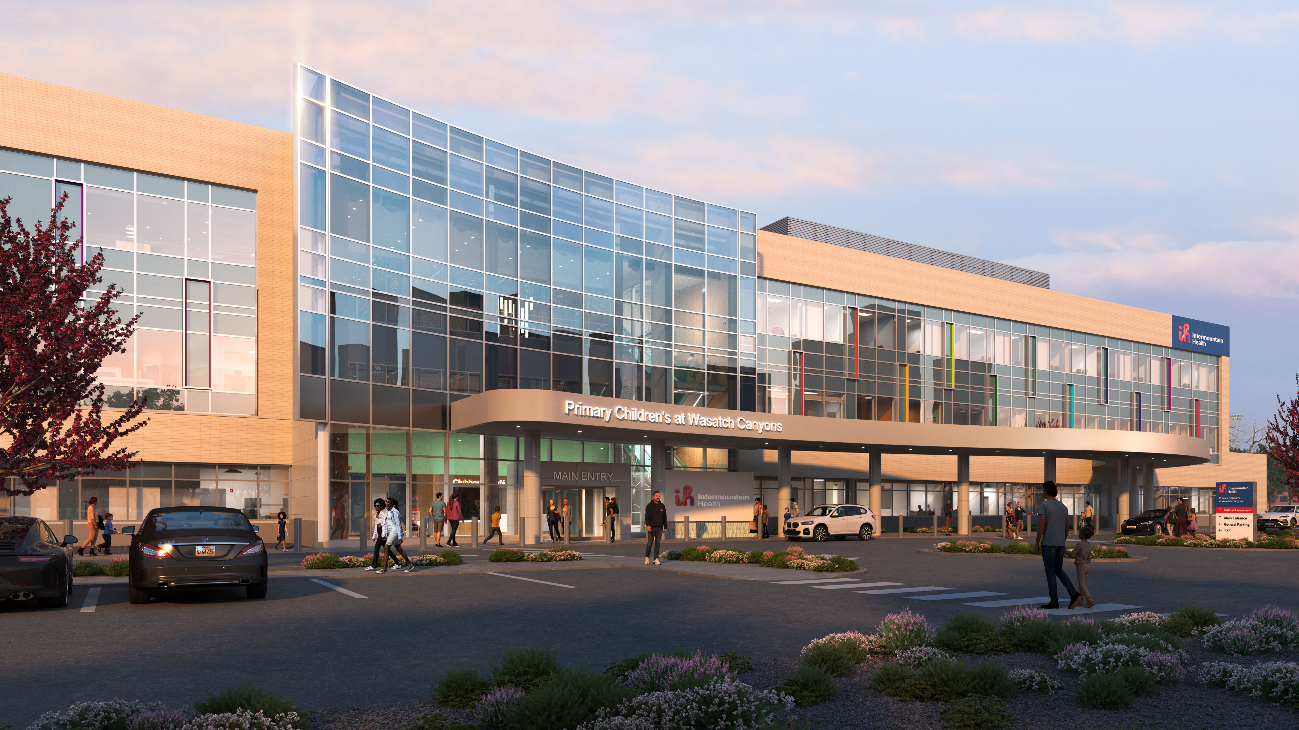
Primary Children’s Hospital at Taylorsville
Behavioral Health Campus
What’s There
24/7 Walk In Crisis Center with Observation Beds
50% More Inpatient Beds
Expanded Partial Hospitalization Services
Outpatient Behavioral Health Clinic
Ronald McDonald Family Room
Meditation Room
~100,000 SF
09/06/25

Slide 15
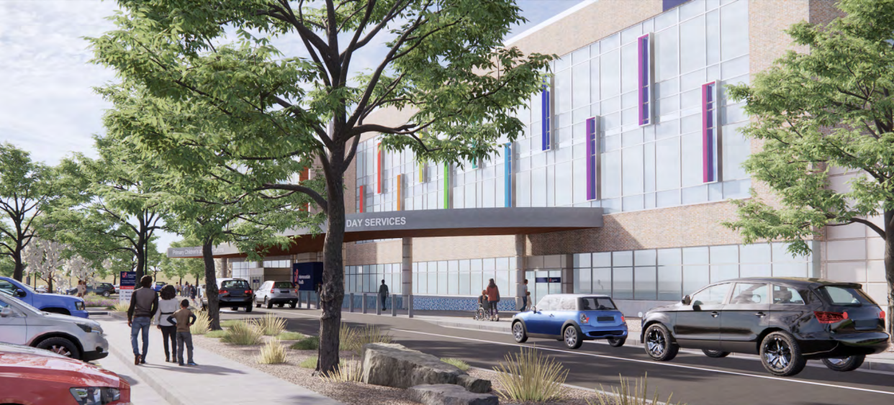
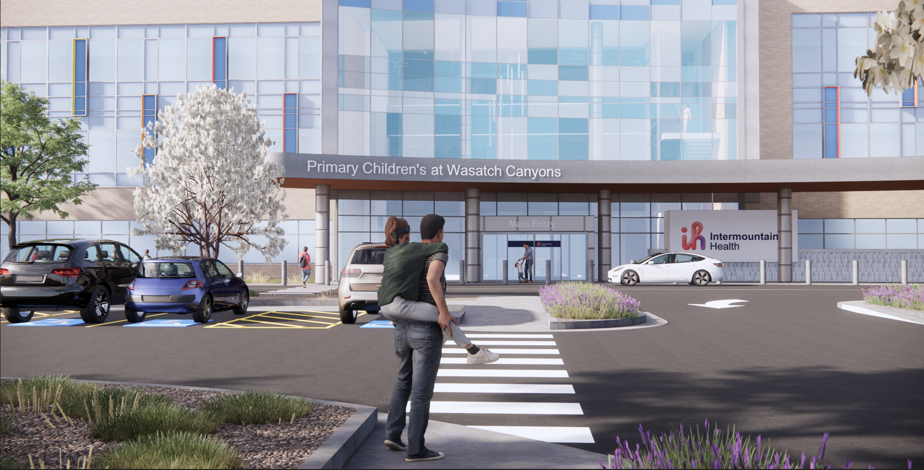
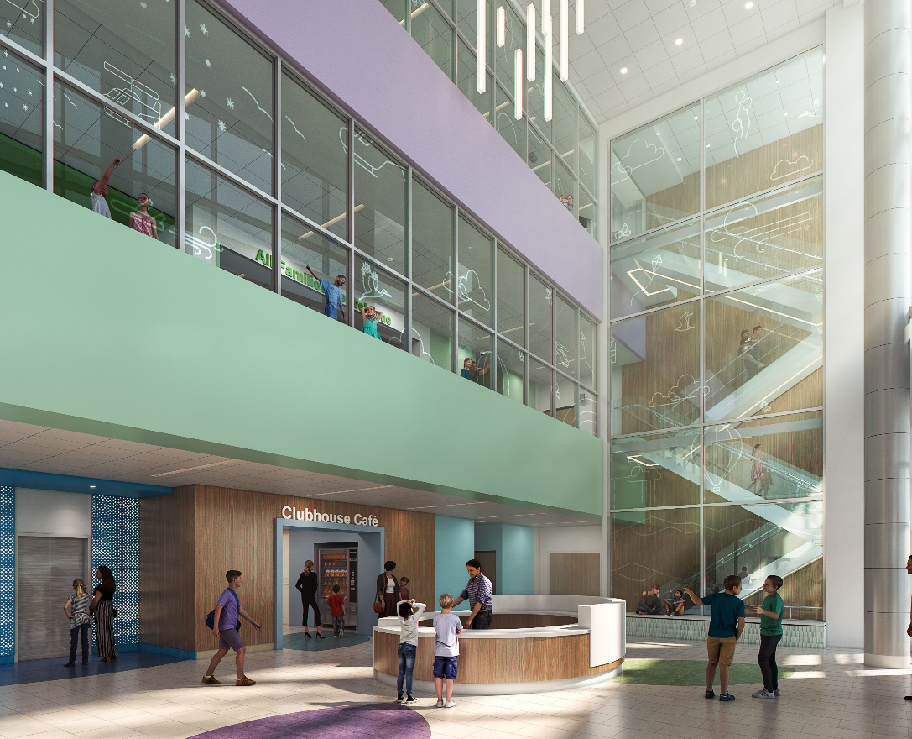
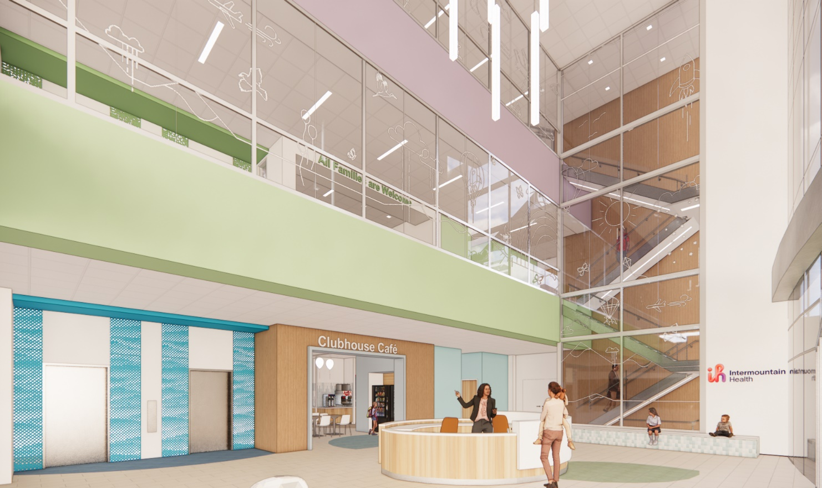

New Building
Exterior
Notes:
Design –
Involving patients

Slide 16
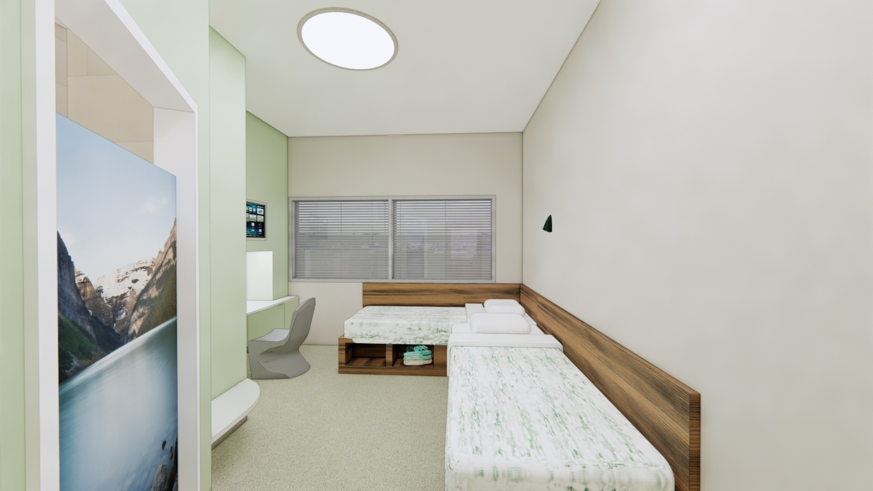
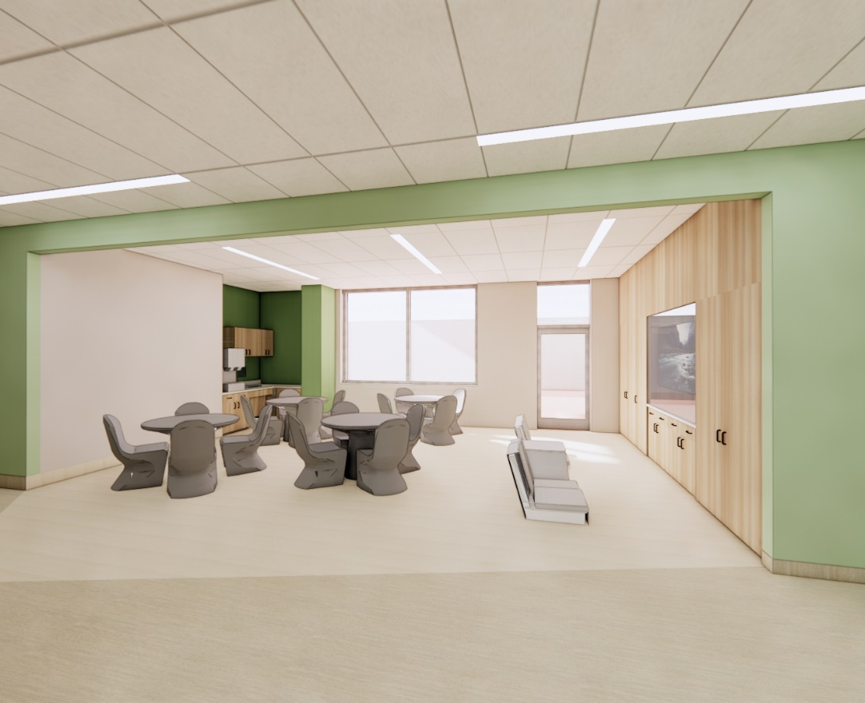
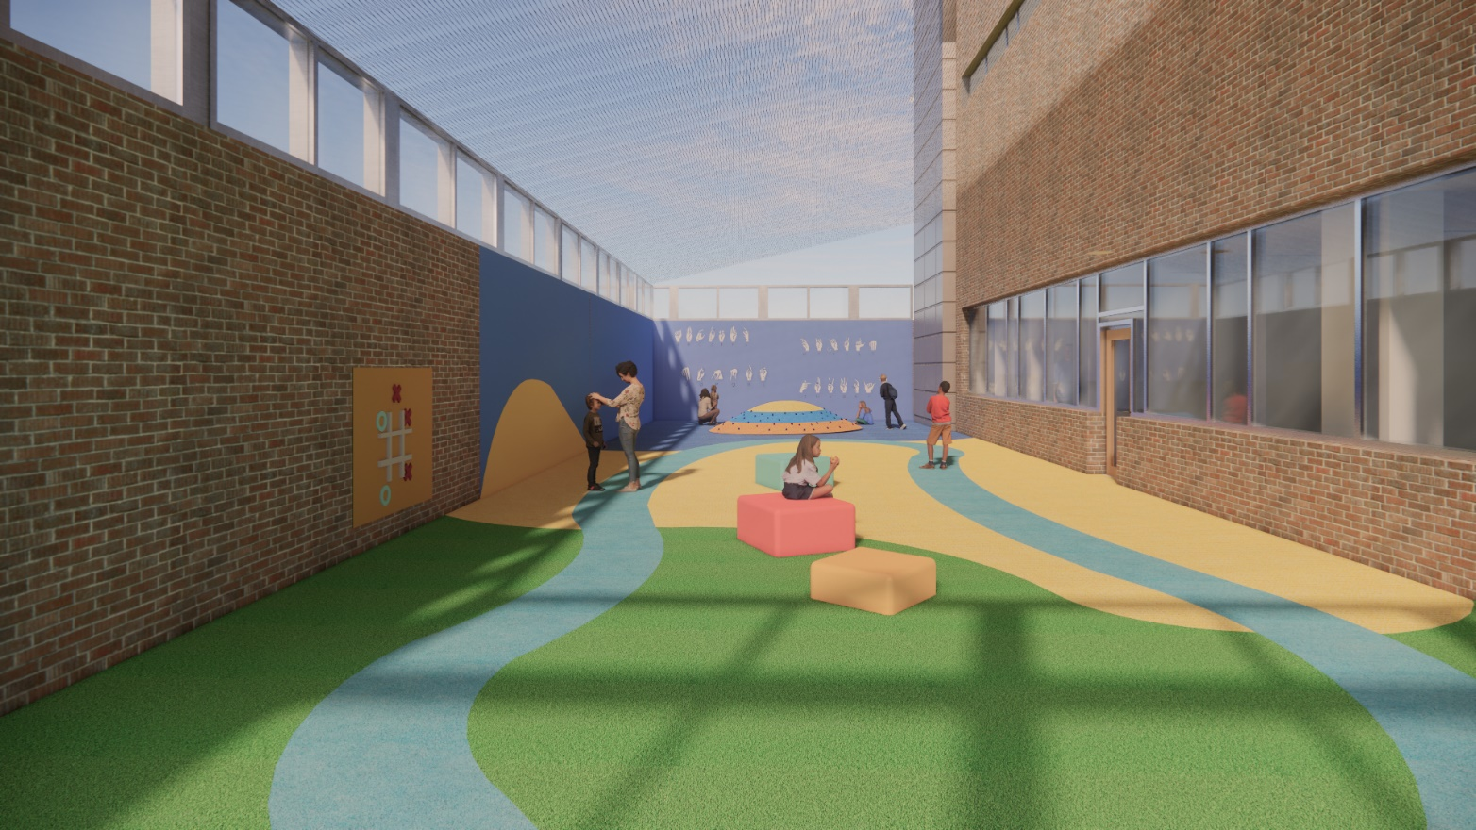
New Building
Patient Areas
Notes:
Family friendly

Slide 17
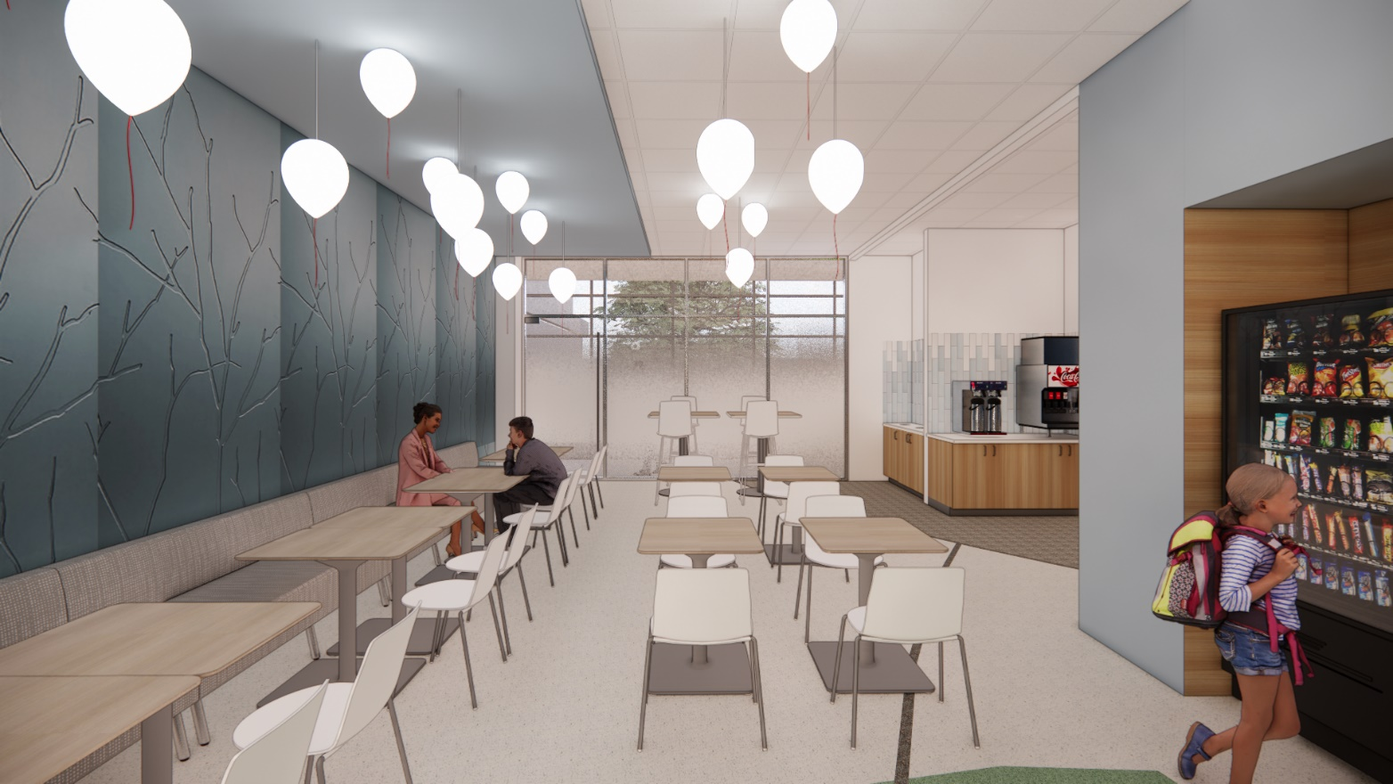
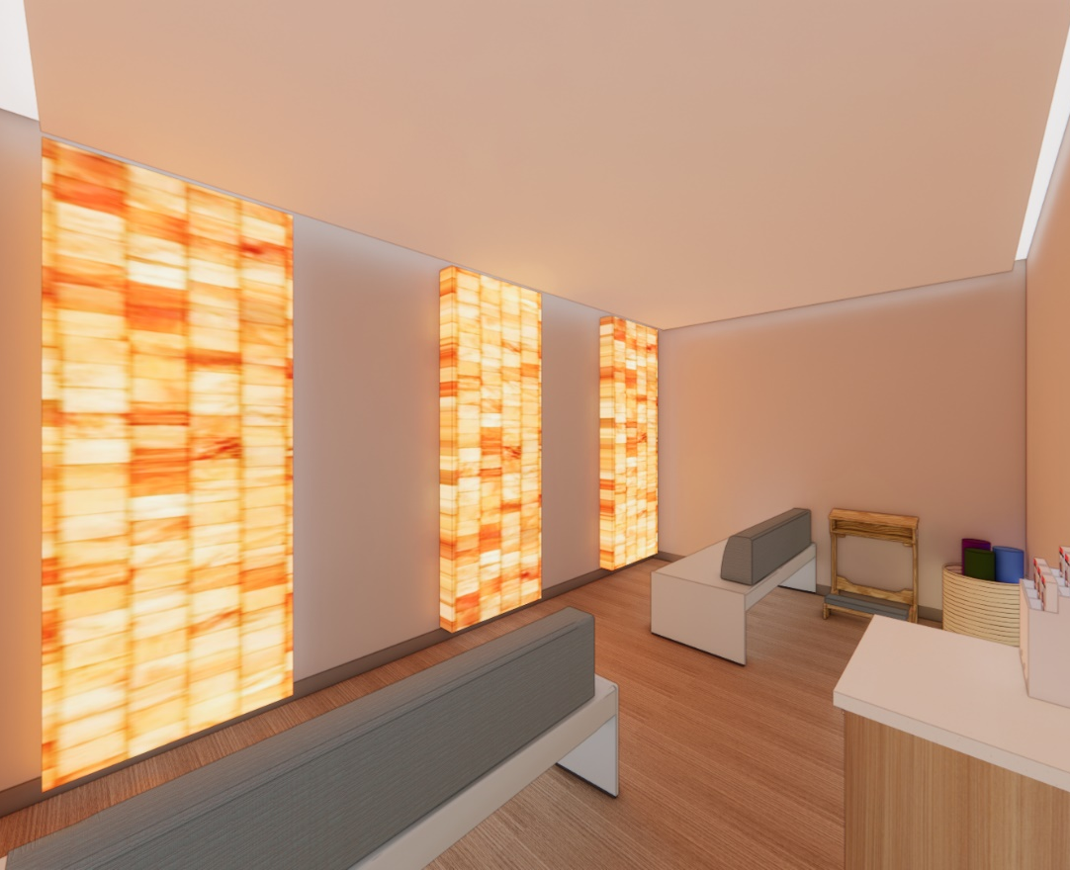
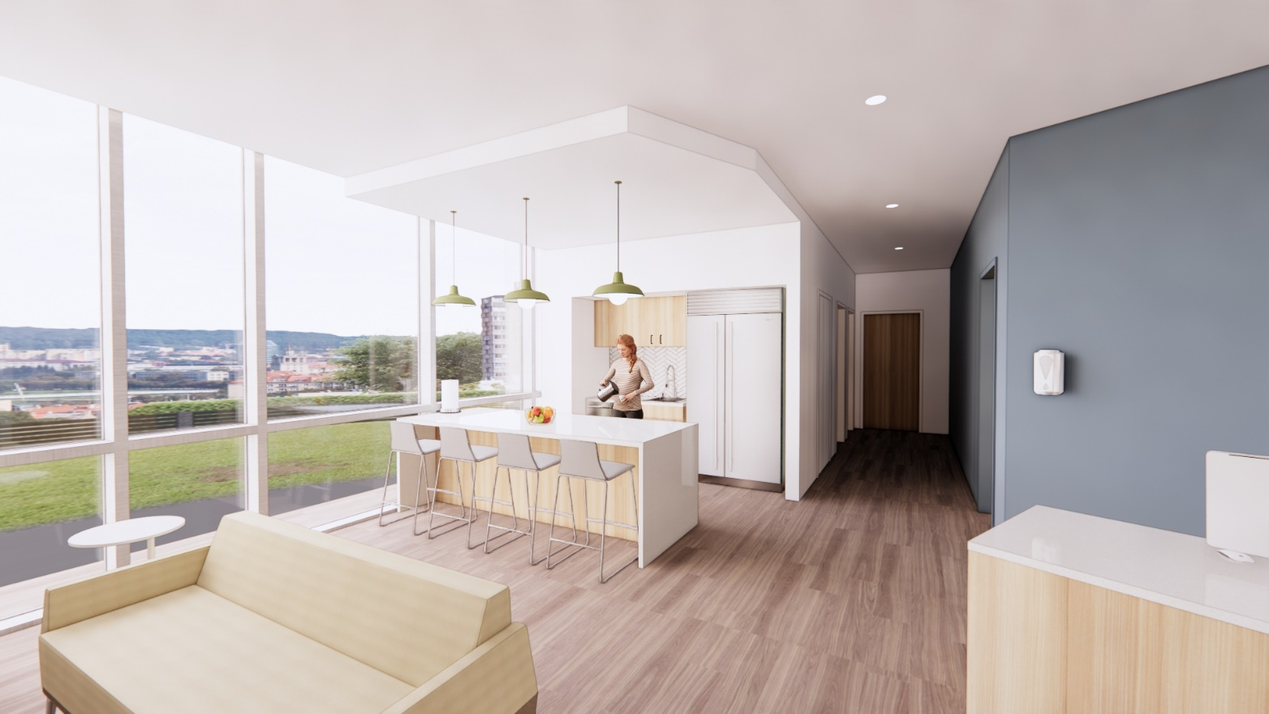
New Building
New Spaces
Notes:
New spaces

Slide 18
Solutions
Right Treatment at the Right Place at the Right Time
Upstream work in the primary care setting
Improve triage and access to services
Increase workforce
Expand clinical services
Build right infrastructure to provide evidence-based treatments
Notes:
Lisa
So what is the solution??
Good news is that we have EBT but accessing those treatment is problematic
The solution is to get kids to the right treatment at the right place at the right time.
So I wanted to briefly share the work we are doing in 4 areas to get closer to this solution.
In

Slide 19
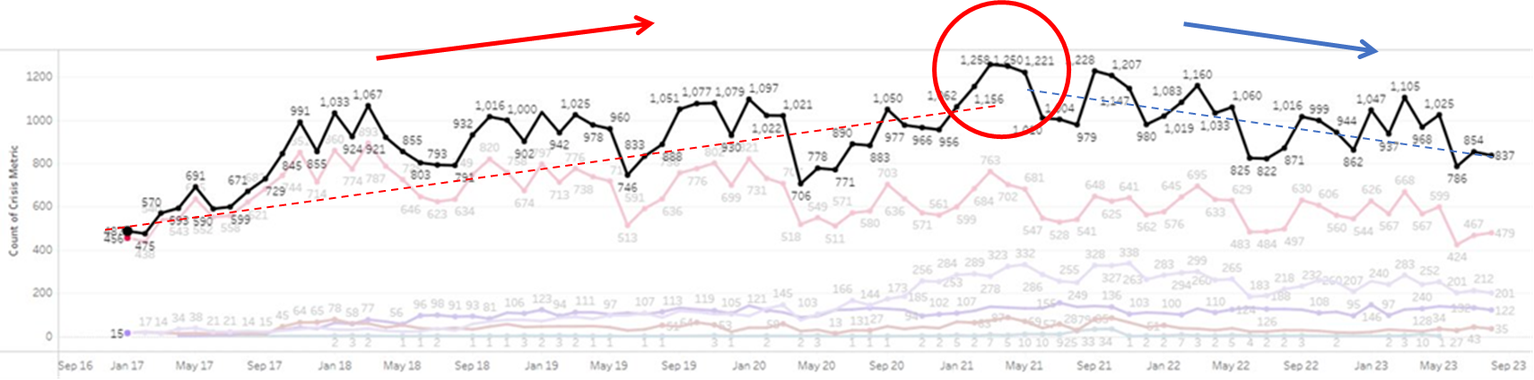
Decreasing ED Crisis Visits
Intermountain Health Emergency Department Visits for BH Crisis, ages 0-17, 2016-2023
Notes:
Lisa
This complicated graph shoes the number of crisis visits per month in Intermountain EDs for young people. For decades this rate was increasing, with a clear peak in early 2021. Super excited to see u the rate gradully decrease since that time, suggesting that all our diversion efforts are helping.

Slide 20
Increasing Capacity
Total unique # of children served by Primary Children's Behavioral Health services 2018-2025
2025 numbers are estimated Sept-Dec
Notes:
Increase of 84% since 2018

Slide 21
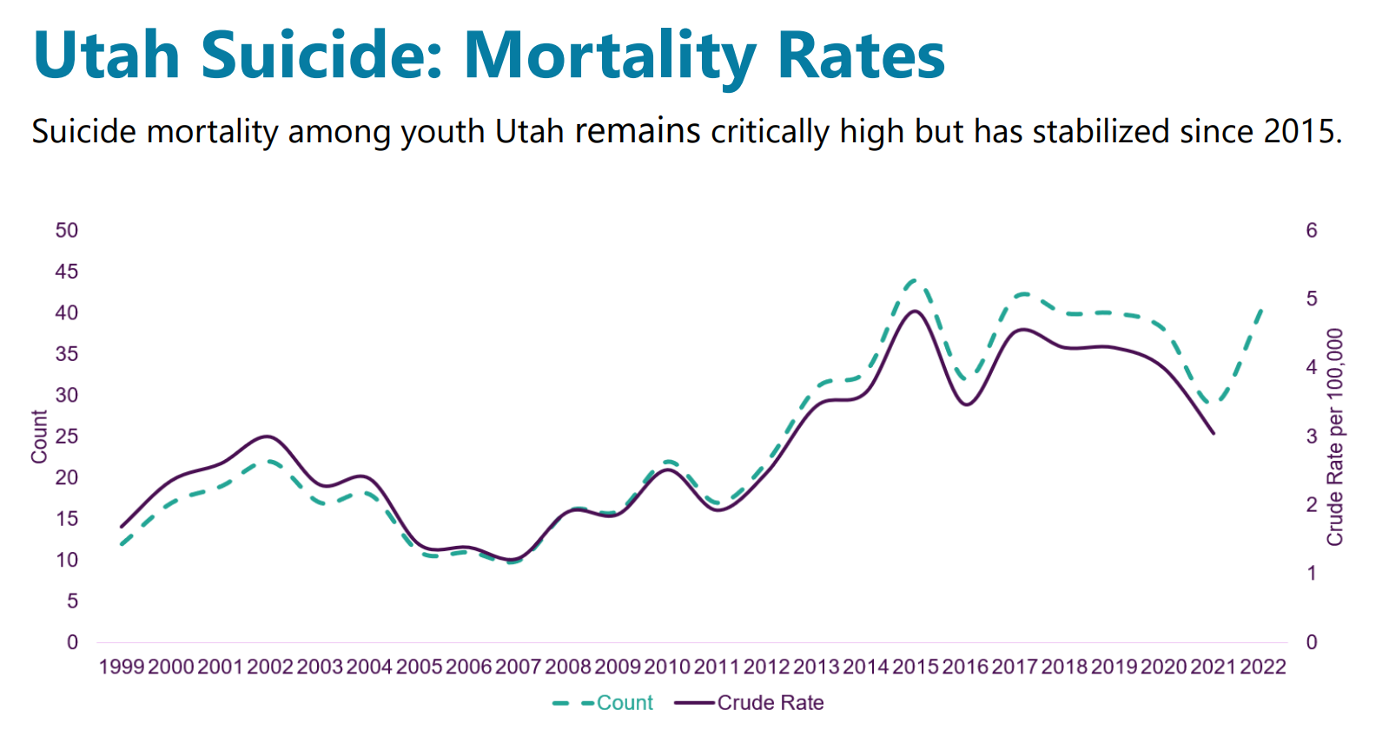

Slide 22

2026: Behavioral Health Division
Division Size = 17 Psychiatrists and 16 Psychologists
Provide services across 5 different geographic sites (+ multiple primary care practices)
Continue to set goals to increase access, improve safety and quality
Hoping for a year (or two) with no growth to stabilize
Find myself designing behavioral space again☺

