Slide 1
Value & Impact: A Model for Integrated Behavioral Health in a Pediatric Sleep Center

Slide 2
Child and Adolescent Psychiatry and Behavioral Sciences
Children of all ages with emotional, behavioral and mental health problems find care in the Department of Child and Adolescent Psychiatry and Behavioral Sciences (DCAPBS) at Children’s Hospital of Philadelphia (CHOP), where we believe mental health is health.
We have many programs for specific mental and behavioral illness. We also have experts in our hospital to care for hospitalized children, in specialty divisions to help kids and families cope with chronic conditions, and in primary care locations to help identify and treat conditions when they are less severe.

Slide 3
Behavioral Health in Specialty Divisions
Amplified Musculoskeletal (AMPS)
Autonomic Dysfunction Program (ADS)
Cardiology
Center for Childhood Communication
Center for Fetal Diagnosis & Treatment
Concussion Program
Craniofacial Surgery
Endocrinology
Feeding and Swallowing
Gastroenterology
Neurology
Neonatal Intensive Care Unit
Oncology/Cancer Center
Pediatric Health & Behavior – Psychology
Safe Place
Sleep Center
Solid Organ Transplant
Urology

Slide 4
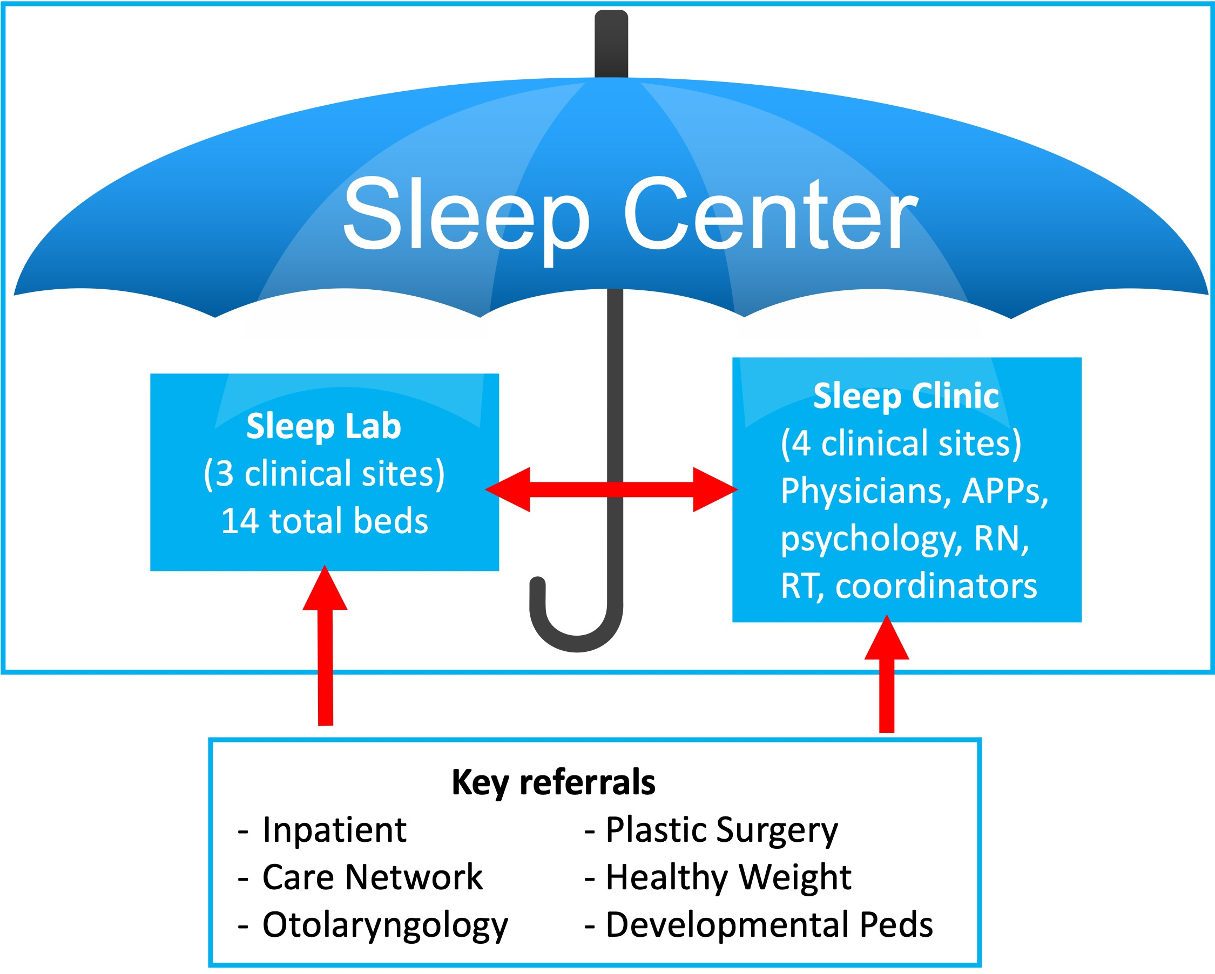
The Sleep Center
Interdisciplinary program that cares for children with conditions across the spectrum of sleep health
Multiple components work collaboratively
(4 clinical sites)
22 total beds
22

Slide 5

Sleep Health is critical to child health!
In children, sleep problems affect:
Mood and behavior
Growth and learning
Cardiovascular health
Obesity and metabolism
Child and family quality of life
Sleep problems are common:
  25-50% of children experience trouble falling and staying asleep
  Up to 15% of children have breathing problems during sleep
Sleep problems are more common in children:
  Of racial/ethnic minority groups
  With underlying medical problems
  With intellectual disabilities

Slide 6


Interdisciplinary Sleep Clinic
New patients in the Sleep Clinic are seen in an interdisciplinary clinic – they are scheduled with both a medical and behavioral health provider at their initial visit
The Sleep Clinic saw 3,500 outpatient medical visits and 2,200 psychology visits in FY25
  Interdisciplinary team includes:
  Sleep boarded medical physicians (Pulmonologists, Neurologists, Psychiatrists)
  Behavioral health clinicians
  Respiratory therapists
  Nursing and NP support
Melanie Franklin, PhD
Clinical Director, Behavioral Sleep Medicine
Clinic
Lab
Melissa Xanthopoulos, PhD
Director, CPAP Adherence Program

Slide 7
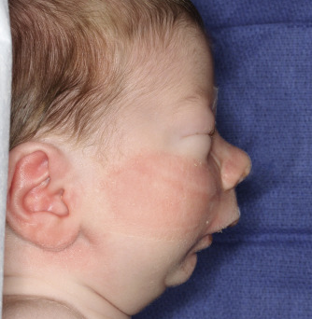




The Sleep Center pathways
2 week old with Robin sequence
in NICU
Sleep study ordered per pathway:
Severe OSA
Plastic surgery manages with mandibular distraction
Referred to Sleep Clinic for medical management
14 year old with hypersomnia in Care Network
Referred to Sleep Clinic for interdisciplinary evaluation
Sleep study:
Consistent with narcolepsy
Follow up in Sleep Clinic for medical and BH management
6 year old with snoring after T&A in ENT
Sleep study ordered:
Moderate OSA
Referred to Sleep Clinic for interdisciplinary CPAP initiation
Sleep study: CPAP titration
Follow up in Sleep Clinic for CPAP including CPAP adherence
4 year old with
trouble falling asleep in Developmental Peds
Referred to Sleep Clinic for interdisciplinary eval:
behavioral insomnia
Follow up in Sleep Clinic for BH management
15 year old with
obesity evaluated for bariatric surgery by Healthy Weight
Sleep study ordered:
No significant OSA
Sleep physician communicates results to referring team and patient proceeds with surgery

Slide 8
Impact: Interdisciplinary Sleep Clinic
Integrating the behavioral health team into the Sleep Clinic improves:
Clinical Care
Patient Experience
Efficiency of Care Delivery
Research
Quality Improvement
Clinic
Lab

Slide 9
Keys to Success
Establish key leaders and meeting cadence
Align on shared goals
Define what success looks like
  Metrics for review
  Cadence
Financial Impact / Support
Clinic
Lab

