Slide 1
Mental & Behavioral Health Institute
Cincinnati Children’s Hospital
Department of Pediatrics
Max Warner, Vice-President
Department of Pediatrics & Cincinnati Children’s Research Foundation

Slide 2



Cincinnati Children’s – Institutes
We created Institutes for areas like heart and cancer to solve a fundamental problem in healthcare: complex diseases require coordinated, multidisciplinary care and research.
Example (Heart Institute):
Cardiology (diagnosis & management)
Cardiothoracic surgery (procedures)
Molecular biology (research & innovation)
Example (Cancer Institute):
Oncology (treatment)
Hematology (blood disorders)
Experimental hematology & cancer biology (research)
✅ Result:
Faster translation of discoveries into treatments
More clinical trials
Cutting-edge therapies available sooner

Slide 3
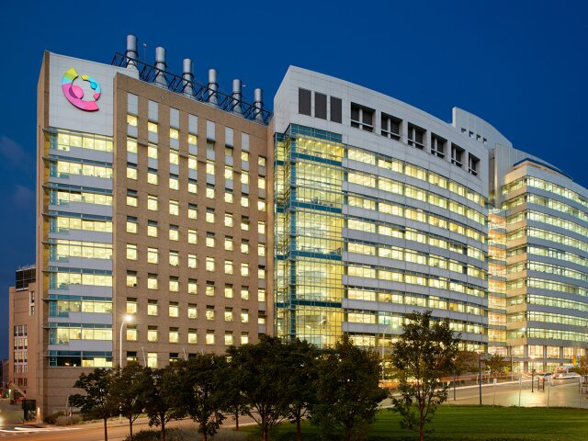
Cincinnati Children’s – Institutes
Heart Institute:
Divisions of Cardiology, Molecular Cardiovascular Biology & Cardiothoracic Surgery
Cancer & Blood Disease Institute: Divisions of Bone Marrow Transplantation and Immune Deficiency, Oncology, Hematology & Experimental Hematology and Cancer Biology
Perinatal Institute:
Divisions of Neonatology and Pulmonary Biology
Heart Institute – External Partnerships
UK Golisano Children’s,
Peyton Manning Children’s Hospital in Indiana,
Akron Children’s Hospital in Ohio,
Mary Bridge Children’s in Washington

Slide 4

Cincinnati Children’s – Institutes
Problem:
Multiple appointments across departments
Repeating information
Lack of coordination
Institute model:
👉 “One front door” for a condition
Care is organized around the patient, not departments
Multidisciplinary visits are coordinated
Teams communicate internally
✅ Result:
Simpler, more seamless experience
Less stress for families
Faster treatment decisions

Slide 5

Mental and Behavioral Health Institute
Cincinnati Children’s Research Foundation (CCRF) (1931)
Mind Brain Behavior Collaborative (2017)
Mental & Behavioral Health Institute (2023)

Slide 6
Mental and Behavioral Health Institute
Behavioral Medicine & Clinical Psychology
Child & Adolescent Psychiatry
Developmental & Behavioral Pediatrics
Integrated Expertise
Three divisions - Behavioral Medicine & Clinical Psychology, Child & Adolescent Psychiatry, & Developmental & Behavioral Pediatrics - are realigned to create a cohesive & strategic approach to behavioral, developmental, & mental health at Cincinnati Children’s
Expansive Team
MBHI includes over 900 faculty, staff, allied health professionals, & trainees, representing a robust & diverse network of professionals dedicated to transforming clinical care, research, & education
Large Service Line
In over 75 schools.
99 IP mental health Beds.
30 residential beds.
3 partial hospitalization program sites.
2 24/7 emergency room staffed with mental health staff for intakes
Mental & Behavioral
Health Institute (MBHI)

Slide 7
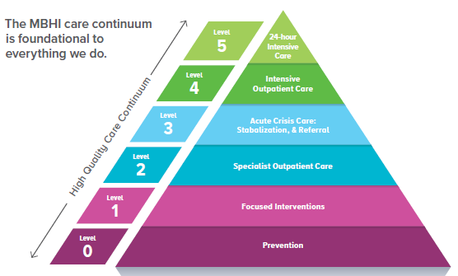
Clinical Ecosystem Domain: MBHI Framework for Mental Health System of Care
J Pediatrics 2023
24-hour
Psychiatry
Management
Intensive Integrated Services
Crisis Care
Specialist Outpatient
Behavioral, Developmental, & Mental Health Management
Integrated Behavioral & Development Health
in the Community & Schools
Home & Community
Comprehensive Care Management
27,000 Inpatient Bed Days
7,700 Residential Bed Days
5
Level
5
15,235 Therapeutic Preschool Days
5900 Partial Hospital Days
4
Level
4
3
6,445 ED PIRC visits
2,253 Bridge visits
3,272 Crisis Calls
Level
3
Level
2
2
240,537 outpatient visits across CCHMC outpatient, 70+ schools & integrated behavioral health
Level
1
1
9,000 Therapeutic Behavior Support Visits
9,865 Families reached through Trainings
Level
0
0
FY25 Volumes for BMCP, CAP, and DDBP

Slide 8

What is our opportunity
Where to invest
Is growth of services what we need
Can we ever meet the demands for these services
Create new research ventures
MBB = studied where we were
Philanthropy = where we can invest
Structure = research collaboration

Slide 9
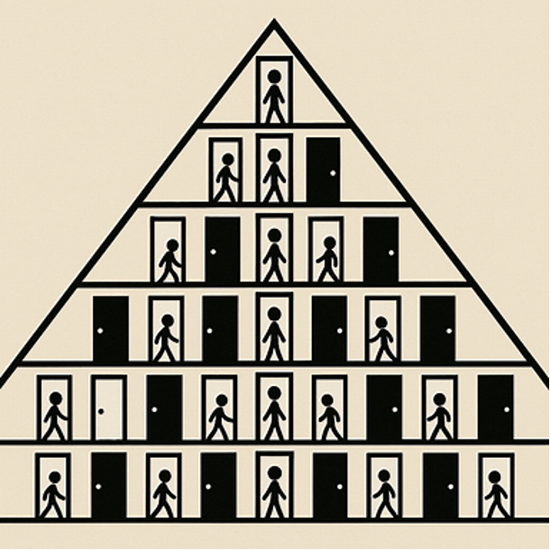
Cross-MBHI Projects
Single triage system wherever patients & families enter
Clear care pathways
Anxiety
Depression
Attention deficit/hyperactivity
Neurodevelopmental delays
Trauma/systems-engaged youth (e.g., child welfare, juvenile justice
Substance use
Disruptive behaviors
Chronic medical conditions
Eating disorders
Serious mental illness (e.g., psychosis, bipolar disorder)
Digital addiction (e.g., gaming, gambling, social media)

Slide 10
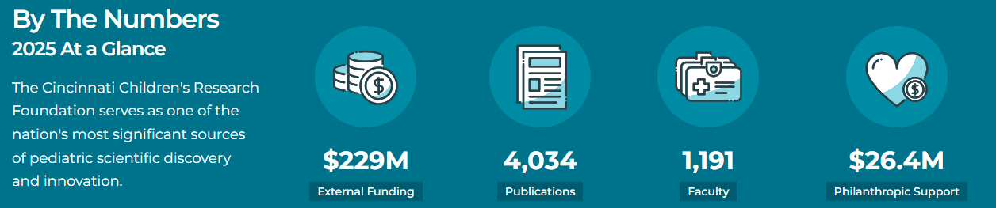
Research
Research portfolio for the Mental & Behavioral Health institute – 5 Internal Funded Projects
Heading into next fiscal year: $39M research across the Institute
Portfolio for work going forward: anxiety and depression focus, AI/machine learning/prediction, digital health, more bench to bedside, preclinical models, innovative therapeutics and lots of plans for implementation research

Slide 11
Research
Exploring the Role of Epigenetic Factors in Mental Health Outcomes after Mild Traumatic Brain Injury in Adolescents
Hyper-extralemniscal model of Fragile X Syndrome
Regulating Together for emotionally dysregulated children with ADHD
Advancing Measurement-Based Care in a Neurobehavioral Partial Hospitalization Program for Youth with Developmental Disabilities,
Improving outcomes in adolescent inpatient depression with Deep Transcranial Magnetic Stimulation (dTMS)

Slide 12
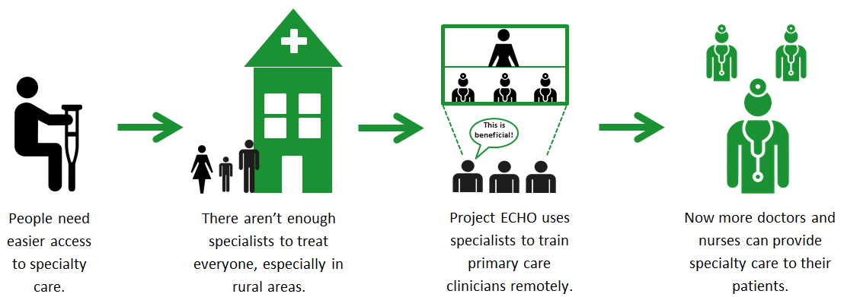
Levels 0-1: Provider Training
Goal: Clinicians develop the skills & knowledge to treat patients in their own communities
Outcomes: reduced travel costs & wait times, expanded access in a non-stigmatized setting, decreased preventable ED visits & inpatient stays, decreased variation/disparities in care

Slide 13
Levels 0-1: Provider training
CORE MENTAL HEALTH
AUTISM
TARGETED SPECIALTY
1
Depression for PCP
7
10
Supporting Children of the Opioid Epidemic for anyone who works with children who have been impacted by substance use disorders.
11 cohorts
Autism for PCPs
2
Anxiety for PCP
9 cohorts
8 cohorts
10 cohorts
3
Psychopharm for PCP
8
11
Act Early for health care providers, early childhood educators, community-based professionals, and administrators who work with and care for young children
12 cohorts
Autism for Allied Health
5 cohorts
4
Therapy for SW/CC
5 cohorts
8 cohorts
5
Trauma for Mixed Audience
9
12
Community Inclusion for Greater Cincinnati community and recreation organization staff; pre-selected list.
Launched 2026
6 cohorts
Early Diagnosis PCP
6
Adv. Therapy for SW/CC
2 cohorts
1 cohort
7 cohorts
Depression and Trauma are both on hold. Two new courses are being introduced this fall for PCPs, Crisis Interventions and Disruptive Behaviors.

Slide 14
Levels 0-1: Integrated Behavioral Health (Primary Care)
Study, build infrastructure and spread
+2 CCHMC primary care sites
Developed model for spread
+4 community practices
+2 community practices
FT IBH provider integrated into 1 CCHMC primary care clinic
+2 community practices
+3 community practices
25+ sites

Slide 15
Clear Objectives
Objective 1
Build a unified behavioral, developmental, & mental health institute
Objective 2
Cultivate access, quality, & equity across the care continuum
Objective 3
Act through partnerships to improve care
Objective 4
Promote world-class, interdisciplinary research, discovery, & innovation
Objective 5
Educate & empower our workforce through training & development

Slide 16
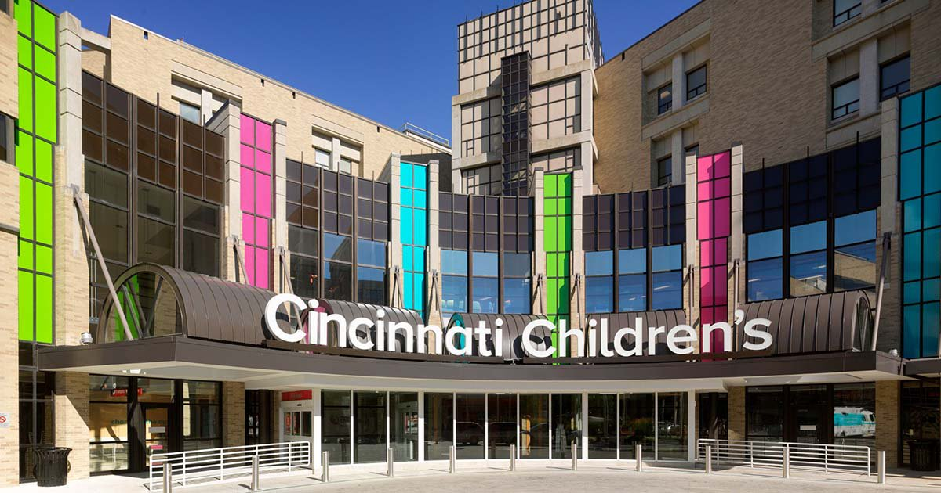
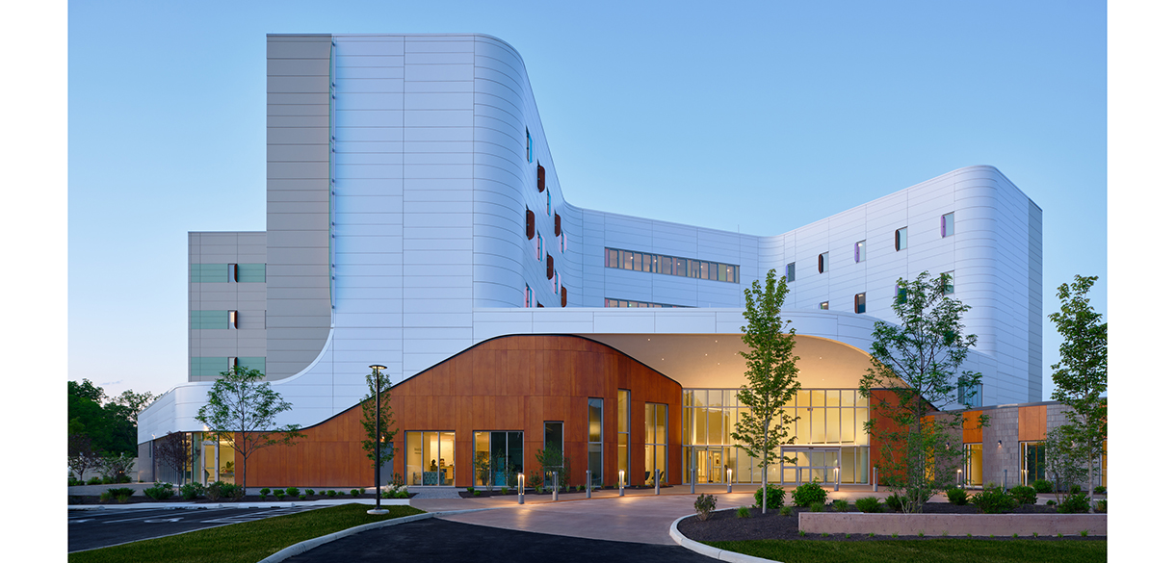
Thanks to the AAAP planning committee and our Utah hosts.

