Slide 1


IMPORTANCE OF THE CHAIR/CHIEF AND ADMIN RELATIONSHIP
Going for the Gold!
Angelo P. Giardino, MD, PHD
Chair, Department of PEDIATRICS
University of Utah
Spencer Fox Eccles School of Medicine
Chief Medical Officer
Intermountain Primary Children’s Hospital
2026 Annual Spring Meeting
May 18 – May 20, 2026
University of Utah (Park City, UT) and St. Regis Deer Valley

Slide 2

DISCLOSURE
I have no relevant financial relationships to disclose.

Slide 3

OLYMPIC MINDSET
(IN PEDS)
PREPARATION
Knowledge, skills, attitude and supports needed to compete at Elite level
PRACTICE
Even when you set world records you still practice to improve
PERFORM
On game day you show up and produce!

Slide 4
“OBLIGATE” BY THE NUMBERS
University of Utah’s Spencer Fox Eccles School of Medicine
Department of Pediatrics
442 Faculty
940 Staff
10+ Practice/ Clinical Locations
20 Clinical SubspecialtieS
4 Major Enterprises
$272M in Revenue
$293M
CHILDREN: … ~30% of the population, and 100% of the future …

Slide 5


MISSION AND VISION
Mission: Improving the lives of children through excellence in advocacy, education, research, and clinical care.
Vision: Caring for children, caring for their future
Primary Children’s: The Child First and Always
Aspirational Goal: Become the model health system for children whereby children of the Intermountain West are (measured to be) the healthiest in the country

Slide 6
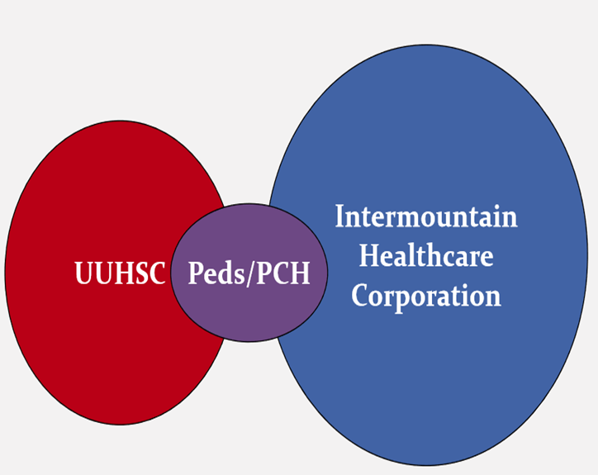
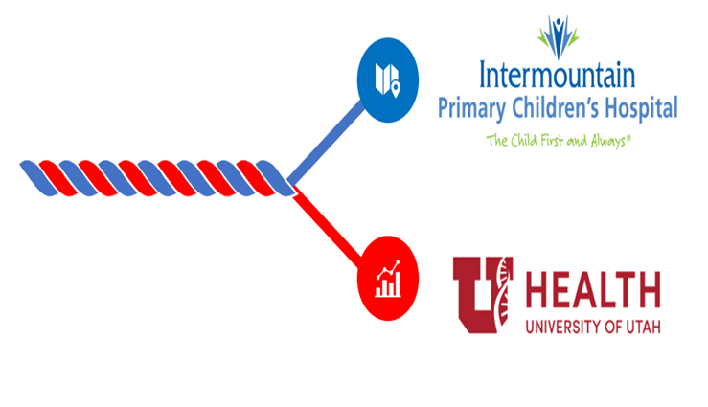
PARTNERSHIP WITH INTERMOUNTAIN CHILDREN’S HEALTH

Slide 7
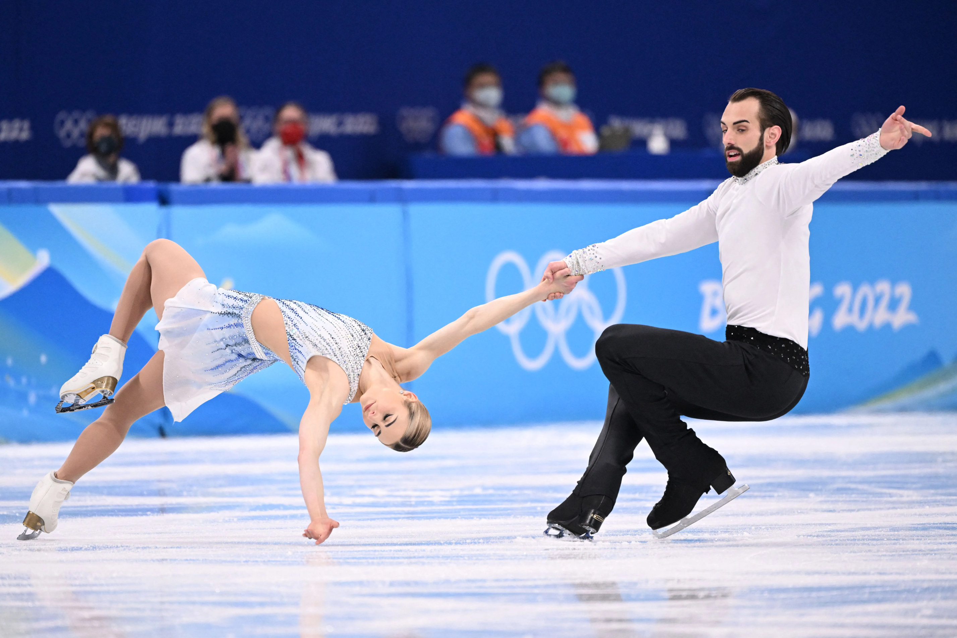
THE “RELATIONSHIP”
CHAIR/DIVISION CHIEF RELATIONSHIP WITH
DEPARTMENT/DIVISION ADMINISTRATOR
IDEAL
  Dyad partners
SUBOPTIMAL
  Good cop/Bad cop
  No cop/you’re the cop
  Mad scientist/clean up crew

Slide 8
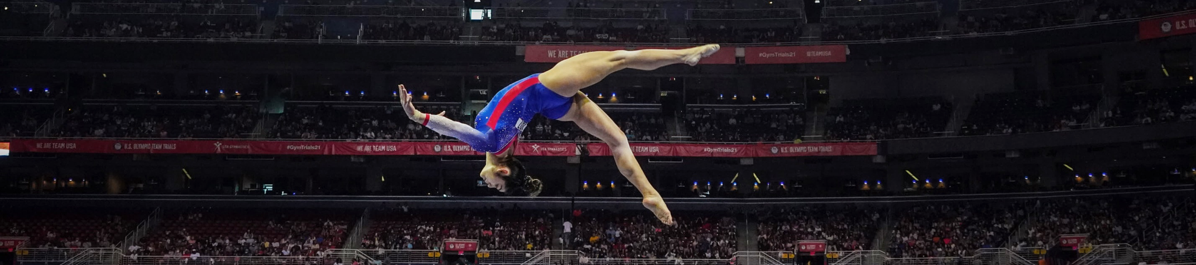
METAPHORS, MENTAL MODELS & BOOKS GALORE!

Slide 9

HEALTHCARE/ACADEMIC MEDICINE POLICY POST CONCUSSION SYNDROME
COGNITIVE SYMPTOMS:
  Concentration Problems: Trouble focusing on tasks or following conversations.
  Mental Fog: A feeling of confusion or lack of clarity in thinking.
EMOTIONAL AND BEHAVIORAL SYMPTOMS:
  Irritability: Increased frustration or mood swings.
  Anxiety and Depression: Feelings of sadness, worry, or hopelessness.
  Sleep Disturbances: Insomnia or excessive sleeping.
….. When can you safely return to the game?

Slide 10
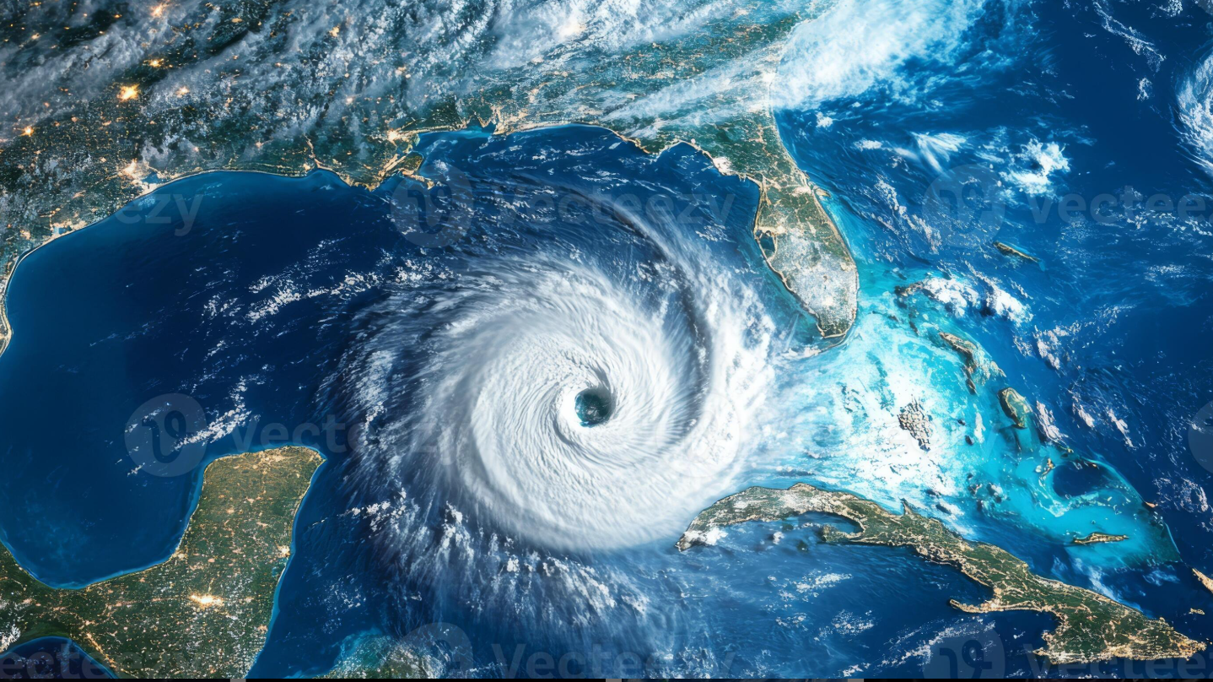

HEADWINDS AND TAILWINDS – EVOLVING MESSAGE

Slide 11
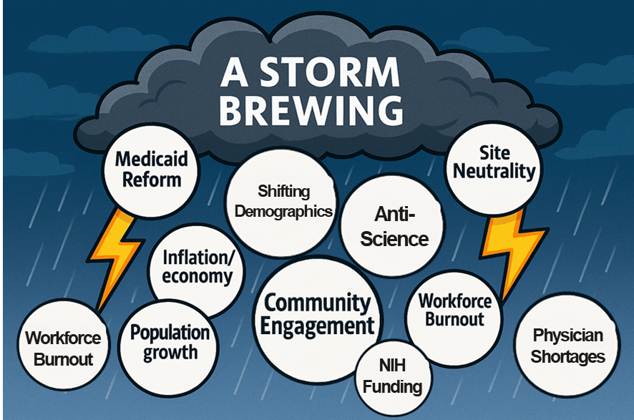
STORM CLOUDS ON THE HORIZON
Medicaid Cuts
NIH Funding/Indirects
CDC/FDA Tumult
Anti-Science Attitude
  Vaccines/Vit K
  “With all due respect, Doctor, ‘I’ve Googled it’”
Workforce Burnout
  Engagement Survey Results

Slide 12

PREPARING FOR THE STORM
Ignore It / Run Away
Cut/Decrease Expenses
Increase Work Expectations
Enhance Efficiency plus Growth
  Data/Dashboards
  Optimization
  Better Tools/Focus

Slide 13
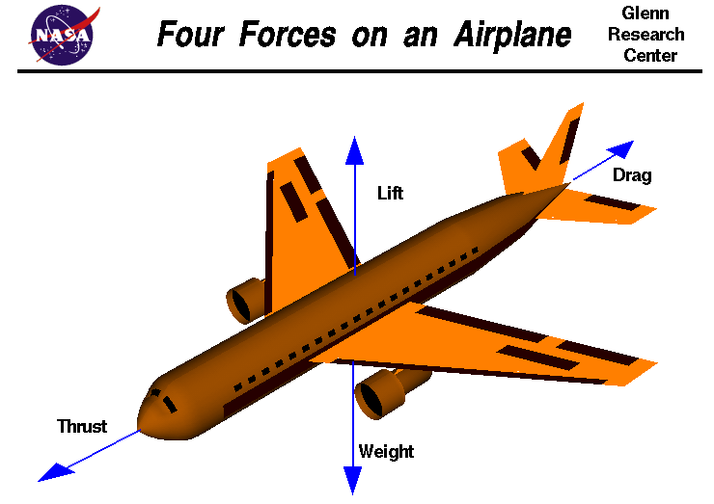
Notes:
A force may be thought of as a push or pull in a specific direction. A force is a vector quantity, so it has both a magnitude (size) and a direction. So when we describe these forces, we have to specify both the magnitude and the direction. This slide shows the forces that act on an airplane in flight, which include Lift, Weight, Drag, and Thrust. We’re going to look at each of these individually, but first, a little from the “Fathers of Flight”.

Slide 14
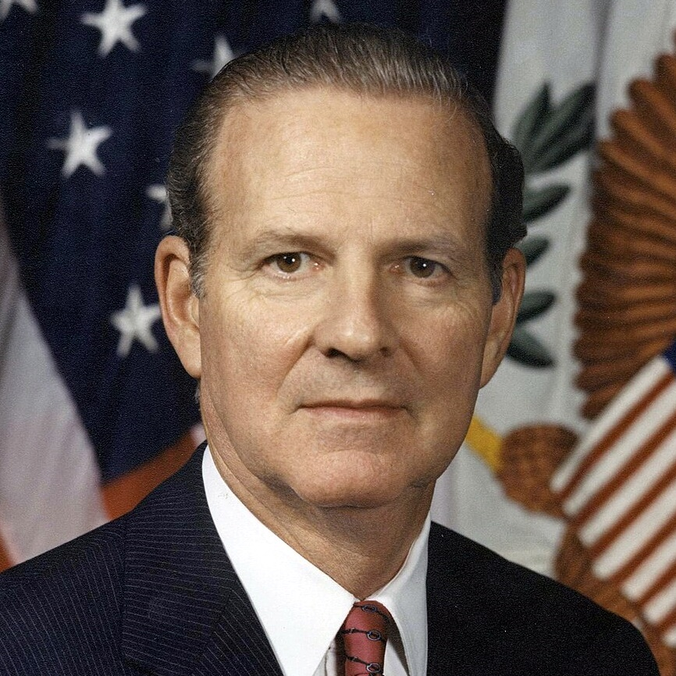
THE FIVE P’S
Proper Preparation Prevents Poor Performance.
JAMES BAKER
Former Secretary of State

Slide 15


THE ACADEMIC TRICYCLE

Slide 16
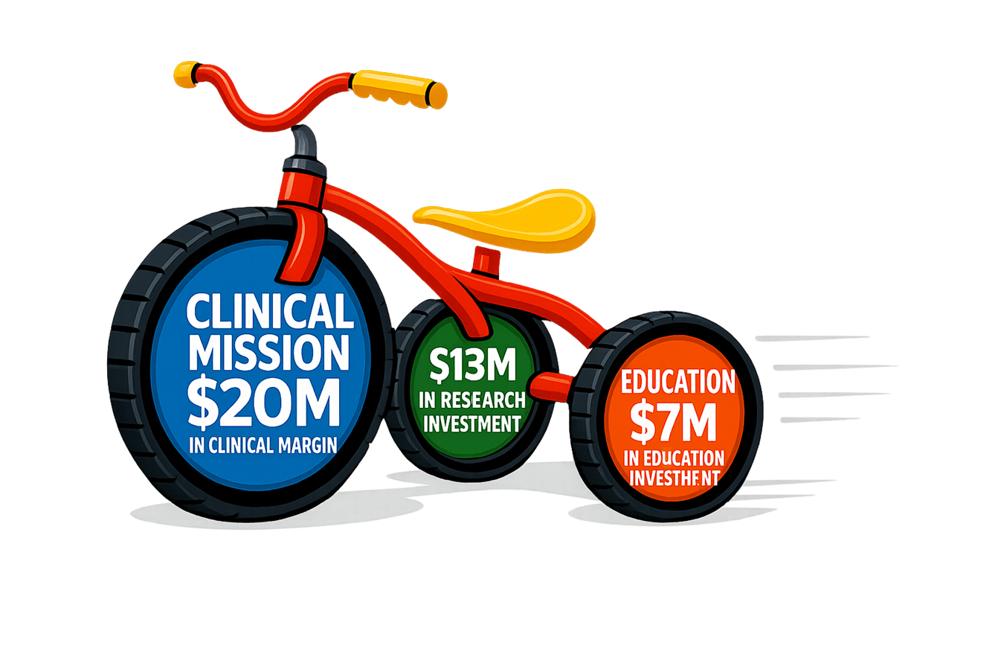
THE ACADEMIC TRICYCLE
$60M in Supported Research
#22 in BRIMR
150+ Trainees
20+ Training Programs

Slide 17

BUILT TO LAST
Leadership and Engagement for the Future of Pediatrics

Slide 18
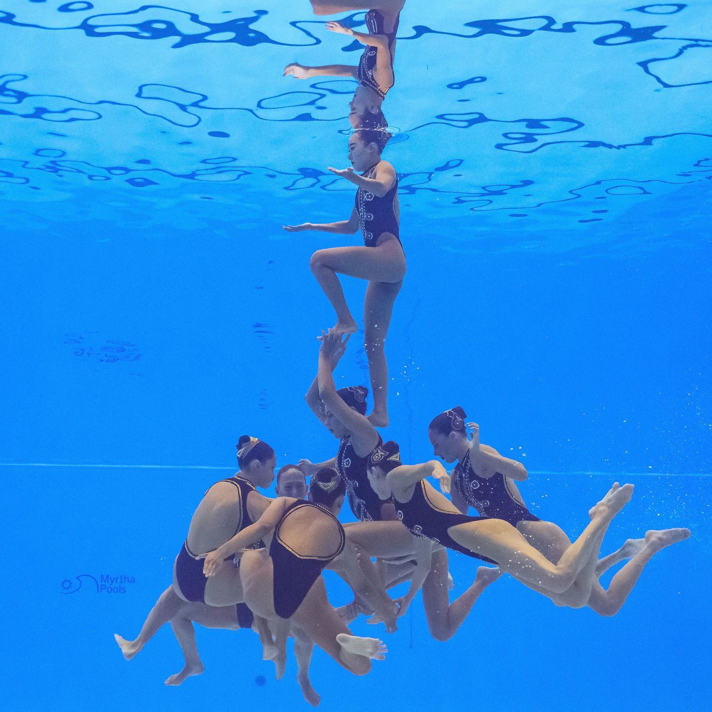
DEFINITIONS
Leadership for the common good:
  Leader vs. Leadership
  A high degree of mutuality among leaders and followers
  Leadership may happen within a community that itself is in conflict, and which does not seek collaboration
Crosby, B.C. & Bryson, J.M. (2005). Leadership for the Common Good (2nd ed). San Francisco: Jossey-Bass

Slide 19
DEFINITIONS
Leadership happens when people:
  Acknowledge shared work
  Use dialogue and collaborative learning
  Accomplish across dividing lines of differing perspectives, values, beliefs, cultures and world-views.
Crosby, B.C. & Bryson, J.M. (2005). Leadership for the Common Good (2nd ed). San Francisco: Jossey-Bass

Slide 20

BUILT TO LAST
6 year research project at the Stanford University Graduate School of Business
18 exceptional publicly traded companies in direct comparison to one of its top competitors
Study questions:
  What makes the truly exceptional organizations different from the comparator?
  What were the common practices these enduringly great organizations followed throughout their history?

Slide 21
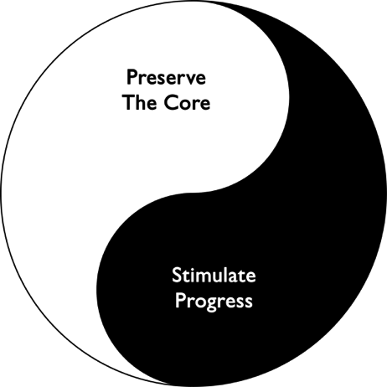
BUILT TO LAST
PRESERVE THE CORE AND STIMULATE PROGRESS
“What makes for an enduring enterprise?”
  Think of it as a yin and yang symbol.
On one side is a need to preserve the core:
  It’s about holding to the core, about remaining consistent and true to something.
On the other side is a need to stimulate progress:
  It’s about change, improvement, innovation, going forward, being on the balls of your feet.
A marvelous ability to, on the one hand, preserve the core and, on the other hand, stimulate progress at the same time, all the time.
https://www.jimcollins.com/media_topics/Preserve-the-Core.html

Slide 22
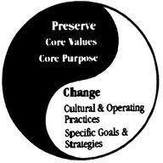
BUILT TO LAST
https://www.google.com/search?q=built+to+last+preserve+the+core+stimulate+progress&rlz=1C1GCEU_enUS880US882&source=lnms&tbm=isch&sa=X&ved=2ahUKEwjB1u-si8jrAhXPVc0KHaUED24Q_AUoAXoECA4QAw&biw=1261&bih=589#imgrc=7PfK5Bdl-B7IaM

Slide 23
BUILT TO LAST
https://www.google.com/search?q=built+to+last+preserve+the+core+stimulate+progress&rlz=1C1GCEU_enUS880US882&source=lnms&tbm=isch&sa=X&ved=2ahUKEwjB1u-si8jrAhXPVc0KHaUED24Q_AUoAXoECA4QAw&biw=1261&bih=589#imgrc=7PfK5Bdl-B7IaM

Slide 24
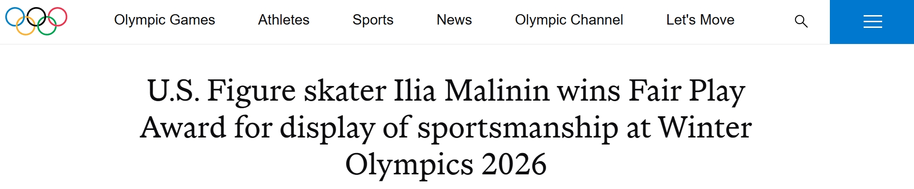
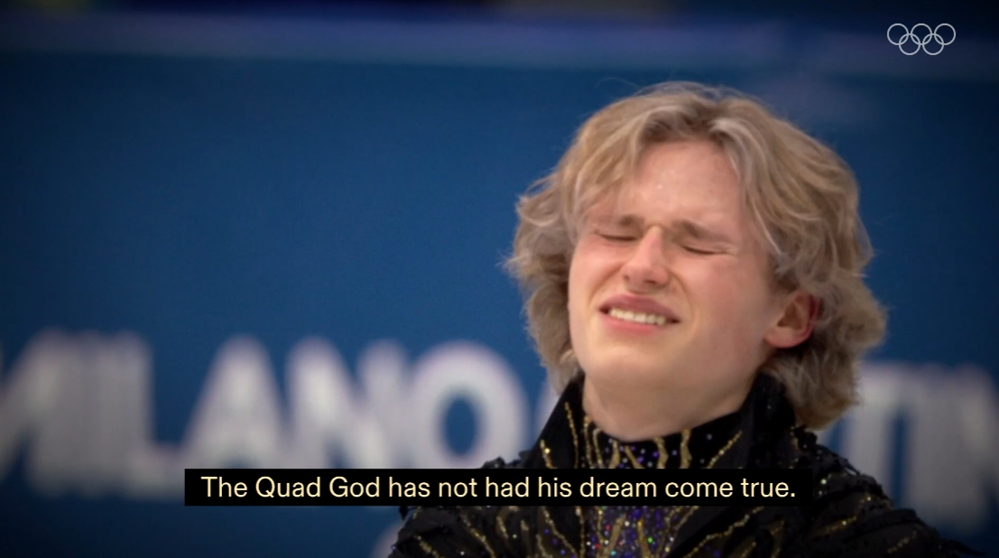
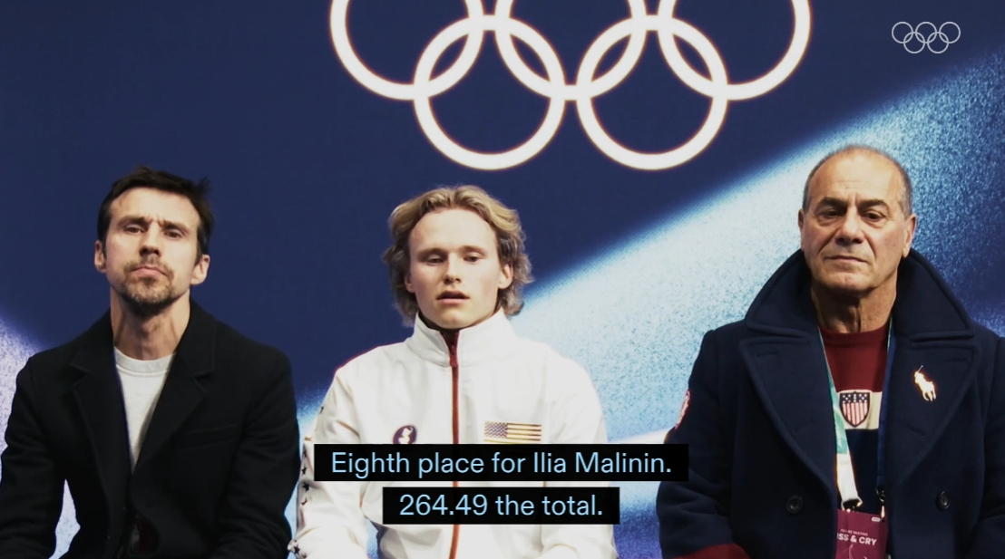


Slide 25
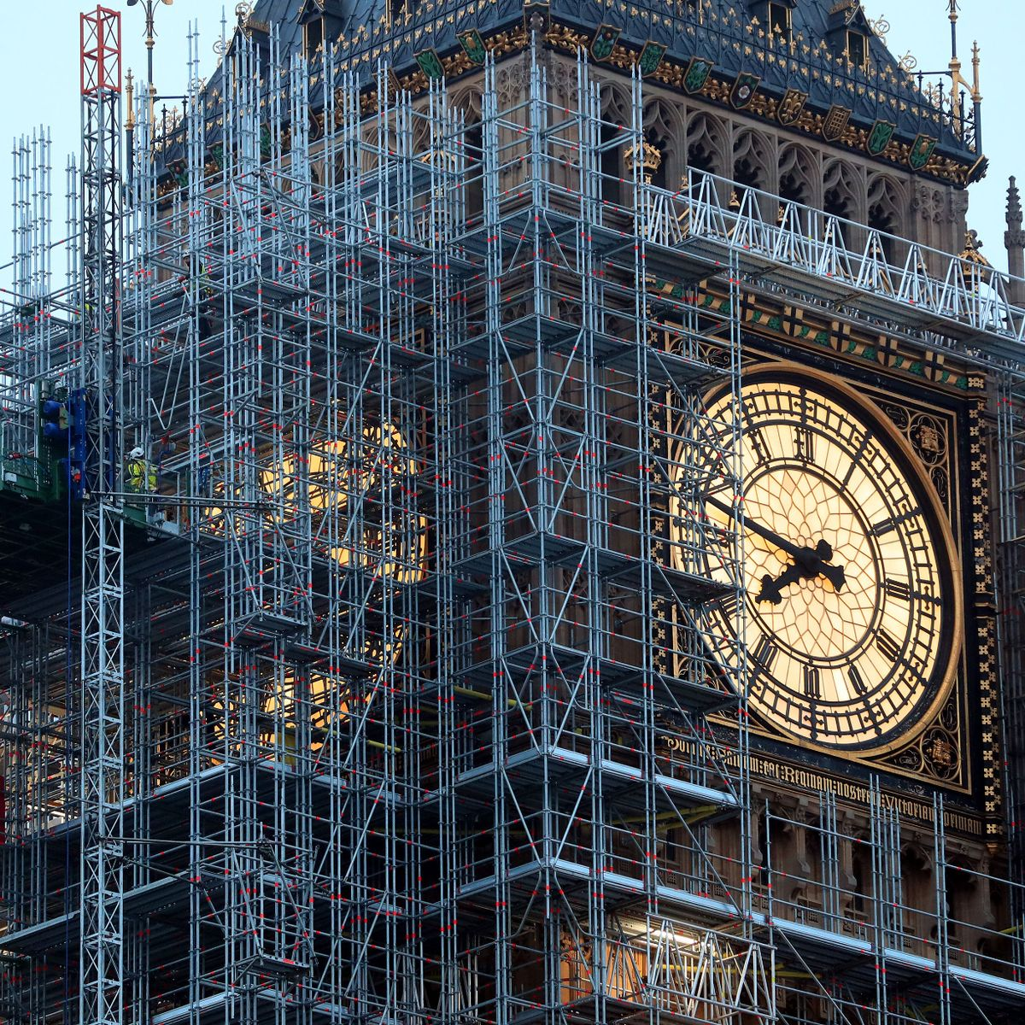
BUILT TO LAST
CLOCK BUILDING
Time telling is leading as a charismatic visionary
  A “genius with a thousand helpers”
  Searching for a single great idea on which to build success is time telling
Clock building is shaping a culture that can thrive far beyond any single leader
  Enduring greatness requires clock building
  Building an organization that can generate many great ideas over a long period of time is clock building.
https://www.jimcollins.com/concepts/clock-building-not-time-telling.html

Slide 26

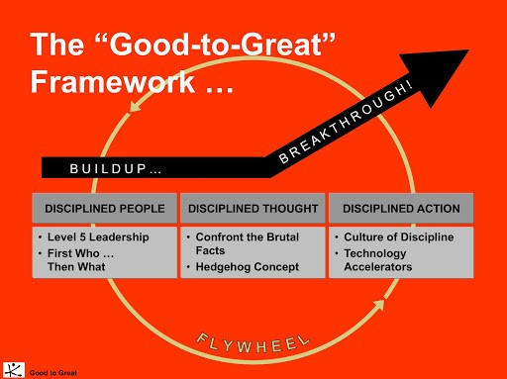

Slide 28
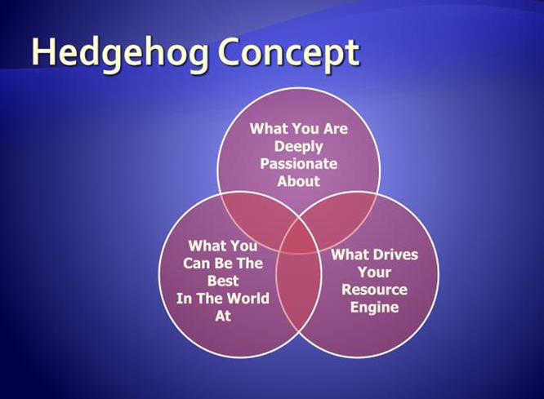

Slide 29
CAREGIVER ENGAGEMENT: BRUTAL REALITY
I love the people/teams I work with
I can’t keep up this pace at work
IT is a big dissatisfier
What do I need to be successful as a leader?

Slide 30
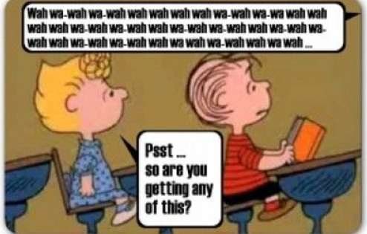

Peanuts Cartoon Adults Talking - Search Images

Slide 31
2023 MHA PROJECT
The Department of Pediatrics would like a plan of action to address faculty development and engagement in the next 12, 24, and 36 months.
The project’s purpose is to address areas of concern outlined and identified through survey data, qualitative interviews, and administrative interests.
Through the creation and development of an engagement framework, the Department of Pediatrics would like to increase retention, provider satisfaction, and opportunities for advancement.

Slide 32
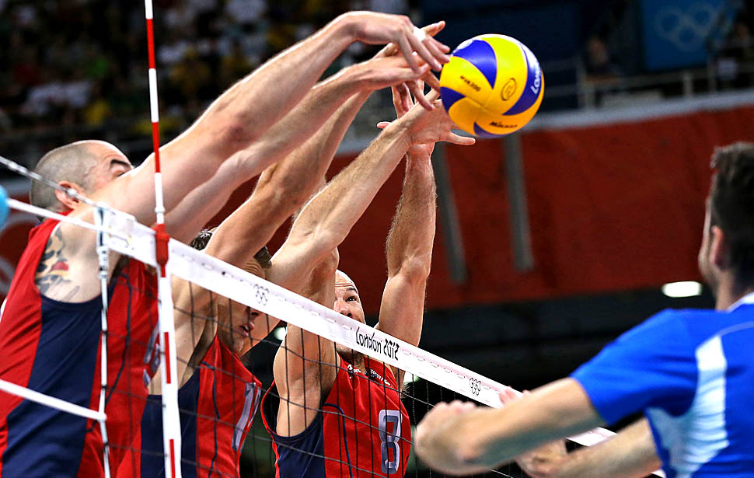
THE PRACTICE OF LEADERSHIP
Accountability, Adaptability, and Connection

Slide 33

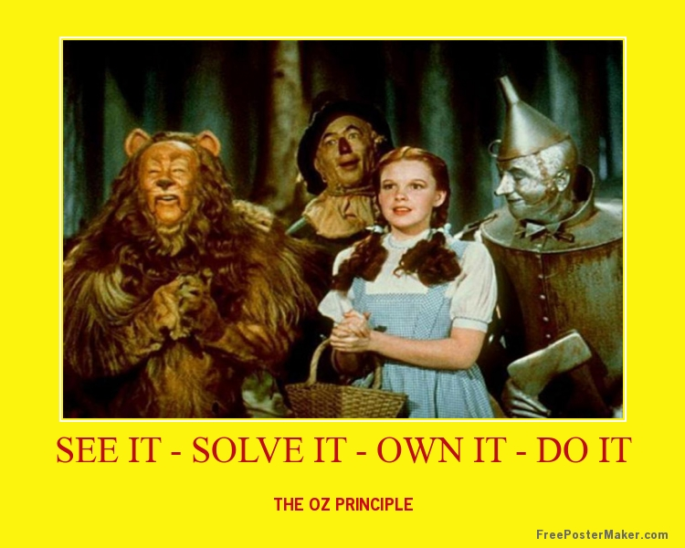
Published in 1994
Sold 600,000 copies
The core message:
  When people take personal ownership of their organization's goals and accept responsibility for their own performance, they become more invested and work at a higher level to ensure not only their own success, but everyone's.

Slide 34
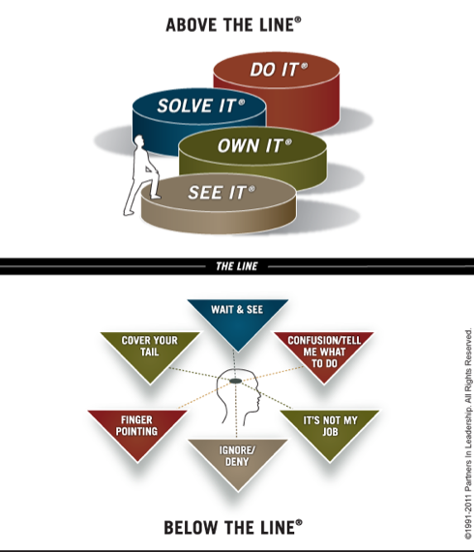

Slide 35

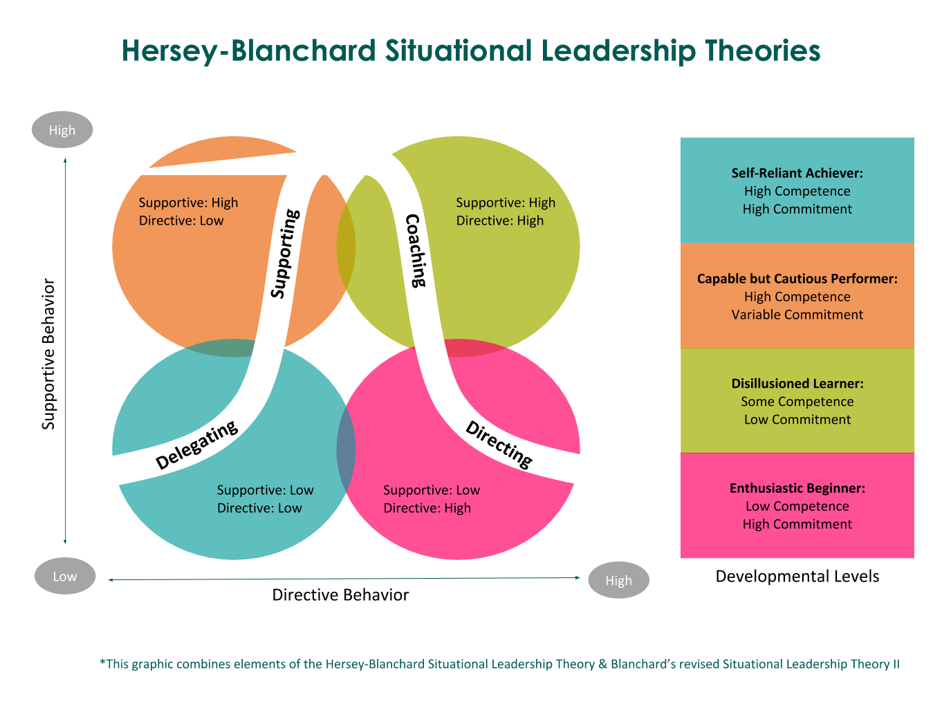
4 leadership styles &
4 levels of follower development
Leadership style must match team
https://www.google.com/search?q=hersey+and+blanchard%27s+situational+leadership+theory&tbm=isch&chips=q:hersey+and+blanchard%27s+situational+leadership+theory,g_1:model:W1Lpgz5l25s%3D&rlz=1C1GCEU_enUS880US882&hl=en&sa=X&ved=2ahUKEwi8mamNj8jrAhWVAp0JHQAsCdkQ4lYoAHoECAEQFQ&biw=1244&bih=540#imgrc=Nwcpu4iAZq7xkM

Slide 36

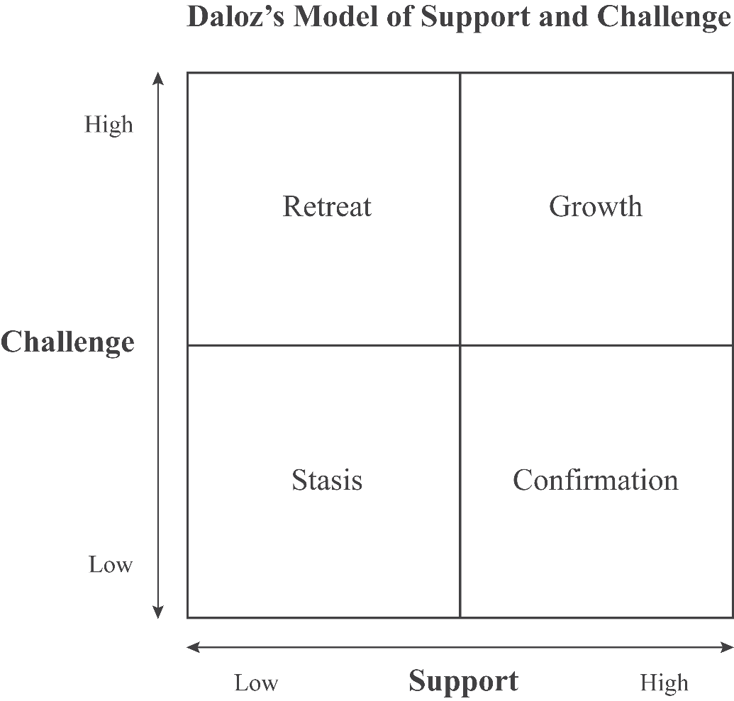

Daloz, L., (1986). Effective Teaching and Mentoring: Realizing the Transformational Power of Adult Learning Experiences. Jossey Bass, San Francisco, CA

Slide 37

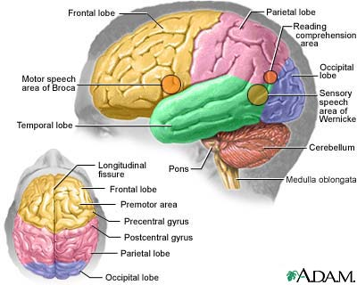
Author: psychiatrist, business consultant, and coach
powerful techniques to break through the challenging and at times hardened outer layers of coworkers, friends, and strangers
The Three-Part Brain
Amygdala Hijack and the Death of Rational Thought
Power of Asking a Question

Slide 38
JUST LISTEN: CORE RULES
Rewire Yourself to Listen
Make the Other Person Feel “Felt”
Be More Interested Than Interesting
Make People Feel Valuable
Caution: Toxic People
  Abandonment Strategy
Goulston, M. Just Listen. American Management Association. New York, NY:AMACOM. 2010

Slide 39

CORE PRINCIPLES OF HUMBITIOUS LEADERSHIP
Low Ego, High Drive: Leaders balance intense corporate ambition with personal humility. They channel drive into organizational success rather than self-promotion.
Cultivate Self-Awareness: True humility requires an accurate, honest assessment of personal blind spots. Leaders must actively seek feedback from "loving critics" rather than sycophants.
Foster Psychological Safety: High-performing teams thrive when leaders openly admit mistakes and listen to understand. Welcoming diverse perspectives drives long-term team resilience.

Slide 40
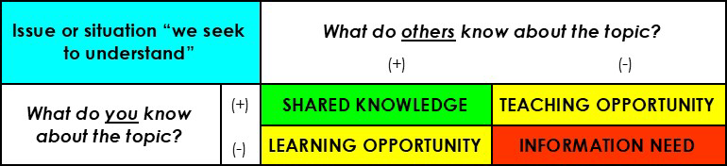
GUIDING PRINCIPLES FOR OUR SHARED WORK
No one has all the answers… So, we learn from each other…
Luft J.; Ingham H. (1955). "The Johari window, a graphic model of interpersonal awareness". Proceedings of the Western Training Laboratory in Group Development. University of California, Los Angeles.

Slide 41
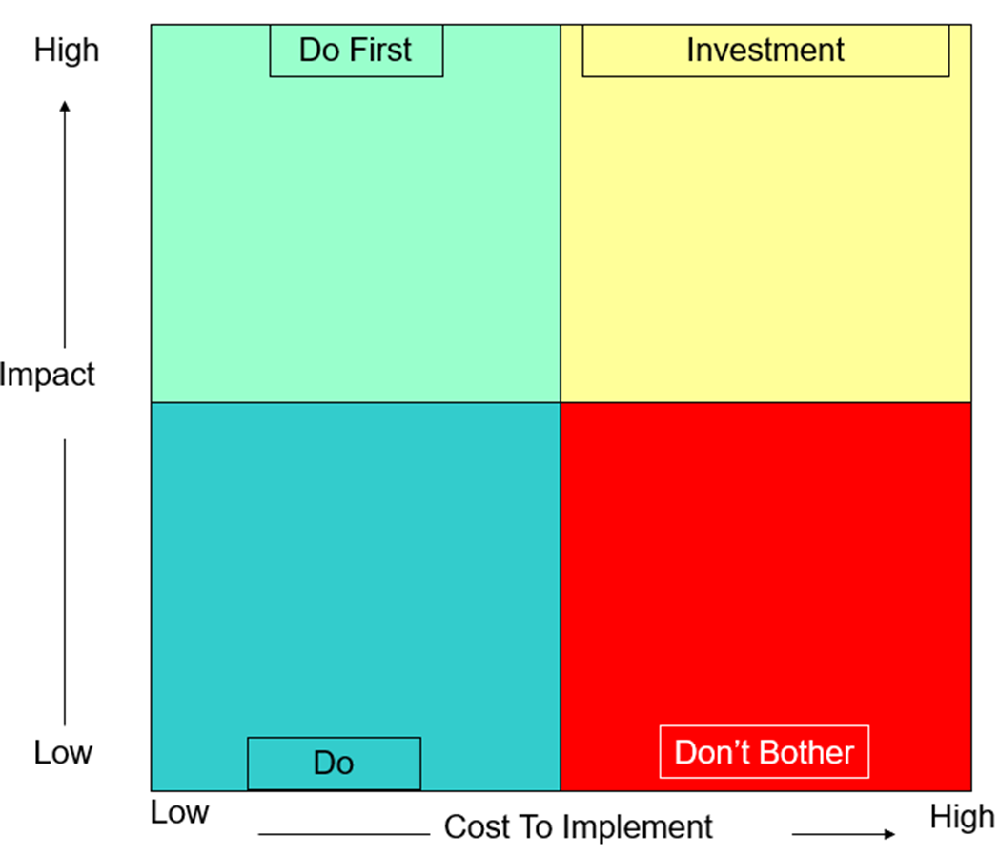
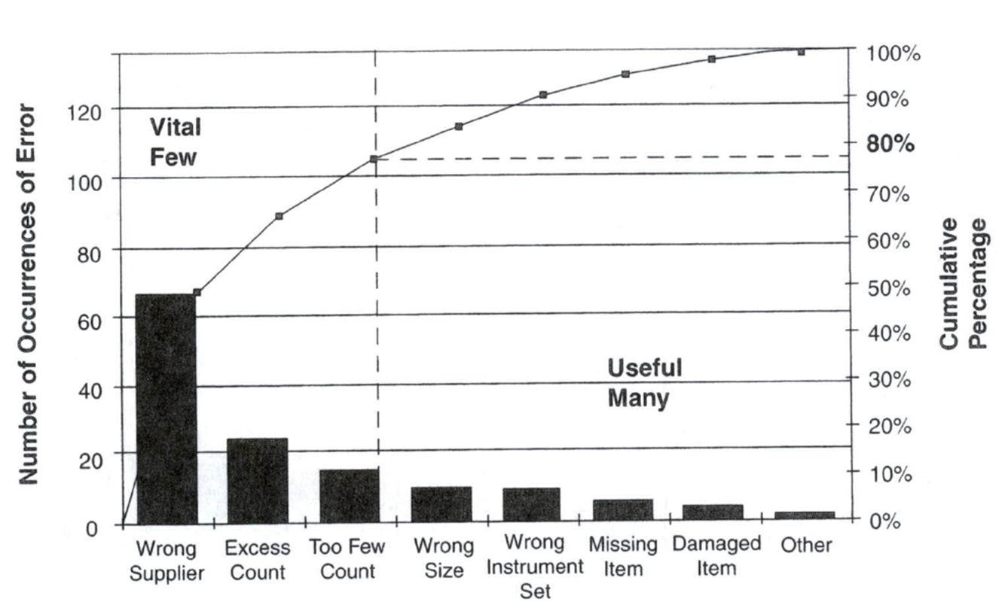
FOCUS ON THE “VITAL FEW”
Wisdom: Can’t boil the ocean… If everything is a priority, nothing is a priority
Varkey, P. Medical Quality Management: Theory and Practice. American College of Medical Quality. Jones and Bartlett Publishers: Sudbury, MA 2010. p. 62

Slide 42

FROM DATA TO DECISIONS
Optimizing Clinical and Financial Performance

Slide 43
HEALTHCARE/ACADEMIC MEDICINE POLICY POST CONCUSSION SYNDROME
COGNITIVE SYMPTOMS:
  Concentration Problems: Trouble focusing on tasks or following conversations.
  Mental Fog: A feeling of confusion or lack of clarity in thinking.
EMOTIONAL AND BEHAVIORAL SYMPTOMS:
  Irritability: Increased frustration or mood swings.
  Anxiety and Depression: Feelings of sadness, worry, or hopelessness.
  Sleep Disturbances: Insomnia or excessive sleeping.
….. When can you safely return to the game?

Slide 44

CURRENT ACTIVITIES/SUCCESSES/INITIATIVES
Improve what we can influence
Spotlights
Clinical FTE
Faculty Profile
Compensation Model
APC Profiles
Enhance Research
Support

Slide 45
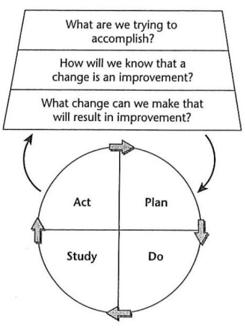
DATA IS A CORNERSTONE OF Quality Improvement
Data is used to describe how systems are working
Using data:
  Separates what is thought to be happening from what is really happening
  Establishes a baseline
  Indicates whether changes lead to improvements
  Allows comparisons of performance across sites
https://www.hrsa.gov/sites/default/files/quality/toolbox/508pdfs/qualityimprovement.pdf

Slide 46
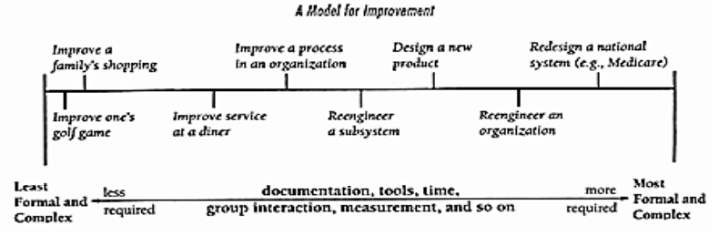
SCALE OF FORMALITY OF APPROACH FOR IMPROVEMENT EFFORTS
In QI, “directionally correct”→
…Data should always be accurate, but the precision can vary.
Langley, G. J., Nolan, K. M., Nolan, T. W., Norman, C. L., & Provost, L. P. (1996). The improvement guide: A practical approach to enhancing organizational performance. San Francisco, CA: Jossey-Bass. p.11.

Slide 47

ACTIONS/TOOLS FOR FINANCIAL SUCCESS
Define Clinical Expectations – cFTE Definition
Set Clear Overall Expectations – Faculty Profile
Utilize QGenda to Track Output – cFTE Reconciliation
Compare wRVUs to National Benchmarks – Clinical Productivity
Ensure Clinical Optimization – Template/Scheduling Review
Effective Billing & Coding – UMB Reviews
Track Finances – Variance Reports
Workforce Planning – HR Summaries

Slide 48
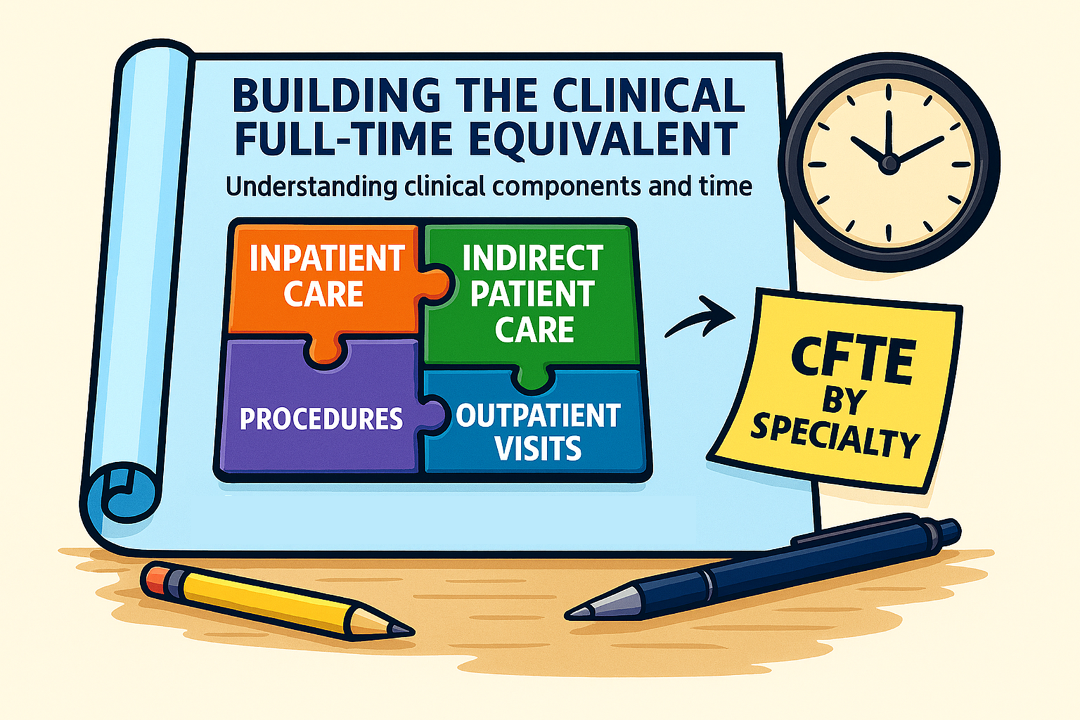
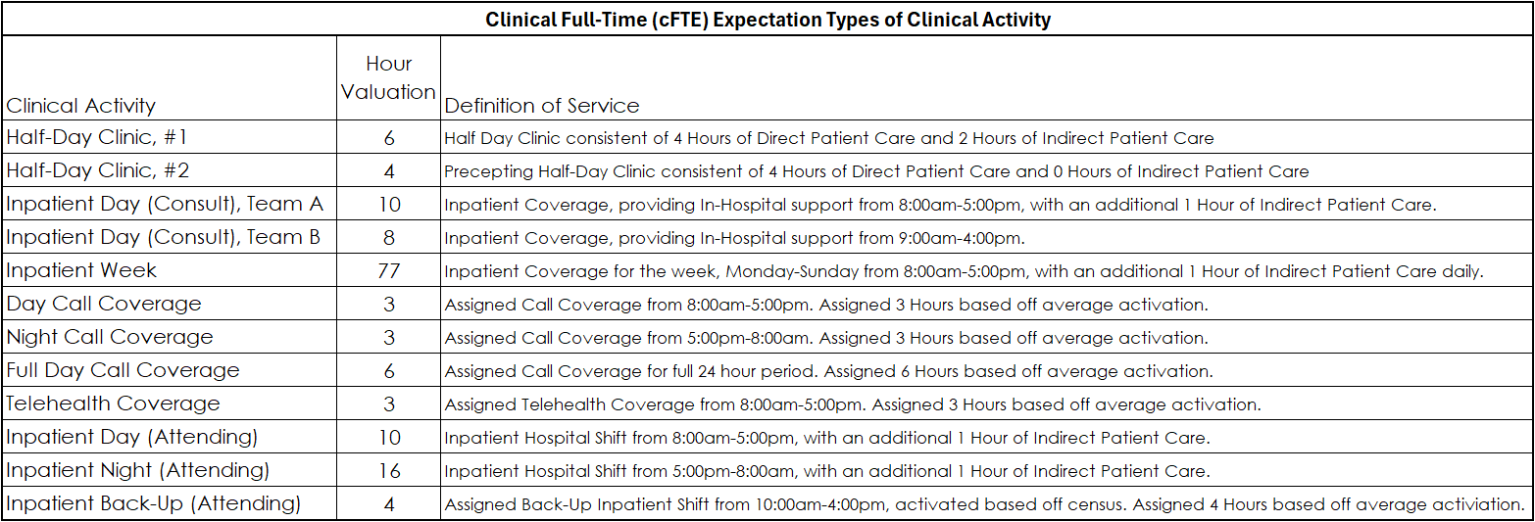
cFTE EXPECTATIONS
Defined by Specialty
Value:
  Communication with Faculty
  National Benchmarking
  Evaluation of Workload
Question Answered: What does a clinical workload look like for each specialty, in aggregate and by component of clinical work?

Slide 49
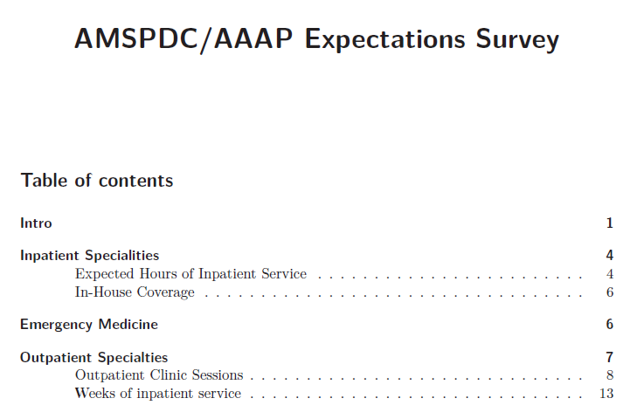




VARIOUS BENCHMARKS
May 2026
Various Benchmarks Available:
  Association of American Medical Colleges (AAMC)
  Association for Administrators in Academic Pediatrics (AAAP)
  American Medical Group Association (AMGA)
  Sullivan Cotter (SVC)
Why AAAP and AAMC?
  Benchmarks by Academic Rank
  Type of Organizations Included (Medical Centers, Teaching Institutions, Academic Affiliations)
  Number of Institutions and Responses

Slide 50

FACULTY & APC PROFILES
FTE by Mission & Funding
Value:
  Communication with Faculty
  Determining cFTExpectation
  Aligning Faculty Efforts with Funding
  Provider Planning and Needs
Question Answered: What each faculty member’s allocation of effort and resulting clinical expectation?

Slide 51
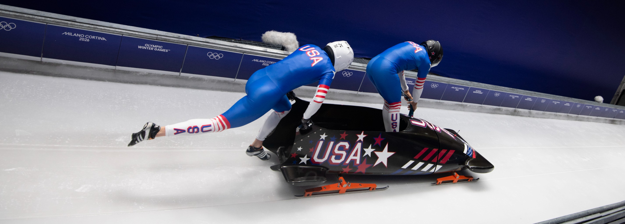
CLOCKBUILDING AS DYAD PARTNERS

Slide 53
OBJECTIVES
Explore
  Leadership principles that everyone involved in the care of children can use to promote excellence in pediatric care and children’s health
Consider
  How to model a questioning culture, an empowering spirit and a learning orientation on one’s teams, whether a designated leader or a member
Recognize
  The value of producing clock-builders rather than time-tellers in one’s leadership agenda

Slide 55
Peanuts Cartoon Adults Talking - Search Images

Slide 56
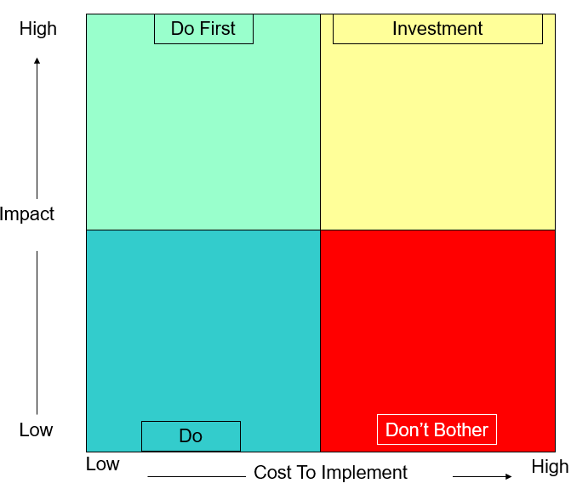

Prioritization
Wisdom:
Can’t boil the ocean…
If everything is a priority nothing is a priority

Slide 57

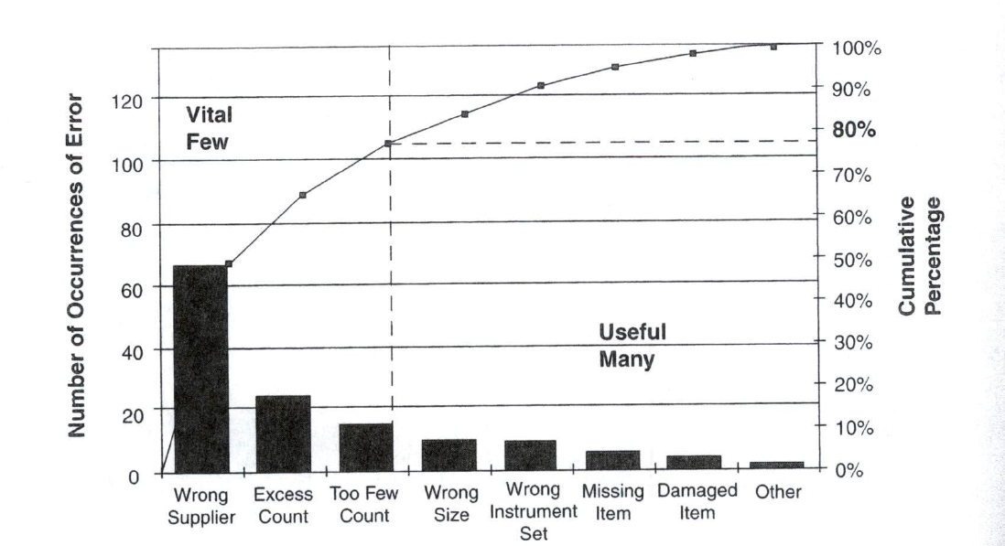
The “Vital Few” vs. the “Useful Many”
Varkey, P. Medical Quality Management: Theory and Practice. American College of Medical Quality. Jones and Bartlett Publishers: Sudbury, MA 2010. p. 62

Slide 58
IMAGE RESOURCES
National Aeronautics and Space Administration (NASA). (n.d.). Virtual skies: Aeronautics tutorial. Retrieved June 24, 2009, from http://virtualskies.arc.nasa.gov/main/maeronautics.html

Slide 59
ELEMENTS OF COMPENSATION PLANS
Align to Specialty Specific Benchmarks
Annual Salary Based off Rank, Experience and Benchmarks/Percentile
Total Compensation emphasized and used when comparing externally
Provide a general example of faculty compensation over a career

