Slide 1

Leadership Resilience
Rachel Tkaczyk, MSN, MBA, CRNP
Children’s Hospital of Philadelphia

Slide 2


Slide 3


Slide 4
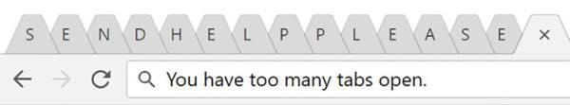

Slide 5
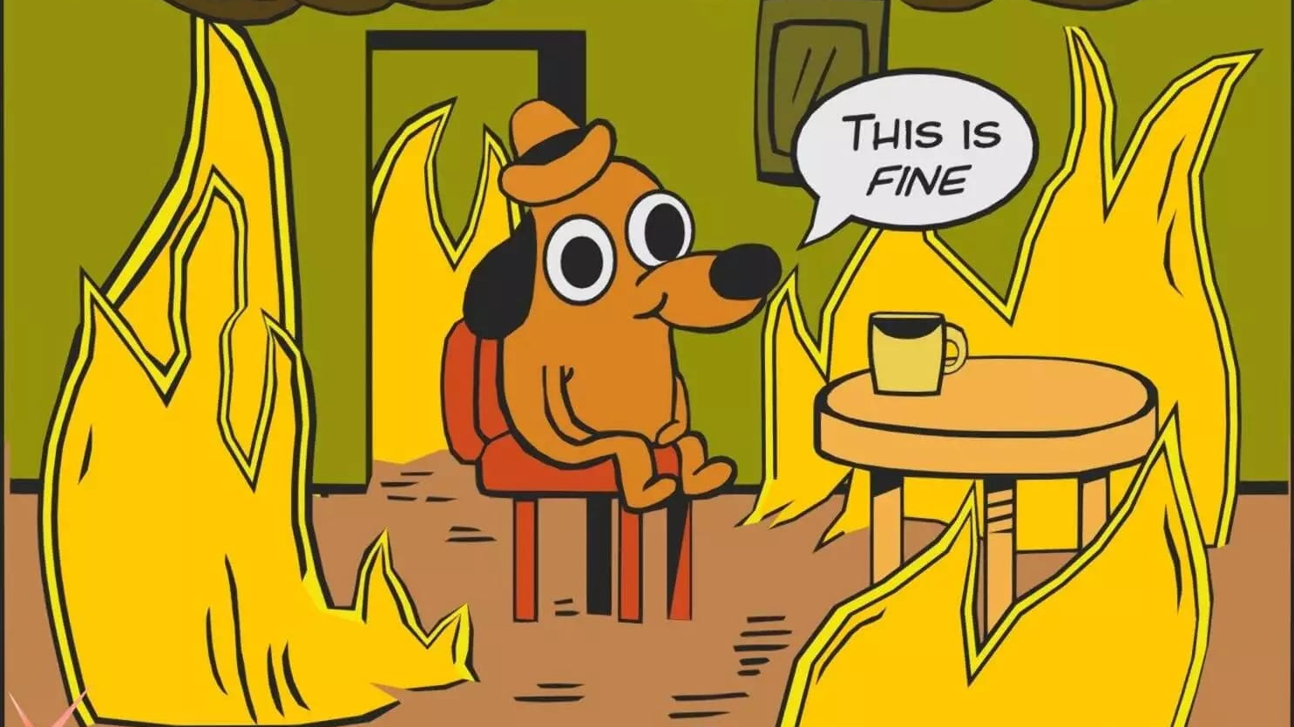

Slide 6


Slide 7
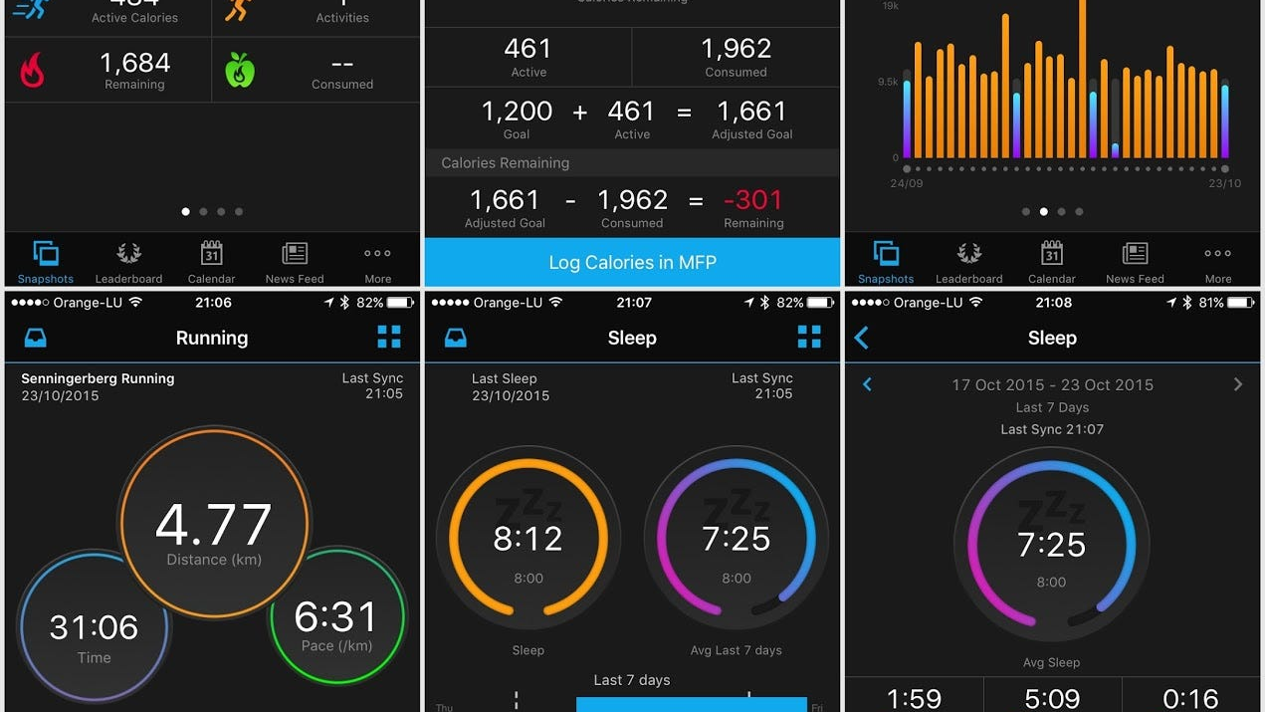

Slide 8


Slide 9



Slide 10

Notes:
https://www.youtube.com/watch?v=sKsb0kHw8u8&list=RDsKsb0kHw8u8&start_radio=1

Slide 11


Slide 12


Slide 13


Slide 14


Slide 15


Slide 16


Slide 17


Slide 18


Slide 19
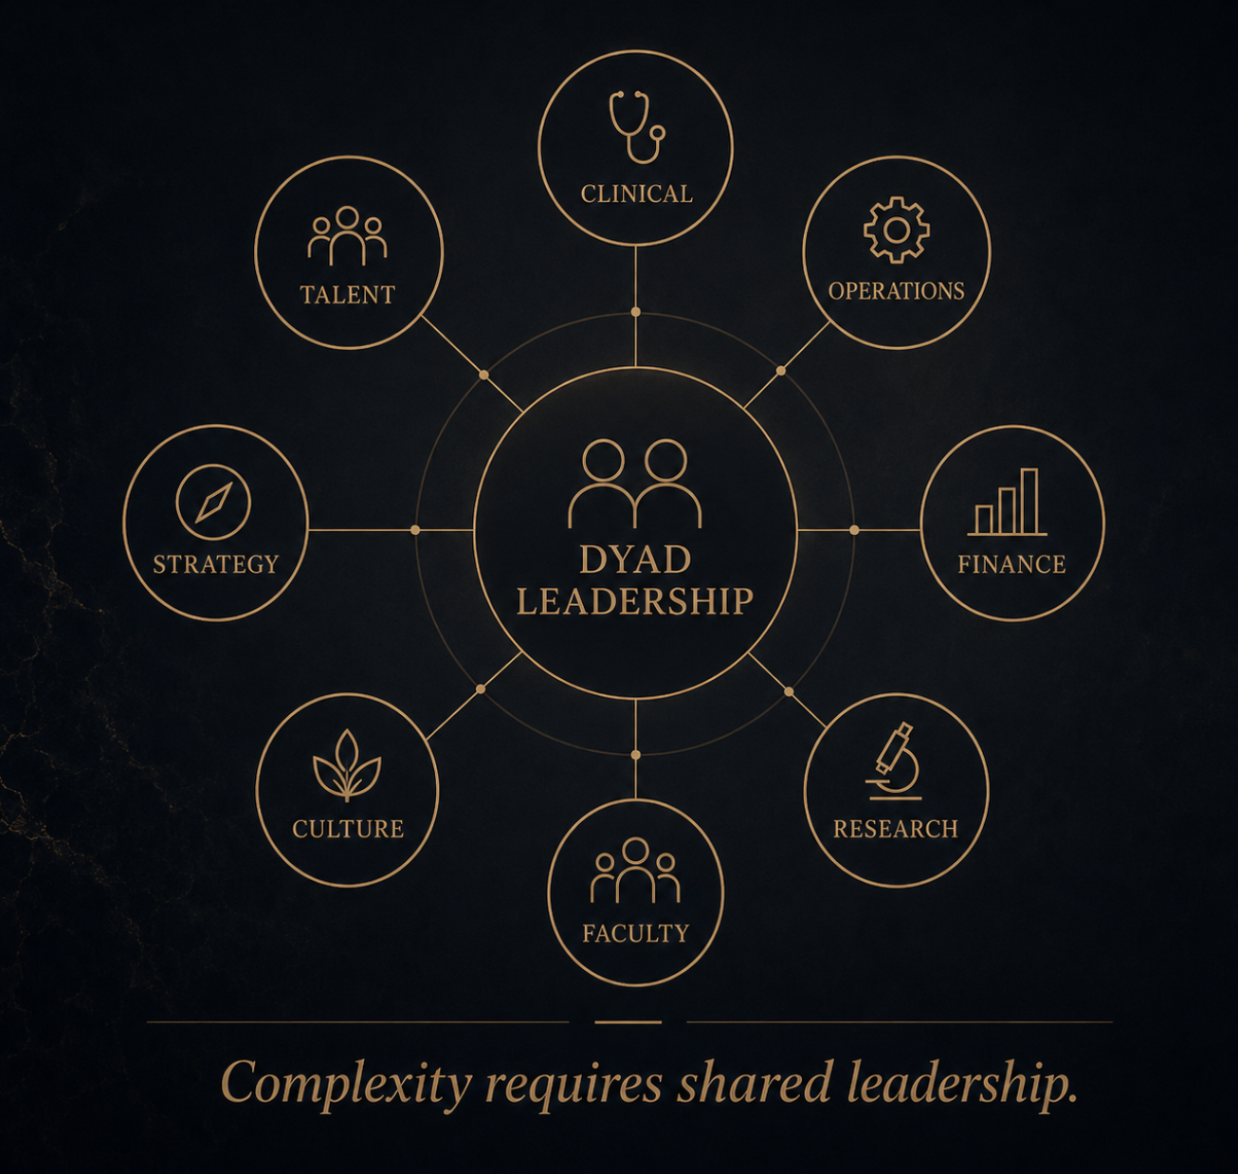

Slide 20
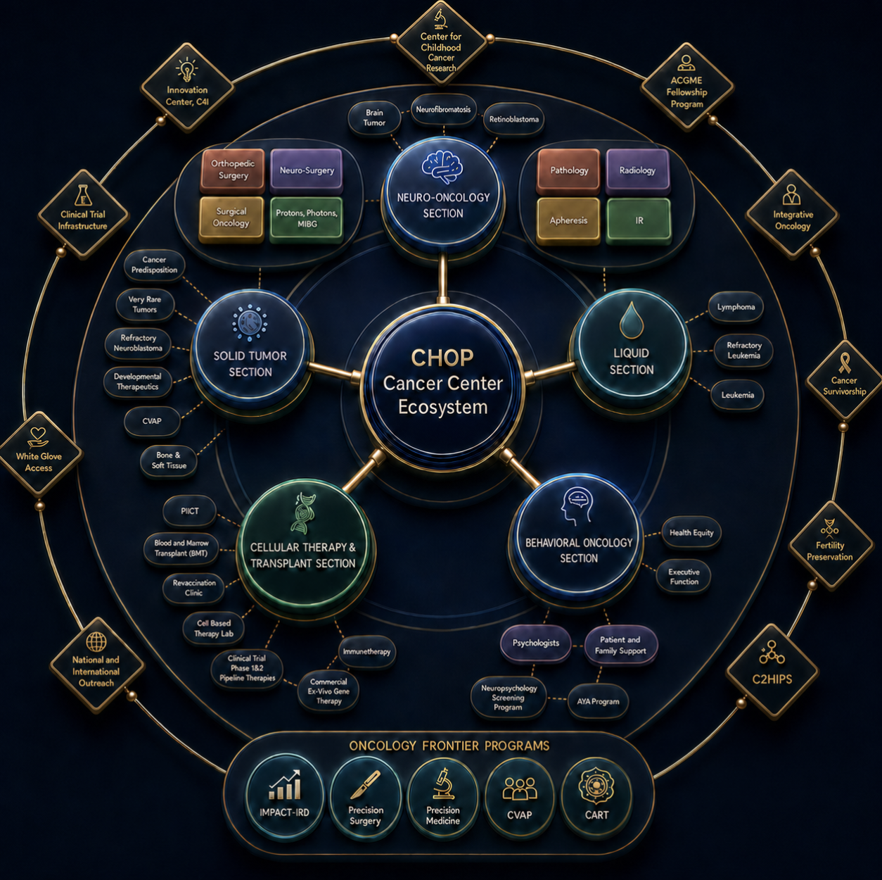
Notes:
CHOP Cancer Ecosystem- 5 Clinical Sections, 19 Clinical Programs, 2 IP locations, 3 Day hospitals, Proton, 100+ Pediatric Oncologists, 1200 employees, 500 clinical trials, UPENN v. CHOP

Slide 21
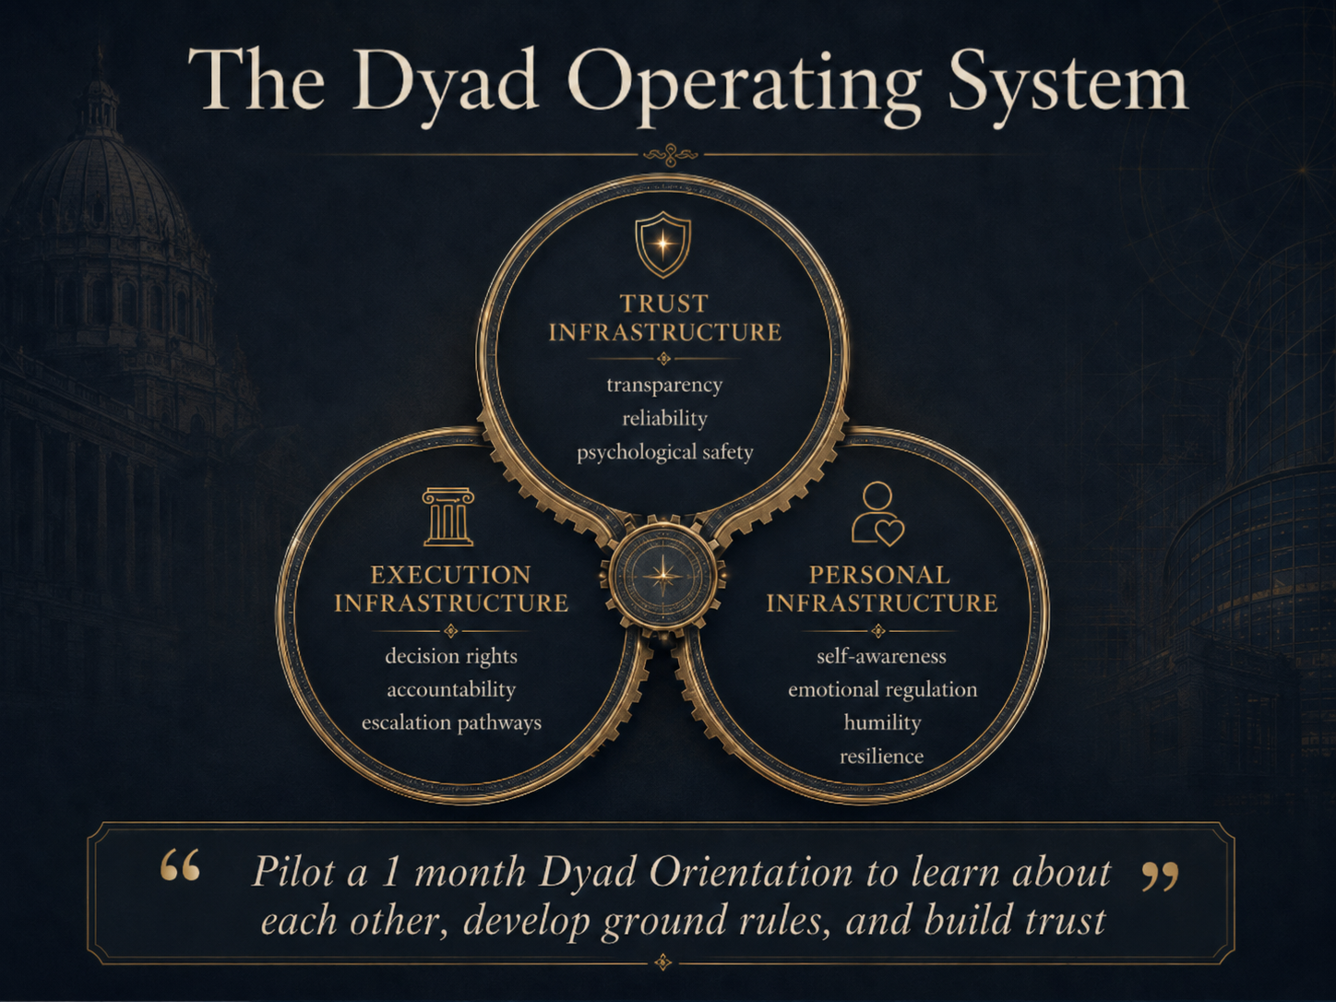

Slide 22
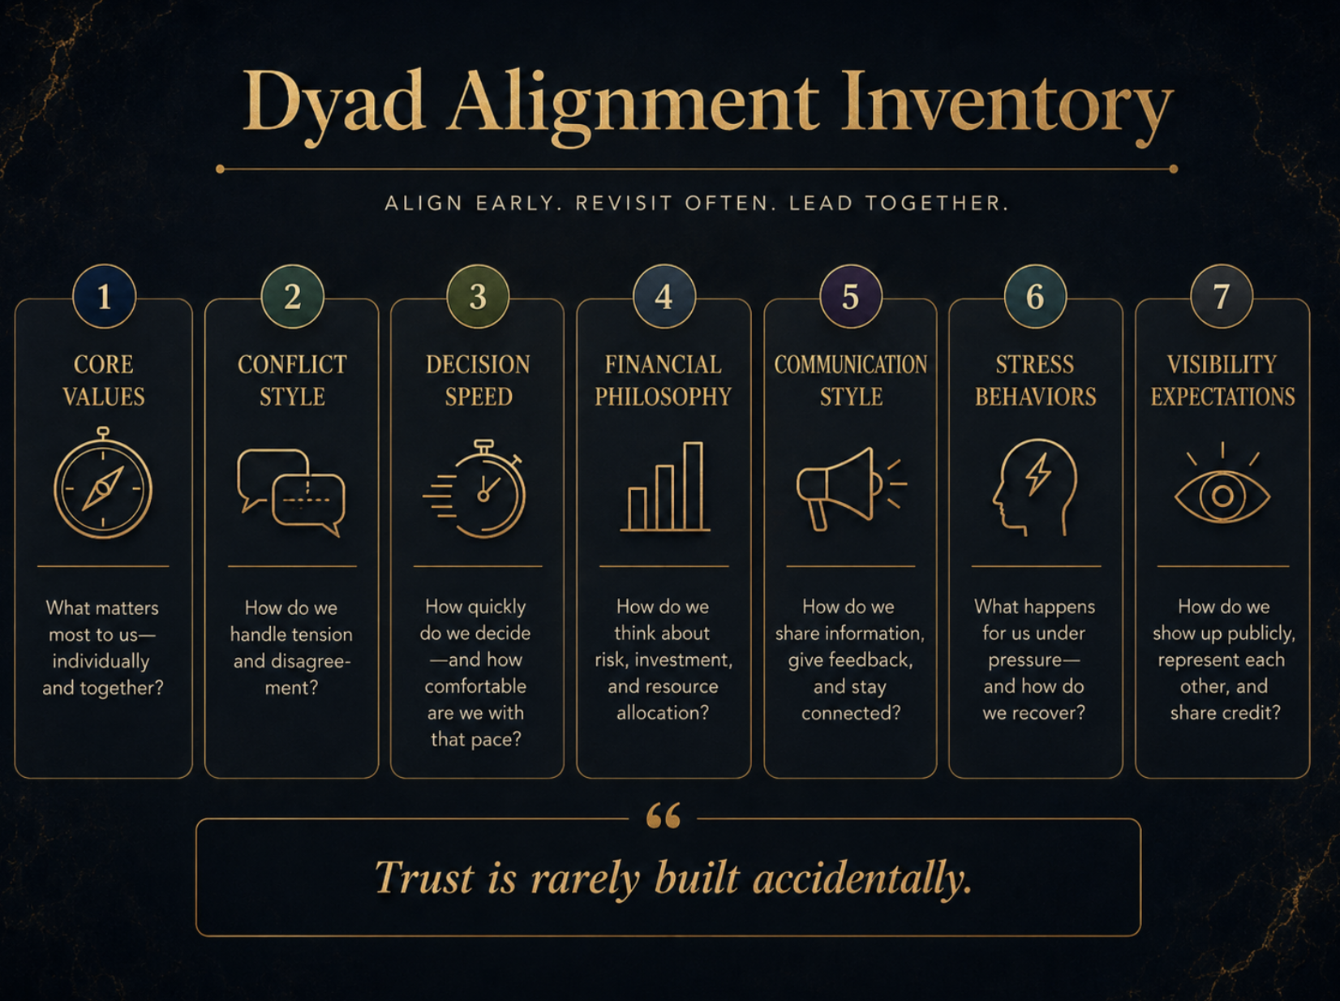

Slide 23
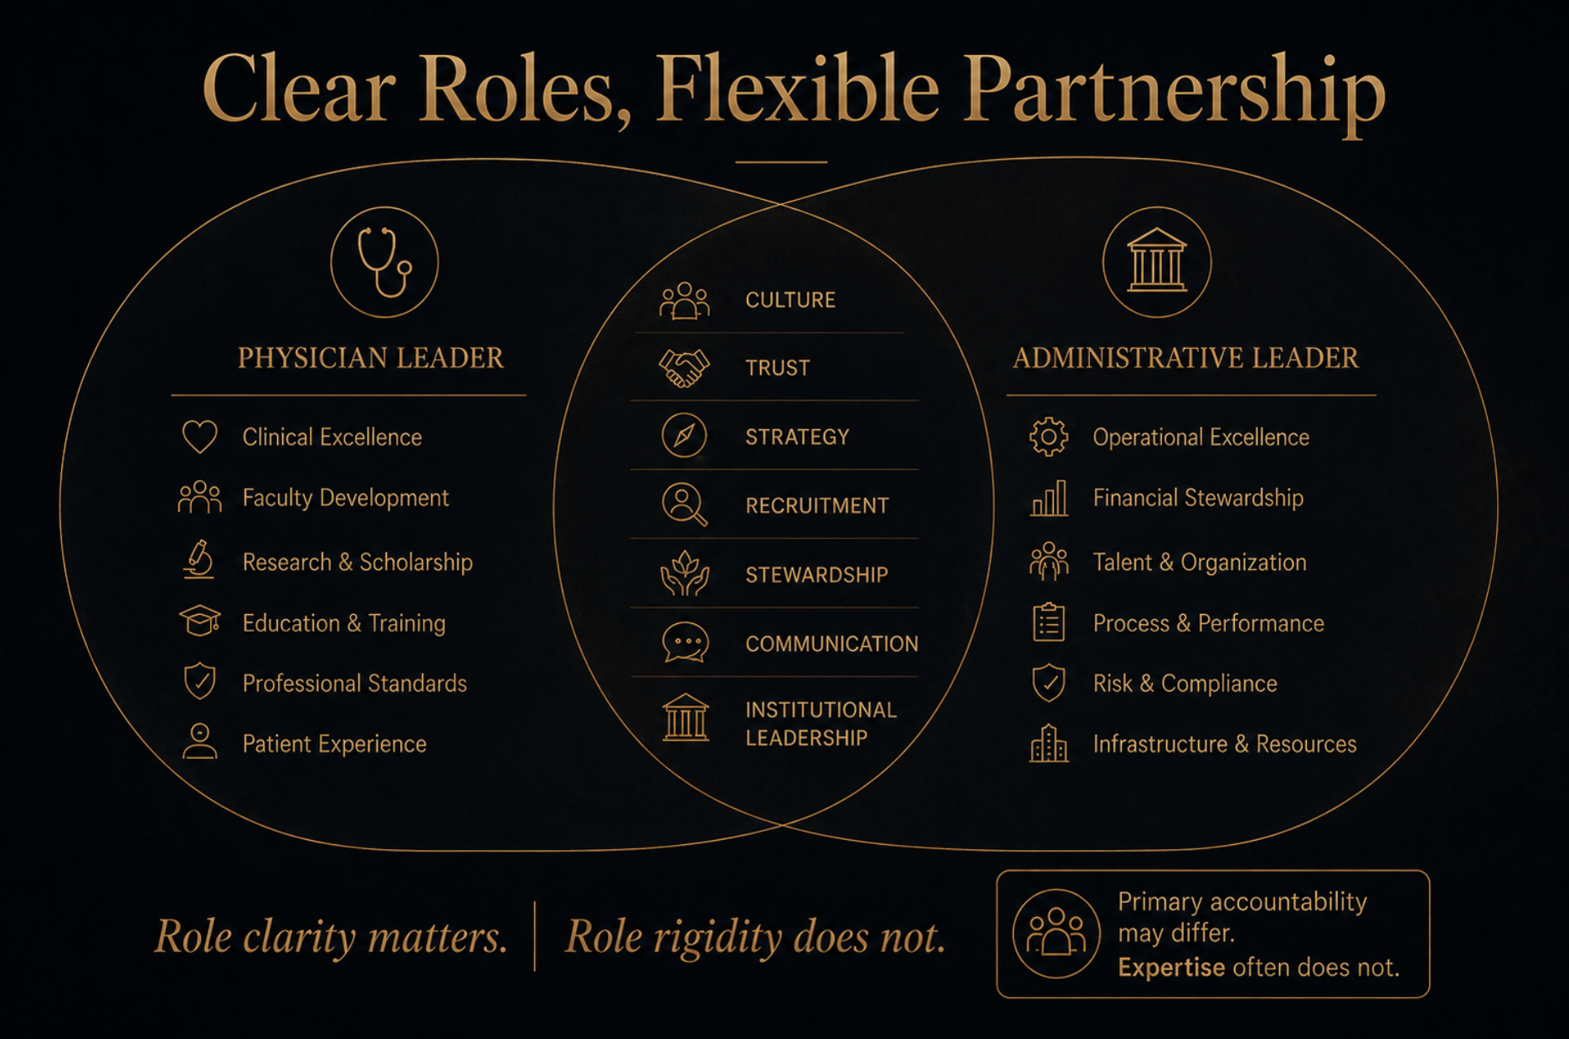
Notes:
Slide 11
Clear roles, flexible partnership
expected roles versus reality.
On paper, one could assume the physician leader is expected to own the academic and clinical mission, while the administrative leader is expected to own operations and finance. In reality, the strongest dyads are clear without being rigid. They know where primary accountability sits, but they do not assume that expertise follows their training or an org chart.
My current Chief happens to have tremendous financial acumen skills, he is one of the best (physician or non-physician) I have ever worked with.
Those skills coupled with his philosophy that philanthropy should not be hoarded for some undefined rainy day. It should be stewarded thoughtfully and put to work in service of mission now. This is not just a finance lesson. It is a resilience lesson
The best dyads are clear about accountability, but flexible about where expertise leads.

Slide 24


Slide 25
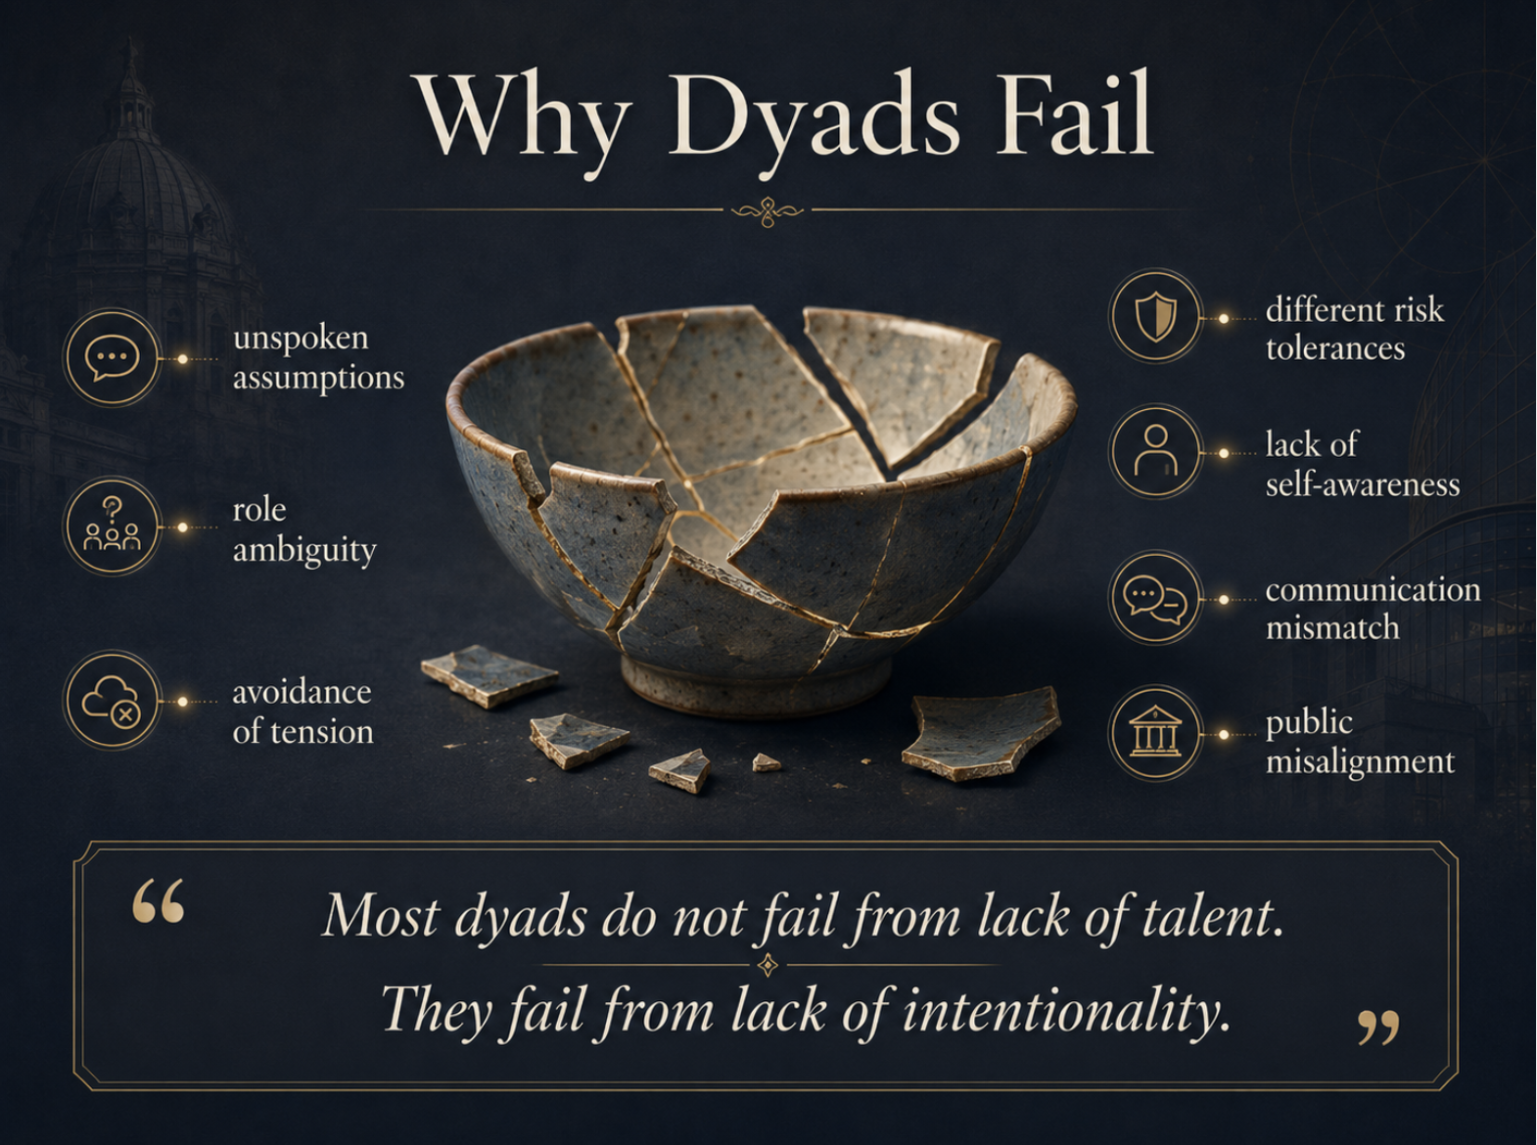

Slide 26


Slide 27
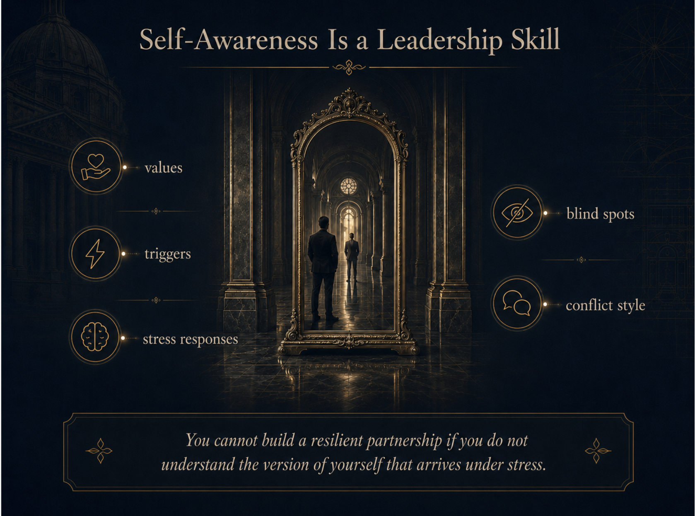

Slide 28
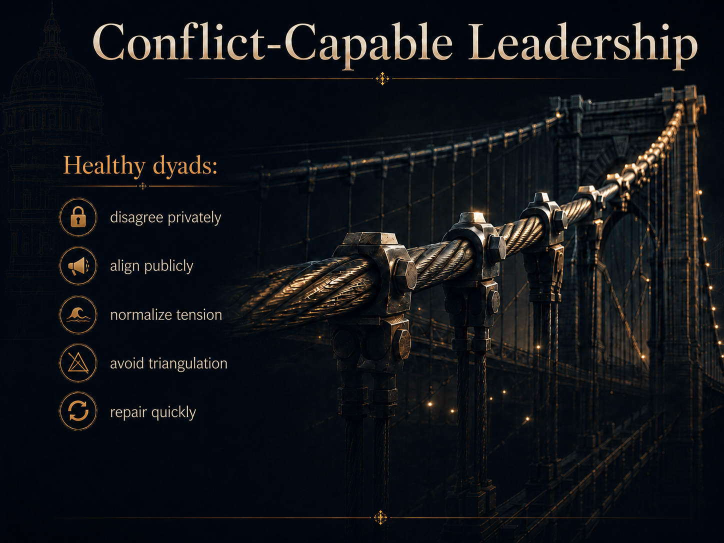

Slide 29
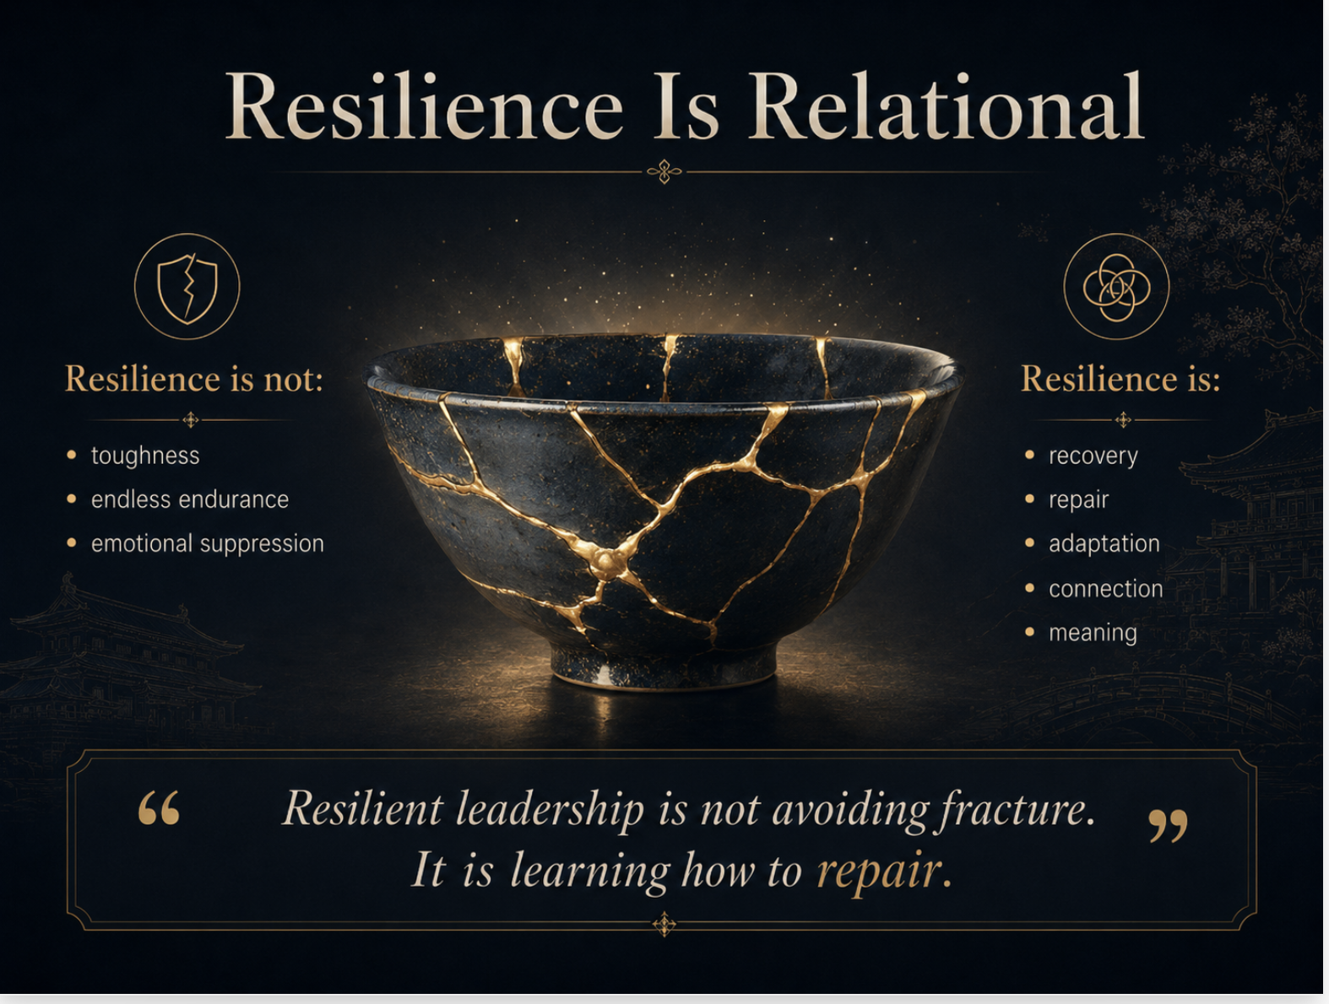

Slide 30
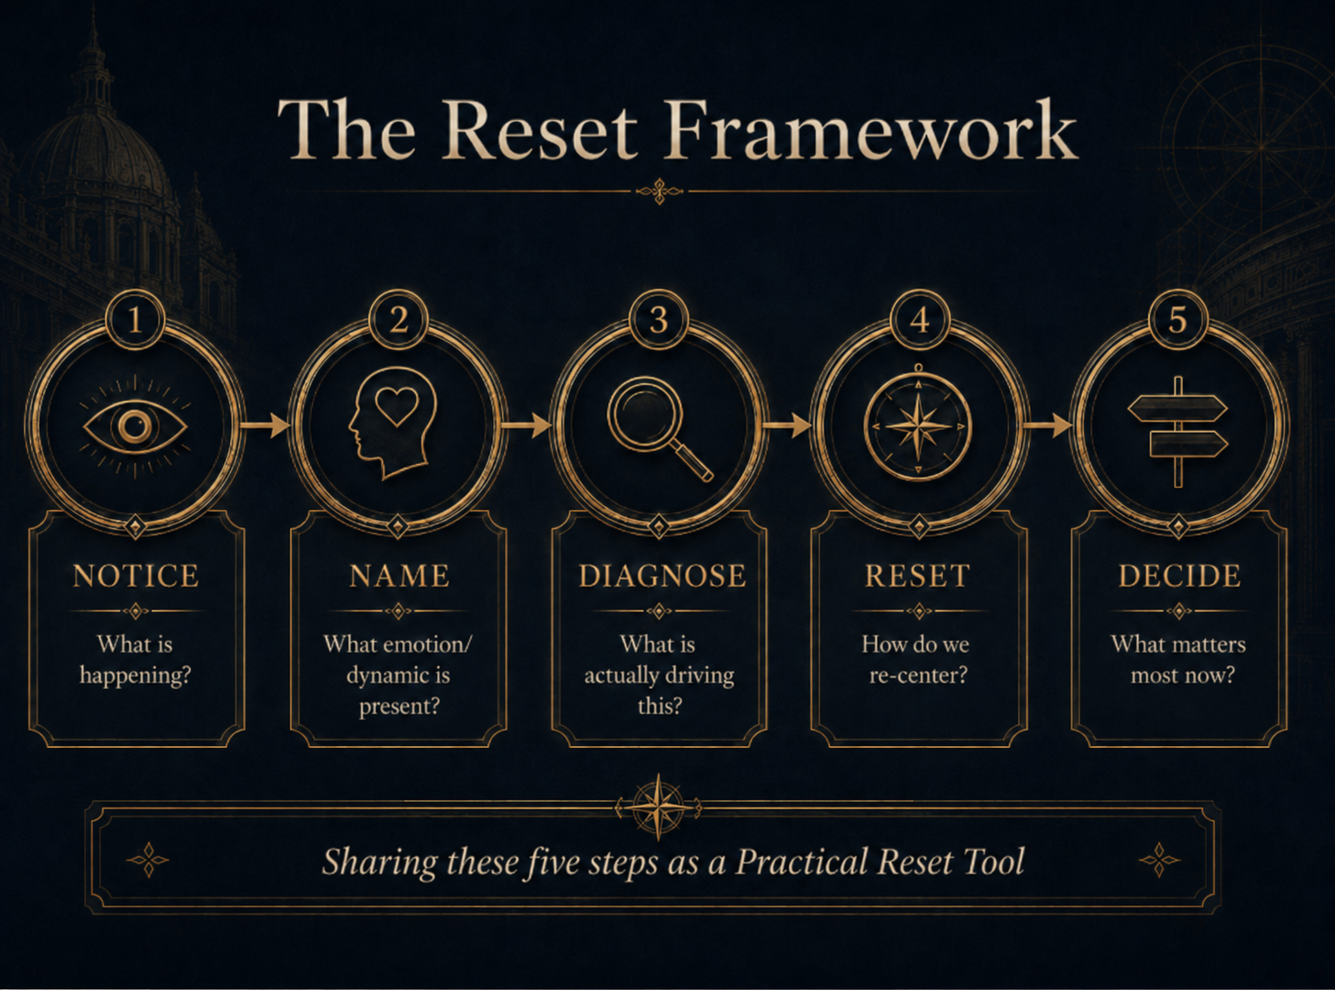

Slide 31
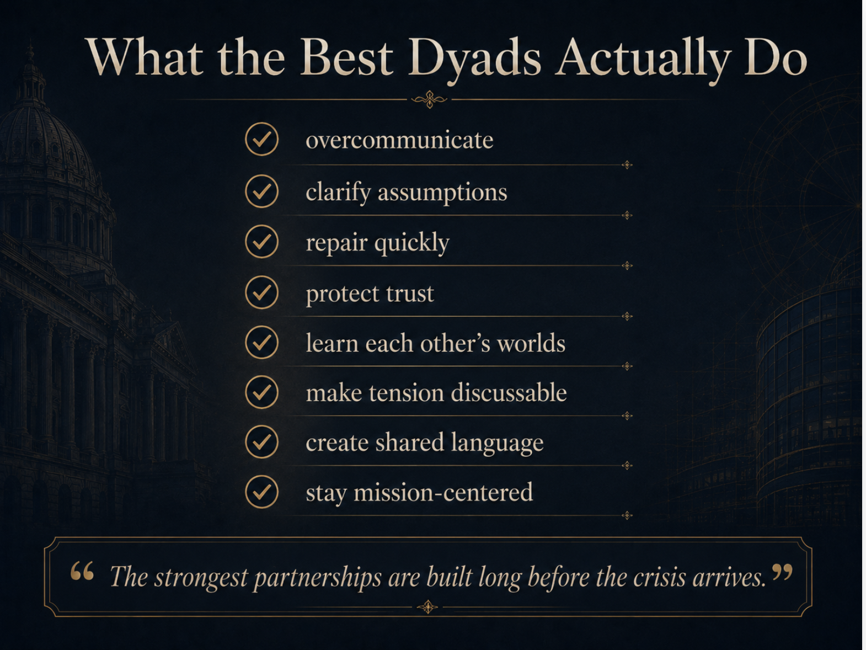

Slide 32


