Slide 1

Medicaid & 340B: What’s at Stake for Children’s Hospitals and How You Can Help
Hailey Ritchie, JD
Chief Health Policy Officer for University of Utah Health
Associate General Counsel
University of Utah

Slide 2
Disclaimer
This presentation is:
Intended only for educational purposes
Any views expressed are my own and not necessarily those of the University of Utah
Not comprehensive
Not legal advice

Slide 3




Medicaid

Slide 4
Quick Overview / Reminder
Federal-state partnership
Entitlement program
Federal government establishes minimum requirements
States allowed to do more

Slide 5
The Backbone of Pediatric Care
Medicaid covers a disproportionately large portion of kids (4 in 10 kids)
Many of these kids are:
  Living in poverty (8 in 10 kids)
  From historically marginalized groups and low-income communities
  Have special health care needs (4 in 10 kids)
    Only source of coverage for 1 in 3 kids with special health care needs
Require services that are resource-intensive, essential for community health, and often not financial sustainable without Medicaid support
Rudowitz, R., Tolbert, J., Burns, A., Hinton, E., Chidambaram, P., & Mudumala, A., Medicaid 101. In Altman, Drew (Editor), Health Policy 101 (KFF, Oct. 2025) https://www.kff.org/health-policy-101-Medicaid/ (May 6, 2026); Elizabeth Williams, 5 Key Facts About Children with Special Health Care Needs and Medicaid (KFF, Apr. 18, 2025) https://www.kff.org/medicaid/5-key-facts-about-children-with-special-health-care-needs-and-medicaid/ (May 6, 2026).

Slide 6
Dominant Payer . . .
In 2022:
  Medicaid and CHIP covered nearly half of all pediatric hospitalizations—48.3% of all discharges, including 44.2% of newborns and 54.9% of non-newborns
    Just 10% of urban hospitals handled more than half of all Medicaid pediatric discharges
    Rural hospitals more reliant on Medicaid, even though they have far fewer pediatric patients
  Medicaid was the primary payer for most hospitalizations involving children with complex chronic conditions and those living in rural areas
  For some children’s hospitals, Medicaid covers close to 75% of patients
Children’s hospitals are structurally dependent on Medicaid in ways that many other hospitals are not
Rudowitz, R., Tolbert, J., Burns, A., Hinton, E., Chidambaram, P., & Mudumala, A., Medicaid 101. In Altman, Drew (Editor), Health Policy 101 (KFF, Oct. 2025) https://www.kff.org/health-policy-101-Medicaid/ (May 6, 2026); Berry JG, Williams DJ, Wright SM, et al. US Pediatric Hospitalizations Among Children Enrolled in Medicaid. JAMA Pediatr. 2026;180(1):101–103. doi:10.1001/jamapediatrics.2025.4537; Medicaid’s Role for Kids and Children’s Hospitals, Children’s Hosp. Ass’n. (June 12, 2023), https://www.childrenshospitals.org/content/public-policy/reference-material/medicaids-role-for-kids-and-childrens-hospitals.

Slide 7
. . . and Least Profitable Payer
Medicaid pays below the cost of care—well below Medicare and commercial rates
2023 Medicaid shortfall: $27.5B
Supplemental / directed Payments
Cross-subsidization
Financial Pressure
On average, Medicaid supplemental payments reimburse children’s hospitals only 79% of the cost of care provided
High Medicaid Volume
Fact Sheet: Medicaid, Am. Hosp. Ass’n. (Mar. 2026), https://www.aha.org/fact-sheets/2026-03-02-fact-sheet-Medicaid; Medicaid’s Role for Kids and Children’s Hospitals, Children’s Hosp. Ass’n. (April 2023), https://nann.org/wp-content/uploads/2025/04/2023_cha_medicaid-payment-8d2.pdf#:~:text=Medicaid%2C%20on%20average%2C%20provides%20health%20insurance%20coverage,some%20children's%20hospitals%20patient%20mix%2C%20closer%20to.

Slide 8
Medicaid policy changes have outsized system-wide effects for children’s hospitals
Children lose coverage or experience churn
Financial pressure leads to cuts in programs and services, threatening access
Lower revenue and increased uncompensated care
Policy Change
Operational strain: staffing, capacity, bed availability
Increased ED visits, delayed care, & worsening outcomes

Slide 9

One Big Beautiful Bill Act (AKA H.R.1 or Working Families Tax Cuts Act)
“Strengthening Medicaid by eliminating waste, fraud, and abuse . . . .”
- White House Press Release on what H.R.1 means for everyday Americans
Immigrant eligibility
Eligibility redeterminations
Retroactive eligibility
Cost-sharing
Restrictions on provider taxes & SDPs
Work & community engagement
Of the 21 Medicaid provisions, 4 address waste, fraud, and abuse. CBO estimates these 4 provisions will reduce federal payments to states by $25B over the next decade, which amounts to about 2.5% of the $990B in total Medicaid cuts in H.R. 1
The work reporting & redetermination requirements on expansion states = ~40% of total cuts
Andy Schneider, Fraud and Abuse Against Medicaid: The Truth About the Budget Reconciliation Law, Georgetown Univ. McCourt Sch. Of Public Policy Ctr. for Children & Families (July 25, 2025), https://ccf.georgetown.edu/2025/07/25/fraud-and-abuse-against-medicaid-the-truth-about-the-budget-reconciliation-law/.

Slide 10
Medicaid Provision | Before H.R. 1 | After H.R. 1 | Impact
Immigrant Eligibility | Individuals who are lawfully present | Effective 10/1/2026, legal permanent residents, certain Cuban and Haitian immigrants, and Compact of Free Association migrants | Individuals with temporary protected status, refugees, & asylees lose coverage
Eligibility Redeterminations | Redeterminations at least every 12 months | Effective 12/31/2026, adults in expansion population = every 6 months | Loss of coverage
Emergency Medicaid | Emergency Medicaid reimburses hospitals for cost of emergency care provided to individuals who would qualify for Medicaid but for their immigration status (EMTALA) 90% federal match for expansion adults | Effective 10/1/2026, federal match = regular match rate | Increased costs for states
New Mexico: state budget included $40M in state funds for coverage for lawfully present immigrant Medicaid enrollees
April 2023: unwinding of continuous eligibility
May 2024: disenrollment of 5.22M kids in Medicaid
Indiana: SB 1 requires biannual redeterminations for most non-elderly, non-disabled adults, not just the expansion adults.
West Virginia: SB 729 requires biannual redeterminations to the entire Medicaid population
Virginia: workgroup focused on mitigating disenrollment of kids
Mark L. Hudak, James M. Perrin, Jennifer D. Kusma, Jean L. Raphael, Committee on Child Health Financing; Medicaid and the Children’s Health Insurance Program: Technical Report. Pediatrics March 2026; 157 (3): e2025075749. 10.1542/peds.2025-075749; Jade Little, How are H.R. 1 Cuts and Changes to Medicaid and SNAP Playing out in 2026 State Legislative Sessions So Far? Georgetown Univ. McCourt Sch. Of Public Policy Ctr. for Children & Families (Mar. 16, 2026), https://ccf.georgetown.edu/2026/03/16/how-are-h-r-1-cuts-and-changes-to-medicaid-and-snap-playing-out-in-2026-state-legislative-sessions-so-far/.

Slide 11
Medicaid Provision | Before H.R. 1 | After H.R. 1 | Impact
Verifying Enrollee Information | No verification requirement | Requires states to use USPS databases or MCO to verify address No multistate enrollment Must review Master Death File quarterly | Loss of coverage
Retroactive Coverage | States must cover qualified medical expenses incurred up to 90 days prior to application | For expansion population, retroactive coverage limited to services provided 1 mo. prior to application For all other enrollees, retroactive coverage limited to services provided 2 mo. prior to application | State savings Provider losses
Cost Sharing | States may charge premiums and cost-sharing for Medicaid enrollees within limits (certain populations & services exempt) | Effective 10/1/2028: Requires states to impose cost sharing up to $35/service on expansion adults (maintains exemptions) Permits states to allow providers to deny services for failure to pay cost sharing | Limited state savings Reduced coverage Decreased access and use of care Increased financial burden on families
Jade Little, How are H.R. 1 Cuts and Changes to Medicaid and SNAP Playing out in 2026 State Legislative Sessions So Far? Georgetown Univ. McCourt Sch. Of Public Policy Ctr. for Children & Families (Mar. 16, 2026), https://ccf.georgetown.edu/2026/03/16/how-are-h-r-1-cuts-and-changes-to-medicaid-and-snap-playing-out-in-2026-state-legislative-sessions-so-far/; Madeline Guth, Meghana Ammulua, and Elizabeth Hinton, Understanding the Impact of Medicaid Premiums & Cost-Sharing: Updated Evidence from the Literature and Section 1115 Waivers (KFF, Sep. 9, 2021) https://www.kff.org/medicaid/understanding-the-impact-of-medicaid-premiums-cost-sharing-updated-evidence-from-the-literature-and-section-1115-waivers/ (May 6, 2026).

Slide 12
Work/Community Engagement
Before H.R. 1 | After H.R. 1 (effective 1/1/2027) | Impact
States cannot* condition eligibility on meeting work requirement | Before becoming eligible for Medicaid, able-bodied adults age 19-64 must complete at least 80 hrs/mo of work, education, or community service (1-3 mos) Excludes: pregnant individuals, foster youth, youth under age 26, American Indians/Alaskan Natives, individuals who are medically frail or have special needs, individuals already complying with TANF or SNAP work requirements, veterans, parents/caregivers of a dependent child age 13 or younger or an individual with a disability, and individuals who are incarcerated or recently released States may grant short-term hardship waivers for certain medical treatments, natural disasters, and counties with high unemployment | Depends on state response: Option 1: Minimize burden 1 mo lookback Adopt all optional exemptions Accept participants’ statements about compliance and exemptions Maximize data to automatically verify compliance and exemptions Deploy user-friendly pathways to report compliance and exemptions Option 2: Add requirements Regardless on option pursued: A group of folks will be unable to meet the requirements A much larger group will remain eligible but lose coverage because they cannot navigate the requirements
Indiana and Idaho: 3-mo lookback
Missouri: seeking constitutional amendment to bar state from offering optional exemptions
Jennifer Wagner et. al, A Guide to Reducing Coverage Losses Through Effective Implementation of Medicaid’s New Work Requirement, Ctr. On Budget & Policy Priorities (Nov. 3, 2025), https://www.cbpp.org/research/health/a-guide-to-reducing-coverage-losses-through-effective-implementation-of-medicaids; Samantha Liss, New Federal Medicaid Rules Require One Month of Work. Some States Demand More (KFF, April 16, 2026) https://kffhealthnews.org/insurance/federal-medicaid-work-rules-one-three-months-indiana-missouri/ (May 6, 2026).
Notes:
https://kffhealthnews.org/insurance/federal-medicaid-work-rules-one-three-months-indiana-missouri/

Slide 13
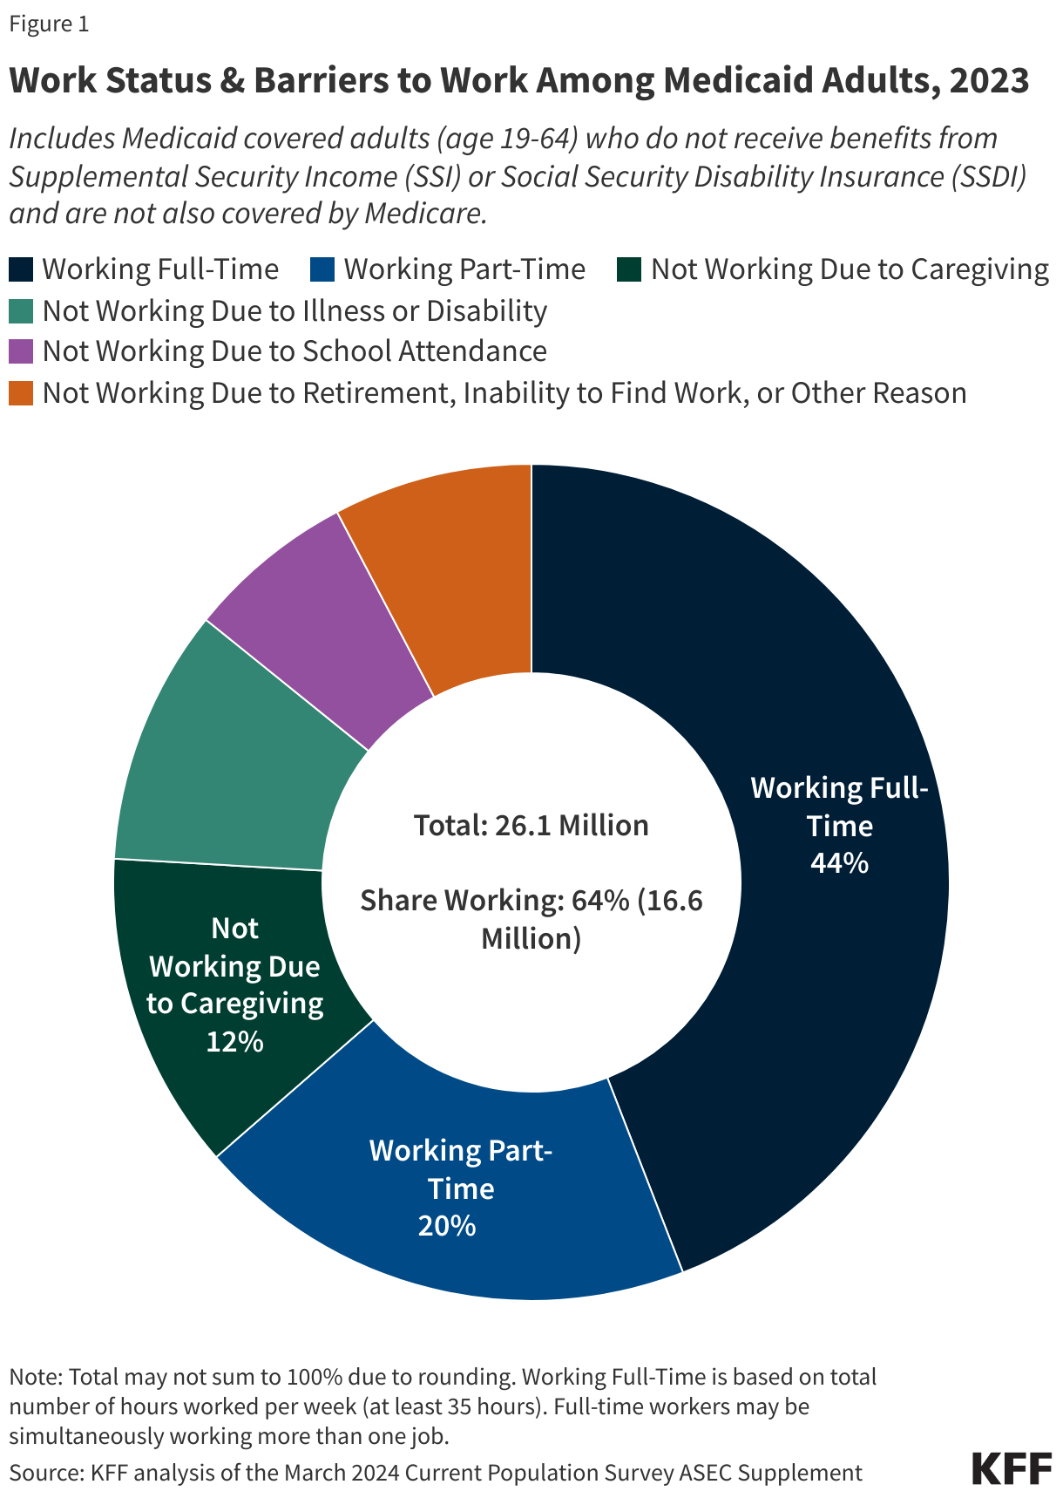
Most Medicaid adults under age 65 are working already without a “work requirement.”
CBO estimates of national work requirements show lower federal spending and an increase in the number of uninsured, but no increase in employment.
In Arkansas, implementing Medicaid work requirements resulted in more than 18,000 people losing coverage.
Evidence shows Medicaid work and reporting requirements are confusing to enrollees and complex and costly for states to implement.
Research shows access to affordable health insurance and care promotes individuals’ ability to obtain and maintain employment.
Elizabeth Hinton and Robin Rudowitz, 5 Key Facts About Medicaid Work Requirements (KFF, Feb. 18, 2025) https://www.kff.org/medicaid/5-key-facts-about-medicaid-work-requirements/ (April 3, 2026).

Slide 14
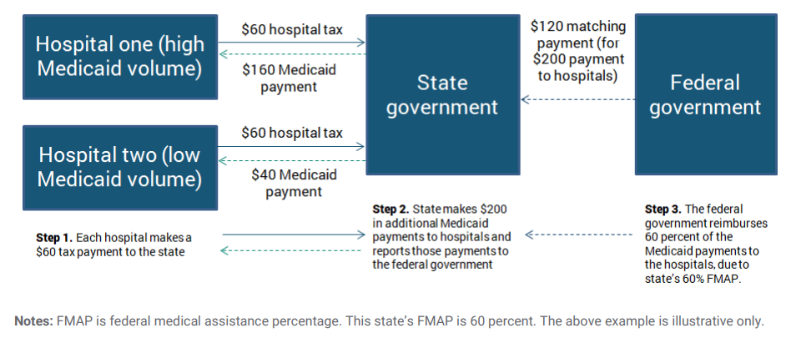
Medicaid Provision | Before H.R. 1 | After H.R. 1 | Impact
Provider Taxes | “Tax” on providers to finance state share Taxes must be broad-based (i.e., states can’t limit taxes to Medicaid providers only) Taxes must be uniform (i.e., tax can’t be higher on Medicaid revenue than non-Medicaid revenue) States may not hold providers “harmless” (i.e., guarantee they receive their money back) Safe harbor/hold harmless threshold: tax revenues comprise 6% or less of net patient revenue | Provider taxes frozen at current rates Reduces the safe harbor limit for expansion states by 0.5% annually starting in fiscal year 2028, until the safe harbor limit reaches 3.5% in FY 2032 For expansion states, taxes in effect on 10/1/2026, that apply to nursing facility services and intermediate care facility services are exempt from this cap ramp down | Increased pressure on states’ budgets, especially expansion states Increased financial pressure on providers
$1000
$800
$1000
$200
Medicaid and CHIP Payment and Access Commission, Health Care-Related Taxes in Medicaid (May 2021), available at https://www.macpac.gov/wp-content/uploads/2020/01/Health-Care-Related-Taxes-in-Medicaid.pdf.

Slide 15
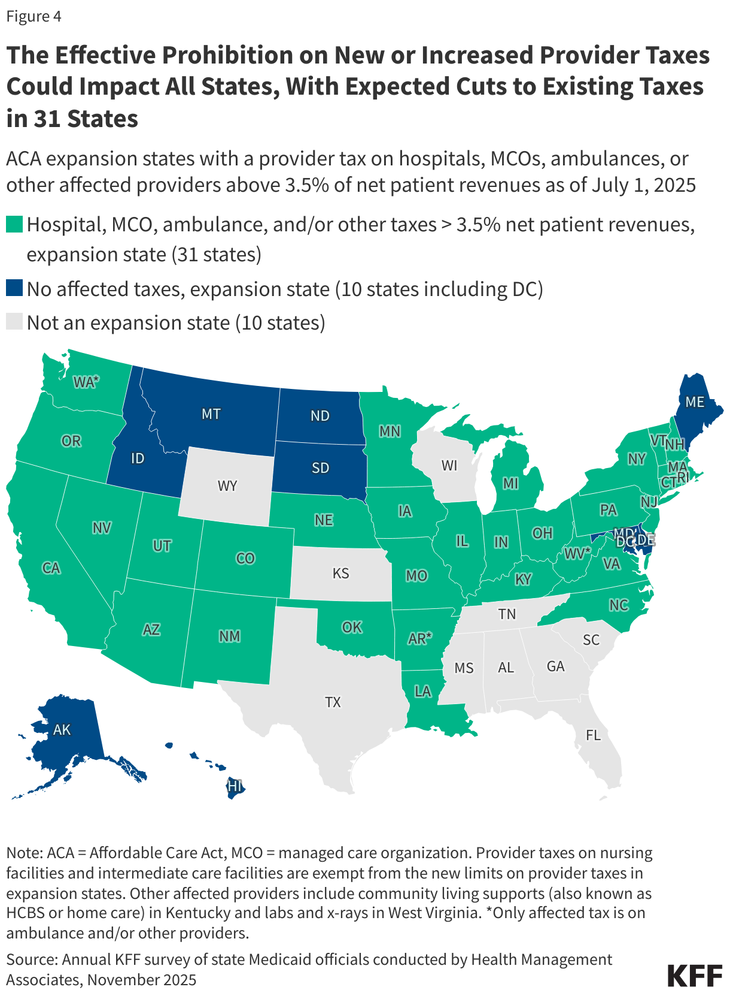
Alice Burns, Elizabeth Williams, Anna Mudumala, Elizabeth Hinton, and Robin Rudowitz, 5 Key Facts About Medicaid and Provider Taxes (KFF, Dec. 1, 2025) https://www.kff.org/medicaid/5-key-facts-about-medicaid-and-provider-taxes/ (May 6, 2026).

Slide 16
Medicaid Provision | Before H.R. 1 | After H.R. 1 | Impact
State-Directed Payments | In general, states can’t tell MCOs how to pay their providers Subject to CMS approval, states may use SDPs to require MCOs to pay providers certain rates, make uniform rate increases (that are like FFS supplemental payments), or use certain payment methods The upper limit for SDPs is the average commercial rate | Prospectively caps SDPs at 100% of Medicare rates for expansion states and 110% of Medicare rates for non-expansion states (as opposed to the average commercial rate) Temporarily grandfathers existing SDPs Starting 1/1/2028, grandfathered SDPs are phased down by 10 percentage points each year until they comply with the new SDP limits | Increased pressure on states’ budgets, especially expansion states Increased financial stress on providers
SDPs account for 39% of pediatric hospitals’ Medicaid funding and 15% of overall operating resources
3 Ways H.R. 1 Puts Kids’ Health Care at Risk, Children’s Hosp. Ass’n. (June 5, 2025), https://www.childrenshospitals.org/news/cha-blog/2025/06/3-ways-hr-1-puts-kids-health-care-at-risk.

Slide 17
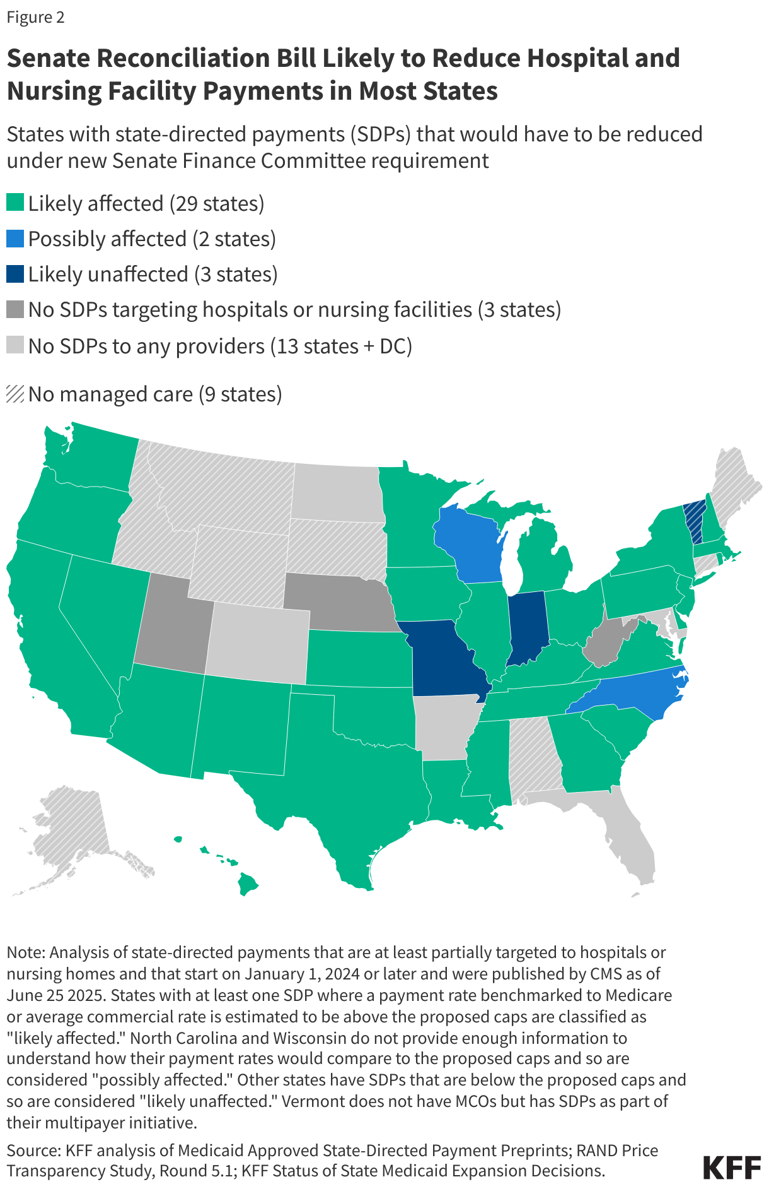
Scott Hulver, Alice Burns, and Jessica Mathers, Reconciliation Language Could Lead to Cuts in Medicaid State-Directed Payments to Hospitals and Nursing Facilities (KFF, June 27, 2025) https://www.kff.org/medicaid/reconciliation-language-could-lead-to-cuts-in-medicaid-state-directed-payments-to-hospitals-and-nursing-facilities/ (May 6, 2026).

Slide 18
Rural Health Transformation
$50B
(FY26-FY30)
$25B
Baseline Funding
$25B
Workload Funding
Equal allocations to all 50 states
CMS discretion

Slide 19
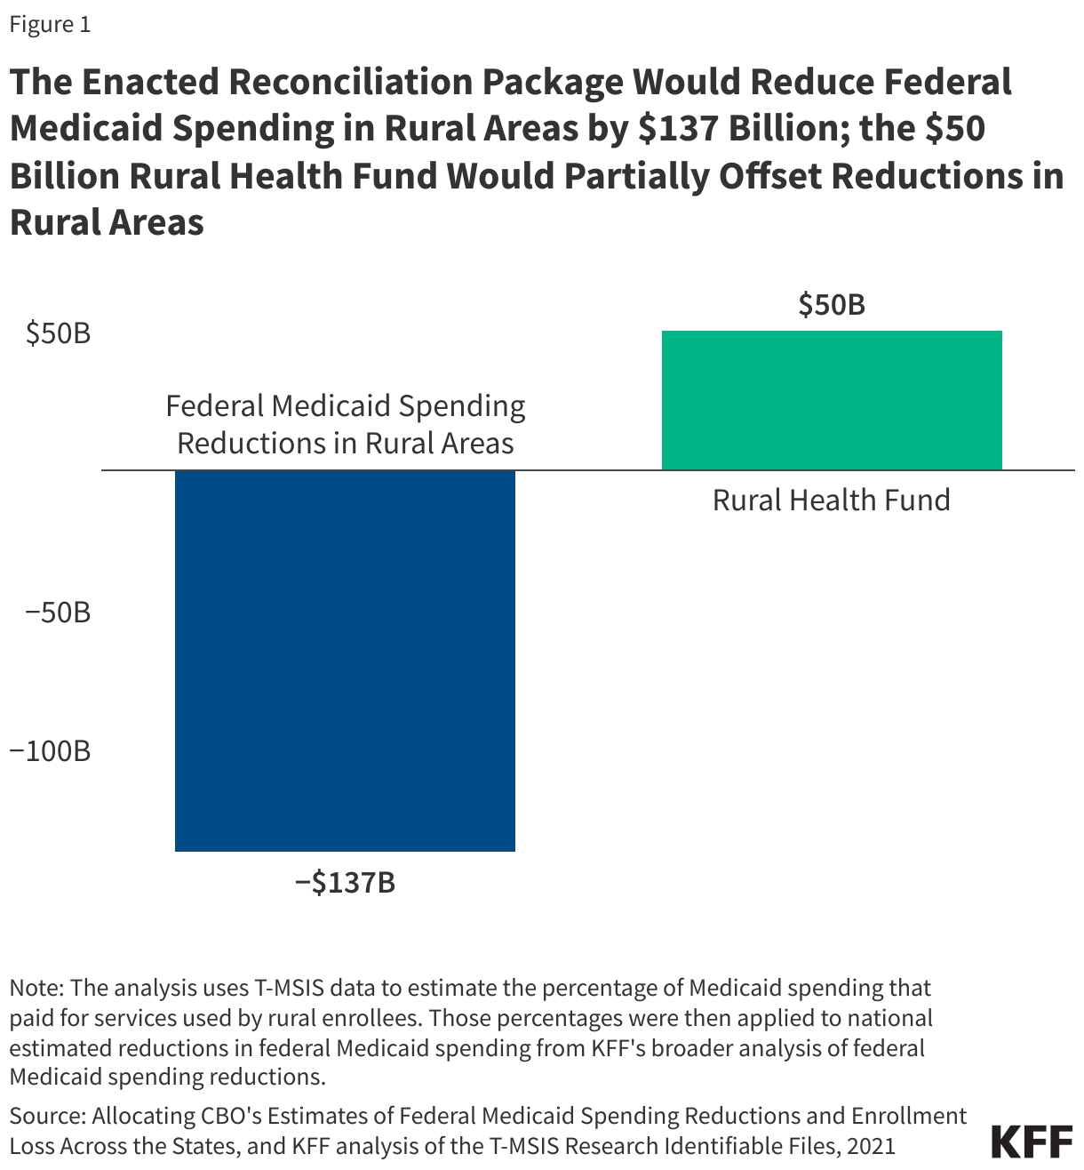
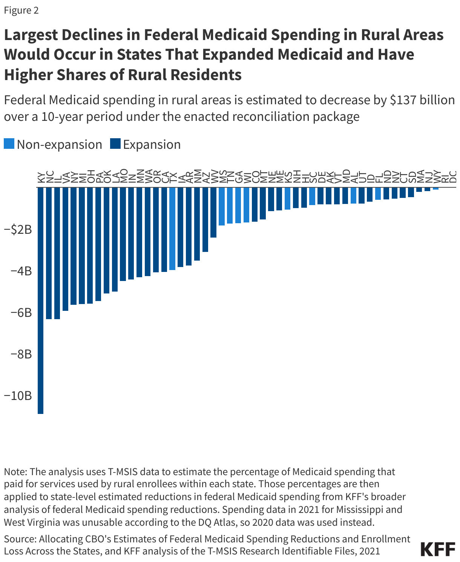
Heather Saunders, Alice Burns, and Zachary Levinson, How Might Federal Medicaid Cuts in the Enacted Reconciliation Package Affect Rural Areas? (KFF, July 24, 2025) https://www.kff.org/medicaid/how-might-federal-medicaid-cuts-in-the-enacted-reconciliation-package-affect-rural-areas/ (May 6, 2026).

Slide 20
340B

Slide 21
Background
Established in 1992 through Section 340B of the Public Health Service Act
Drug Manufacturer discounts on covered outpatient drugs
340B discounts available only to “covered entities”

Slide 22
340B Hospitals
Disproportionate Share Hospitals (DSH) (DSH > 11.75)
Children’s Hospitals (DSH > 11.75)
Freestanding PPS-Exempt Cancer Hospitals (DSH > 11.75)
Sole Community Hospitals (DSH ≥ 8)
Rural Referral Centers (DSH ≥ 8)
Critical Access Hospitals
Medicare SSI Days
____________________________
Total Medicare Days
Total Medicaid Days
____________________________
Total Patient Days

Slide 23
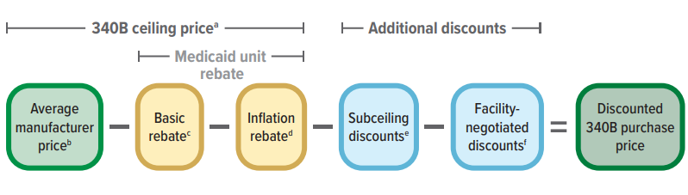
340B Savings
For most brand-name drugs, rebate is equal to the greater of 23.1% of AMP or difference between AMP and best price (lowest net price offered to any private buyer)
If AMP of Rx grows faster than overall inflation, the rebate is equal to the excess amount of that growth
“Penny pricing” rule
Congressional Budget Office, Growth in the 340B Drug Pricing Program (Sept. 2025), available at https://www.cbo.gov/system/files/2025-09/60661-340B-program.pdf.

Slide 24
Rx manufacturer (or distributor) ships Rx to CE’s on-site pharmacy
Insurer reimburses CE for Rx
Insurance
CE buys Rx at 340B price
Patient pays premium & cost sharing
Rx administered or dispensed to eligible patient
Rx manufacturer (or distributor) ships Rx to contract pharmacy (“bill to ship to”)

Slide 25
Use of 340B Savings
The 340B program is “corporate welfare” and provides “handouts” to hospitals
- Washington Post editorial board
340B statute is silent on use of savings/margin
But Congressional intent: to “reduce the costs of operations” for CEs, allowing them to “stretch scarce Federal resources as far as possible, reaching more eligible patients and providing more comprehensive services.”
“Those kinds of thefts we’re seeing all the time, and that’s one of the ways that this system of perverse transfer of wealth from rural America to more affluent areas is happening every day.”
- HHS Secretary Kennedy
“[M]any hospitals are taking advantage of the program – pocketing these savings for themselves instead of using the money to lower cost sharing on medicines for vulnerable patients.”
- PhRMA
How Corporate Welfare for Hospitals is Raising Health Care Costs, Wash. Post (Editorial Bd.), Apri. 18, 2026, https://www.washingtonpost.com/opinions/2026/04/18/340b-drug-discounts-hospitals-have-become-corporate-welfare/; Nicole Longo, New Year, Same Exploitation of the 340B Program, PhRMA (Jan. 25, 2024), https://phrma.org/blog/new-year-same-exploitation-of-the-340b-program.
.

Slide 26
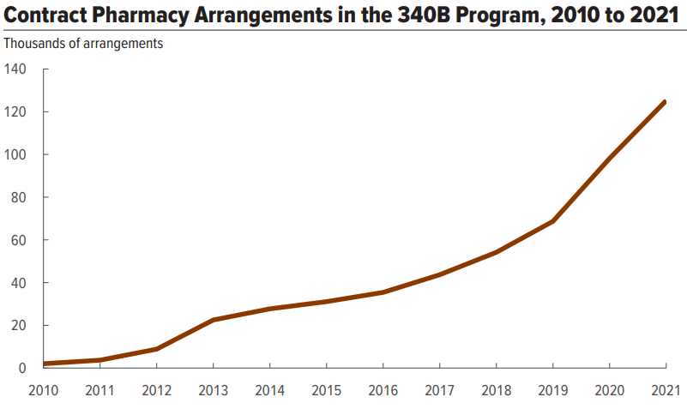
Contract Pharmacy
ACA expanded categories of 340B hospitals
ACA Medicaid expansion (DSH %)
2010 HRSA guidance → expanded use of contract pharmacies
Shift to outpatient care
Congressional Budget Office, Growth in the 340B Drug Pricing Program (Sept. 2025), available at https://www.cbo.gov/system/files/2025-09/60661-340B-program.pdf.

Slide 27


Contract Pharmacy Trends
Manufacturer Restrictions
Claims data submission (5 manufacturers requiring this for in-house claims data)
Restrictions on number of CRx’s
Geographic restrictions
Denial of 340B pricing for drugs dispensed in CRx
Shipping only to CE and child sites
States
In 2025, almost 30 states introduced 340B CRx access bills
  13 passed
21 states have laws
  Litigation
State 340B Contract Pharmacy Access Laws and Bills, 340B Report (Apr. 22, 2026), https://340breport.com/trackers/contract-pharmacy-protection-bill/.

Slide 28
340B Rebate Model
CE submits rebate request with claim info
Rx manufacturer reviews request
Rx manufacturer provides rebate (WAC minus 340B price)
CE dispenses Rx to eligible patient
CE purchases Rx at WAC ($$$)

Slide 29

340B Rebate Model
Commercial rebates?
“Bloat”
Prevents duplicate discounts by verifying claims first
Reduces diversion

Slide 30
340B Rebate Model
Significant reduction in cash flow / “floating” drug manufacturers
Disruption of inventory management processes
Loss of wholesaler prompt payment incentives
Higher cost to maintain inventory
New costs to prepare, submit, and track data required for rebates and to reconcile payments (new IT systems, labor)
Extremely complex and administratively burdensome
Reduce access for and services to patients
No evidence of widespread integrity issues
No limit on what drug manufacturers may do with data (commercial rebates)
Drug manufacturers are incentivized to deny rebates

Slide 31
Other Policy Developments
Patient Definition
Child Site Registration
GPO Prohibition
OPPS Cuts
Transparency & Accountability

Slide 32
Effective Engagement

Slide 33

Relationships
Kept a confidence
Showed up
Showed kindness
Remembered a detail or something important
Broke promise
Dishonest
Didn’t follow through
Ruman Baig, Dr. Brene Brown’s ‘Marble Jar’ Lesson Teaches Kids How to Know Who to Trust, Motherly (Nov. 10, 2025), https://www.mother.ly/parenting/dr-brene-brown-marble-jar-trust-kids/.

Slide 34

Helpful Interactions

Slide 35
Meeting
Have a polished “elevator pitch”
Be respectful of their time
Be helpful

Slide 36
Letter / Email
Personalized note instead of cut-and-paste template
If you are a constituent, say so—in the email subject line and the first sentence of your note
Legislators cannot be expected to memorize every bill number; identify the policy issue you are addressing
Keep it brief

Slide 37
Testimony
Introduction
  Thank the committee chair(s) and members
  State your name, title, and who you represent (no acronyms)
  State if you have materials for the committee
Message
  Clearly state position and explain why
  Address counterarguments
  If you have concerns, identify potential solutions / paths forward
  Keep it simple and use examples
  Humanize the science/medicine
  Say thank you and offer to answer questions in committee or offline
Questions
  Be prepared to answer
  Never interrupt
  It’s okay to say, “I don’t know, but I will find out and get back to you.”

Slide 38

Remember
“I know you may already know this, but to level set . . . .”
Timing is important
Be approachable
Assume good intentions—always!
Reasonable minds can differ
Don’t assume knowledge
Don’t be a jerk
Goal is dialogue, not humiliation
Be honest and respectful no matter what
Offer expertise and perspective
Be a problem solver not a bellyacher
Be responsive
Say thank you
Be careful what you ask for
“I applaud Rep. ABC for digging into this really difficult issue. I am concerned that HB 1 may have an unintended impact on XYZ. I look forward to working with Rep. ABC on this.”
“I see that a little bit differently . . . .”

Slide 39


Slide 40
Thank you!
Q&A

