Slide 1
GEMs and Pebbles:
Where Employee Engagement Data Meets Action
Julia Evans, MA, OTR/L, MBA

Slide 2
Learning Objectives
1) Explain how employee engagement survey data can be translated into actionable insights that guide program development and organizational culture initiatives.
2) Describe the design and purpose of the GEMs & Pebbles program and how it impacted specific employee engagement scores.
3) Assess strategies for scaling the GEMs & Pebbles program to additional divisions.

Slide 3
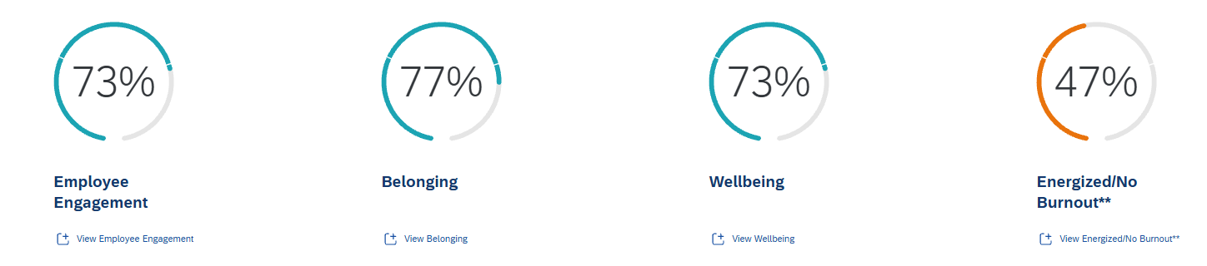
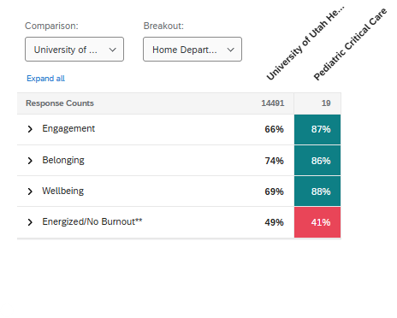


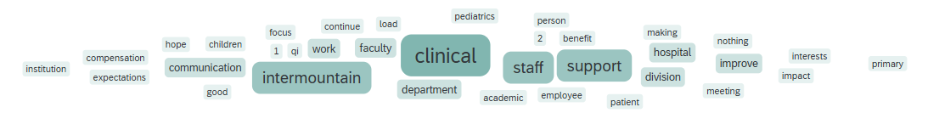
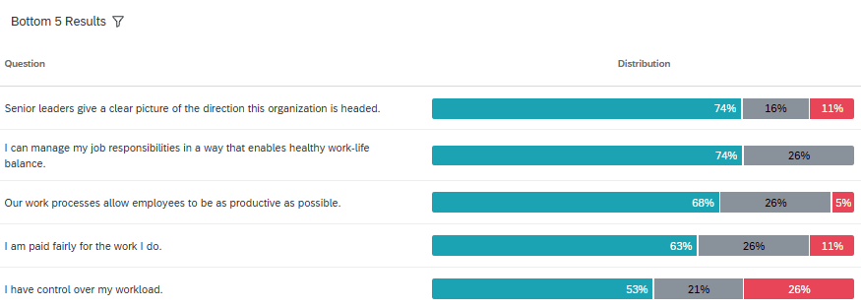
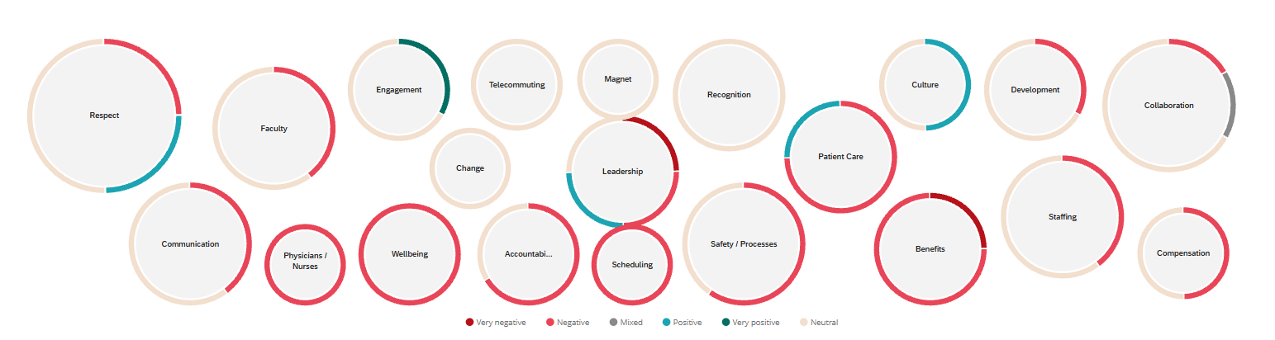

What do you do next??
Notes:
Every year when we receive our employee engagement survey data it feels a little like this – start, stop, continue, word clouds, percentiles, comments. So what can you do to make sense of this data and actually do something about it?
Division of Critical Care – data driven, concrete, skip the fluff division (not the folks who want to do meditation and attend wellness workshops)
Data came out about the time Kristi said she was done being the Wellness champion in the division; Critical Care folks just don’t respond to “wellness”
What if we could use the data to inform our wellness approach?

Slide 4
2023 Critical Care Bottom 2 Responses
Notes:
We jumped into the data and decided that the place to start was with the two worst scores
Wellness committee brainstormed and used ideas from previous institutions to create a division initiative to target both of these areas

Slide 5
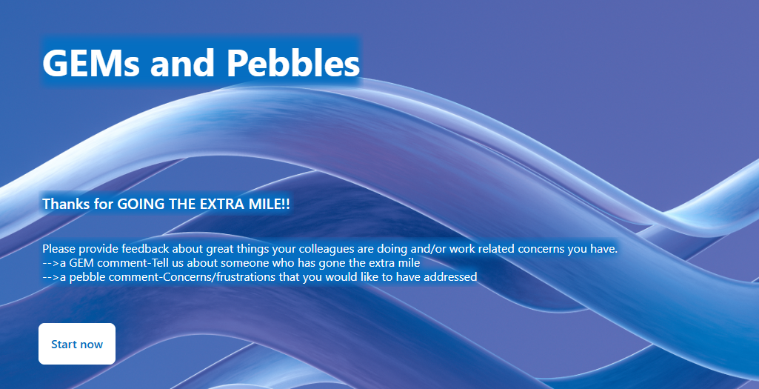
Notes:
GEMs and Pebbles program was born
GEM – Going the Extra Mile
Pebble – frustration or annoyance that drives you crazy like a pebble in your shoe
Created form to fill out and put QR codes in offices, bathrooms, workspaces that allows for named or anonymous submissions

Slide 6
Example Submissions
GEMs
Pebbles
“Provider 1- she has checked in on me multiple times following some hard patients the past few months and it means the world.”
“Provider 2 searched high and low for a surgeon to take out 2 ECMO sutures, saving the patient an ED visit."
"I wanted to let you all know that the research team did an excellent job this last week and weekend. We have had a flurry of flu admissions and they are doing awesome getting kiddos enrolled. Excellent teamwork, excellent communication. I am so pleased."
Admit calls are not reaching the docs in a consistent or protocolized manner, some come through text, pages, cell calls, etc.
In the PICU call room for the attendings, the keyboard letters, x and z don’t work. Seems like a new keyboard is in order or somebody who’s good at fixing them?
Perhaps a small request, but can we have a shower curtain in the Lehi call room?
We do not get daily weights in either unit! If we get beds and cribs that can weigh patients and if we change the culture to prioritize this, then we will do it more often.
Notes:
I’ll let you review some of the GEMs and Pebbles that were received as I discuss what we did with the information
Pebbles: Monthly the PICU medical director and I meet to review and determine next steps: address within the division, escalate to department or hospital, acknowledge as unable to address
New pebbles with the plan for next steps or updates on old pebbles are listed in the division monthly newsletter for accountability
GEMs: Monthly new GEMs are reviewed and one GEM of the month is chosen to be highlighted with a small prize (Extra gum, stress ball, note). This is presented at division meeting and the submission is read aloud. All other GEMs for that month are listed in the monthly newsletter and put up on slides at the beginning of meetings throughout the month
Not just for physicians. APPs, admins, nurses, techs, research staff, etc.

Slide 7
Participation and Outcomes
Notes:
Program began in June 2024
Addressed – either we were able to address it in the division or it has been escalated and addressed at another level
In Process – escalated, working on it within the division, someone assigned
Not addressed – something we talked about but have no good way to make changes on – PARKING!

Slide 8
Engagement Survey Results
Percent of division who reported “I receive meaningful recognition when I do a good job”
Percent of division who reported “Our work processes allow employees to be as productive as possible”
Notes:
Notable growth between 2023 and 2024 with some dropoff in 2025 but still remaining above the baseline
*Specifically of note for the questions on productivity, the hospital had implemented a new EMR the month before this survey came out
Determine if there is a more “meaningful” way to provide recognition that would keep that number higher

Slide 9
Expanding to Other Groups
Pediatric Palliative Care
  Relatively small division (8 providers)
The Heart Center
  Large, complex division
Points to consider when implementing
  Ease of gathering meaningful data
  Determining who will address Pebbles
Notes:
Palliative Care – also involved in this division and they heard about it from me and wanted to implement;
Heart Center – CICU physician is Wellness champion and shared this with them
Considerations:
Specifically about using employee engagement data
-Small divisions may not have the scores available due to number of people filling out the survey; worked extra hard in 2025 to get everyone to fill out survey so we could get data
-Large entities have to find ways to combine all the data to get an aggregate that represents the full group
Specifically about implementing GEMs and Pebbles program
-Complex divisions need to have a process in place to address pebbles and provide feedback on them to stakeholders for accountability

Slide 10
Thank You

