Slide 1


Stanford Pediatrics
Faculty Dashboard
Empowering Faculty and Enhancing Engagement
Through Data Transparency
Michael Propst, Associate Chair & Director of Finance & Administration
Surabhi Agrawal, Senior Director of Finance
Jennifer Tran, Associate Director of Finance

Slide 2



Background & Challenges
Background
Key Challenges
The evolving academic medicine landscape requires meaningful faculty engagement. Existing incentive structures are inconsistent and difficult to understand, highlighting the need for a transparent, standardized approach to clinical productivity.
Disconnected from performance data
Uncertain about progress throughout the year
Surprises when bonus checks arrived
No tools to monitor achievements in real-time
"I never knew where I stood until the check arrived"
— Anonymous Faculty Member

Slide 3
Objectives
1
Simplified Bonus Plan
Develop a simplified, standardized clinical bonus plan across divisions
2
Maximize Productivity
Motivate faculty to maximize clinical productivity through wRVU achievement
3
Transparent Tracking
Establish transparency in performance tracking across all divisions
4
Real-Time Data Access
Empower faculty with real-time access to productivity data

Slide 4



Methods
Phase 1
Faculty Engagement
Phase 2
Plan Development
Phase 3
Buy-In & Rollout
Met with each Division Chief and Administrative Director
Presented at individual division faculty meetings
Announced at Department meeting
Interviewed 40 faculty across various specialties
Collected feedback on incentive structure needs
Identified barriers to engagement
Designed streamlined bonus structure based on feedback
Developed faculty individual dashboard for data transparency

Slide 5
Results: Faculty Dashboard
77%
New Faculty Dashboard
Transparency to RVU and deployment data
Insight into CPT codes billed
Real-time performance tracking toward RVU benchmark and bonus projection
User-friendly, mobile-accessible interface
Historical performance trends
Direct link for questions and feedback
Dashboard Open Rate
62%
Used Multiple Times This Fiscal Year

Slide 6
Results: Incentive Plan & Adoption
New Clinical Incentive Plan
$XX,XXX bonus upon reaching predetermined wRVU threshold
Additional compensation for every wRVU beyond threshold
Standardized across all divisions within Group or Individual bonus structure

Slide 7
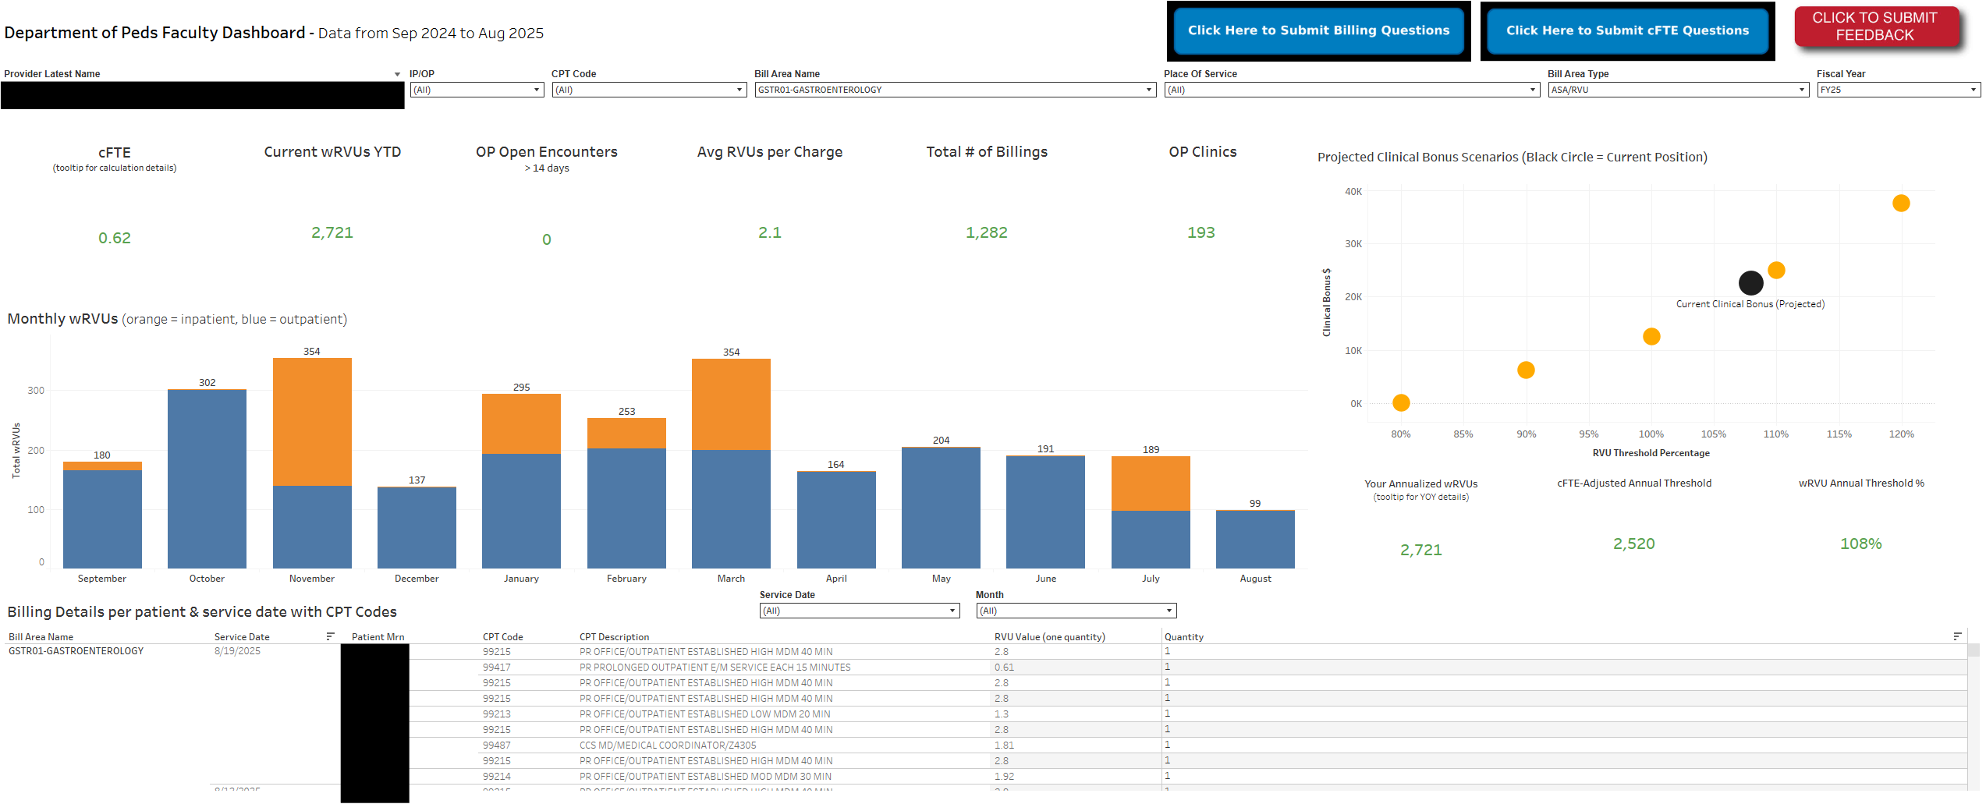
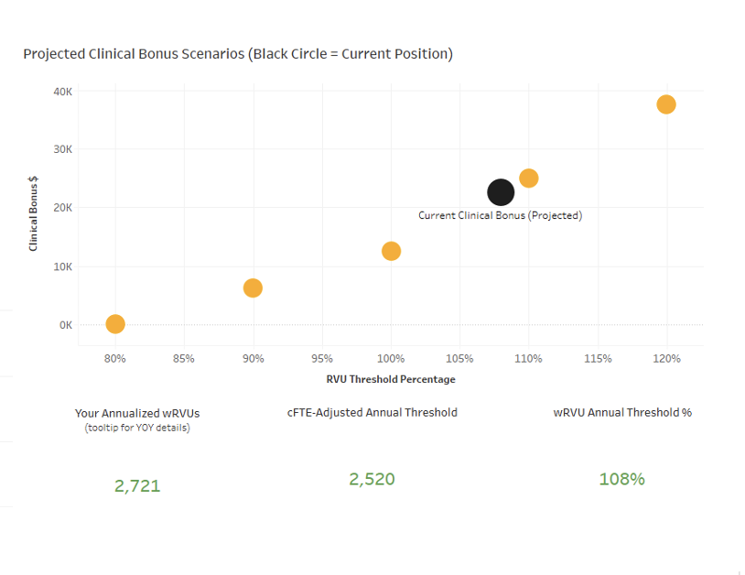
Results: Faculty Dashboard

Slide 8
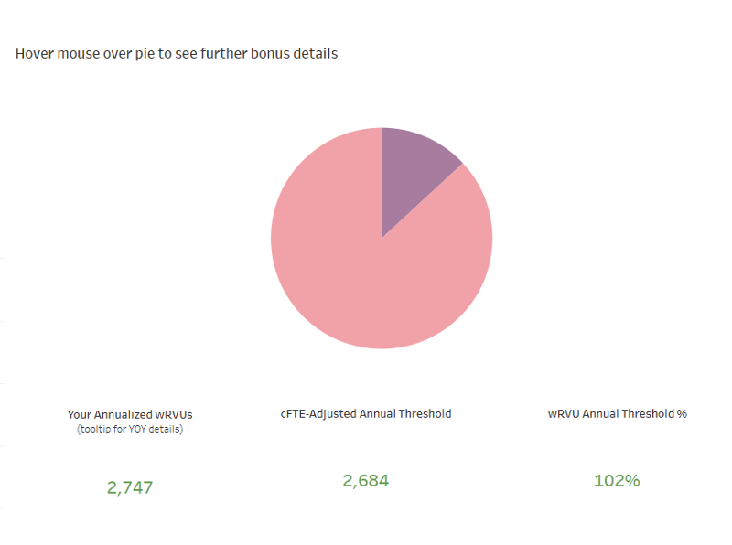
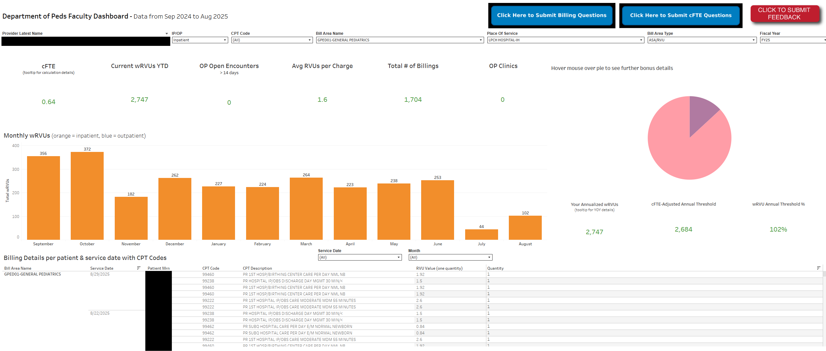
Results: Faculty Dashboard (cont.)

Slide 9

Impact & Future Directions
Transformative Potential
Next Steps
Scalable across academic medical centers
Bridges technology with meaningful faculty engagement
Promotes a culture of active, informed productivity management
Empowers faculty to identify and flag potential billing discrepancies in real time
Full implementation of dashboard and bonus plan across all divisions
Longitudinal assessment of faculty productivity and engagement outcomes
Continuous refinement based on ongoing faculty feedback

Slide 10
Acknowledgements
Arezou Motamedi
Assistant Director of Finance, Clinical Operations — Co-leading dashboard design and implementation
Stanley Tang
Senior Data Analyst — Dashboard design and implementation
Clarissa Yau
Financial Analyst — Incentive data modeling and review

