Slide 1
Changes in Pediatric Research: Diversifying Funding
Stella M. Ghattas, Esq., BSN
Vice President, Academic and Research Operations
Children’s National Research Institute

Slide 2
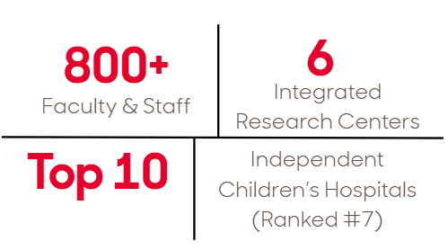
Children’s National Research Institute (CNRI)
Our Vision
To lead the nation in advancing the health and well-being of all children.
To be a premier pediatric health system, with leadership in advocacy, research, education and clinical care.
To set the standard in delivering the highest quality care in ways that put the child at the center.

Slide 3
CNRI Research Centers
Center for Cancer and Immunology Research
Drive basic and clinical research that advances treatment for childhood cancer, infections, and blood and immune-related disorders.
Center for Health Outcomes Research & Delivery Science
Advance multidisciplinary research that improves child health outcomes across clinical and community settings.
Center for Neuroscience Research
Advance research to prevent and treat childhood neurological, developmental, and behavioral disorders.
Center for Precision Medicine and Genomics Research
Harness genomics to enable precision health and prevent illness for every child.
Center for Prenatal, Neonatal, and Maternal Health Research
Advance cross‑disciplinary research to transform prenatal and neonatal care for mothers and babies.
Sheikh Zayed Institute for Pediatric Surgical Innovation
Advance surgical innovation to make pediatric procedures more precise, less invasive, and pain‑free.

Slide 4
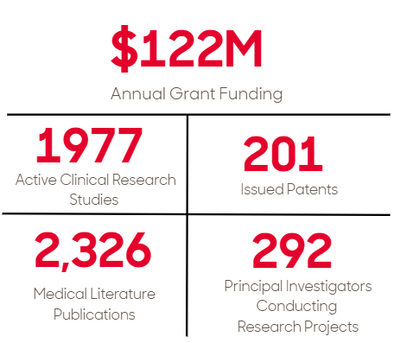
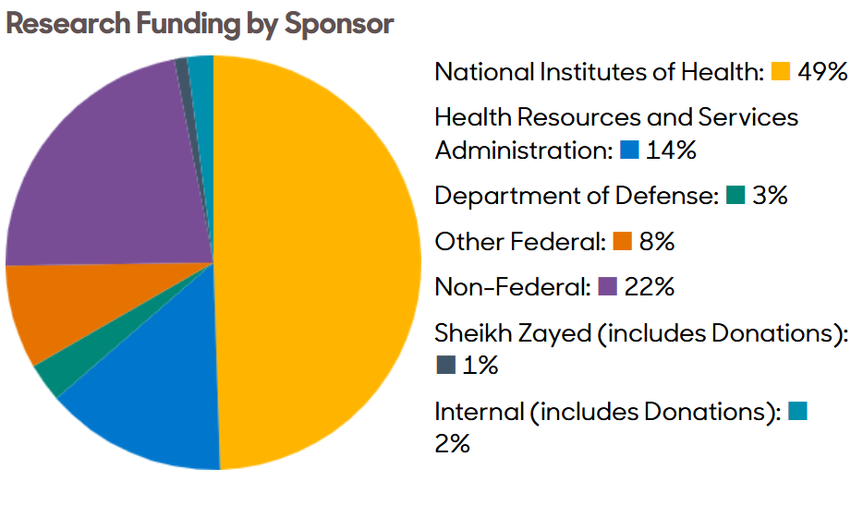
CNRI FY25 Funding Snapshot

Slide 5
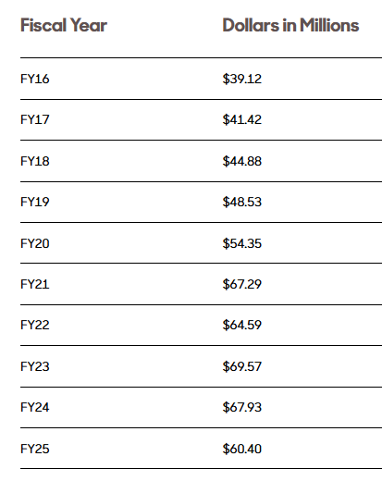
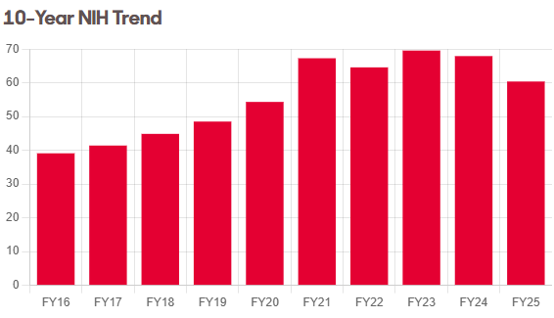
10-Year NIH Trend

Slide 6



Diversified Funding Streams
Innovation-Driven Funding
Academic Research Partnerships
Institutional Support

Slide 7

Innovation-Driven Funding
Local Government Collaborations
Advances regional innovation through projects supported by local, government-backed funding
Intellectual Property and Commercialization
Supports patent development, licensing, and technology transfer through industry collaboration and generates revenue and reinvestment opportunities

Slide 8

Innovation-Driven Funding
Industry-Sponsored Research Collaborations
Engages industry partners in sponsored research agreements and provides non-federal research funding that support translational studies with real-world application.
Children’s National Research and Innovation Campus
Revenue and partnership opportunities driven by startup biotech companies within an innovation ecosystem

Slide 9
Innovation-Driven Funding
Industry-Sponsored Research Collaborations
Engages industry partners in sponsored research agreements and provides non-federal research funding that support translational studies with real-world application.
Children’s National Research and Innovation Campus
Revenue and partnership opportunities driven by startup biotech companies within an innovation ecosystem

Slide 10

Academic Research Partnerships
Collaborative Projects
Expand funding access via:
Pilot awards
Joint grant submissions
Multi-institutional expertise
Increased access to patient populations

Slide 11

Institutional Support
Cost Recovery & IDC Optimization
Analyzes non-federal IDC rates to better reflect the true cost of conducting research and updating industry-sponsored IDC rates to improve cost recovery.
Research Core Facilities
Provides specialized in-house research technologies through a fee-for-service model that supports investigators and enables partial cost recovery and sustainability.
Philanthropy & Endowment Growth
Grows long-term donor investments to support endowment funding for faculty and junior faculty research programs while directing major donor support toward institutional research priorities.
Example: CNRI received major donor gift to support pediatric brain research.

Slide 12
Thank you!

Slide 13


Recruiting for Research
amid Margin pressure
A National Search Firm Perspective & Insights from Pediatric Executive Leaders
Notes:
Speaker Notes:
Good afternoon, and thank you for the opportunity to be here.
Jennifer and I are excited to share a national perspective on what we are seeing across children’s hospitals when it comes to recruiting for pediatric research roles.
Today’s conversation brings together two vantage points. First, what we are seeing every day from a national search firm perspective as organizations try to hire and retain research talent in an increasingly constrained financial environment. And second, early insights from survey data and in‑depth interviews we have been conducting with pediatric executive leaders across the country.
At a high level, the message is simple but important. Financial margin pressure is no longer just an operational issue. It is directly shaping your ability to recruit, support, and sustain the research mission.
Our goal today is not just to describe the challenge, but to help frame what this means in practice and how leaders are navigating these realities in real time.

Slide 14
The Tension We’re All Managing
■ THE CORE TENSION
MISSION
RESEARCH IS
MISSION-CRITICAL
MARGINS ARE TIGHTENING
RECRUITING SITS AT THE INTERSECTION
“Sustainable Research Enterprise?”
MARGIN
TALENT
AMN Healthcare physician & leadership solutions • Recruiting for the Research Mission In A Margin Constrained Environment
Notes:
Speaker Notes:
This slide captures the core tension we’re seeing across almost every pediatric organization we work with.
On one hand, research is mission‑critical. It’s central to identity, differentiation, academic credibility, and long‑term impact.
On the other hand, margins are tightening. Clinical productivity expectations are rising, financial scrutiny is increasing, and tolerance for risk is shrinking.
Recruiting sits directly at the intersection of those forces.
Because the research mission only moves forward if you can attract and retain the people who do that work, and margin pressure isn’t just constraining research anymore, it’s actively shaping who you can recruit and what kind of research enterprise you can realistically sustain.
That’s the tension leaders are managing today, often without clear playbooks, and it’s what sits underneath many of the recruiting challenges we’ll talk about next.

Slide 15
What’s Changed in the Last 3-5 Years
■ WHAT WE’RE SEEING IN THE MARKET
Longer Time-to-fill Research Roles
Fewer Candidate For Research-intensive Positions
Increase Negotiation Around Resources
More Failed Or Restarted Searches
AMN Healthcare physician & leadership solutions • Recruiting for the Research Mission In A Margin Constrained Environment
Notes:
Speaker Notes:
Over the last three to five years, we’ve seen very consistent shifts in the recruiting market for research‑focused roles.
First, time to fill is longer. Searches that once closed in six months are now more commonly stretching to nine or even twelve. That has real downstream impact on programs, coverage, and momentum.
Second, candidate supply has narrowed, particularly for highly research‑intensive roles. Fewer physicians are willing to step into positions where expectations around funding, infrastructure, and protected time aren’t clearly defined.
We’re also seeing much more negotiation, especially around startup resources, protected research time, and institutional support. These are no longer “nice to have” conversations, they are gating factors.
And finally, in some cases, searches are stalling or being restarted altogether when alignment isn’t there.
So this isn’t just perception or anecdote. These shifts are showing up in real recruiting outcomes, and they reflect a market where both candidates and institutions are being far more selective under financial pressure.
Taken together, these shifts are driving a fundamental change in how top research candidates evaluate opportunities.

Slide 16


■ EMERGING PATTERS
Top Candidates Are Asking Different Questions
“Is my research time truly protected?”
“Is infrastructure real—or promised?”
“What happens if funding dips?”
“Will I be pushed into clinical productivity?”
AMN Healthcare physician & leadership solutions • Recruiting for the Research Mission In A Margin Constrained Environment
Notes:
Speaker Notes:
What’s really changed is how top candidates are evaluating opportunities.
They’re no longer just asking about titles or compensation, they’re asking much more pointed, practical questions about risk.
Is the infrastructure already in place, or is it something I’m expected to build?
Is research time truly protected, or will it erode as clinical pressure mounts?
What happens if funding dips?
And how much clinical productivity will I actually be held to once I’m there?
These questions reflect a shift in mindset.
Candidates are looking for evidence of commitment, not just intent. They want to understand how the organization behaves when financial pressure shows up, not just what’s written in the job description.
When commitment to research is ambiguous, candidates don’t hesitate, they walk.
Top research candidates aren’t just choosing institutions anymore, they’re choosing certainty.

Slide 17
How Margin Pressure Shows Up in Recruiting
■ THE MARGIN → RECRUITING IMPACT LINK
MARGIN REALITY
Tight operating margins
RECRUITING IMPACT
Smaller startup packages
Clinical revenue dependence
Risk sensitivity
Less protected time
Slower approvals
Narrower candidate pools
AMN Healthcare physician & leadership solutions • Recruiting for the Research Mission In A Margin Constrained Environment
Notes:
Speaker Notes:
This is where margin pressure becomes very tangible in recruiting.
When operating margins are tight, organizations naturally become more cautious. There is greater reliance on clinical revenue, more scrutiny on every investment, and less tolerance for risk.
That reality shows up in recruiting in very specific ways.
Startup packages are often smaller or less flexible.
Protected research time becomes harder to guarantee.
Approvals slow down.
And ultimately, the pool of viable candidates narrows.
From a candidate’s perspective, these signals are very clear, even when they are not explicitly stated.
Candidates interpret caution as uncertainty. And uncertainty is often enough to stall or derail a search, especially for research‑focused roles.
Transition to Slide 6:
To better understand how these dynamics are being experienced at pediatric institutions across the country, we stepped back and asked a broader question—what are pediatric leaders actually seeing and doing in this environment?

Slide 18

Implications for Sustaining the Research Mission
■ WHAT THIS MEANS FOR LEADERS
Clarity of commitment matters more than ever
WHY WE DO
WHAT WE DO
Protected time must be real—not aspirational
Competitive packages are now table stakes
Alignment between finance + academic leadership is critical
AMN Healthcare physician & leadership solutions • Recruiting for the Research Mission In A Margin Constrained Environment
Notes:
Speaker Notes:
So what does all of this mean for leaders?
First, clarity of commitment matters more than ever. Candidates are looking for consistency between what’s said and what’s funded. Mixed signals are often interpreted as uncertainty.
Second, protected research time has to be real, not aspirational. In a margin‑constrained environment, candidates want to know what holds when pressure shows up. If it only exists on paper, they assume it will erode.
Third, competitive packages are now table stakes. Compensation and support are no longer differentiators. Falling short doesn’t create savings, it often creates vacancies.
And finally, alignment between finance and academic leadership is critical. Candidates quickly sense misalignment, especially around expectations and risk tolerance, and it directly affects recruiting success.
At the end of the day, sustaining the research mission isn’t about saying yes to everything. It’s about being clear, intentional, and aligned in the choices you make.

Slide 19


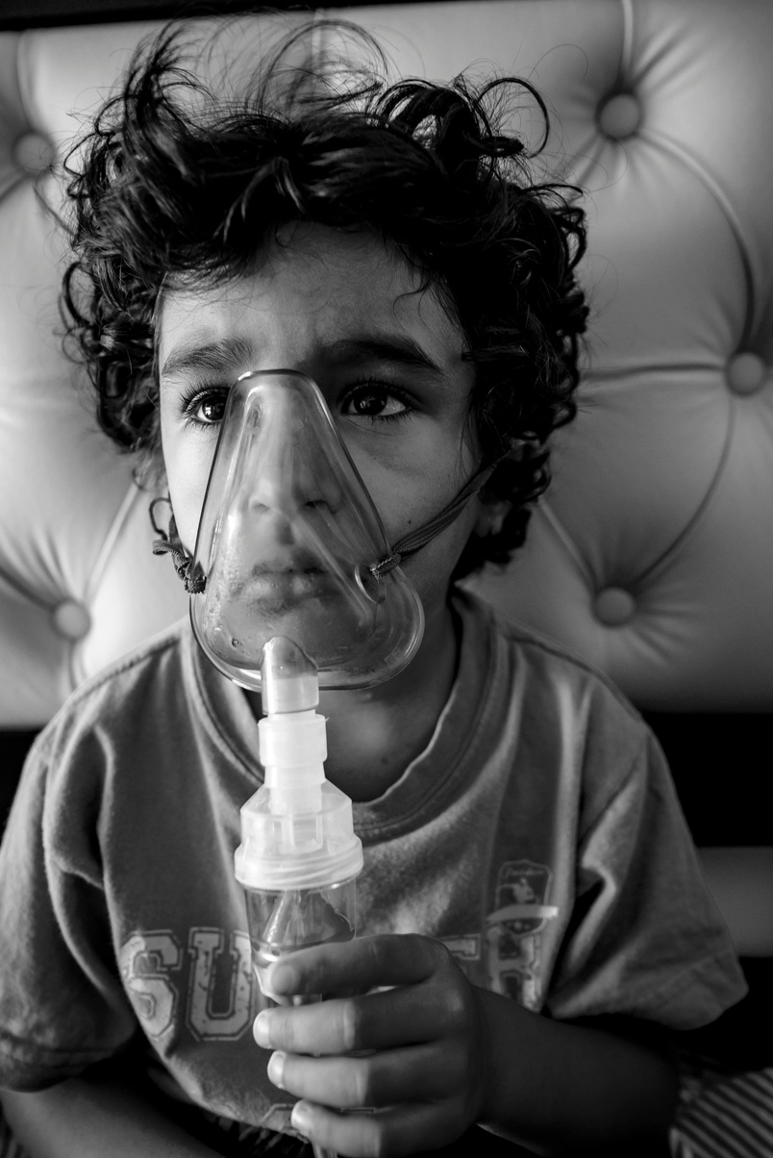
























Notes:
Speaker Notes:
Before we dive deeper into the data, I want to briefly ground us in why we did this work.
At the center of pediatric research is the mission. It is about advancing care, discovery, and outcomes for children and families, even in an environment of growing financial pressure.
To better understand how that mission is being experienced on the ground, we launched a national pediatric research initiative made up of two components.
First, we conducted qualitative interviews with pediatric leaders across children’s hospitals and academic medical centers. These conversations allowed us to go beyond surface-level trends and hear directly how margin pressure, clinical demand, and workforce constraints are influencing research strategy, recruitment decisions, and sustainability concerns.
Second, we deployed a national survey to pediatric executives and research leaders to quantify what we were hearing. The survey captures perspectives on time to fill, vacancy rates, compensation, and how financial pressure is shaping recruiting outcomes and research capacity.
Together, the survey data and interviews give us a grounded view, not just of what is changing, but how leaders are actively responding to these forces.
What you will see next is a synthesis of what pediatric leaders are telling us, both in the numbers and in their own words, about what it now takes to recruit and sustain the research mission.

Slide 20

AMN IS INVESTING IN THE PEDIATRIC MISSION
Notes:
Speaker Notes:
Up to this point, we’ve focused on the challenge, the tension, and what pediatric leaders are experiencing in real time.
This is where we want to be very clear: we are not just studying this—we are investing in it.
At AMN, pediatric research is not a theoretical priority. It’s a mission we are actively supporting.
That’s why we launched this national pediatric research initiative. Not to generate a white paper, but to help leaders navigate real decisions around recruiting, sustainability, and workforce strategy in a margin‑constrained environment.
We are investing time, data, and expertise to help pediatric institutions:
Understand what top candidates are actually responding to today
Bring clarity to value propositions that are under pressure
And make smarter, more durable recruiting decisions that protect the research mission
This work is about showing up as a partner, helping translate financial reality into actionable strategy, and being part of the solution at a time when the research mission cannot afford ambiguity.
And everything you’ll see next is grounded in that commitment.
And because this commitment is grounded in real data, let’s now look at what pediatric leaders across the country are actually telling us.

Slide 21
■ SURVEY SNAPSHOT (QUANTITATIVE)
What Pediatric Leaders Are Telling Us (Survey Data)
Recruiting is materially harder
90% of organizations report average time-to-fill of nine months or longer.
55% of pediatric leaders report time-to-fill has increased over the last three years
Only 10% report an improvement.
Compensation meaningfully changes outcomes
Offer acceptance rates jump ~30 points when organizations are competitive on compensation (77% vs. 47.5%)
Impact on Vacancy rates
Organizations citing significant Medicaid influence report nearly 4x higher vacancy rates (19.4% vs. 5.5%)
The largest organizations report 73.5% desired-but-unfilled positions.
AMN Healthcare physician & leadership solutions • Recruiting for the Research Mission In A Margin Constrained Environment
Notes:
Speaker Notes:
“I’ll briefly highlight a few themes from our survey data.
[Pause and reference your actual numbers]
What we’re seeing is a high percentage of leaders identifying funding constraints as a primary barrier to growing research programs.
A similarly large portion are reporting increased difficulty recruiting research-focused faculty.
And many are shifting toward more hybrid roles—blending clinical and research responsibilities.
So the challenges we’re seeing in searches are very much aligned with what leaders themselves are reporting.”

Slide 22
■ WHAT WE’RE HEARING (QUALITATIVE)
What We’re Hearing in Interviews
“50% of kids are covered by Medicaid… I can’t negotiate that contract to allow me to increase provider salaries.”
CEO, LARGE PEDIATRIC HEALTH SYSTEM
“We’re not going to recruit our way out of this.”
PHYSICIAN CEO, LARGE PEDIATRIC HEALTH SYSTEM
“You can’t just think about hiring one person anymore… it has to be a system approach.”
C-SUITE PHYSICIAN EXECUTIVE, PEDIATRIC HEALTH SYSTEM
“Challenges in the workforce and market economics require us to rethink traditional delivery models and design care that is innovative and scalable using technologies and flexible team operating structures to ensure long-term sustainability.”
CEO, LARGE PEDIATRIC HEALTH SYSTEM
“We’re constantly reacting… instead of getting ahead of it.”
C-SUITE PHYSICIAN EXECUTIVE, PEDIATRIC HEALTH SYSTEM
AMN Healthcare physician & leadership solutions • Recruiting for the Research Mission In A Margin Constrained Environment
Notes:
Speaker Notes:

Slide 23
Emerging Patterns Across Institutions
■ EMERGING PATTERS
1
  Margin-Demand Inversion Is Shaping Workforce Strategy
  Highest-demand pediatric subspecialties are often the least well-reimbursed and most Medicaid-exposed
  These high-demand specialties also require subsidies
2
  The Workforce Value Proposition Is Breaking
  Compensation expectations continue to rise without a corresponding increase in clinical labor supply
  Younger subspecialists are prioritizing flexibility and sustainability, acceleration new workforce models
  Institutions are competing more selectively for scarce talent and are customizing offers around candidate priorities
3
  APPs Are Rebalancing Care Model—Unevenly
  APP-led clinics and team-based care models are the most common redesign strategy
  Utilization varies widely, and leaders express concern about long-term sustainability
AMN Healthcare physician & leadership solutions • Recruiting for the Research Mission In A Margin Constrained Environment
Notes:
Speaker Notes:
Pattern 1: Margin-Demand Inversion
When you put the survey data together with what leaders and candidates are telling us, three patterns emerge. Our research correlates with the narrative we have heard from Beckers over the past 12-18 months.
One of the clearest patterns we see is what we call a margin‑demand inversion. The specialties institutions need the most are often the least financially supported. From a recruiting standpoint, this limits flexibility on start‑up packages, protected time, and speed to decision. Candidates experience this as hesitation — even when leadership intent is strong. This isn’t a planning failure. It’s a structural constraint.
Pattern 2: The Value Proposition Breaking
Historically, higher compensation offset higher workload. That equation is no longer holding. We’re seeing fewer entrants into some subspecialties and fewer clinical hours per physician. This creates a double supply shock that no single lever — comp, benefits, title — can fix alone. Candidates are evaluating roles based on career durability, not just first‑year compensation.
Pattern 3: APPs and Care Redesign
APP integration is no longer optional. It’s the dominant redesign strategy — but implementation is uneven. Leaders recognize the value. At the same time, many worry we’re pushing APP utilization faster than infrastructure and supervision models can support. Physicians are asking how team‑based care actually functions day‑to‑day — not just whether it exists.
Creative solutions institutions are replacing the traditional full-time with shared appointments, fractional FTEs, regional partnerships and hybrid models.

Slide 24






Two Opportunities!
Executive Round Table Series
DALLAS
Wednesday, June 3rd 8:00am to 1:00pm CT
AMN Healthcare Executive Boardroom
2999 Olympus Drive, Suite 500
Dallas, TX 75019
Join a peer roundtable discussion focused on the evolving challenges of pediatric subspecialist workforce management. This interactive session will bring healthcare leaders together to explore current physician demand dynamics, competitive recruitment pressures, compensation trends, and persistent vacancy and time-to-fill challenges.
BOSTON
Thursday, June 11th 8:00am to 1:00pm ET
Hilton Boston Park Plaza
50 Park Plaza
Boston, MA 02116
register today
Scan the QR Code
Andrea Hanson
Vice President, Institutional Partnerships
Academic and Life Sciences Practice
Physician & Leadership Solutions
Andrea.Hanson@AMNHealthcare.com
Jennifer Schaulin
Academic and Life Science Practice Leader
Pediatric Practice Leader
Physician & Leadership Solutions
Jennifer.Schaulin@AMNHealthcare.com
THANK YOU!
AMN Healthcare physician & leadership solutions • Recruiting for the Research Mission In A Margin Constrained Environment
Notes:
Speaker Notes:
Before we close, we want to start by saying thank you.
This work would not be as rich or as grounded without the willingness of pediatric leaders to share their perspectives, their challenges, and their experiences so candidly.
In particular, we want to thank our co‑presenters:
Stella Ghattas from Children’s National,
Christine Boyes from CHLA,
and Sara Stephens and Lisa Deberry from Johns Hopkins Children’s,
for contributing their voices, insights, and leadership to this conversation.
Throughout today, we’ve shared what we’re seeing in the market, what pediatric leaders across the country are telling us, and how margin pressure is reshaping the research mission.
What we don’t believe is that any organization should be navigating this alone.
That’s why we’re continuing this work beyond today through a series of peer executive roundtables. These sessions are designed to bring pediatric leaders together to exchange perspectives on physician demand, recruiting pressure, compensation, and persistent vacancy and time‑to‑fill challenges, in a candid, off‑the‑record setting.
The goal isn’t presentations. It’s conversation, shared learning, and practical insight from leaders facing the same constraints and trade‑offs.
We’ll be hosting two sessions, one in Dallas and one in Boston, and we would truly welcome the opportunity to continue the dialogue with you or members of your team.
Thank you again for your time, for the work you’re doing to advance pediatric research, and for allowing us to be part of this conversation.

Slide 25
Navigating Disruption in Academia: A Pediatric Research Program Evaluation and Management
Lisa DeBerry, MNM- Associate Dean, Academic Administration
Sarah Stephens, MHA- Senior Manager, Academic Administration
Johns Hopkins University School of Medicine / Johns Hopkins All Children's Hospital

Slide 26
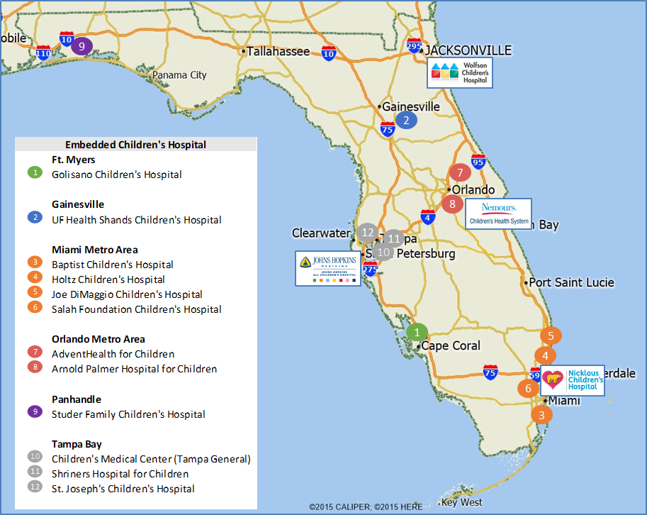
Florida Market Overview
Children’s Hospitals
Stand Alone Children’s Hospitals
  Johns Hopkins All Children's
  Nemours
  Nicklaus
  Wolfson
Embedded Children’s Hospitals
  12 locations
(closed in 2022)
Notes:
Of states with at least 2 million kids we have the highest concentration of children's hospitals on a per patient basis. Texas best place to be doing business.

Slide 27

Johns Hopkins All Children’s | System Overview
Increase access to Johns Hopkins Medicine across the region in an academic health system model
Most recognized academic leader in pediatrics with highest acuity care and highest Medicaid in Florida
Celebrating 100 years in St. Petersburg, FL
#1 children’s hospital in Florida according to U.S. News & World Report. Nationally ranked in 8 specialties #4 in Southeast
259 Licensed beds
Affiliate network of inpatient and outpatient organizations to bring care closer to home (13 Outpatient Care Centers)
Highest case mix index of any children's hospital in the state
Over 60% of patients are on Medicaid, 2nd by volume and percent among children's hospitals
Single inpatient campus and an ambulatory network
Strong depth in specialty and sub-specialty care employing more than 300 providers
Primary service area includes 17 counties and 1.2 million children
Building a 2nd hospital in 2027

Slide 28
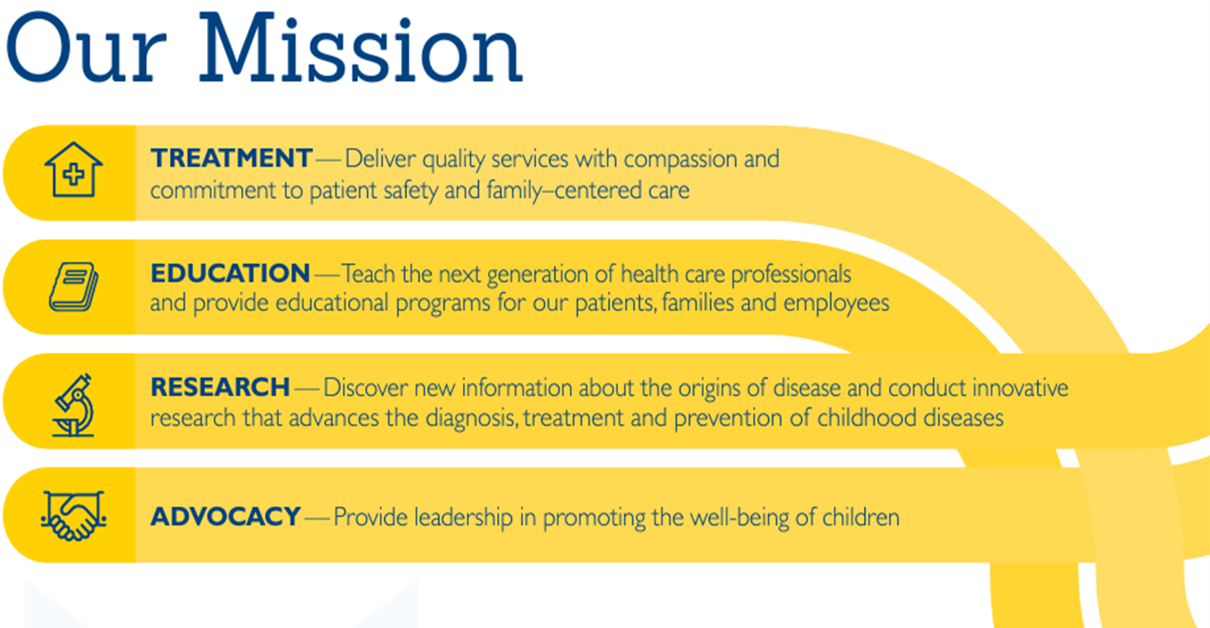
Notes:
Did you know that we are approaching our centennial in 2026? We have some exciting plans in the works and hope you will be able to join us in our celebrations. Speaking of celebrations, earlier this year we celebrated together being named #1 by USNWR. This is in part to our focus in the four areas of our mission: treatment, education, research & advocacy.

Slide 29
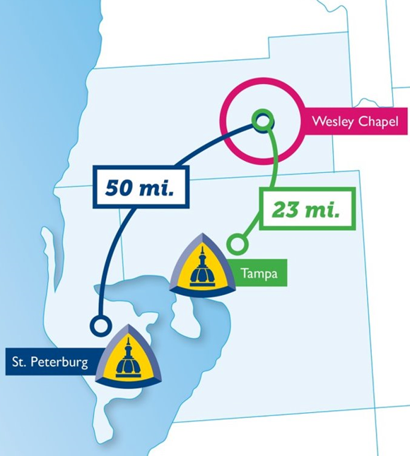

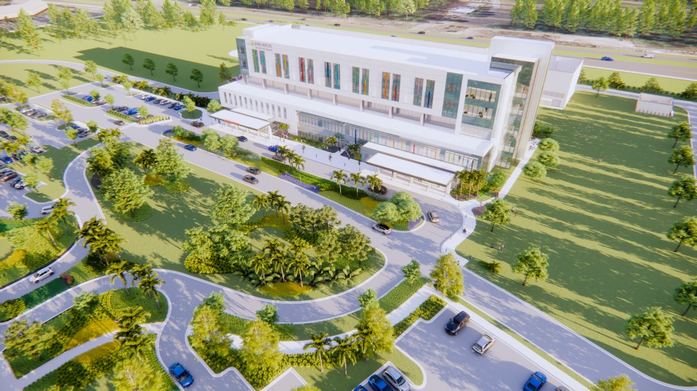
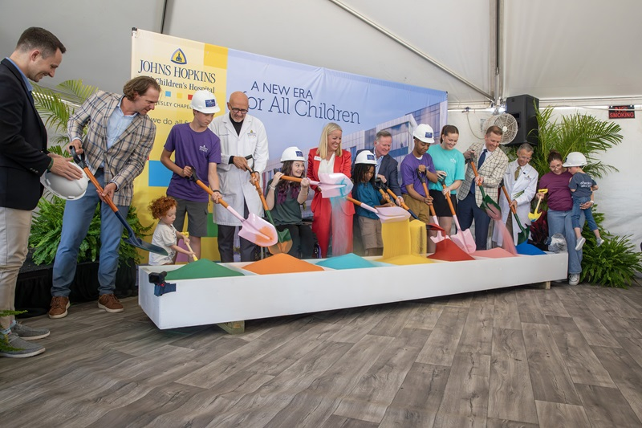
Make Johns Hopkins All Children’s Easy
Wesley Chapel Campus
  2025 Groundbreaking Ceremony
  56 beds, plus emergency and outpatient care center
  Opening planned for 2027
Notes:
Broke ground on our Wesley Chapel Campus and met all major deadlines to support the current project timeline
Established committees with local and system leaders to support the Wesley Chapel Campus
Prepared financial statements for the Wesley Chapel Campus
Began construction on our St. Petersburg hospital expansion (additional Emergency Center and operating rooms to open in the fall of 2026)
Executed an ambulatory redesign, creating 6 new roles to improve patient flow, enhance care coordination and streamline operations
Improved patient access by reviewing templates and decision trees for easier scheduling

Slide 30
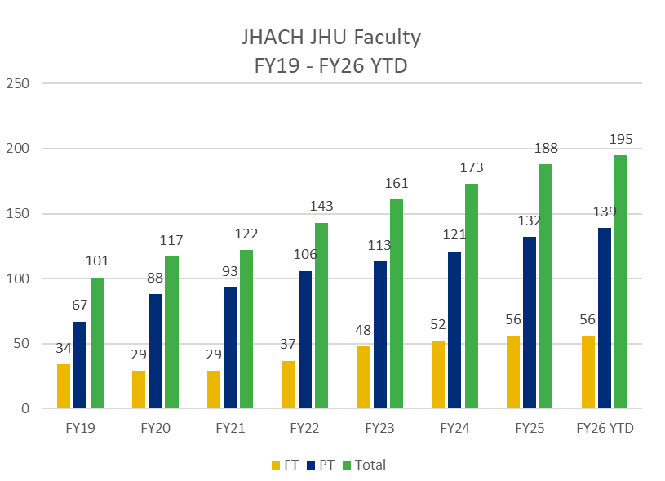
Our Academic Growth
Integrate with Johns Hopkins Medicine
Expansion of research infrastructure
Build JHM faculty presence
Welcome JHACH Pediatric Residents
(1st class)
Open 225,000 Sq ft Research and Education Building
Launch Research Institutes
Pre-2010
2012
2016
2019 - 2025
2011
2014
2018
Future
All Children's Hospital
All Children's Research Institute
USF academic affiliation (50+ years and ongoing)
Establish
Office of Medical Education
Mission: Build a Pediatric Residency and various fellowship programs
Name Update: Johns Hopkins All Children's
Hospital
Rapid Growth of Education and Research Programs

Slide 31
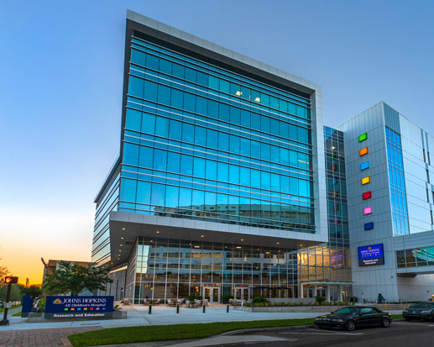
Our Academic Landscape- Current State
Hybrid Academic Environment
Academic Faculty on Campus
  ~200 total faculty appointments
  ~60 Johns Hopkins University-employed
Institute Clinical Translational Research (ICTR)
  12 clinical/translational research faculty
Institute for Fundamental Biomedical Research (IFBR)
  10 Principal Investigators / 19 basic science faculty
Diverse Research Trainee Environment
Medical Education Programs
  2 Pediatric Residency Programs (40 residents)
  15 Pediatric Fellowships (31 fellows)
Notes:
Hybrid academic environment
Transformed from private practice model to
academic + hospital employed
Academic faculty on campus
Institute Clinical Translational research (ICTR)
12 clinical/translational research faculty
Institute for Fundamental Biomedical Research (IFBR)
10 Principal Investigators / 19 basic science faculty
Diverse research trainee environment
High school/undergraduate interns
PhD students / Postdocs
Visiting scholars and faculty
Medical Education Programs

Slide 32
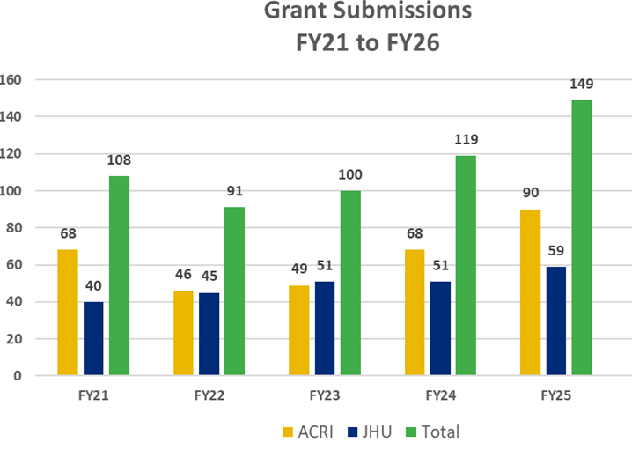
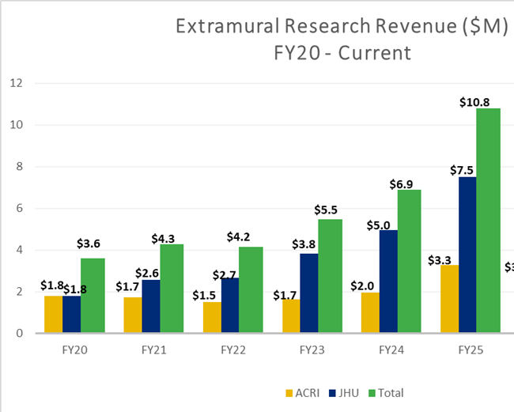
Research Growth at JHACH
Programmatic investments over last decade
  Biorepository (centralized, pediatric only, 2.2M sample capacity)
  Dedicated Clinical Research Unit (5 beds)
  Basic science shared equipment & resources
  Centralized Clinical Translational Research Organization (CTRO): Study start up, investigational drug, monitoring/QA, clinical research coordination/nursing, epidemiology, biostats ~ 75-100 research dedicated staff
Current: 450+ research studies / 150+ interventional clinical trials
Established processes to build and support a culture of expected financial performance
  Regular financial reporting and reviews with PIs
  Salary and research extramural coverage guidelines

Slide 33


2025 Sweeping Changes and Shifts
New Awards?
IDC's?
Vulner-ability
Portfolio Diversity
Sweeping Process Changes
Panicked Scientists
Resilience
Grant Contin-uations?
Academic Organizations Nationwide Review Impacts to Research Mission
Review/assess research programs
Diversify research funding
  Commercial clinical trials, extramural foundations, state resources
ThePhoto by PhotoAuthor is licensed underCCYYSA.

Slide 34
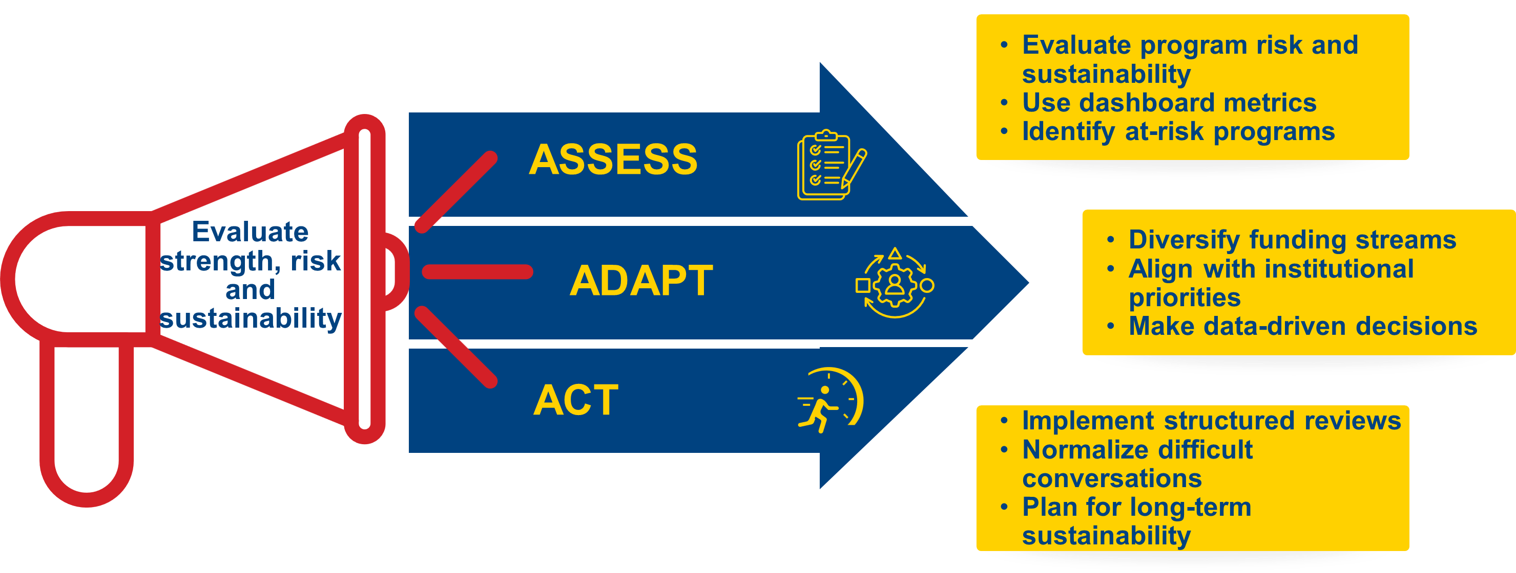
A Call to Action
Notes:
In light of these sweeping federal changes, Johns Hopkins School of Medicine issued a call to action to all of our academic departments.
Primary objectives were to increase awareness of federal funding declines, establish primary domains to evaluate programs and promote long term financial sustainability.
Key to our implementation approach included a full 360 review for our all of our PI-based research programs by a consistent workgroup from varying backgrounds, including representation from both sponsored and nonsponsored administrative leadership, as well as both research associate deans (clinical/translational and basic science research).

Slide 35
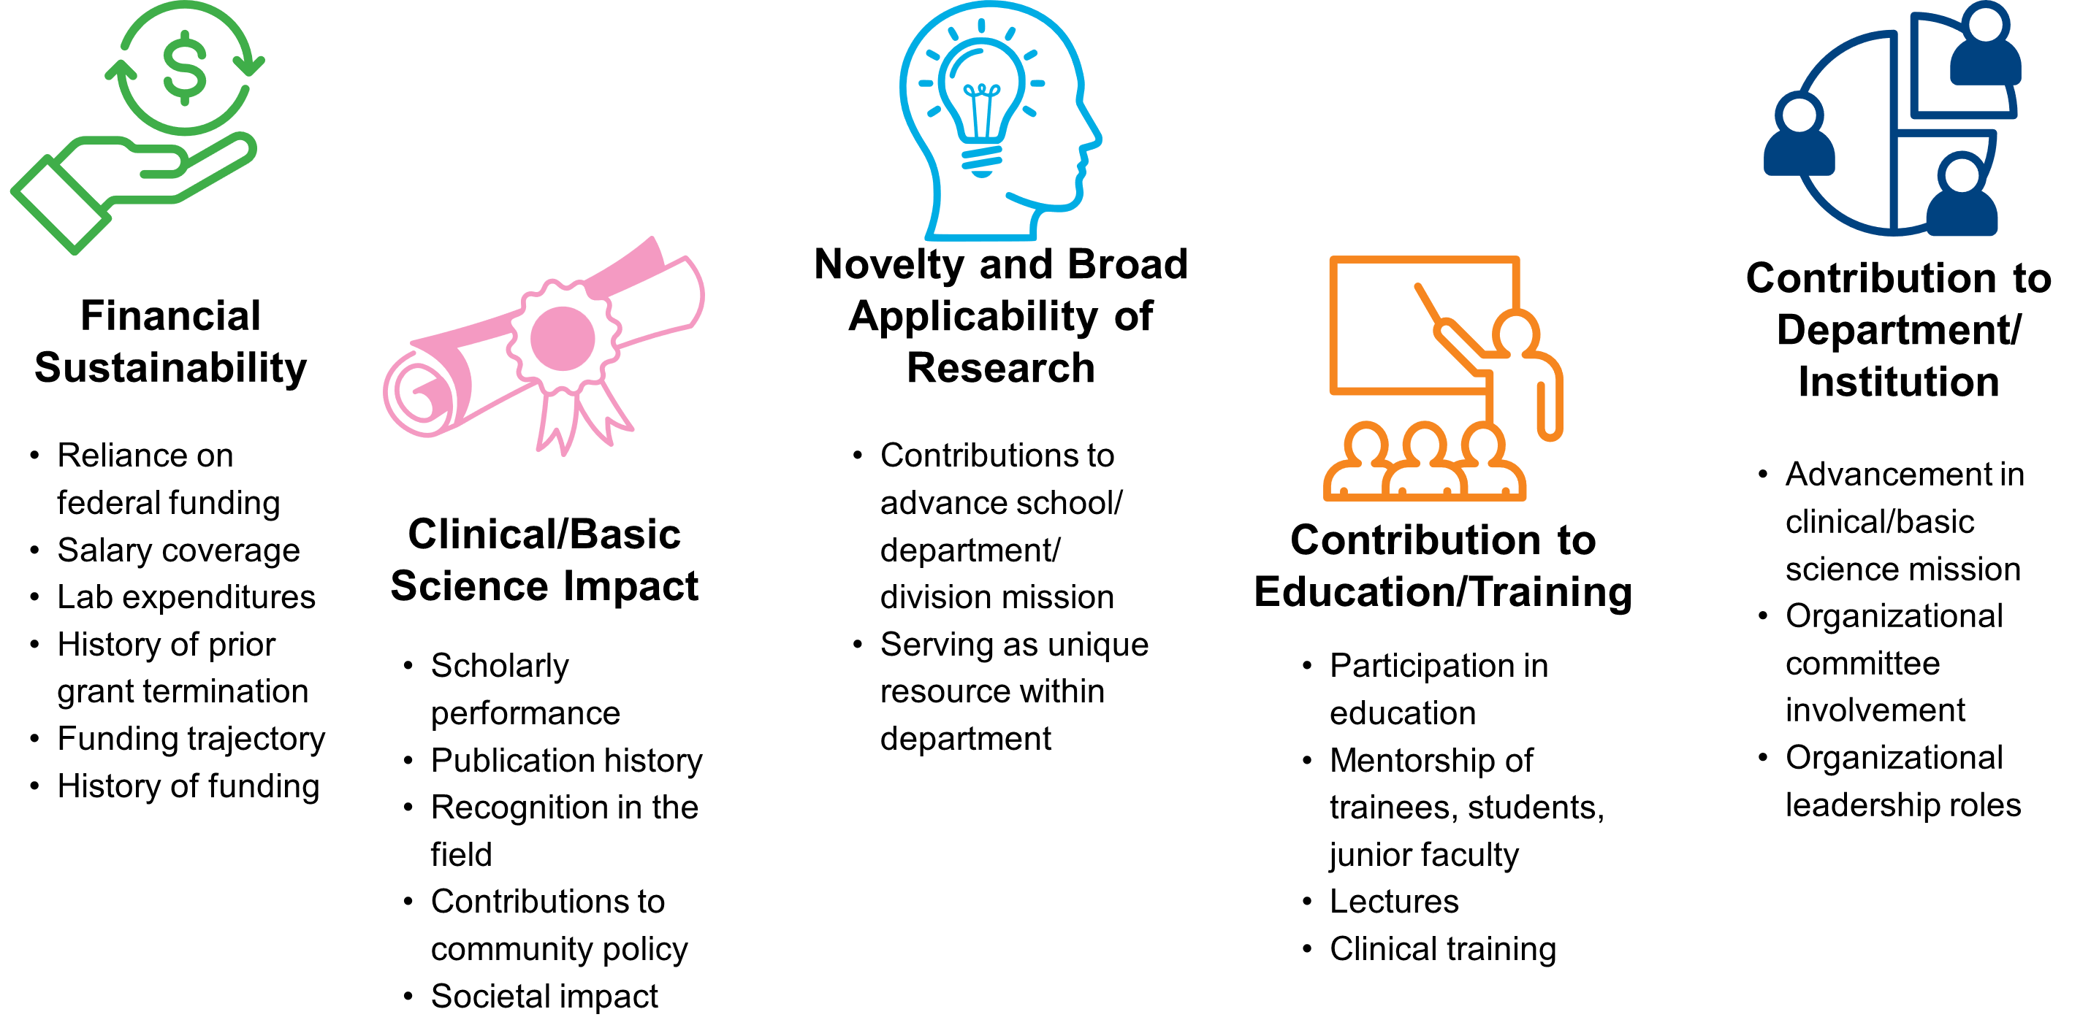
Criteria for Review
Notes:
5 key criteria
Financial sustainability- include reliance on federal funding, salary + lab coverage, any history of prior grant termination, grant history and trajectory
Clinical/Basic Science impact- publications, field recognition, impact to society
Novelty and broad applicability of research- how are they advancing the department, do they provide a key resource for other researchers such as a specialized core?
Contribution to education/training- teaching, mentorship
Contribution to department/institution- committee and leadership roles

Slide 36
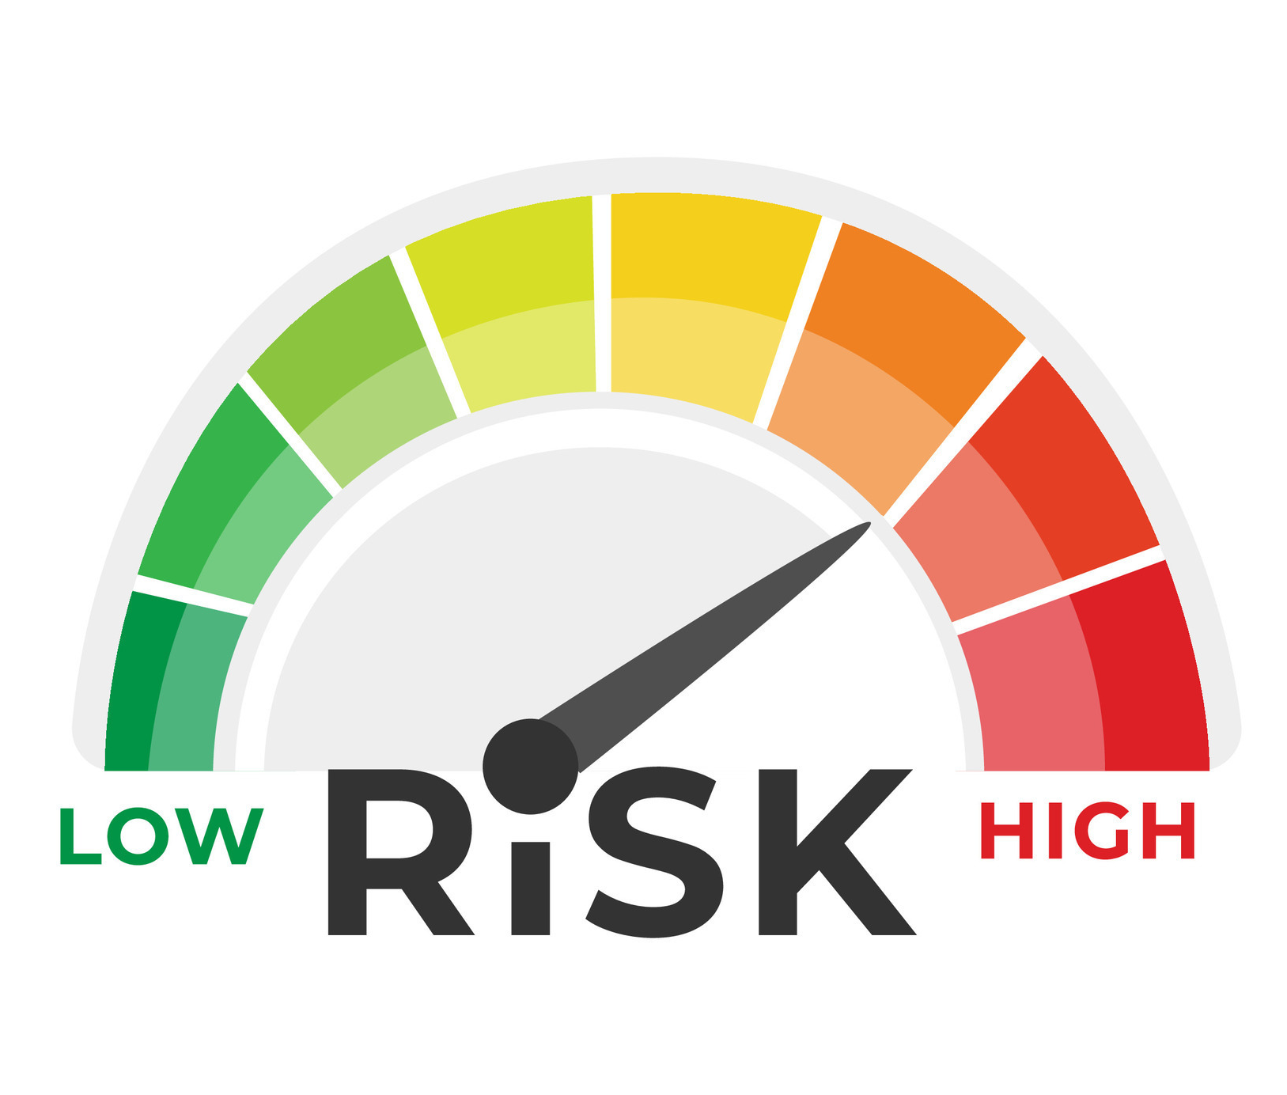
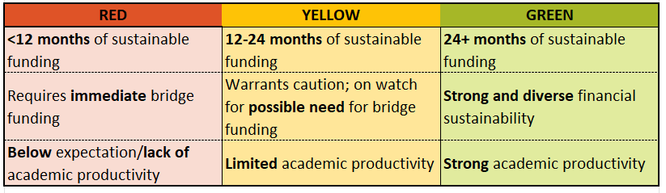
Evaluation of Program Risk
Notes:
Used red yellow green to delineate risk levels

Slide 37
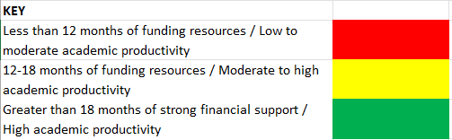
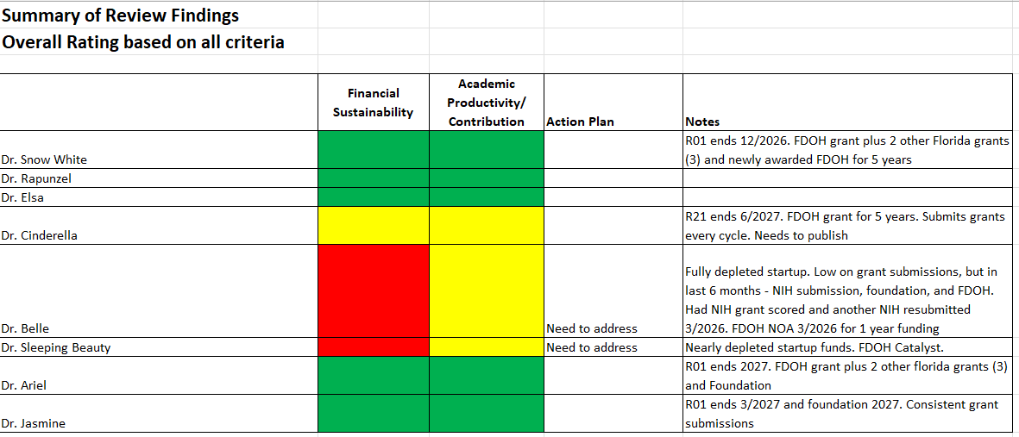
Summary Dashboard
Notes:
Summary of our dashboard of all of our basic science PIs compared by risk

Slide 38
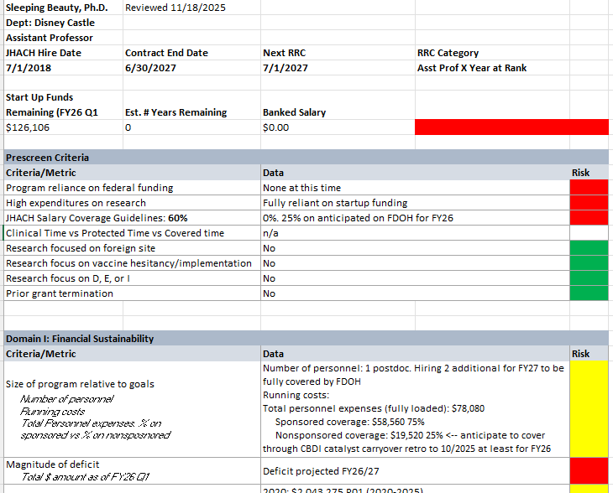
Example Faculty Review Page
Notes:
Example of dashboard for individual PI

Slide 39
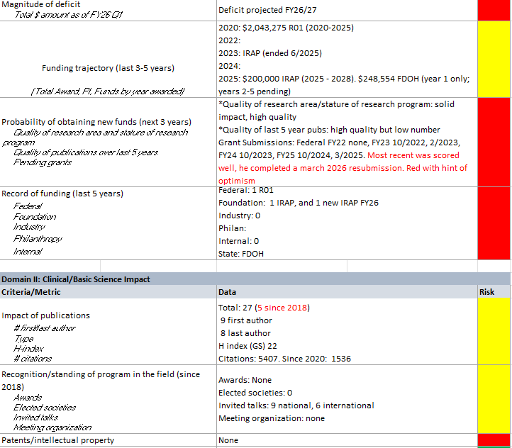

Slide 40
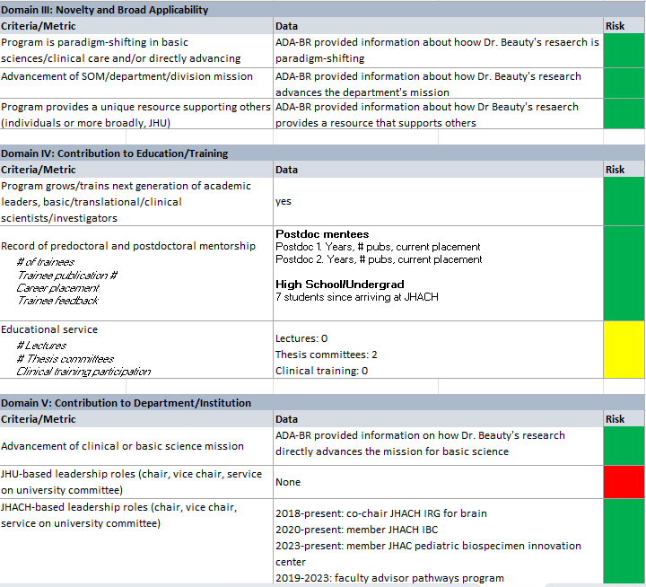

Slide 41
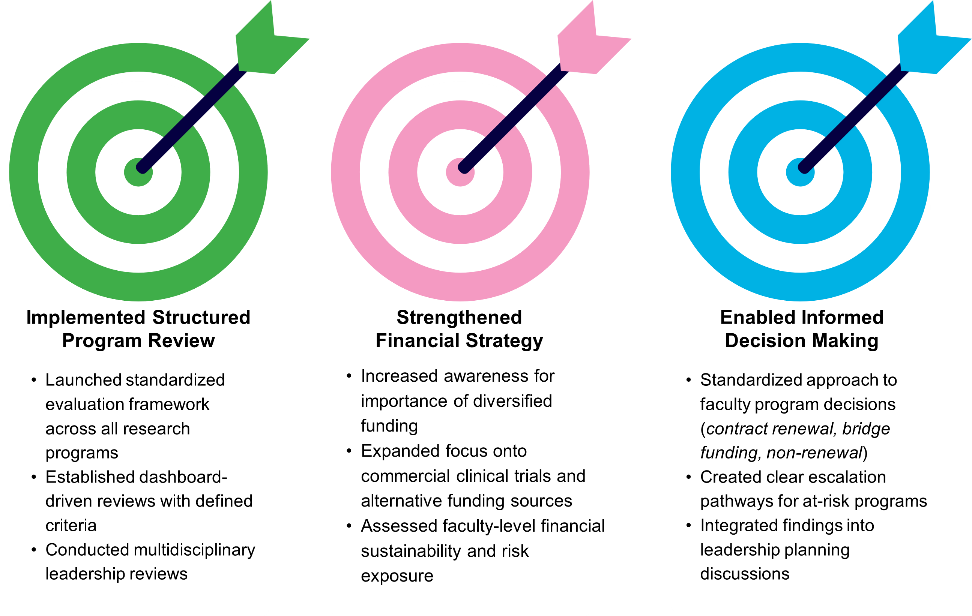
Actions Taken As A Result
Notes:
Several actions were immediately taken
Structured program review- standardized across ALL research programs, data dashboard, same core leadership group for all reviews
Strengthened financial strategy- awareness of financial risk and need to diversify
Allowed for more informed decision making- need for bridge funding, naturally facilitated planning discussions for at risk programs including consideration for contract renewal/nonrenewals

Slide 42
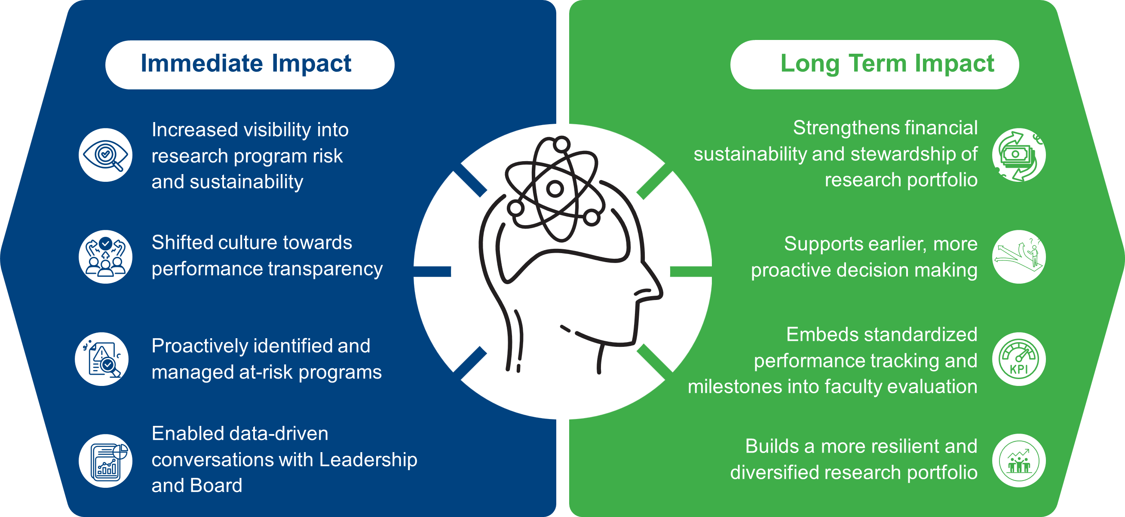
Impact to Our Organization
Notes:
Exercise has both immediate impact. To mention a few, culture shift towards performance transparency, as well as data-drive conversations with leadership. Normalized having difficult conversations and making difficult decisions about programs
Long term impact anticipated includes strengthened financial sustainability, earlier decision making, standardized performance metrics to evaluate

Slide 43
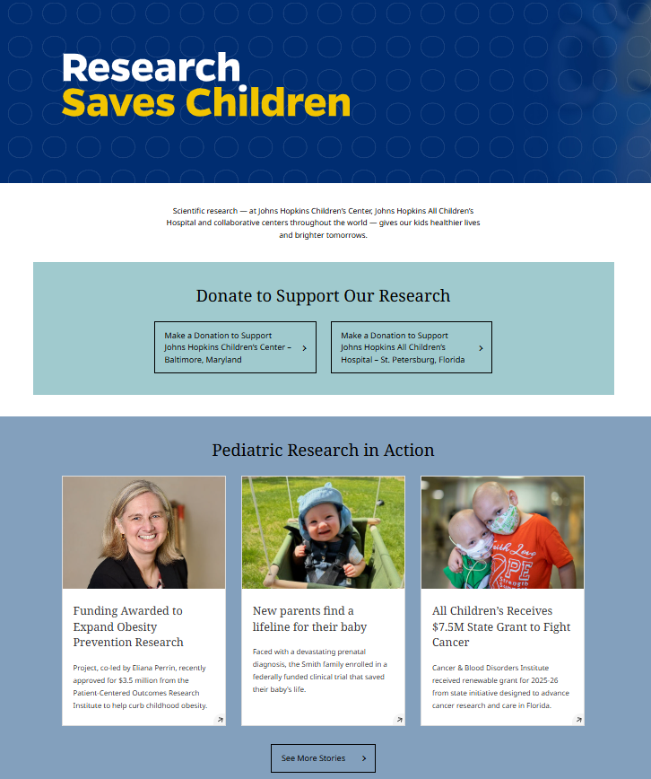
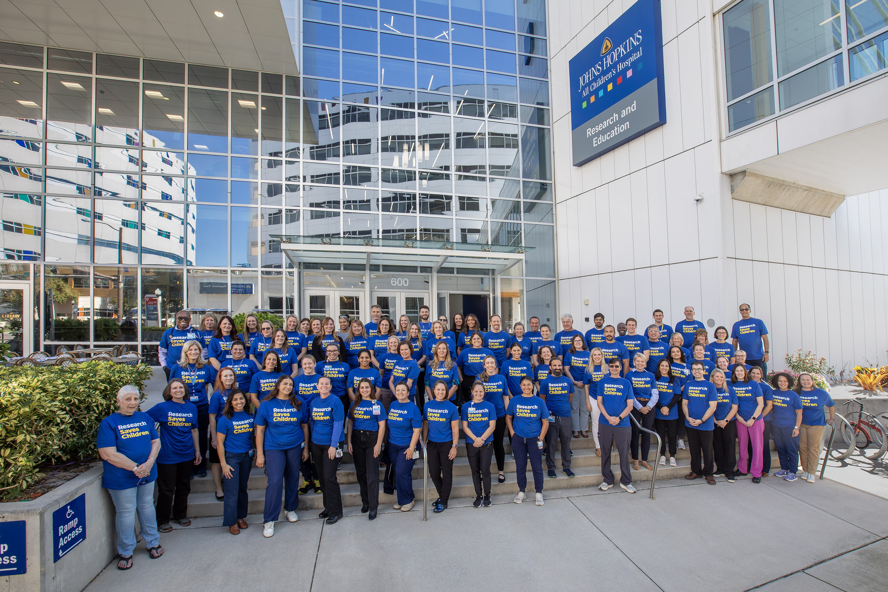
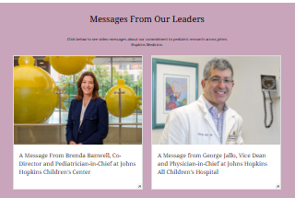
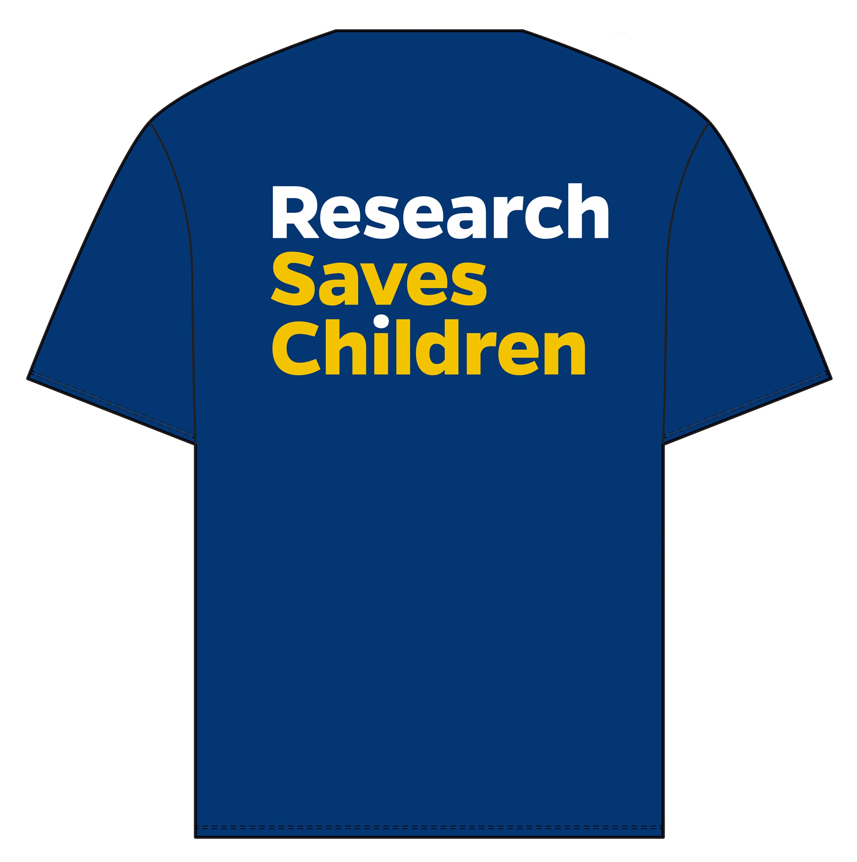
Notes:
We have shared how we've internally evaluated our programs for financial sustainability and academic success in response to federal funding challenges.
Wanted to close and leave you with an example of how Hopkins- Baltimore and St Pete- have joined together to share the mission of our research programs externally through our "Research Saves Children" campaign and show support for our researchers during this difficult time.
Our Research Saves Children campaign features an external website that highlights testimonials and examples of research success transforming pediatric care, includes messages from our leadership, and we've also launched a "Research Saves Children" t shirt campaign that was available to all employees at JHACH.

Slide 45
Strenghtening the CHLA Pediatrics Research Mission
DEPARTMENT OF PEDIATRICS
Christine Boyes
Associate Vice President, Pediatrics

Slide 47

Children’s Hospital Los Angeles (CHLA)
Founded in 1901 – 2026 is our 125th anniversary
7000 employes, 950 physicians
438 bed hospital
  ADC of 329
18 operating rooms
90,000 ED visits
750,000+ annual outpatient visits
  Main campus
  6 ambulatory care centers
Safety Net Hospital – 75% Medicaid payor mix

Slide 48
CHLA’s Academic Structure
CHLA is a standalone children’s hospital
  Affiliation agreement with USC
  Not part of the Keck Medicine hospitals
Faculty are employed by USC and CHLAMG, have privileges at CHLA
  Department of Pediatrics is located at CHLA
When faculty are primarily located at CHLA, extramural awards are submitted and accepted by CHLA – not USC
CHLA requires its own research administration infrastructure
  The Saban Research Institute
  Department of Pediatrics research administration support

Slide 49
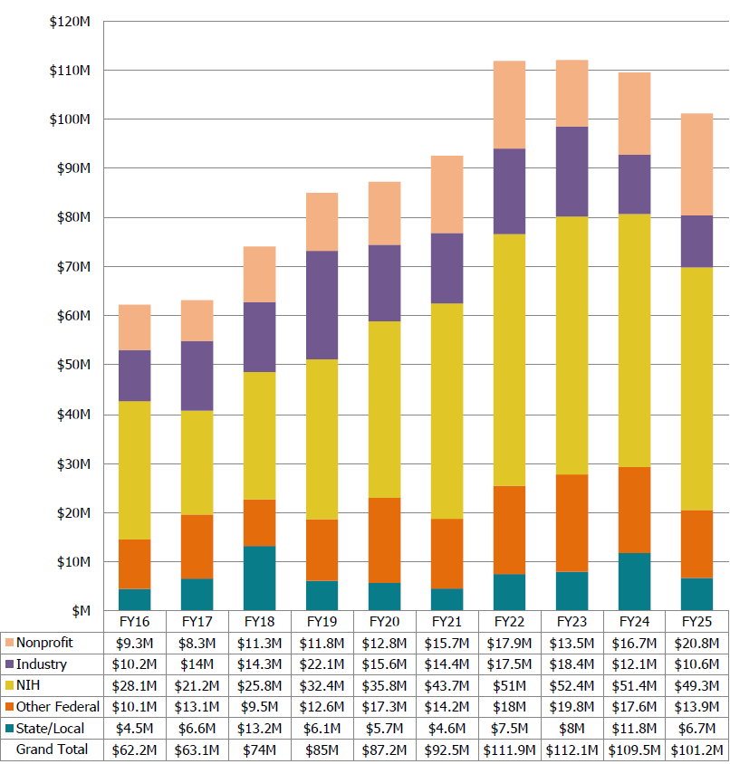
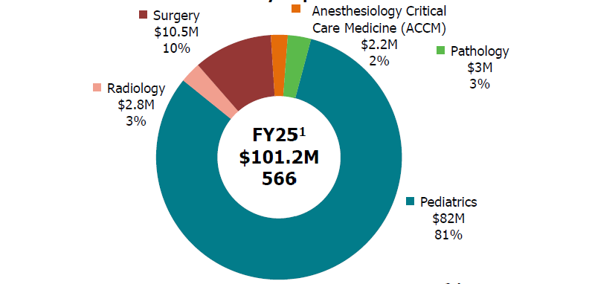
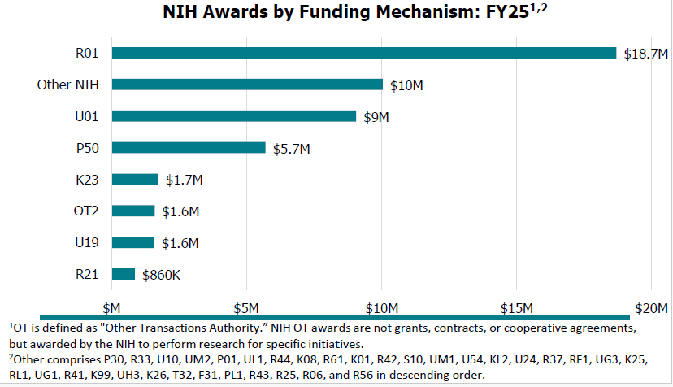
Research at CHLA

Slide 50
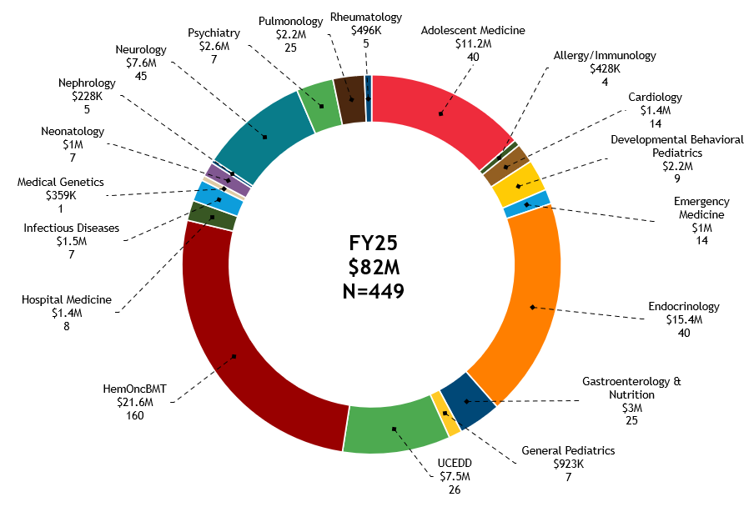
Research at CHLA in Department of Pediatrics
Department of Pediatrics

Slide 51
Support Infrastructure and Partnership with TSRI
Department of Pediatrics
  Local PI pre-award and post-award support
    *Research Services
  Payroll transactions for Faculty and Staff
  Completion of cost transfers
  Purchasing and contract review/processing
  Invoice review and payment requests
  Effort Certification
  Management of Philanthropic funds
  Monthly account reconciliations
The Saban Research Institute
  Central office for institutional research administration functions
    Pre-Award
    Post-Award
    Contracting
    Subawards
  Regulatory bodies
    IRB, IACUC, IBC
  Core Services
  Training, Education, Career Planning and Development (TECPAD
  Research Services*
  Clinical Research Office
  Research Support Office

Slide 52
Investment in Research Faculty Recruits
All new recruits are supported by a business plan prior to job posting
  Outlines research protected time and how that time will be funded
  DOP utilizes CART methodology
  Business plans include expectation about securing research funding to support salary and research team
  Clinical faculty salaries include variable component witheligibility metrics to evaluate research success
Chief Scientific Officer is integrated into interview and review process
Recruitment packages funded through cooperative commitments across organization

Slide 53
Ongoing Monitoring
Annual budget process
  CART
  Sunsetting awards
  Pending proposals
Annual faculty review process
Variable Compensation review for clinical faculty

Slide 54
Changes in the Research Landscape
Cross functional workstreams launched to review new federal guidance including Executive Orders, Revised grant terms and conditions, Terminations, etc
  Includes legal, research, government relations
  ACP protected weekly newsletter
GAC program closure
Reductions in workforce as a result of terminations
AI tool in development for proposal preparation assistance

Slide 55

Q&A

