Slide 1
cFTE Survey
Association of Administrators in Academic Pediatrics
Association of Medical School Pediatric Department Chairs

Slide 2
cFTE Workshop Team
Erin Bruzda (University of Utah)
Susan Cameron (University of Washington)
Nikki Feucht (Huron Consulting Group)
Angela Fuste (University of Miami)
Amanda Kirkland (Huron Consulting Group)
Susan Kline (Duke University)
Gil Pak (Penn State Health Children’s)
Jeff Renner (University of Washington)
Jennifer Rigby (University of Utah)
Notes:
Overview of agenda:
cFTE survey history
Data journey
Table group discussions
Summary & next steps
Before we get started, a quick poll of the room:
How many folks are here at their first AAAP conference?
For how many of you is this your first time learning about the cFTE survey?
How many of you are directly managing providers’ effort?

Slide 3
Pre-conference Survey
34 responses
Department sizes ranging from <20 to >1,000 faculty

Slide 4
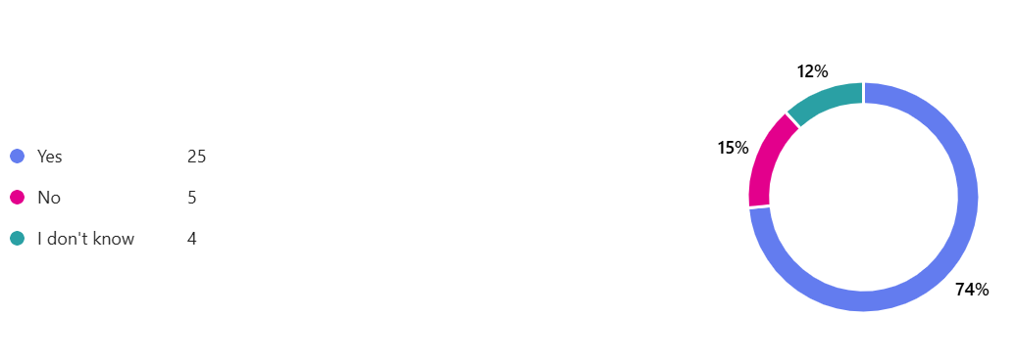
Did your institution participate in the cFTE survey?

Slide 5
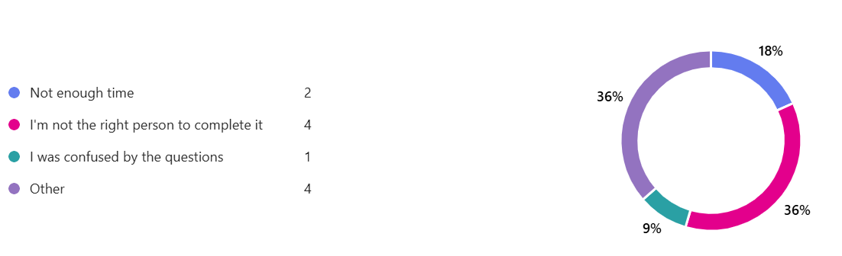
If no, what prevented you from participating in the survey?
Notes:
Other responses:
Emails were sent to clinic administrator instead of me
we were undergoing a revamp of how we think about clinical fte
was not in the role at the time
too much variation in our current faculty effort distribution

Slide 6
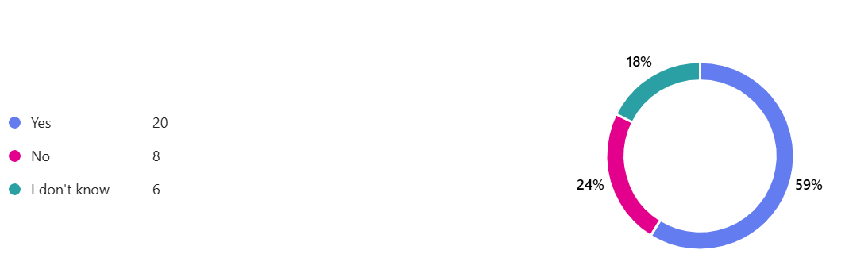
If you know, is the person/group who completes the cFTE survey the same person/group who completes the salary survey?

Slide 7
If you did participate in completing the survey, how did you include the physicians in collecting the data?
65% collaborated with Division Leadership by:
Communicating via email about this survey
Verified where clarity was needed
Notes:
Followed the instructions provided
We did not. We used a previous department-level survey from Division Chiefs that captured outpatient and inpatient requirements and nuances.
Asked for input from the Division Directors and Division Administrators
They are not involved when gathering the data to complete the survey
Worked with Division Chiefs
sent instructions to division chiefs for guidance and confirmation of data
Based on work clinic leadership previously completed in partnership with division chiefs to set cFTE definitions
Worked with divisional leadership to compile the data.
Payroll/HR Data
Physician leadership was engaged as needed.
Checked with division Chiefs to confirm
Not clear on what this question is asking but we did not involve our physicians with completing the actual survey but they are of course involved in understanding the division expectations.
we met with division chiefs about a year prior, so I did some clarifying follow up questions, but mostly used that data to translate into the AAAP approach
Asked for input from the Division Directors and Division Administrators
We didn’t
We already have this data
Asked for physician input where there were questions.

Slide 8
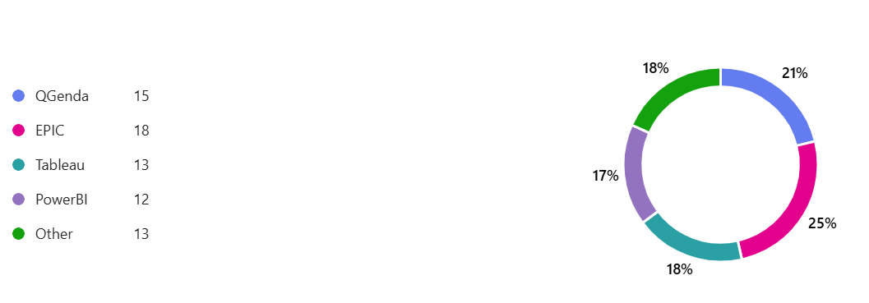
What systems are you using for data gathering and/or reporting?
Notes:
Other responses:
Affiliate hospital is responsible for all things clinical
We did a manual review with each Division Chief about a year prior to this survey, so we extrapolated from that data set
Effort Calculators
Excel
Other than inpatient (we use Tiger Scheduling) to confirm weeks worked, but outpatient clinics - we have Tableau, but it's not set up for easy reporting at dept level on actual clinics per division/faculty at this time
Cerner scheduling

Slide 9
Agenda
The Past
  The Why
  The Project Roadmap
The Present
  Clinical Expectation Survey
  Clinical Actual Work Survey
  ACTIVITY - Table Group Discussion
The Future
  Next Steps

Slide 10
The Past

Slide 11
Why is understanding clinical EFFORT (cFTE) important?
No comprehensive benchmarks; many email inquiries and webinars highlighting what some groups are doing
Can help ensure better understanding of work culture and physician burnout factors
Defining cFTE is always a topic of interest for everyone:
  Physician practices, hospitals, academic departments/divisions
  Academic and non-academic organizations (AAMC, MGMA, specialty organizations, etc)
  Consultants (Sullivan Cotter, Vizient, Huron, etc)
Consistent definition can ensure alignment in reporting of productivity data, salary for benchmarking, and workforce planning purposes.

Slide 12
AAAP & AMSPDC Roadmap
2021
Distributed inaugural Clinical Work Survey and collected data
Share summary/recommendations with AAAP and AMSPDC members
2023
Developed education sessions, common definitions and frameworks on clinical effort
2026
Present at AAAP Annual Meeting
1
3
5
7
2
4
6
2022
Analyze and develop summary plus recommendations related to survey goals – definitions and insights on how reporting is done
Department Chairs and Administrators review own data and understand how collected, calculated and share own learning with AAAP
2024-2025
AAAP and AMSPDC leadership conducted clinical expectations survey
Notes:
Recorded bootcamp on AAAP Member Resources (past webinars)

Slide 13
The Original 2021 Survey
Our approach was to initiate a survey to:
Gain an understanding of institutions’ general definitions as it relates to overall FTE expectations and how institutions interpret/report cFTE.
Our initial key goals were to be able to do the following:
Develop consistent terminology and definitions we use with each other and when we talk about FTE and cFTE
Collate a data summary to begin understanding what actual work is being performed at reported cFTE levels in each specialty.
Gather actual clinical work data (not expectations) at the individual provider level to better understand what reported “billable cFTE” information means.

Slide 14
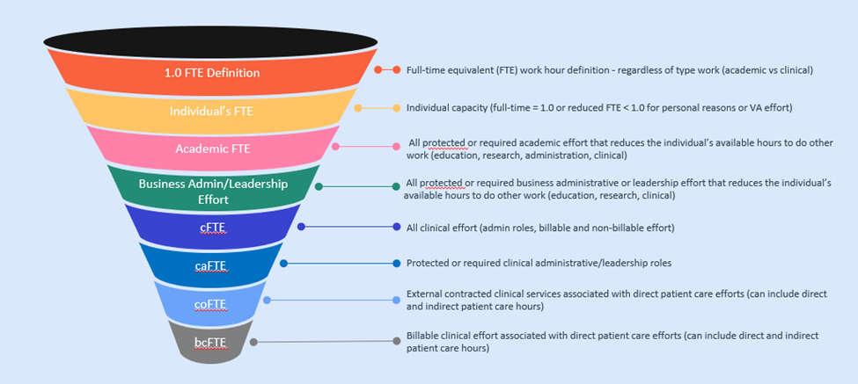
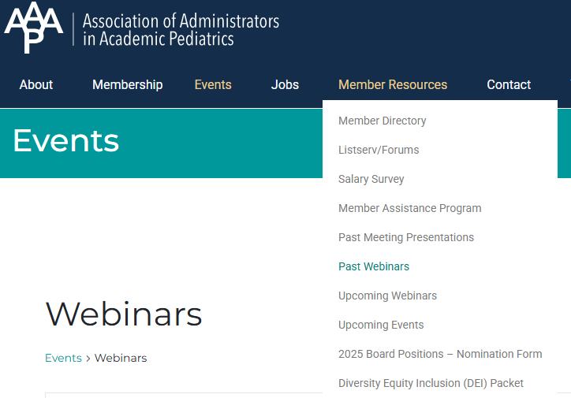
Initial Deliverables
Survey Data and Analysis; publication in The Journal of Pediatrics
Education Webinars to standardize AAAP terminology with members (found under Member Resources on AAAP website)

Slide 15
The Present

Slide 16
A Tale of Two Surveys: Expectations vs Actual
Expectation Survey (sent out June 24, 2024 to Chairs and July 11, 2024 to AAAP)
  Survey sent to AMSPDC member Chairs as the focus to drive engagement
  Purpose was to understand what the work expectations of a newly hired faculty with only clinical responsibilities in a fully staffed specialty division would be.
  75 Participating Institutions
  Overall report sent April 26, 2026
  Report was shared openly with the benefit of an individualized report for participating institutions that was sent on May 5, 2026
Actual Work Survey (sent May 28, 2025; updated version of the original 2021 survey)
  Sent to all AAAP members; requested engagement of Chair and Chiefs
  Purpose was to gather a second round of data on total ACTUAL hours devoted to clinical care by our physician providers.
  Included data about 7,026 physicians across 28 specialties, representing ~47 academic medical centers
  This data will be shared with participating institutions, and for a fee to non-participating, as we do with the salary survey.
  If there is a belief in the value of this information, our goal will be to encourage broad participation and investigate a more robust and dynamic data analysis tool.
Notes:
Gil

Slide 17
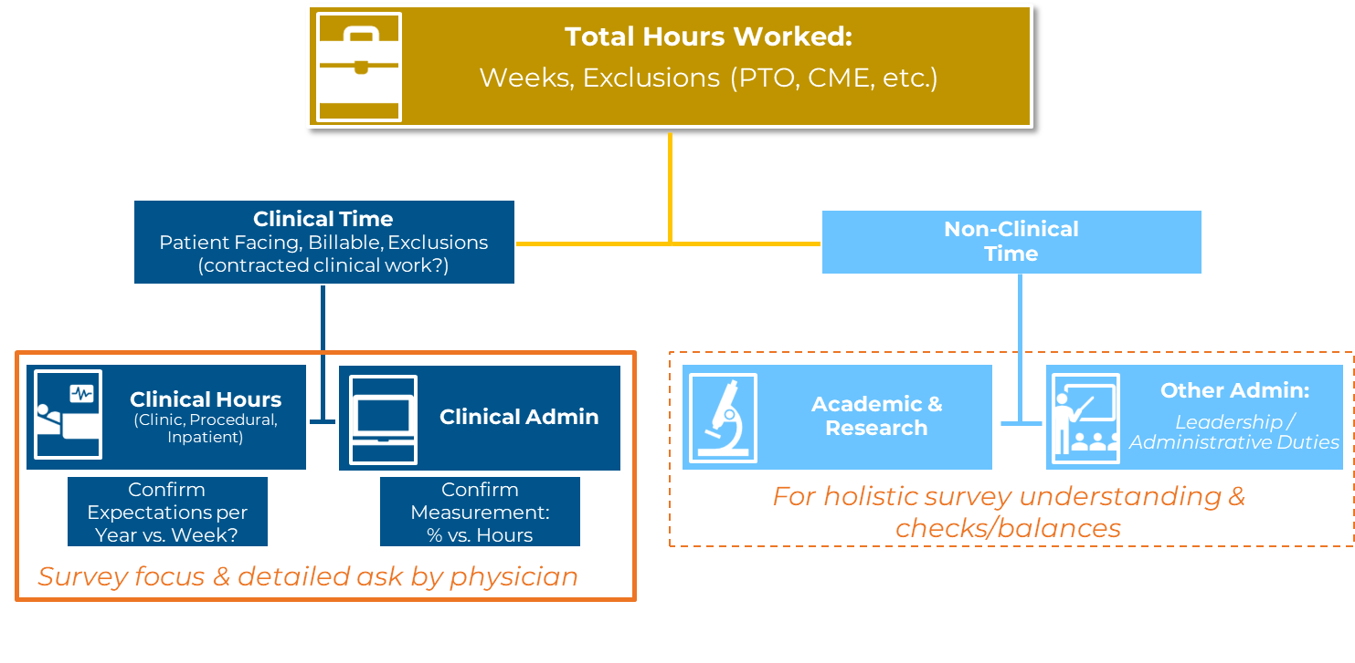
Clinical Actual Work Survey: Scope
1.0 bcFTE Base Clinical Hours
Notes:
Nikki/Amanda

Slide 18
Clinical Actual Work Survey: Details
Surveyed Specialties
Time Focus
  Actuals Only – defined by “base job” duties and expectations
  On-Call should be defined by actual shifts/hours, not assigned
  Administrative and “Other” time not defined in Actuals would be excluded
1.0 bcFTE Expectations
  Time Away Allotted for 1.0 FTE/bcFTE
    CME Allocation
    PTO (sick + vacation)
    FMLA/LOA
  Patient-facing hours & percentage of hours per week
Adolescent Medicine
Allergy/Immunology
Bone Marrow Transplant
Cardiac Critical Care/Intensive Care
Cardiology - Diagnostic
Cardiology - Interventional
Child Abuse Pediatrics
Critical Care/Intensive Care
Dermatology
Developmental & Behavioral
Emergency Medicine
Endocrinology/Metabolism
Epilepsy
Gastroenterology/Nutrition (Hepatology separate)
General Pediatrics
General Pediatrics - Urgent Care
Genetics
Hematology/Oncology
Hepatology
Hospital Medicine
Infectious Diseases
Med/Peds
Neonatology
Nephrology
Neurology
Palliative Care
Pulmonology
Rehabilitation
Rheumatology
Sleep Medicine
Sports Medicine

Slide 19
Clinical Actual Work Survey: Mechanics
Quality controls
Outliers removed per component using the IQR method (1.5× threshold)
Minimum sample sizes: 20+ physicians per specialty, 10+ non-zero values per component
Call analysis separates participation rate (all physicians) from burden (only those who carry call)
Work Component | How it is calculated
Ambulatory | Clinic sessions × hours per session
Procedural | Procedure sessions × hours per session
Inpatient | Admitting + consult + general inpatient hours
Total | Sum of all components above
We report the median — half of physicians work more, half work less. The IQR shows where the middle 50% fall: a practical “expect between X and Y” range
Notes:
Amanda/Nikki Intro; Gil Details

Slide 20
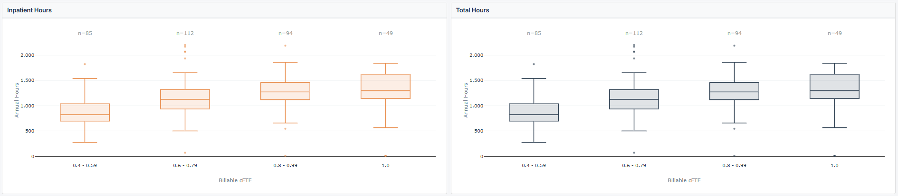
Inpatient: Critical Care – Intensive Care
368 physicians from 35 institutions. At 0.8 - 0.99 cFTE (n=102), the typical physician works 1,270 total hours/year Inpatient. 25% carry call.
CONFIDENTIAL
CONFIDENTIAL
Notes:
Gil

Slide 21
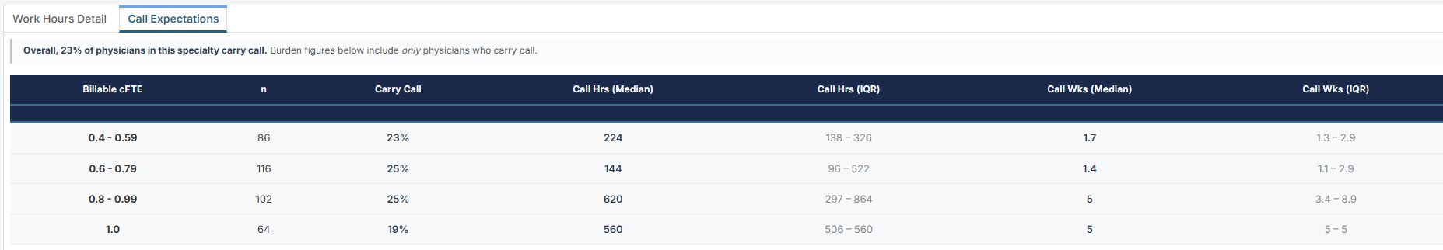
Inpatient: Critical Care – Intensive Care
368 physicians from 35 institutions. At 0.8 - 0.99 cFTE (n=102), the typical physician works 1,270 total hours/year Inpatient. 25% carry call.
CONFIDENTIAL
Notes:
Gil

Slide 22
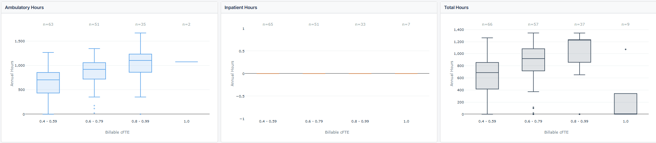
Ambulatory: Developmental & Behavioral
178 physicians from 34 institutions. At 0.8 - 0.99 cFTE (n=39), the typical physician works 1,232 total hours/year - 1,100 Ambulatory. 67% carry call.
CONFIDENTIAL
Notes:
Gil

Slide 23
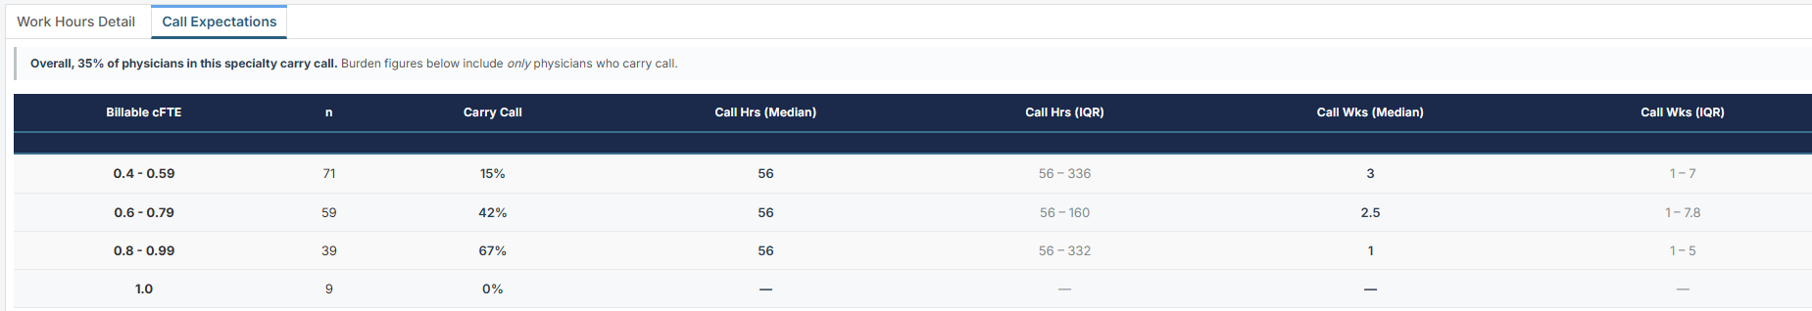
Ambulatory: Developmental & Behavioral
178 physicians from 34 institutions. At 0.8 - 0.99 cFTE (n=39), the typical physician works 1,232 total hours/year - 1,100 Ambulatory. 67% carry call.
CONFIDENTIAL
Notes:
Gil

Slide 24
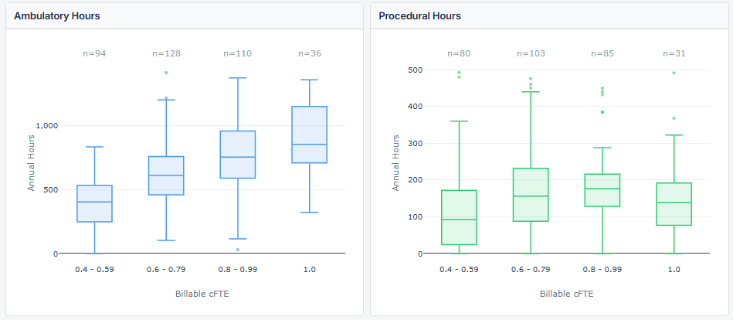
Hybrid: Gastroenterology – Nutrition
393 physicians from 37 institutions. At 0.8 - 0.99 cFTE (n=120), the typical physician works 1,417 total hours/year — 754 Ambulatory, 176 Procedural, 302 Inpatient. 43% carry call.
CONFIDENTIAL
CONFIDENTIAL
Notes:
Gil

Slide 25
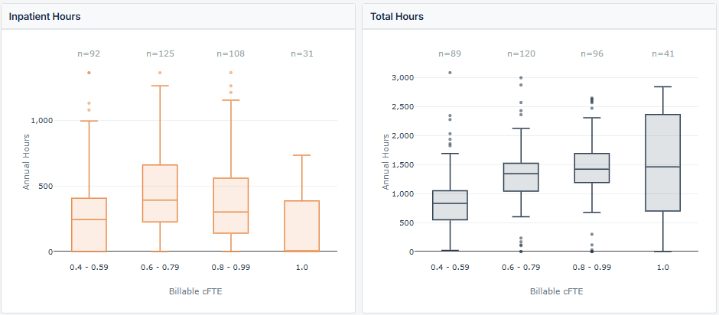
Hybrid: Gastroenterology – Nutrition
393 physicians from 37 institutions. At 0.8 - 0.99 cFTE (n=120), the typical physician works 1,417 total hours/year — 754 Ambulatory, 176 Procedural, 302 Inpatient. 43% carry call.
CONFIDENTIAL
CONFIDENTIAL
Notes:
Gil

Slide 26
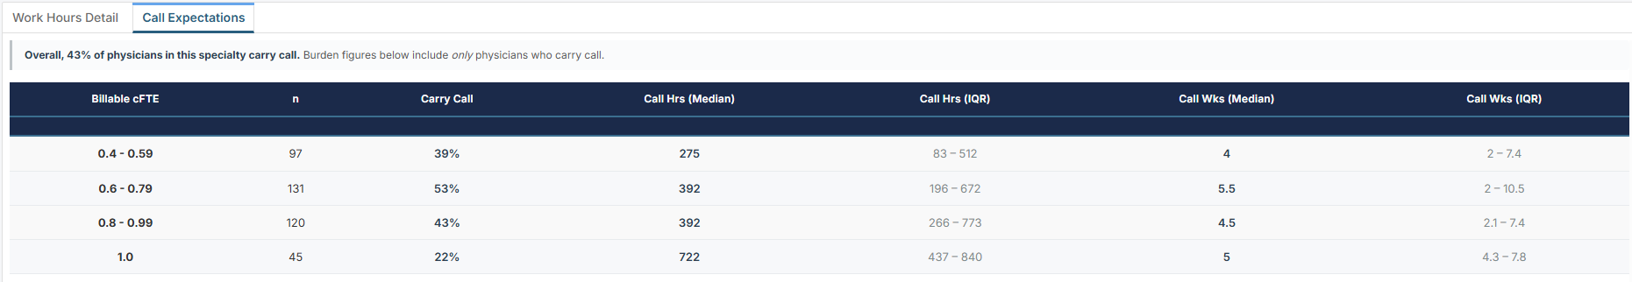
Hybrid: Gastroenterology – Nutrition
393 physicians from 37 institutions. At 0.8 - 0.99 cFTE (n=120), the typical physician works 1,417 total hours/year — 754 Ambulatory, 176 Procedural, 302 Inpatient. 43% carry call.
CONFIDENTIAL
Notes:
Gil

Slide 27
Table Group Discussion

Slide 28
Discussion Questions
What would you do with this directional data?
What types of data-gathering tools are used at your different institutions (include pros/cons)? [Ex. - Qgenda, EPIC, Tableau, Smartsheet, PowerBI, etc.]
How difficult was this information to gather for your institution? (Please share any best practices for gathering the data)
Notes:
10 minutes for table discussions
15 minutes for report-outs to the room
For report out, focus on:
Directional data
Tools (for the system you’re using, is there a really great aspect that you frequently use or find helpful?) [Qgenda, EPIC, Tableau, Smartsheet, PowerBI, etc]
Tips and tricks for how to use it, how can we share that with each other in AAAP?
Post conf survey: What other types of tools or education would benefit you and your institution?

Slide 29
The Future

Slide 30

Mentimeter Poll
Notes:
10 minutes for table discussions
15 minutes for report-outs to the room
For report out, focus on:
Directional data
Tools (for the system you’re using, is there a really great aspect that you frequently use or find helpful?) [Qgenda, EPIC, Tableau, Smartsheet, PowerBI, etc]
Tips and tricks for how to use it, how can we share that with each other in AAAP?
Post conf survey: What other types of tools or education would benefit you and your institution?

Slide 31




Get Involved — Join the Workgroup
Three ways to contribute and help advance cFTE work at AAAP
Refine the Survey
Build Shared Tools
Lead the Conversation
Participate in ongoing development of the cFTE survey — improving questions, testing clarity, and ensuring the results captures what matters most for your institution.
Help develop resources for interpreting and sharing cFTE data — dashboards, benchmarking guides, and practical tools that make findings useful at the division and department level.
Take an active role in facilitating discussions about cFTE across the organization — presenting findings, gathering feedback, and connecting the work to broader workforce planning goals.
If you have questions or you would like to get involved, reach out directly:
Gil Pak • gpak@pennstatehealth.psu.edu

